Slide 1

Fundamentals of Python:
First Programs
Chapter 4: Strings
and Text Files

Slide 2

Objectives
After completing this chapter, you will be able to
Access individual characters in a string
Retrieve a substring from a string
Search for a substring in a string
Convert a string representation of a number from one base to another base
Fundamentals of Python: First Programs

Slide 3
Objectives (continued)
Use string methods to manipulate strings
Open a text file for output and write strings or numbers to the file
Open a text file for input and read strings or numbers from the file
Use library functions to access and navigate a file system
Fundamentals of Python: First Programs

Slide 4
Accessing Characters and Substrings in Strings
In this section, we examine the internal structure of a string more closely
You will learn how to extract portions of a string called substrings
Fundamentals of Python: First Programs

Slide 5
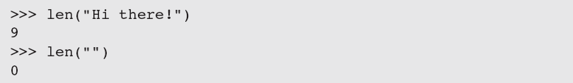
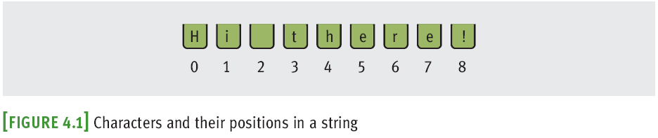
The Structure of Strings
An integer can’t be factored into more primitive parts
A string is an immutable data structure
  Data structure: Consists of smaller pieces of data
  String’s length: Number of characters it contains (0+)
Fundamentals of Python: First Programs

Slide 6
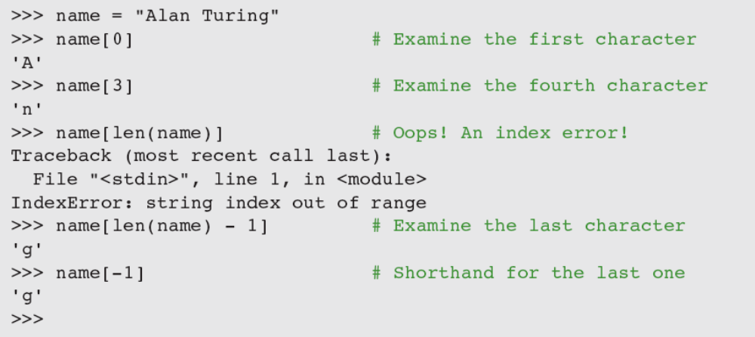
The Subscript Operator
The form of the subscript operator is:
Examples:
index is usually in range [0,length of string – 1];
can be negative
Fundamentals of Python: First Programs

Slide 7
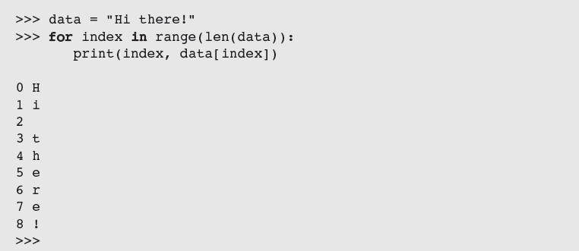
The Subscript Operator (continued)
Subscript operator is useful when you want to use the positions as well as the characters in a string
  Use a count-controlled loop
Fundamentals of Python: First Programs

Slide 8
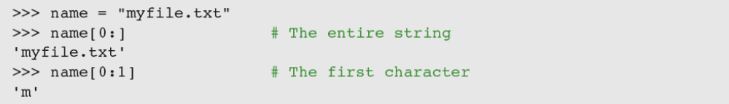
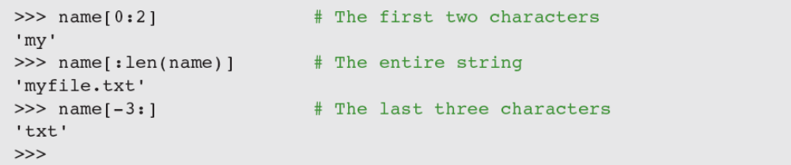
Slicing for Substrings
Python’s subscript operator can be used to obtain a substring through a process called slicing
  Place a colon (:) in the subscript; an integer value can appear on either side of the colon
Fundamentals of Python: First Programs

Slide 9
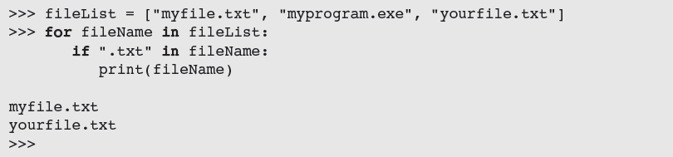
Testing for a Substring with the in Operator
When used with strings, the left operand of in is a target substring and the right operand is the string to be searched
  Returns True if target string is somewhere in search string, or False otherwise
Fundamentals of Python: First Programs

Slide 10
Data Encryption
It is easy to observe data crossing a network, particularly in wireless networks
  Attacker may use sniffing software
Data encryption can be used to protect information transmitted on networks
  Many protocols have secure versions (e.g., HTTPS)
  One or more keys are use to encrypt messages to produce cipher text, and to decrypt cipher text back to its original plain text form
  Examples: Caesar cipher, block cipher
Fundamentals of Python: First Programs

Slide 11
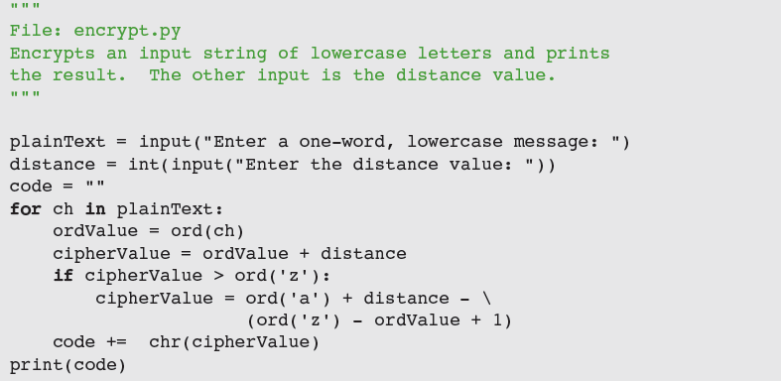
Data Encryption (continued)
Caesar cipher replaces each character in plain text with a character a given distance away
Fundamentals of Python: First Programs

Slide 12
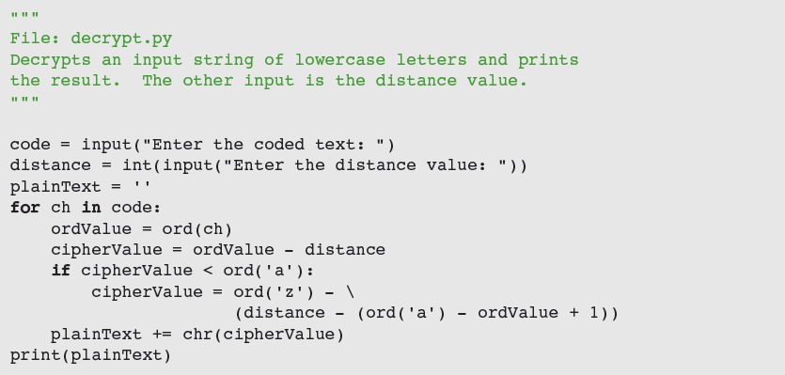
Data Encryption (continued)
To decrypt, use inverse method
Fundamentals of Python: First Programs

Slide 13
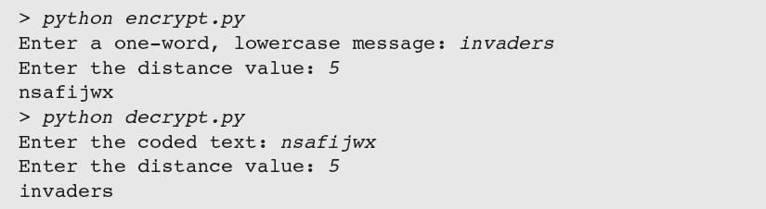
Data Encryption (continued)
Caesar cipher worked well in ancient times, but is easy to break using modern computers
Fundamentals of Python: First Programs

Slide 14
Data Encryption (continued)
Block cipher
  Uses plaintext character to compute two or more encrypted characters
  Each encrypted character is computed using two or more plaintext characters
  Uses an invertible matrix
Fundamentals of Python: First Programs

Slide 15
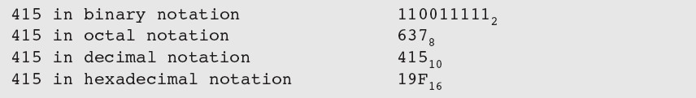
Strings and Number Systems
The digits used in each system are counted from 0 to n - 1, where n is the system’s base
To represent digits with values larger than 9₁₀, systems such as base 16 use letters
  Example: A₁₆ represents the quantity 10₁₀, whereas 10₁₆ represents the quantity 16₁₀
Fundamentals of Python: First Programs

Slide 16
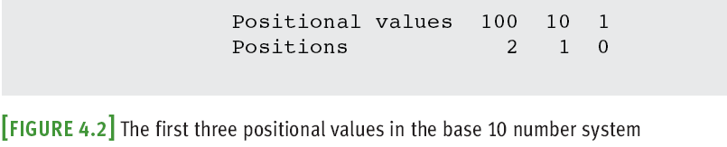
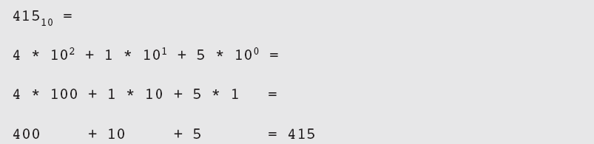
The Positional System for Representing Numbers
In positional notation, a digit has a positional value, determined by raising the base to the power specified by the position (base^{position})
Fundamentals of Python: First Programs

Slide 17
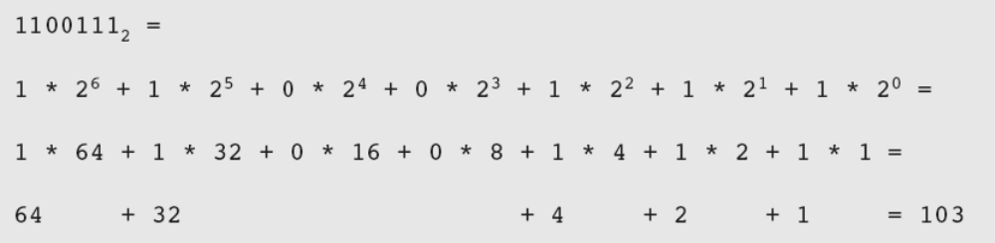
Converting Binary to Decimal
Each digit or bit in binary number has positional value that is power of 2
We occasionally refer to a binary number as a string of bits or a bit string
To determine the integer quantity that a string of bits represents:
Fundamentals of Python: First Programs

Slide 18
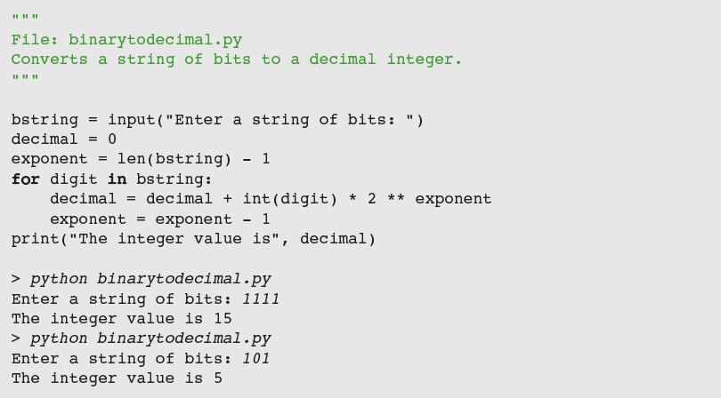
Converting Binary to Decimal (continued)
Fundamentals of Python: First Programs

Slide 19
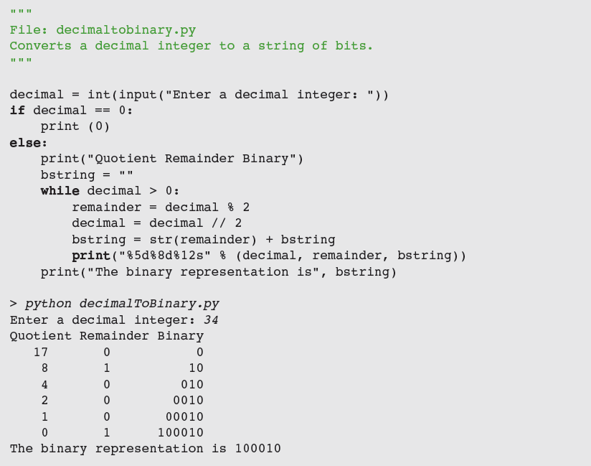
Converting Binary to Decimal (cont.)
Fundamentals of Python: First Programs

Slide 20
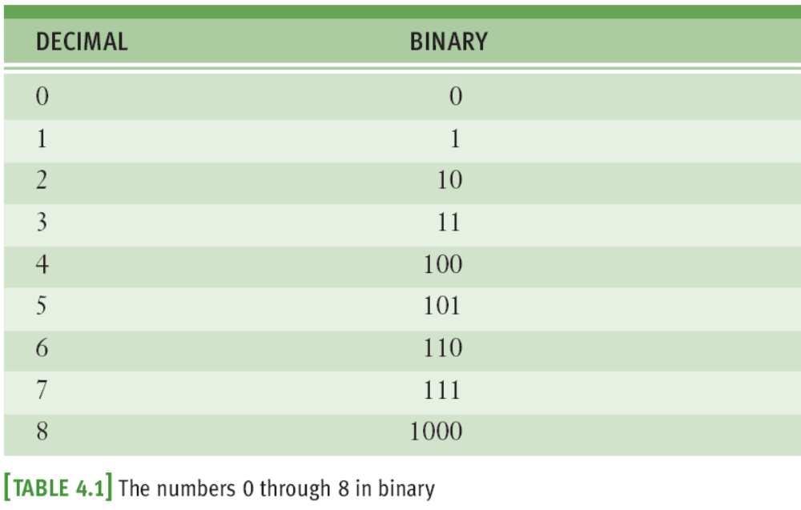
Conversion Shortcuts
Thus, a quick way to compute the decimal value of the number 11111₂ is 2⁵ - 1, or 31₁₀
Fundamentals of Python: First Programs

Slide 21
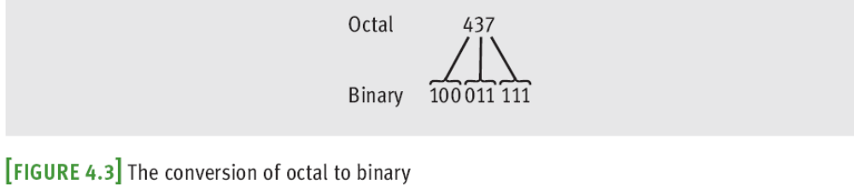
Octal and Hexadecimal Numbers
To convert from octal to binary, start by assuming that each digit in the octal number represents three digits in the corresponding binary number
To convert binary to octal, you begin at the right and factor the bits into groups of three bits each
Fundamentals of Python: First Programs

Slide 22
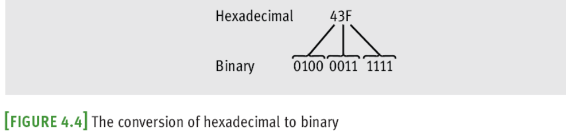
Octal and Hexadecimal Numbers (continued)
To convert from hex to binary, replace each hex digit with the corresponding 4-bit binary number
To convert from binary to hex, factor the bits into groups of 4 and look up the corresponding hex digits
Fundamentals of Python: First Programs

Slide 23
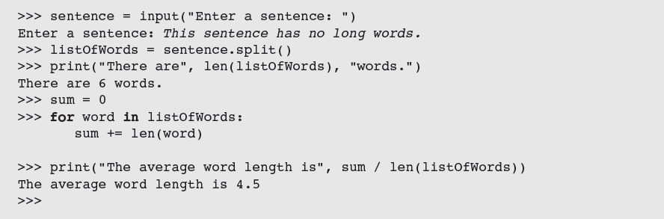
String Methods
Python includes a set of string operations called methods that make tasks like counting the words in a single sentence easy
Fundamentals of Python: First Programs

Slide 24
String Methods (continued)
A method behaves like a function, but has a slightly different syntax
  A method is always called with a given data value called an object
Methods can expect arguments and return values
A method knows about the internal state of the object with which it is called
In Python, all data values are objects
Fundamentals of Python: First Programs

Slide 25
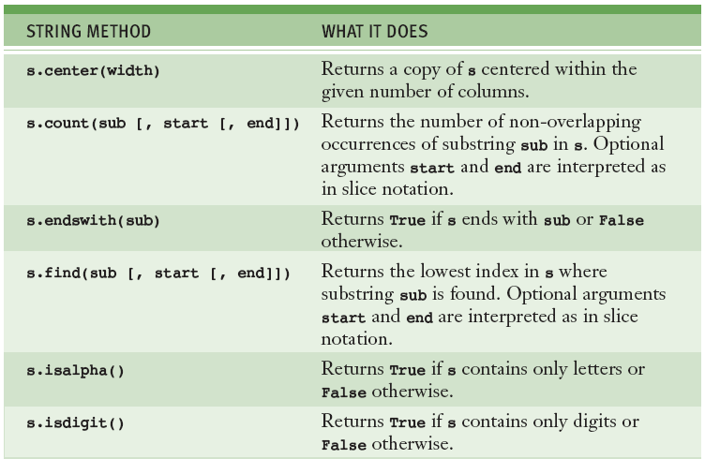
String Methods (continued)
Fundamentals of Python: First Programs

Slide 26
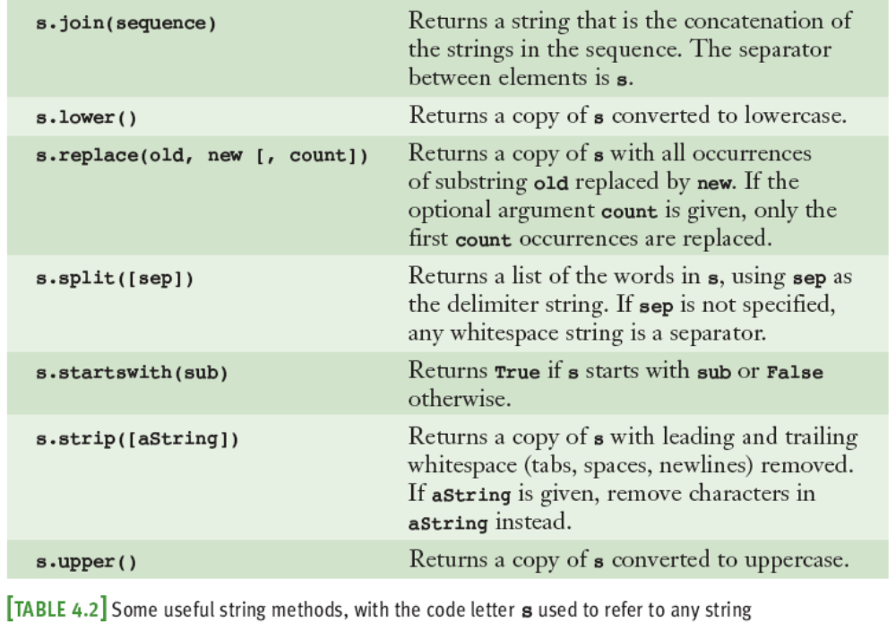
String Methods (continued)
Fundamentals of Python: First Programs

Slide 27
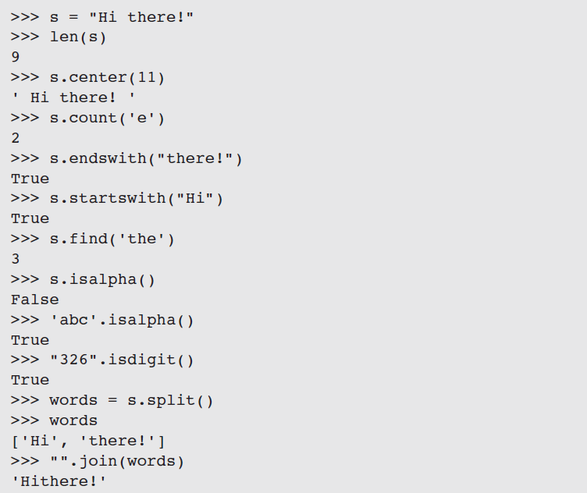
String Methods (continued)
Fundamentals of Python: First Programs

Slide 28
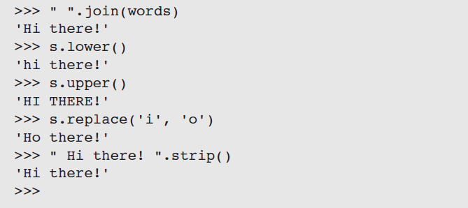
String Methods (continued)
Fundamentals of Python: First Programs

Slide 29
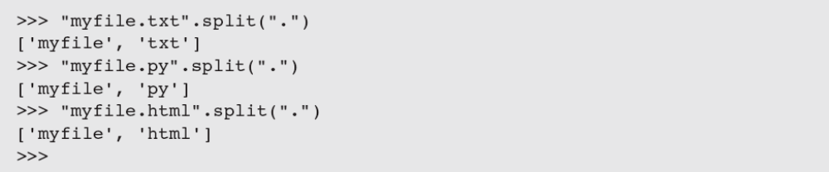
String Methods (continued)
Example: extracting a filename’s extension
The subscript [-1] extracts the last element
  Can be used to write a general expression for obtaining any filename’s extension, as follows:
Fundamentals of Python: First Programs

Slide 30
Text Files
A text file is software object that stores data on permanent medium such as disk or CD
When compared to keyboard input from human user, the main advantages of taking input data from a file are:
  The data set can be much larger
  The data can be input much more quickly and with less chance of error
  The data can be used repeatedly with the same program or with different programs
Fundamentals of Python: First Programs

Slide 31
Text Files and Their Format
Using a text editor such as Notepad or TextEdit, you can create, view, and save data in a text file
All data output to or input from a text file must be strings
Fundamentals of Python: First Programs

Slide 32
Writing Text to a File
Data can be output to a text file using a file object
To open a file for output:
  If file does not exist, it is created
  If it already exists, Python opens it; when data are written to the file and the file is closed, any data previously existing in the file are erased
Failure to close output file can result in data being lost
Fundamentals of Python: First Programs

Slide 33
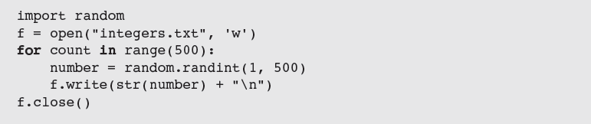
Writing Numbers to a File
The file method write expects a string as an argument
  Other types of data must first be converted to strings before being written to output file (e.g., using str)
Fundamentals of Python: First Programs

Slide 34
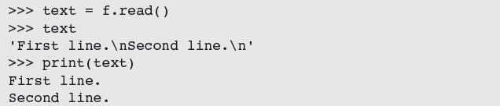
Reading Text from a File
You open a file for input in a manner similar to opening a file for output
  If the path name is not accessible from the current working directory, Python raises an error
There are several ways to read data from a file
  Example: the read method
Fundamentals of Python: First Programs

Slide 35
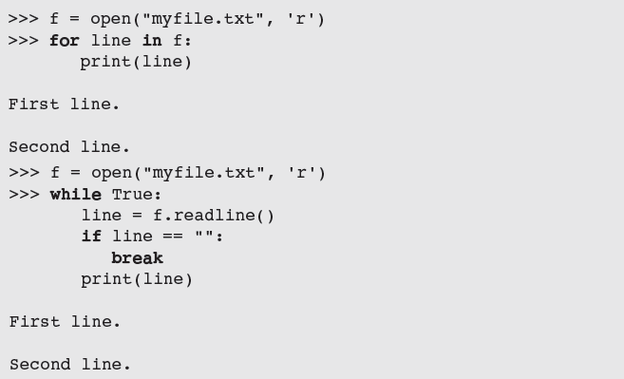
Reading Text from a File (continued)
After input is finished, read returns an empty string
Fundamentals of Python: First Programs

Slide 36
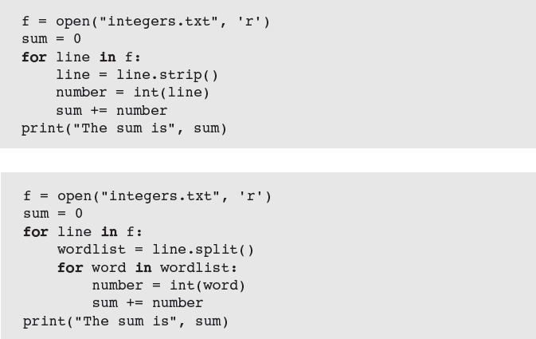
Reading Numbers from a File
Examples:
Fundamentals of Python: First Programs

Slide 37
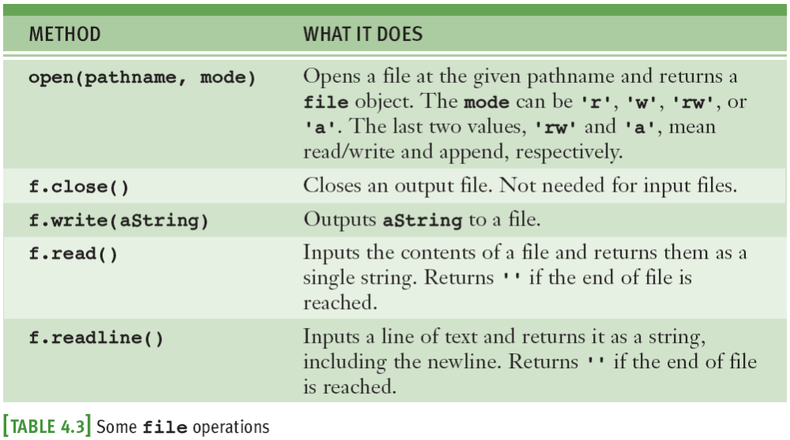
Reading Numbers from a File (continued)
Fundamentals of Python: First Programs

Slide 38
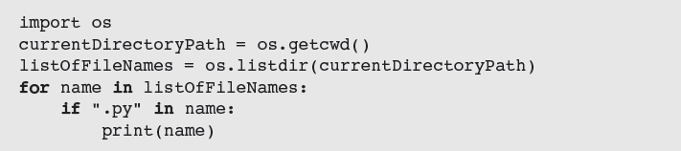
Accessing and Manipulating Files and Directories on Disk
When designing Python programs that interact with files, it’s a good idea to include error recovery
For example, before attempting to open a file for input, you should check to see if file exists
  Function os.path.exists supports this checking
Example: To print all of the names of files in the current working directory with a .py extension:
Fundamentals of Python: First Programs

Slide 39
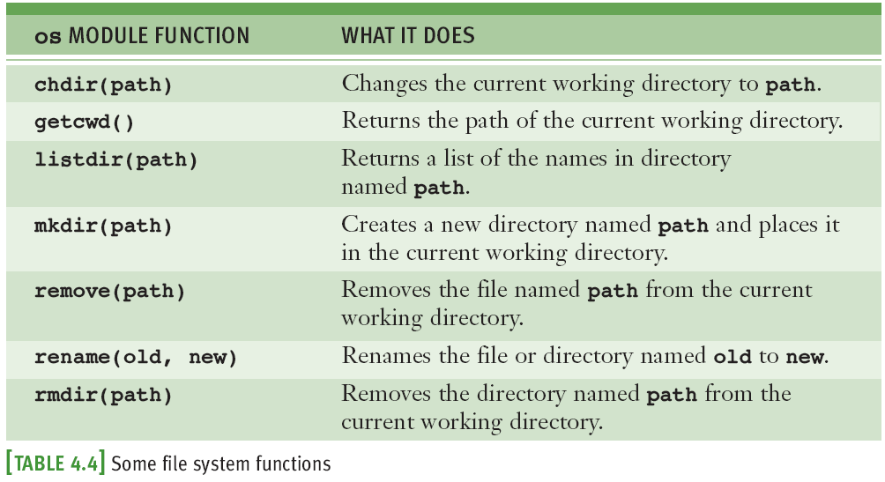
Accessing and Manipulating Files and Directories on Disk (continued)
Fundamentals of Python: First Programs

Slide 40
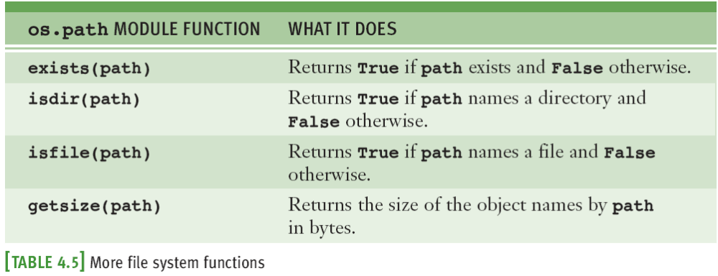
Accessing and Manipulating Files and Directories on Disk (continued)
Fundamentals of Python: First Programs

Slide 41
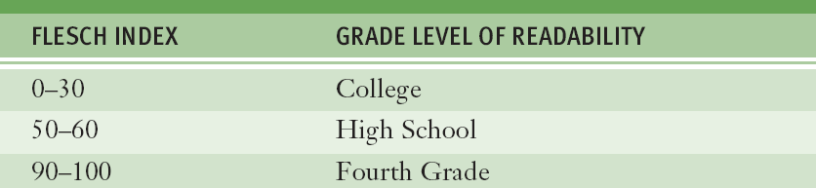
Case Study: Text Analysis
In 1949, Dr. Rudolf Flesch proposed a measure of text readability known as the Flesch Index
  Index is based on the average number of syllables per word and the average number of words per sentence in a piece of text
  Scores usually range from 0 to 100, and indicate readable prose for the following grade levels:
Fundamentals of Python: First Programs

Slide 42
Case Study: Request
Write a program that computes the Flesch index and grade level for text stored in a text file
Fundamentals of Python: First Programs

Slide 43
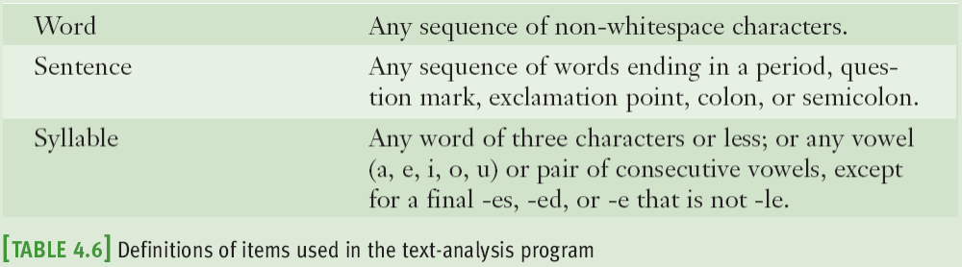
Case Study: Analysis
Input is the name of a text file
Outputs are the number of sentences, words, and syllables in the file, as well as the file’s Flesch index and grade-level equivalent
Fundamentals of Python: First Programs

Slide 44
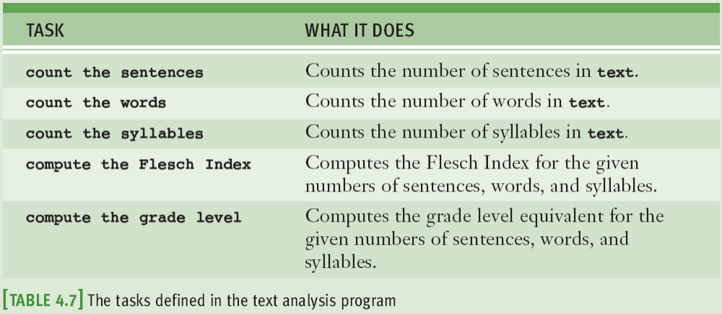
Case Study: Design
Fundamentals of Python: First Programs

Slide 45
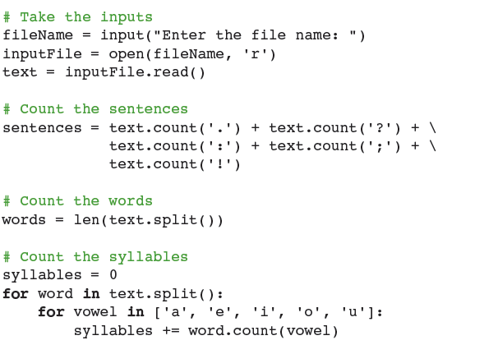
Case Study: Implementation (Coding)
Fundamentals of Python: First Programs

Slide 46
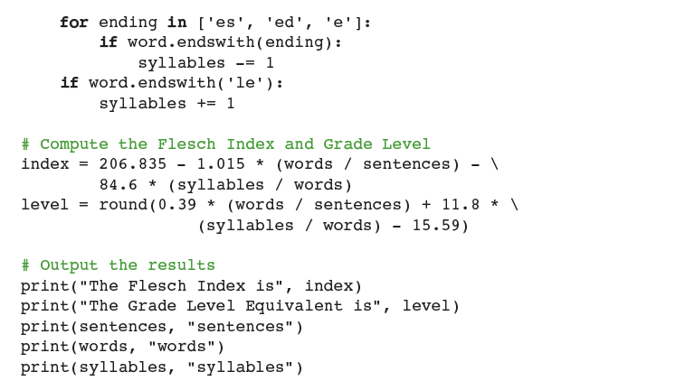
Case Study: Implementation (Coding) (continued)
Fundamentals of Python: First Programs

Slide 47
Case Study: Testing
Bottom-up testing:
  Each task is coded and tested before it is integrated into the overall program
  After you have written code for one or two tasks, you can test them in a short script, called a driver
Fundamentals of Python: First Programs

Slide 48
Summary
A string is a sequence of zero or more characters
  Immutable data structure
  [] used to access a character at a given position
    Can also be used for slicing ([<start>:<end>])
in operator is used to detect the presence or absence of a substring in a string
Method: operation that is used with an object
The string type includes many useful methods for use with string objects
Fundamentals of Python: First Programs

Slide 49
Summary (continued)
A text file is a software object that allows a program to transfer data to and from permanent storage
A file object is used to open a connection to a text file for input or output
  Some useful methods: read, write, readline
for loop treats an input file as a sequence of lines
  On each pass through the loop, the loop’s variable is bound to a line of text read from the file
Fundamentals of Python: First Programs

