Slide 1
Assignment – High Risk Project for Spring 2025 AI395T AI in Healthcare
David Forsyth
dsf735

Slide 2
Theme
My overarching theme for this work is to examine how external factors affect health care outcomes.
In previous assignments for this class, I examined:
Ability to predict heart attack survival from specific test results and secondary diagnoses, and
socio-economic factor influences on health outcomes.
I wanted to broaden this line of work to look at chronic conditions and socio-economic factors impact health care outcomes. The outcome should help support individuals and governments make decisions that can have positive impacts.
The prevalence of chronic conditions in a population is often related to socio-economic factors.
The main data sources I used were:
the MIMIC-III database as a source of information on the outcomes from non-chronic events and any associated chronic conditions
The United States Government Agency for Healthcare Research and Quality’s Chronic Condition Indicator for ICD-9-CM https://hcup-us.ahrq.gov/toolssoftware/chronic/chronic.jsp
Alternate sources of data that could be used if additional electronic health record (HER) data contained more personally identifiable information (PII) include source like:
University of Wisconsin Population Health Institute. County Health Rankings & Roadmaps. www.countyhealthrankings.org
The MIMIC-III data is limited in its geographical spread and is not concurrent with the County Health Rankings data, but it provides a convenient test bed to develop the methodology.

Slide 3
Step 1: Data fusion
Given the MIMIC-III dataset, we want to determine the diagnosis that corresponds to the patient admission.
Age is an obvious factor in patient outcomes, and MIMIC-III has known issues with age due to lack of information and to the anonymizing of the data.
I removed patient records where age < 0 or age > 100
Length of stay (LOS) in hospital is an important metric for patient outcome and cost. Using the logic develop in the class lectures, I created a numerical LOS column in the data table.

Slide 4
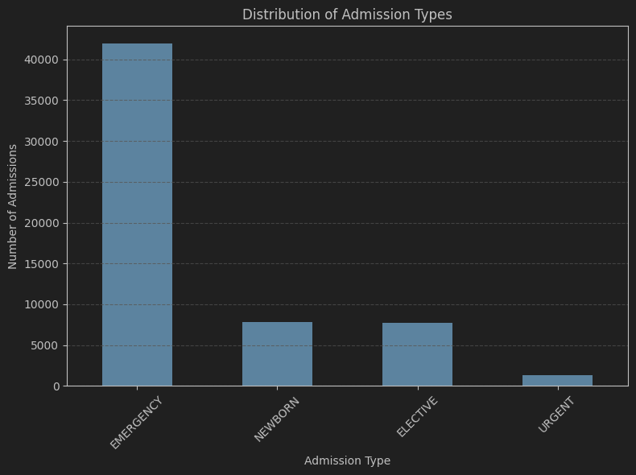
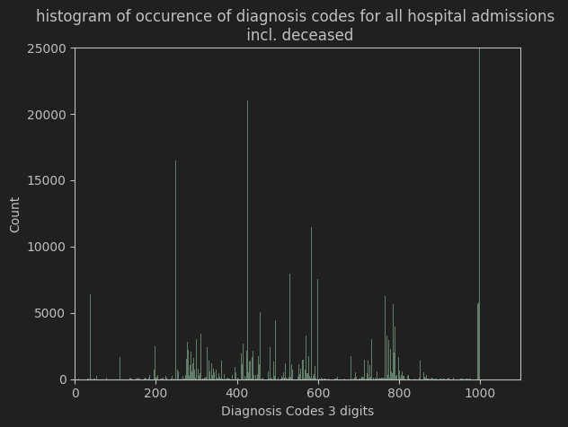
Step 1: Data fusion
Next I reviewed the types of admission. I decided to eliminate newborn and elective admissions as they are very specific classes of health care.
Then I simplified the ICD-9 diagnosis codes again using logic from our lectures.
I separated the ICD-9 codes into chronic and acute diagnoses, using the Chronic Condition Indication
https://hcup-us.ahrq.gov/toolssoftware/chronic/chronic.jsp

Slide 5
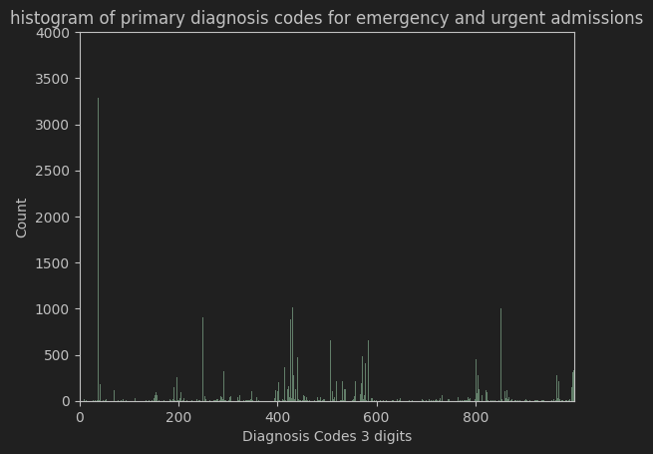
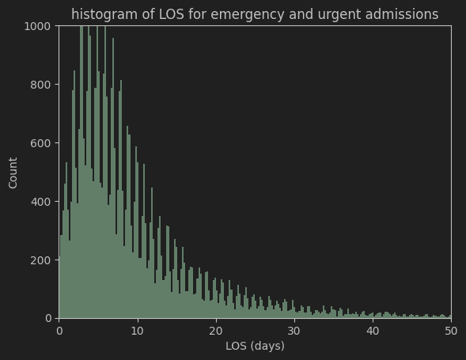
Step 1: Data fusion
I selected the first diagnosis code in the admission as the primary code.
The histogram of LOS for all the admissions is plotted. This is important when we develop the error metric.
After some cleanup and encoding, we now have a table of:
patient, admission_id, LOS, deceased, diagnosis codes chronic, diagnosis codes acute, socioeconomic factors [insurance, language, religion, marital_status, ethnicity]

Slide 6
Step 2: Model Selection
Although this may appear to be out of order, the selection of the model dictates the format of the data.
The data we can get from MIMIC-III includes a selection of ICD-9 codes for chronic and acute diagnoses. The total ICD-9 set is 1000 base codes with many subcodes.
A complicating factor is that any admission can have any set of chronic and acute codes.
The next category of information is patient age and the socioeconomic factors available in MIMIC-III.
Age has values 0 to 100
The socioeconomic factors in this case are represented as inary one hot variables.
If MIMIC-III data had geographical information, we could use that to determine additional socio-economic factors.
For example, county level information is publicly available for median income, distance to hospital, percent insurance type (private, Medicare, Medicaid).
These are continuous real valued data.
I now have a set of fixed type and size of variables, and two lists of variable length.
I’m interested in CNN’s for similar applications of rendering sets of variables as images to use the capabilities of CNN’s.

Slide 7
Step 3: Data Preparation for Model
The data we can get from MIMIC-III includes a selection of ICD-9 codes for chronic and acute diagnoses. The total ICD-9 set is 1000 base codes with many subcodes.
A complicating factor is that any admission can have any set of chronic and acute codes.
For every patient admission, I encode a binary vector for chronic and acute codes separately. This means that my data input can handle any sets of chronic and acute codes.
The third vector encodes age and the socioeconomic factors available in MIMIC-III.

Slide 8
Conclusions
I was able to use information about a patient’s health at time of admission for heart attack-related reasons to predict their odds of survival.
Getting the right input feature set proved critical. Information from the chartevents table of MIMIC-III was complex and included many NaN data points. With these large tables, that can be missed without careful review of data.
Regression models did not perform well for the feature sets I created. Random forest and Feed Forward Neural Network models did perform well and were easily trained and executed on a laptop computer.

Slide 9
References
Ding, Y. (2025). AI In Healthcare: Lecture Series 11. AI 395T, University of Texas.
Krahenbuhl, P. (2025). Deep Learning: Module 3: Deep Networks. AI 394D, University of Texas.

