Slide 1





CASHFLOW
Team Kernel Presents
TRACK YOUR MONEY — JUST BY TALKING.
Offline voice-powered finance for Africa’s informal economy
LET’S GO

Slide 2



THE PROBLEM
Most small business owners in Nigeria don’t track daily cash flow
They mix personal and business money
They forget debts, can’t see profits, and lose track of expenses
80% of African MSMEs operate informally
60% don’t use any digital tool for finances
Gulfs Display
Gulfs Display

Slide 3
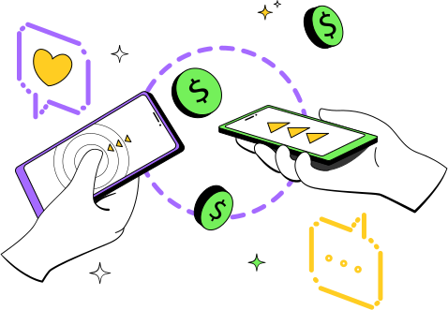

Traders already use voice notes daily not spreadsheets.
They speak in Pidgin or Yoruba while selling.
Voice is the easiest input for Africa’s entrepreneurs.
“I NO GET TIME TO WRITE,
I JUST TALK AM.”
THE INSIGHT

Slide 4



A voice-first, offline cash tracker that lets traders record income, expenses, and debts by simply speaking in their language.
THE SOLUTION: CASHFLOW
Users just say: “Sold 3 shoes, 15k.”
App understands → records → updates profit

Slide 5
HOW IT WORKS
TAP MIC & SPEAK NATURALLY
AI PARSES KEYWORDS (AMOUNT, TYPE, NAME)
STORES DATA OFFLINE
SYNCS LATER + SENDS WHATSAPP SUMMARY
🎙 → 🤖 → 📊 → 📱

Slide 6
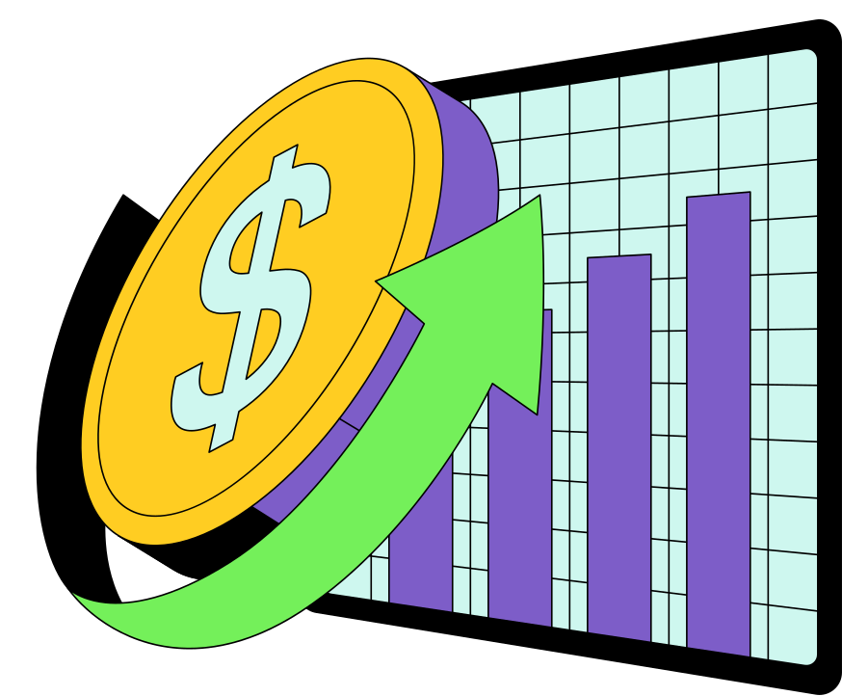
CORE FEATURES
Voice input (English, Pidgin),
Cash vs Mobile Money tracking
Offline mode
Daily/Weekly summaries
Smart debt reminders
WhatsApp reports

Slide 7
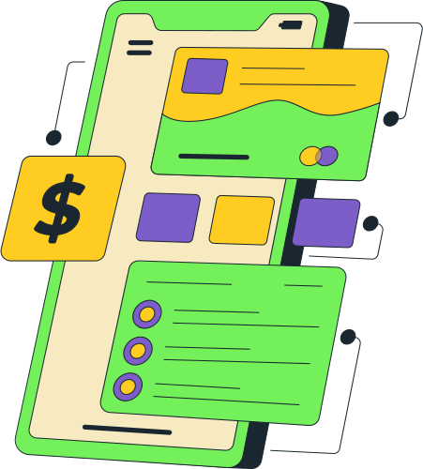
CashFlow is uniquely built for Africa’s informal traders — the market women, barbers, tailors, and mechanics who keep the economy running but are excluded from digital finance. Unlike typical finance apps, it requires no typing, no spreadsheets, and no constant internet connection. Users simply speak naturally in English, Pidgin, or Yoruba, and CashFlow understands, records, and organizes their transactions automatically. By turning everyday speech into structured financial data, the app not only helps traders manage their cash flow effortlessly but also builds a digital credit history that can unlock future access to microloans and financial growth opportunities. In short, CashFlow speaks their language — and helps their business grow.
WHY IT’S DIFFERENT

Slide 8
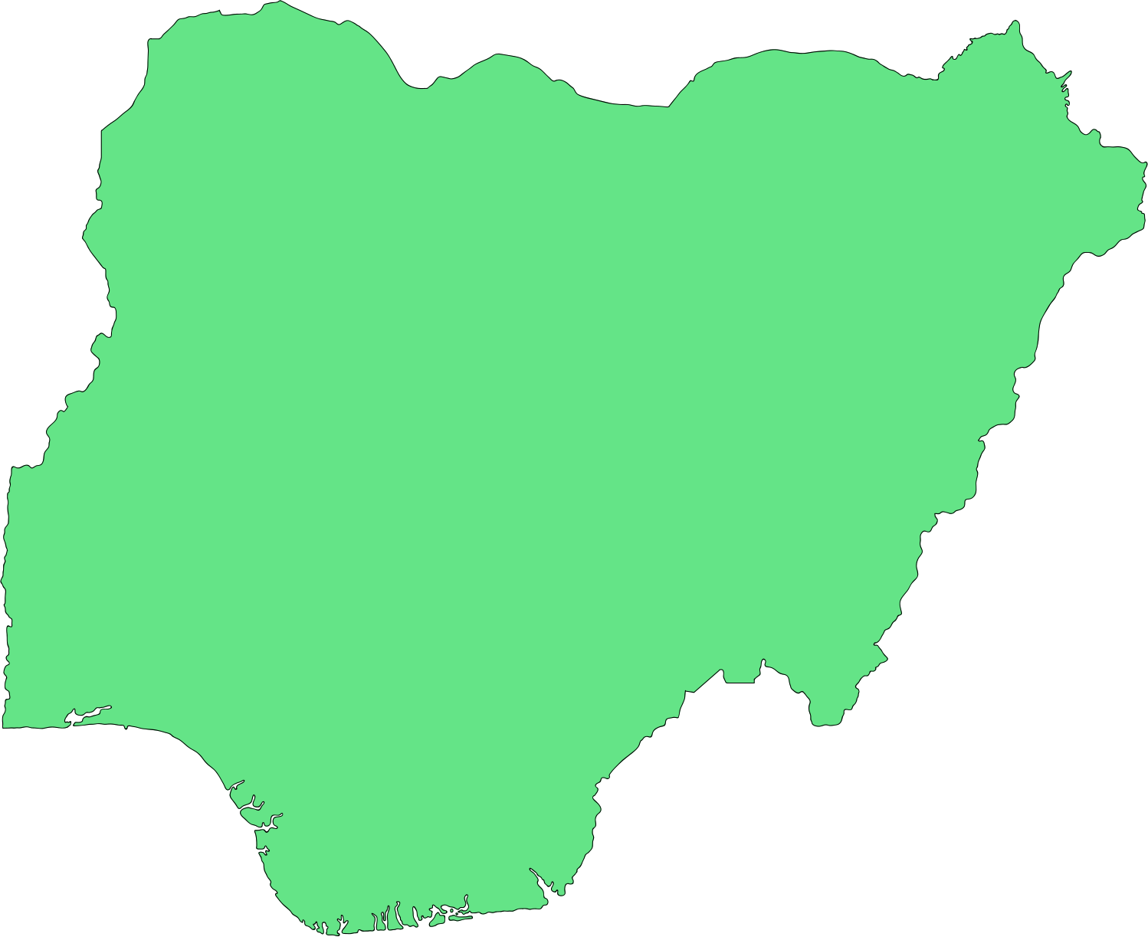

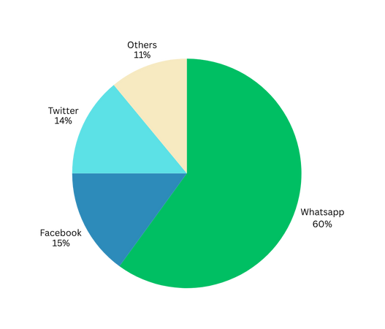
MARKET POTENTIAL
41M+ Nigerian MSMEs
90% use WhatsApp
Massive unserved informal fintech market.
Future: credit scoring, micro-loans, BNPL partnerships

Slide 9

TECH STACK & IMPLEMENTATION
Goal: Show feasibility and your execution plan.
Content:
Frontend: Flutter (mobile app)
AI/NLP: Speech-to-text + keyword extraction (e.g. OpenAI Whisper / Google Speech API)
Database: SQLite (offline), Firebase sync
Integration: WhatsApp Business API for report delivery
SYSTEM ARCHITECTURE DIAGRAM (MIC → AI → DB → DASHBOARD → WHATSAPP)

Slide 10
IMPACT & NEXT STEPS
Goal: End strong — focus on human and business impact.
Content:
“With CashFlow, every trader can finally understand their money — no spreadsheets, no internet, just their voice.”
Next Steps:
Beta testing in local markets
Add Pidgin, Yoruba, Hausa & Igbo support
Partner with microfinance lenders
“IF YOU CAN SAY IT, YOU CAN TRACK IT.”

Slide 11
THANK YOU
let’s embrace the digital financial future with CashFlow!

