Slide 1
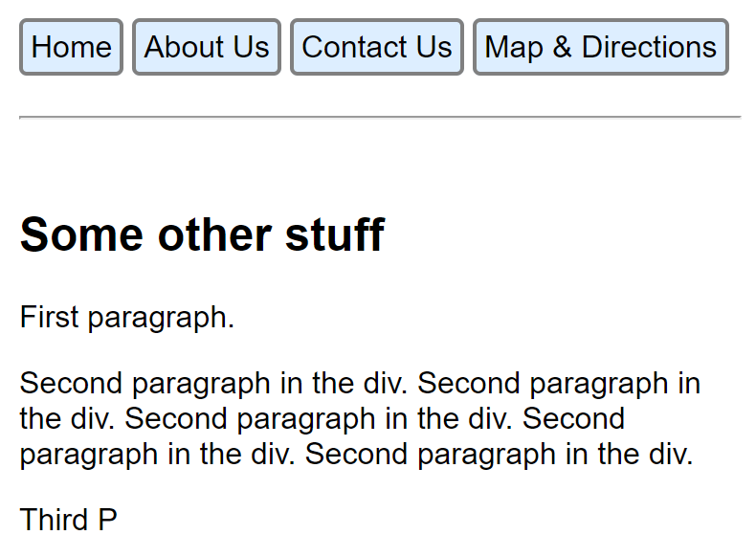
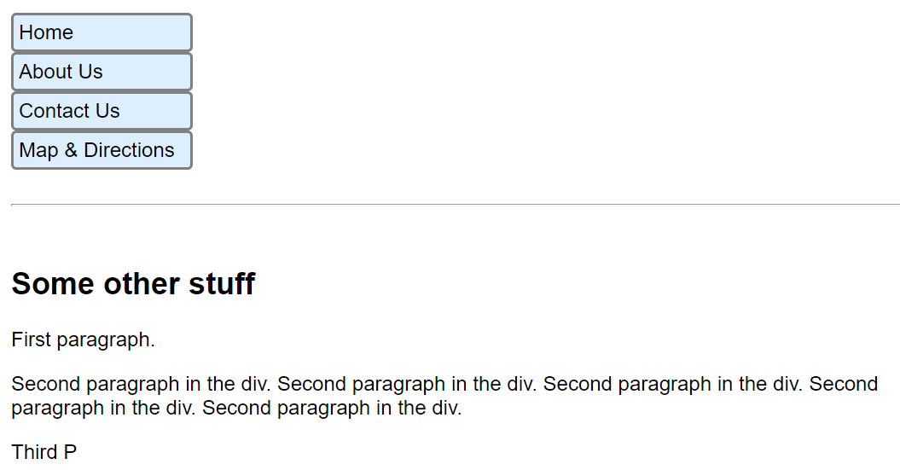
Flex Exercise
Add to the css rule for .navbar to change to vertical menu

Slide 2
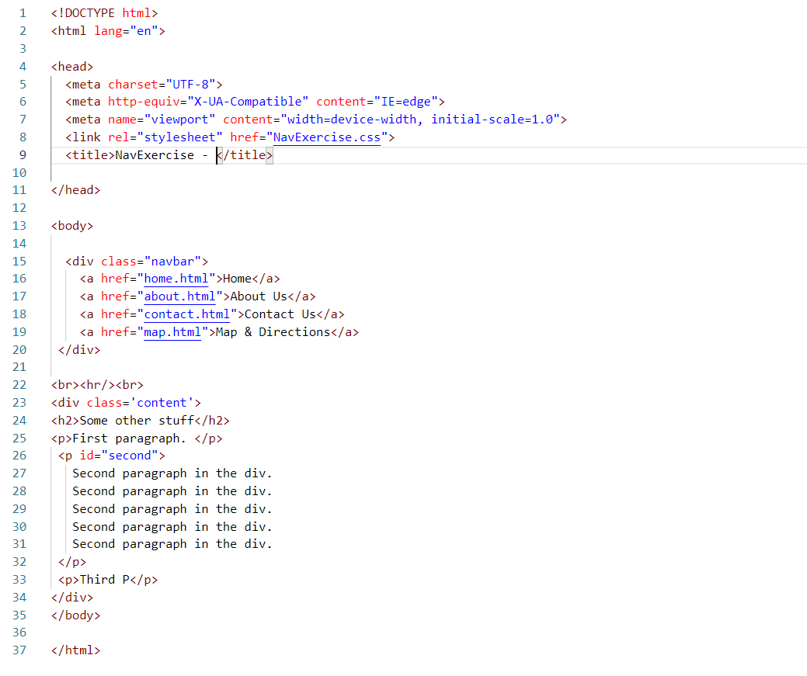
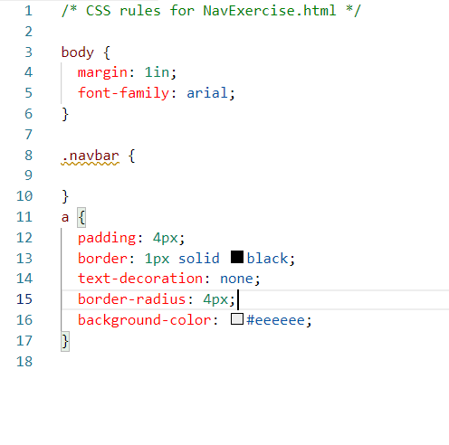
Flex Exercise Files
NavExercise.html
NavExercise.css
Add Properties Here

Slide 3
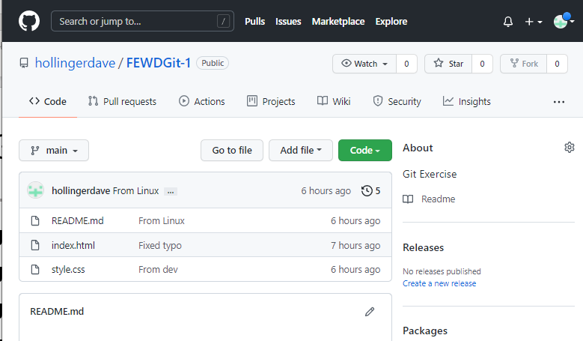
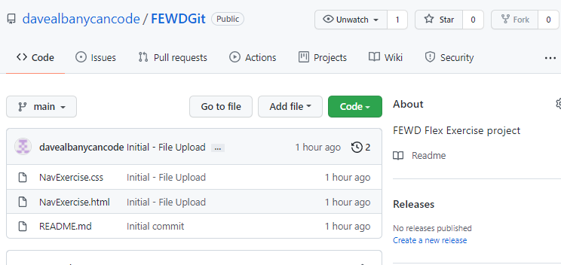
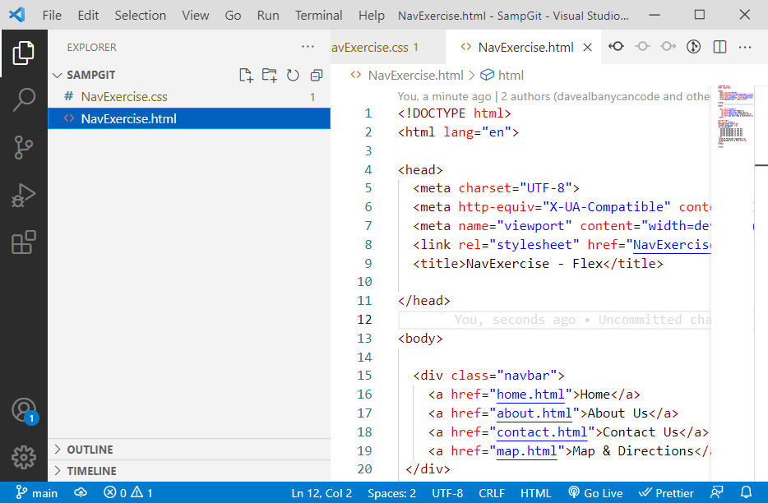

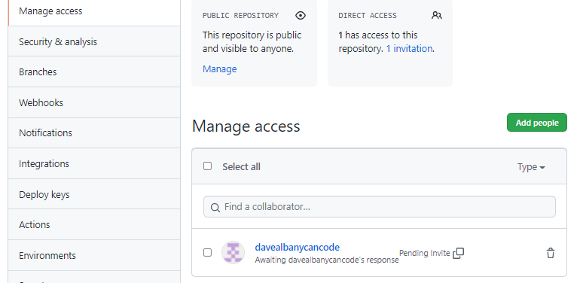
Use git!
My Git Repository on github
Sync with your repository on github
set up synchronization
with github
git clone
add me as collaborator

Slide 4
Git tasks for exercise
use git clone to make a copy of the repository I have set up:
git clone https://github.com/davealbanycancode/FEWDGit.git
Open folder in VSCode and make changes to NavExercise.css
add your changes to the repository.
Open github and create a repository for this exercise.
In VSCode – set up remote to point to the new repository on github.
Synchronize.
Add davealbanycancode as a collaborator.

