Slide 1
APOLLO · DESIGN-SYSTEM ENGINE
Apollo
A governed engine for designing with AI — on brand, accessible, at speed.
Sponsor briefing · July 2026 · David Ewen

Slide 2
THE TENSION
TODAY
AND NOW
Designers spend their days assembling interfaces from components that already exist. Build work — not craft.
AI can generate an interface in seconds. But left ungoverned, it drifts from brand, from accessibility, from every standard we hold.
The opportunity sits exactly between the two.

Slide 3
THE IDEA
Apollo is a governed
design-system engine.
It generates on-brand, accessible interfaces at speed — and it is built so the machine does the build, and the designer does the craft.

Slide 4
WHAT IT IS
Four moving parts. No black box.
01
02
03
04
Canon
Gates
Runbooks
Host agent
The design tokens and the reviewed, gated components — the single source of truth for what “on brand” means.
Executable checks for brand fidelity and accessibility. Not guidance — enforcement that can withhold “done”.
The method: how a task is generated, retrieved, and reviewed. Repeatable, inspectable, improvable.
The AI that operates it — running today in VS Code with GitHub Copilot, the tools designers already have.
Portable by design — no bespoke runtime. Any capable AI agent can operate the engine.

Slide 5
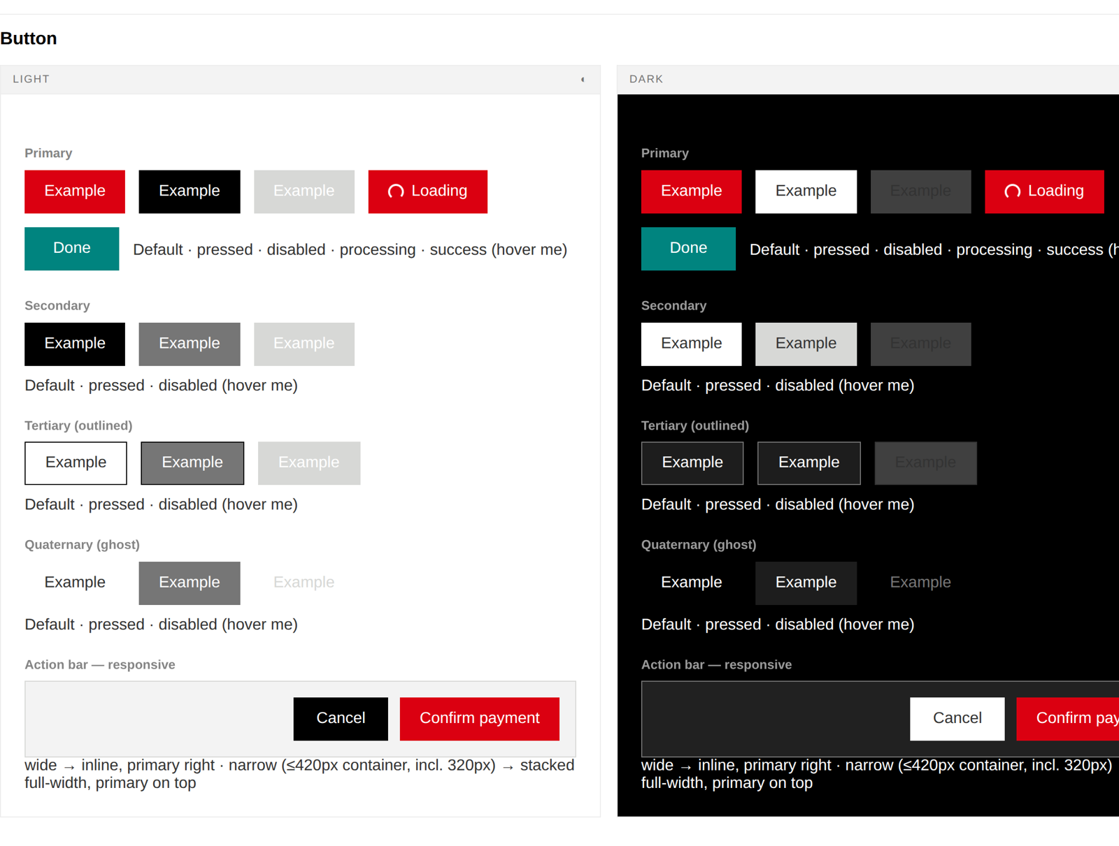
WHAT'S REAL TODAY
Not a concept.
A working system.
Every component here is generated from the canon and rendered in light and dark, together, for review — the same view designers and reviewers use.
38
2.2 AA
Light + dark
reviewed components
WCAG build target
gated, both themes

Slide 6
THE SHIFT
Craft over build.
The machine assembles what is known. The designer is freed for what is new — patterns, journeys, judgment. AI doesn't replace the designer's craft. It clears the ground for it.

Slide 7
ONE ENGINE, MANY MODES
The same brain, tuned for the task.
A
B
C
D
Factory
Creative
Component dev
Explore
Strict, compliant assembly of known components. Boring by design — and for production, that is exactly right.
Inject inspiration to explore new directions. What earns its place flows back to become new canon.
Build and review new components — the raw material the whole system runs on.
Open, low-stakes noodling — where ideas start before they are shaped.
The compliance gates hold across every mode. That shared floor is the moat.

Slide 8
WHY IT MATTERS
Four returns, one system.
VALUE
GOVERNANCE
CRAFT
SPEED
Designers on the high-value work
Accessibility built in
The output quality rises
Brief to compliant UI, faster
Less time assembling the known; more on the craft only they can do.
Brand and accessibility enforced by the engine — not bolted on, not left to chance.
A consistent floor frees attention for taste, nuance, and the new.
The repetitive build collapses from hours to moments.

Slide 9
WHERE IT GOES
NOW
Designers experimenting. A skill pack they run in their own tools — release imminent, feedback flowing back.
NEXT
A richer, well-crafted knowledge base as the source of truth — and a settings layer: admin tuning, a simple view for users.
THE BET
One design brain powering many modes of creation — from strict production to genuinely new patterns.

Slide 10
WHERE WE ARE, HONESTLY
This is experimental. The component inventory is still early, and the approach is deliberately phased. We are showing progress and learning in the open — not claiming a finished product. That candour is the point: it is how we get this right.

Slide 11
THE ASK
Two things.
Backing to keep going — and to widen it.
A next checkpoint — set today.
A signal that the idea is worth pursuing, and worth more room to prove itself. No budget ask today.
Let's agree the date we come back together, so momentum has a deadline to meet.

Slide 12
Apollo
The build is automated.
The craft is the point.

