Slide 1
Marriage Success Predictor
Supervised Machine Learning Algorithm

Slide 2
Overview
To predict if a marriage will end in divorce
Binary classification
Examine individual respondents from census survey
Included 32,000 records
Removed those who were never married or widowed
Left with about 20k record
Several models with similar accuracy and F-1 scores
Settled on an XGBoosted Tree model for F-1 score

Slide 3
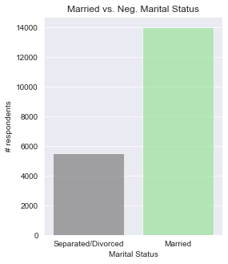
Null Accuracy
Assuming every marriage ends in divorce:
Null Accuracy = 28.2%
US Divorce Rate is closer to 42-45%
(survey limitations)

Slide 4
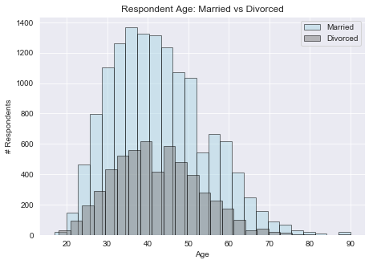
Data Features
Age
Gender
Native Country
Race
Education
Occupation Type
Hours Worked
Income
Capital Gain/Loss

Slide 5
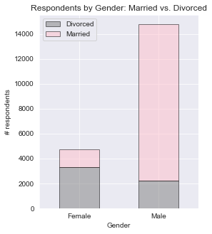
Data Features
Age
Gender
Native Country
Race
Education
Occupation Type
Hours Worked
Income
Capital Gain/Loss
F: 69.04%
M: 15.09%

Slide 6
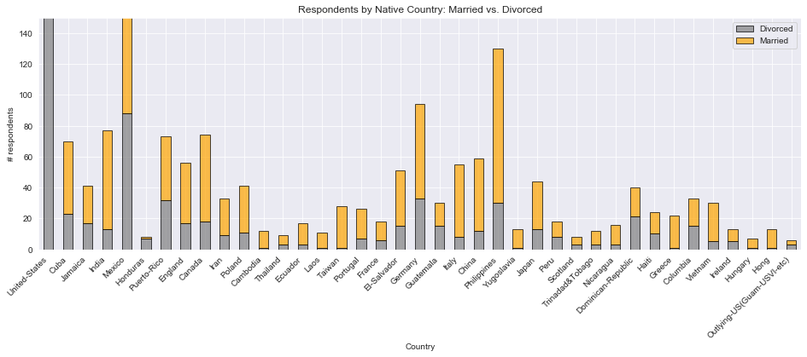
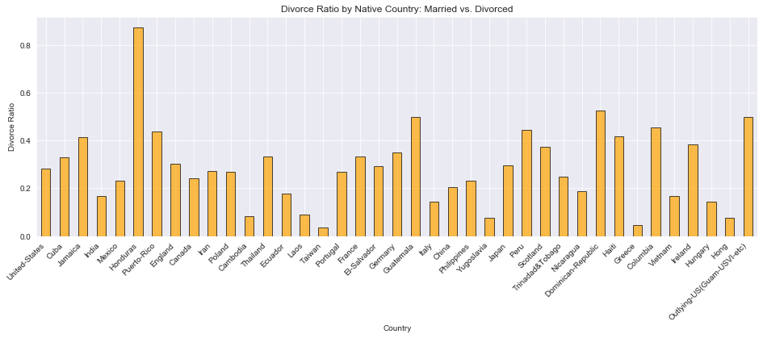
Data Features
Age
Gender
Native Country
Race
Education
Occupation Type
Hours Worked
Income
Capital Gain/Loss

Slide 7
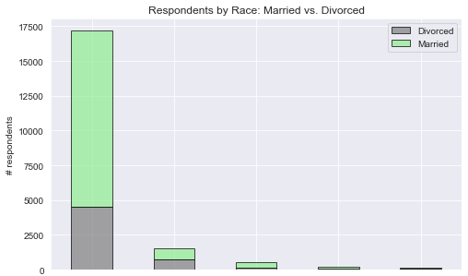
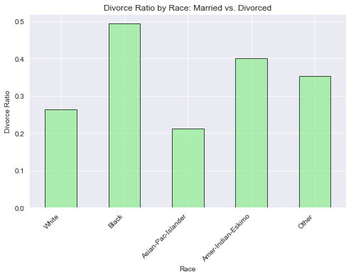
Data Features
Age
Gender
Native Country
Race
Education
Occupation Type
Hours Worked
Income
Capital Gain/Loss

Slide 8
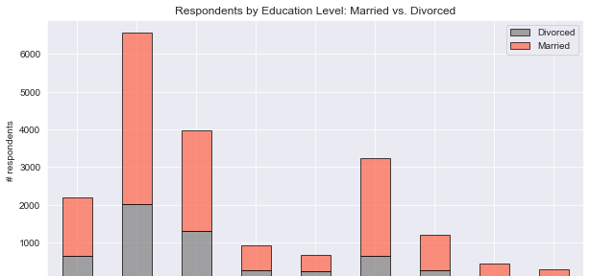
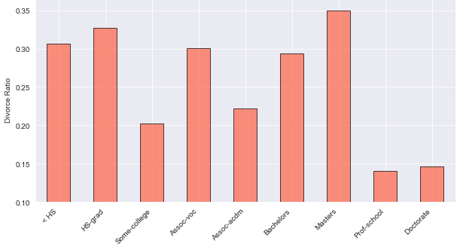
Data Features
Age
Gender
Native Country
Race
Education
Occupation Type
Hours Worked
Income
Capital Gain/Loss

Slide 9
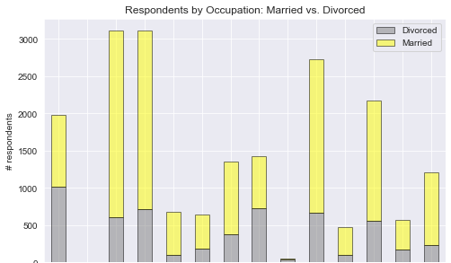
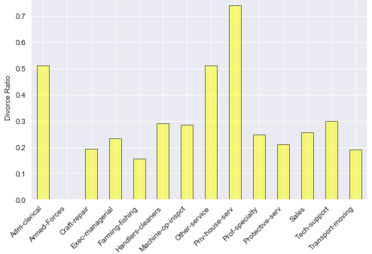
Data Features
Age
Gender
Native Country
Race
Education
Occupation Type
Hours Worked
Income
Capital Gain/Loss

Slide 10
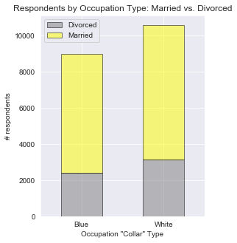
Data Features
Age
Gender
Native Country
Race
Education
Occupation Type
Hours Worked
Income
Capital Gain/Loss

Slide 11
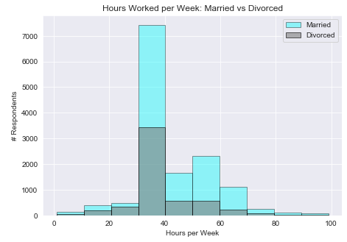
Data Features
Age
Gender
Native Country
Race
Education
Occupation Type
Hours Worked
Income
Capital Gain/Loss

Slide 12
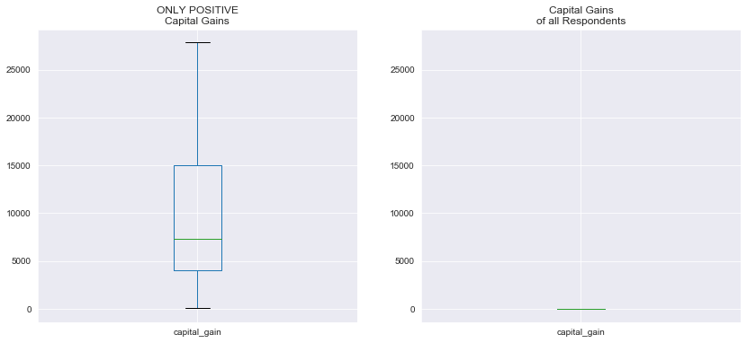
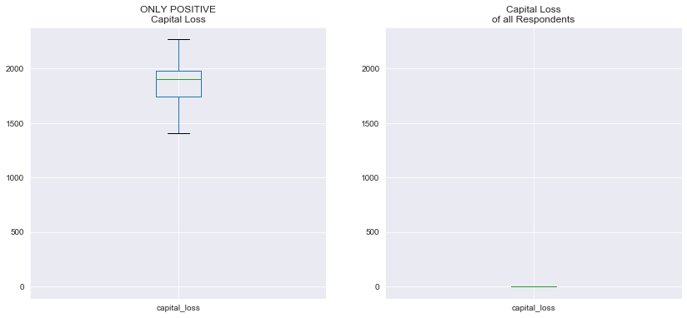
Data Features
Age
Gender
Native Country
Race
Education
Occupation Type
Hours Worked
Income
Capital Gain/Loss
10.5%
5.7%

Slide 13

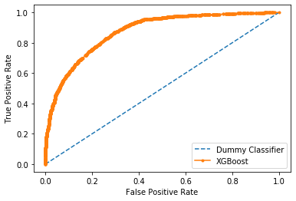
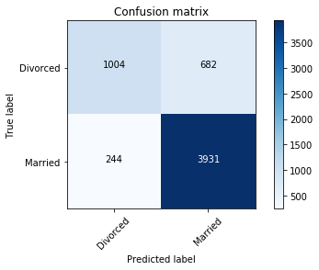
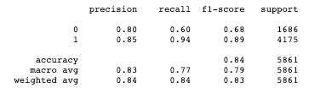
Model
GBoosted Decision Tree Ensemble

Slide 14
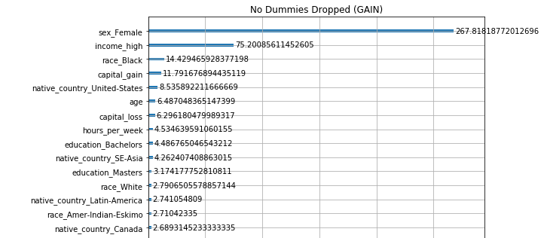
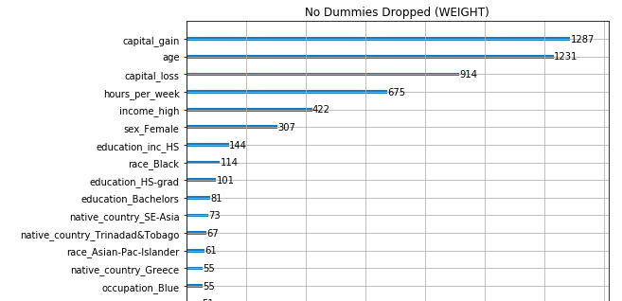
Feature Importance
Gini impurity reduction
# times feature used to split across all trees

Slide 15
Conclusions
What should I focus on to avoid a divorce?
Work > 40hrs/week
prove value to your spouse?
Invest your money
for better or worse?
Make sure you’re above the $85k threshold

Slide 16
What’s Next?
Clustering
To test hypotheses from EDA (occupations with higher divorce rates)
SHAP – individualized interpretation of feature importance
Source current data
Source length of marriage
Source continuous income data (what is the cutoff), geographic location (state by state), # kids in household, marriage #

