Slide 1
Spoiler Alert!
Supervised Machine Learning used to determine:
does a movie review contain a spoiler?

Slide 2
Data Source - IMDb
Total number of reviews = 573,913
From 263,407 reviewers
Of 1,572 movies
Average review length of 136.1442 words
150,924 contained spoilers (35.68%)
What if we divide data between Spoiler vs. Non-spoiler?

Slide 3
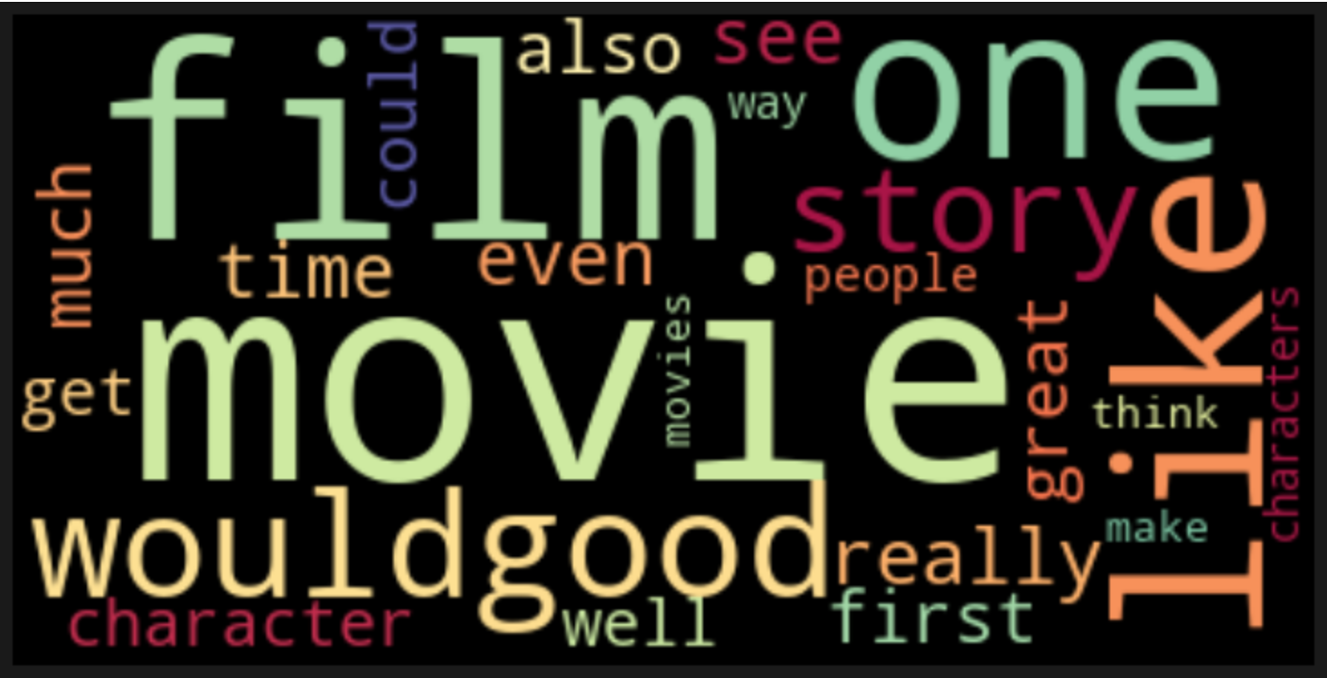
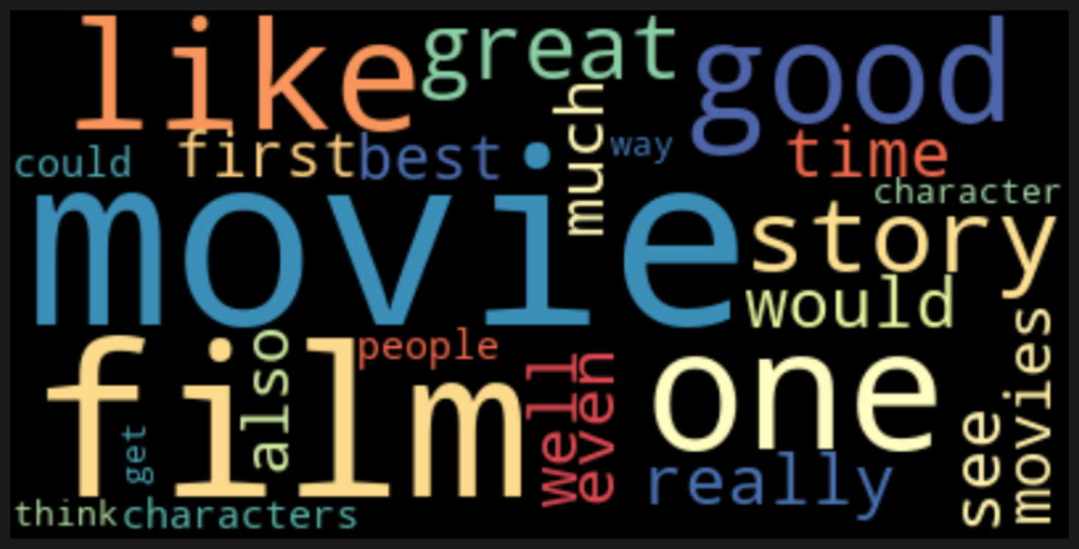
Most Frequent Words

Slide 4
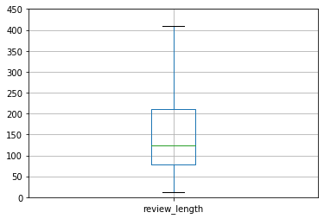
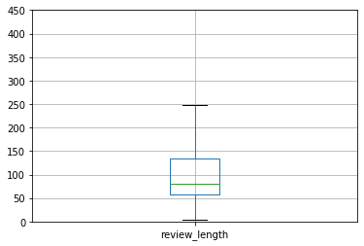
Spoilers 422,989
Non-Spoilers 150,924
Avg. Review Length: 161.98
Avg. Review Length: 110.31

Slide 5
Process
Accuracy: .52
Recall: .88
Accuracy: .62
Recall: .91
Accuracy: .64
Recall: .73
NBclf with ReGex
Cleaner Function
Custom Stop Words / Bigrams
Review Length Importance
Maximize Recall
Accuracy: .42
Recall: .96

Slide 6
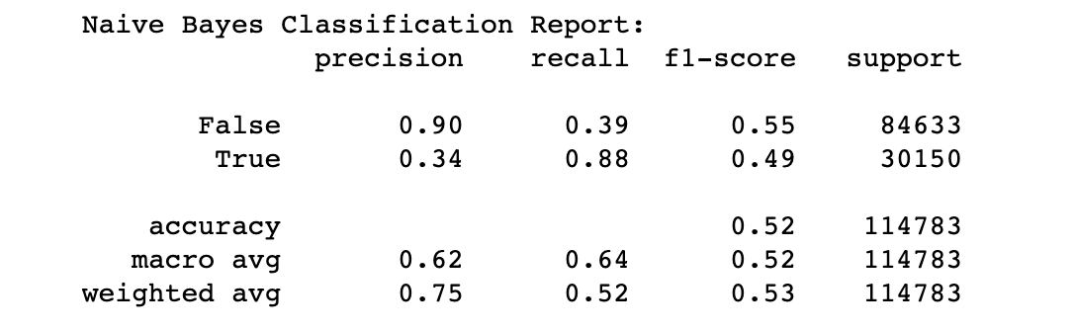
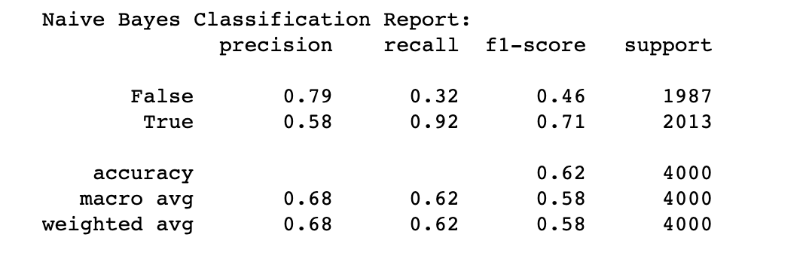
Performance Metrics How do we know if a model performed well?
Initial Model
Optimum Model

Slide 7
Model Performance
 | Naïve Bayes models
 | Initial | Cleaned | Bi-grams | w/ reviewer rating | Optimized
Accuracy | .52 | .64 | .42 | .63 | .62
Recall | .88 | .73 | .96 | .70 | .92
Precision | .34 | .40 | .30 | .61 | .58
F-1 | .49 | .52 | .46 | .65 | .71

Slide 8
Moving Forward
We’ve presented a baseline NLP model
word frequency and uniqueness
How to teach a machine to understand context?
Which instances of words and phrases are more important?
Chunking & rule-definition
Removing “spoiler alert” as stopword to see if model can identify other tokens
Identify non-advertised spoilers
Why were false negatives identified as spoilers?
Incorporate the reviewer’s movie rating (as we did review length)

