Slide 1
Will a Terry Stop end in an arrest?
Dave Bletsch

Slide 2
What is a Terry stop?
Fourth Amendment – protects against unreasonable search and seizure
Define “reasonable” (1968 Supreme Court case of Terry v. Ohio)
Terry Stops include pedestrian searches (”Stop and Frisk”) and traffic stops

Slide 3
The Data
City of Seattle
Records of pedestrian Terry stops
Including:
Date
Time
officer demographics
perceived subject demographics
Was the subject frisked?
Weapon type discovered after search
Whether or not an arrest was made

Slide 4
Hypothesis
In a progressive area like the PNW, the subject’s race and gender do not have an effect on arrest probability
Age of subject will have an effect – the young subjects are more likely to be arrested than older subjects
Age of officer will have an effect – older/more experienced officers might not be so quick to make an arrest (or may not want to deal with the paperwork?)
Time of day will have an effect - people walking around late at night are more likely to be arrested

Slide 5
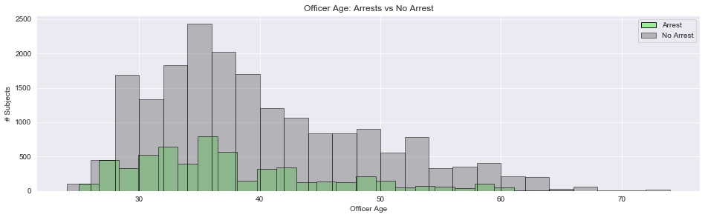
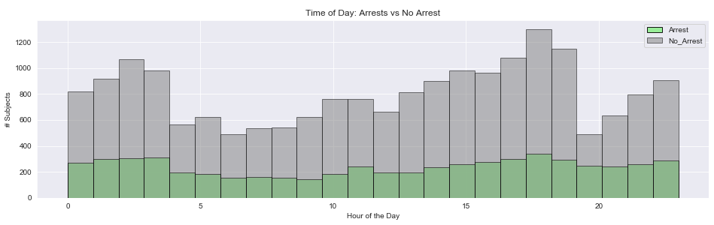
Feature Engineering
Young Officers – under 29 y/o
Late night – hours between 8p – 4a

Slide 6
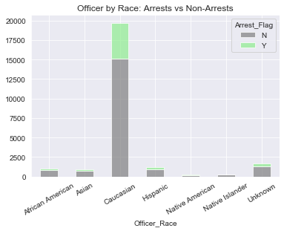
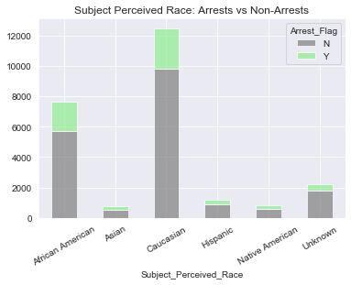
Feature Engineering
Officer white vs. all other races
Subject Perceived white vs all other races

Slide 7
Model Evaluations
Null Accuracy: 76.96%
Model | Accuracy | Precision | Recall | F1
KNN | 75.3 % | 38.2 % | 11.8 % | 18.0 %
Decision Tree | 76.4 % | 39.8 % | 5.0 % | 8.9 %
XGBoost | 77.5 % | 60.5 % | 3.3 % | 6.2 %
XGBoost (GridSearch) | 77.8 % | 62.8 % | 6.4 % | 11.6 %
Logistical Regression | 77.1 % | 53.6 % | 3.1 % | 5.9 %

Slide 8
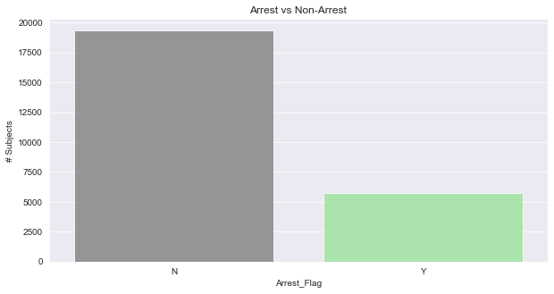
Results and Performance
Models were insignificantly better than just assuming the subject will not be arrested
Problems in feature engineering?
Seattle Police don’t discriminate?
Features not adequate predictors?

Slide 9
Further Investigation
Eliminate those subjects that were not frisked? (weapon type==None overly important)
Repeat offenders
Subject IDs which appear many times vs. few times
Weather
Scrape weather based on date
Does rain/cold effect the officer’s likelihood of making an arrest?
Does presence despite bad weather raise more suspicion resulting in more stops, frisks, arrests?

