Slide 1
Let’s talk about public speaking
Loosely based on AWS New Voices training
Notes:
Facilitator Notes:
Make sure to reinforce that:
-Public Speaking takes practice and time
-This 4-module course is an introduction to public speaking – a set of tools to help plan and organize a talk.
-Anyone / everyone can be a public speaker!

Slide 2
Dave Stauffacher AWS Community Hero Mark Pergola Sr. Community Content Manager AWS

Slide 3
New Voices… What is it?
This is a very new program, offering public speaking training to members of the AWS Community Builders program
Community Opportunities
The AWS Community Builders program offers technical resources, education, and networking opportunities to AWS technical enthusiasts and emerging thought leaders who are passionate about sharing knowledge and connecting with the technical community.
Next Cohort in January 2025
Get on the waitlist now if you’re interested
AWS User Groups

Slide 4
Why offer training?
Help share technical knowledge between communities
Help grow careers & reputations
Help build stronger and more engaged communities
It is a good skill for everyone to have

Slide 5
Module 1
Breaking the ice
Notes:
Facilitator Notes:
This module has participants tell a short personal story to which every one can relate.
Make sure to give students a couple of minutes to think about their talk, then limit their story telling to their partner to only 90 seconds.
The goal is to help the participants muster the courage to tell a personal story to one other person.
If time permits, have one or two students tell their personal 90 second story to the larger group.

Slide 6
The ugly side of public speaking
Intimidating!
Being in front of a crowd.
Imposter Syndrome? Feeling judged? Am I qualified?
What if I suck at explaining something?
Notes:
The goal here is to address participant fears about public speaking. If you’ve felt these too, be open about that.

Slide 7
Discussion Point
What skill or trait would make public speaking easier for you?
Think of a bad / boring / painful talk you’ve attended. What made it painful?
What holds your attention when sitting through a talk?
Notes:
This is another great opportunity to validate what would make speaking easier for participants.

Slide 8
Exercise – your first story
Choose one of the following topics:
A childhood Hero
A time you did something others said you couldn’t do
An important mentor or teacher in your life
A problem you are proud of solving and how you solved it
An event that made you view a colleague in a different light

Slide 9
Exercise – your first story
Instructions:
Choose one of the topics on the next slide
Keep it to 90 seconds
2 minutes: make notes about the following
What's the important point you want others to takeaway?
Why this story matters to you and how it affected you
Share your story with a partner
Notes:
Facilitator Notes
You can also have volunteers share with the awhole group after sharing in partners, based on time. This can be a nice way to have a group feedback discussion.

Slide 10
Exercise – your first story
Tell a short story about one of the following:
A childhood Hero
A time you did something others said you couldn’t do
An important mentor or teacher in your life
A problem you are proud of solving and how you solved it
An event that made you view a colleague in a different light

Slide 11
Exercise 1 – peer feedback
Go through these questions with your partner
What was the key takeaway from the talk?
What in the story grabbed your attention?
What details, if any, would you like to see added or left out?

Slide 12
Module 2
The architecture of a talk

Slide 13
Discussion - A talk you would love to hear
What’s the topic?
Why do you want to hear it?
What makes this talk special?
Who is giving the talk?

Slide 14
The structure of a talk
A well structured talk:
Holds audience attention
Is easier to remember
Ensures your audience gets your most important point
Builds your credibility as a speaker
Helps you feel more confident giving the talk

Slide 15
Exercise – Plan your talk
1. My Topic
2. My Title
3. My Audience
4. Learning Objective
7. Most Important Thing
Key point 1
5. How does this help?
6. Key Points
Key point 2
8. My Personal Story
Key point 3

Slide 16
Example Plan
1. Storage Migration
2. Moving a Billion files to FSx
3. Cloud Engineers
4. Hard migrations can be done
7. You can’t plan too much!
Know your data
5. Builds Confidence / Skills
6. Key Points
Scale the copies
8. I moved 1.5 Billion files (20 TB) with a 2 hour outage
Have a plan
Notes:
Facilitator Note: Feel free to recreate this slide with the details of a talk you have given or seen that you can speak to. Otherwise this talk is based on AWS Hero Dave Stauffacher's AWS re:Invent breakout in 2023 that can be found below. *Option – for a longer session or an activity to take home, share the video and this slide with participants to get a deeper understanding. Video: https://youtu.be/o1r4-tJ7Ezk?si=ldtpcHOpNiDBKX54

Slide 17
Exercise – Plan your talk
Who is my audience?
What is my topic?

Slide 18
Exercise – Plan your talk
What will my audience learn to do?
How will learning this help my audience?
What 3 points do I need to make to teach this to my audience?
What is the MOST important thing my audience should remember?

Slide 19
Exercise – Plan your talk
What makes this important to me?

Slide 20
Exercise – GiveYour Talk
Working from your notes, try giving your talk
3-5 minutes
It doesn't have to be perfect
Notes:
Facilitators: you can have participants break into pairs again for this activity, or if there is time, individuals can try this in front of the group

Slide 21
Exercise 2 - peer feedback
What was the key takeaway from the talk?
What in the story grabbed your attention?
What details, if any, would you like to see added or left out?

Slide 22
Module 3
Building the story in your talk
Notes:
Facilitator Notes:

Slide 23
Think of your talk as a story you tell
Why do you go to a movie?
When you read for fun, what do you read?
In exercise 1, did you just list facts? Why not?

Slide 24
Finding the story in your talk
Great stories are universal
Great stories have a clear structure and purpose
Great stories have a character to cheer for (an underdog)
Great stories appeal to our emotions
Great stories are surprising and unexpected
Great stories are simple and focused
Once upon a time, there was [character].
Every Day, [what did ”normal” look like?]
One day, [a change takes place].
Because of that, [character does something different]
Because of that, [character does something else new]
Until finally [character solves or adapts to the change]

Slide 25
What makes a story great?
Great stories are universal
Great stories have a clear structure and purpose
Great stories have a character to cheer for (an underdog)
Great stories appeal to our emotions
Great stories are surprising and unexpected
Great stories are simple and focused

Slide 26
Finding the story in your talk
Once upon a time, there was [character].
Every Day, [what did ”normal” look like?]
One day, [a change takes place].
Because of that, [character does something different]
Because of that, [character does something else new]
Until finally [character solves or adapts to the change]

Slide 27

Example
Once upon a time there was an outer-space-loving sysadmin. Every day he watched as his file data grew larger and larger. Gigabytes became terabytes, and millions of files became billions of files.
One day, his business announced everything was moving to the cloud – including his super critical storage! Because of that, he would have to sort out how to migrate his data with only a 2 hour window for the cutover. He planned and tested and tuned things, until he was finally ready to move the data.
With the precision of a NASA launch, his cutover was perfect. Ever since then, his data has continued growing to petabytes, living happily ever after in the cloud.

Slide 28
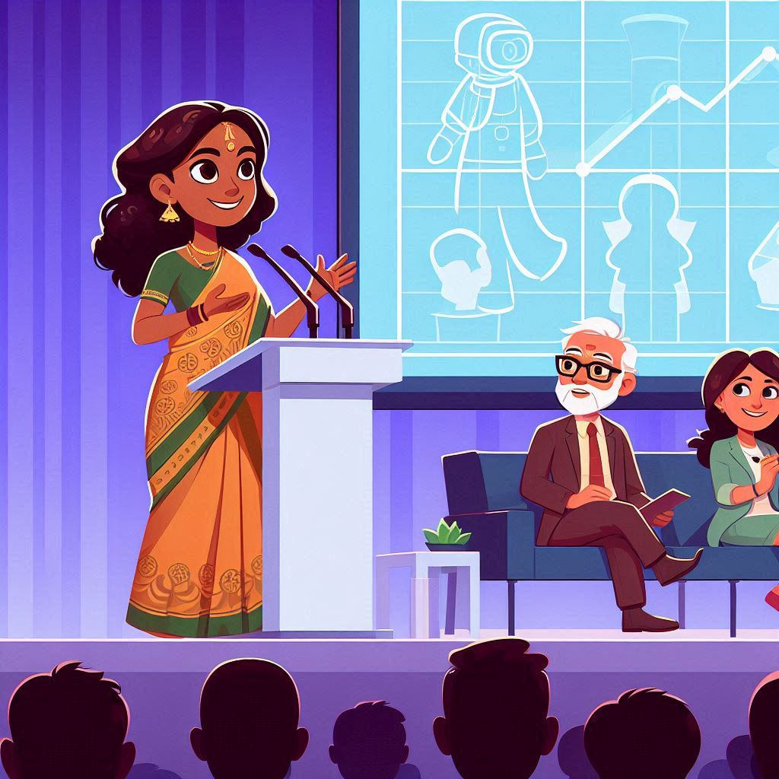
Exercise – Tell Your Story in 90 Seconds
Once upon a time …
Every day …
One day …
Because of that …
Until finally …
Ever since then …

Slide 29

Exercise 3 – peer feedback
What was the key takeaway from the talk?
What in the story grabbed your attention?
What details, if any, would you like to see added or left out?
Would anyone like to share their story?

Slide 30
Module 4
Tie it all together
Notes:
Facilitator notes:
In this module, participants will be focusing on timing their introduction, the body of their talk, and the conclusion.
It is important to stress that the 30 seconds -> 2 minutes -> 30 seconds guidance for timing is just an example for a 3 minute talk, and that there is no rule to keep talk intros or conclusions to 30 seconds.
If time is constrained, focus less on partner sharing and instead focus on having a couple of participants share their stories for the whole group.

Slide 31
Put Your 3-Minute Talk Together!
The Body of the Talk
Opening
Closing
10%
80%
10%

Slide 32
Exercise – Practice Opening
Use your Architecture & Personal Story
Introduce the problem and yourself
Do this in 30 seconds
If you are the listener, give your partner feedback (30 seconds)
Opening

Slide 33
Exercise – The Body of Your Talk
The Body of the Talk
Use your Architecture & Personal Story
Teach your 3 key points, continuing your story where you can
Do this in 2 minutes
If you are the listener, give your partner feedback (30 seconds)

Slide 34
Exercise – Practice Your Closing
Use your Architecture & Personal Story
Tell us how the problem was solved, and what the most important thing to remember is
Do this in 30 seconds
If you are the listener, give your partner feedback (30 seconds)
Closing

Slide 35
Brave Volunteer
The Body of the Talk
Opening
Closing
10%
80%
10%

Slide 36

Next Steps
Finalize your talk
Practice, Practice, Practice
Talk to your user group about giving your talk
Mentor someone else!
Consider applying for Community Builders

Slide 37
Resources
Articles
https://community.aws/content/2g1gTwrVVIVUl5Uc2T8TrWjhRTe/the-architecture-of-a-talk
https://medium.com/@Brian_G_Peters/6-rules-of-great-storytelling-as-told-by-pixar-fcc6ae225f50
https://bguest.blogspot.com/2012/03/storytelling-tips-from-ira-glass.html
Books
Pixar Storytelling (Dean Movshovitz)
How to tell a story (from The Moth)
Podcasts
The Moth
99% Invisible
Mortified
AWS Community Builders
My Talk from re:Invent 2023

Slide 38


Dave Stauffacher Mark Pergola
Normal QR Code
LinkedIn QR Code

Slide 39

Please help us improve this training
for User Groups!

Slide 40


