Slide 1
Load Testing RCDN
David Collier-Brown
David Collier-Brown

Slide 2
The Old Way
Invent a synthetic test
Buy H-P LoadRunner licenses
Get misleading answers
  The H-P product is evil
  And inventing the truth isn’t a good plan
Switch to Jmeter
Which is free and good
  But keep trying to invent a valid test load ...

Slide 3
The Samba team did it better
They carefully created a load script from a debug=10 log
Laboriously!
  And just once…
It’s easier now
  Everything uses REST
    And Apache, and Nginx, and so on
  They log one line per request-response pair
  So we capture those and replay at 1x, 2x, 10x

Slide 4
Nginx example
Logs are the same format as Apache (standardized)
10.76.2.1 - - [28/Nov/2017:06:55:04 -0500] "GET /81eae740-a93a-467c-90d5-c555db9dc8a7 HTTP/1.1" 200 3994 "-" "Dalvik/1.6.0 (Linux; U; Android 4.4.4; Nexus 7 Build/KTU84P)"
Reformat to a particular format:
#date time latency xferTime think bytes url rc op
2017-Nov-28 06:54:52 0 0 0 12578 /81eae740-a93a-467c 200 GET
That’s identical to the output format
  An output can be used as an input for reruns
  Or compared for improvement/degradation

Slide 5
First, run a smoke test
loadGenerator -v --rest --tps 1 --for 1 log.csv
This is super verbose
If the return is not a 2XX, it prints the body (eg, an nginx “no response”)
#yyy-mm-dd hh:mm:ss latency xfertime thinktime bytes url rc op
2017-12-04 19:45:54.987 3.050636 0.000000 0 0 /download/images/00003003-64a4-4e25-ac2e-6c412bbf494d 444 GET expected=200
2017/12/04 19:45:58 restOps.go:182: error getting http response, Get http://calvin//download/images/00003003-64a4-4e25-ac2e-6c412bbf494d: dial tcp 192.168.0.3:80: getsockopt: no route to host

Slide 6
A success
#yyy-mm-dd hh:mm:ss latency xfertime thinktime bytes url rc
2017/11/11 21:11:20 runLoadTest.go:194: starting, at 1 requests/second
2017/11/11 21:11:20 runLoadTest.go:137: Loaded 1 records, closing input
2017/11/11 21:11:22 restOps.go:189:
Request:
GET /zaphod-beebelbrox.jpg HTTP/1.1
Host: calvin
User-Agent: Go-http-client/1.1
Cache-Control: no-cache
Accept-Encoding: gzip
Response headers:
Length: 122944
Status code: 200 OK
Response contents:
HTTP/1.1 200 OK
Content-Length: 122944
Accept-Ranges: bytes
Connection: keep-alive
Content-Type: image/jpeg
Date: Sun, 12 Nov 2017 02:11:47 GMT
Etag: "598db85d-30f2"
Last-Modified: Fri, 11 Aug 2017 13:59:57 GMT
Server: nginx/1.10.3 (Ubuntu)
Body:
���'���OJ�����cDe��*�7;
followed by many lines of gibberish from viewing a gif as text.

Slide 7
Now run from end to end
Instead of –for 1, run through the whole file at some convenient speed
If the system is expected to handle 100 request/second (TPS), try running at --tps 100 --crash, and see if you can get a clean run from beginning to end.
Any error will put the verbose switch on, and --crash will stop on the first error

Slide 8
They you can try a load test
Once you have a test that will run from end to end at a moderate load,try a test with a load varying from small to perhaps ten time the maximum
10x so you find the point at which the response time curve turns upwards in the classic hockey-stick, "_/".
ulimit -n 100000
runLoadTest --rest --tps 100 --progress 10 \
--duration 10 --strip "images/" \
./resize_test_oldfiles.csv \
http://10.92.10.202:80/images/v1/images.s3.kobo.com \
>raw.csv

Slide 9
Convert to 1-second samples
$ perf2seconds raw.csv
#date time latency xfertime think bytes transactions
2017-09-04 15:44:15 0.004726 0.018895 0 1176955 6
2017-09-04 15:44:16 0.007143 0.01705 0 1976766 9
2017-09-04 15:44:17 0.005686 0.004471 0 471158 9
2017-09-04 15:44:18 0.00705 0.006686 0 672129 9
2017-09-04 15:44:19 0.009134 0.012883 0 1099113 9
...
2017-09-04 15:44:25 0.010516 0.005597 0 783936 13
2017-09-04 15:44:26 0.009564 0.012994 0 1398995 19

Slide 10
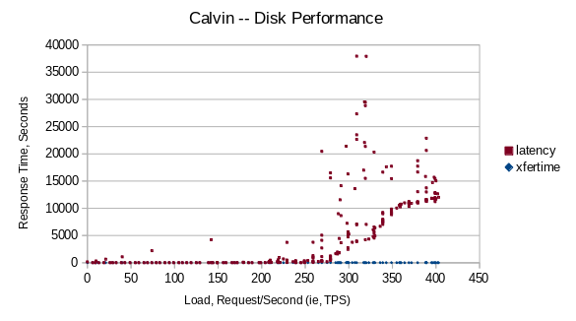
And plot as a scattergram
It should look like “_/”

Slide 11
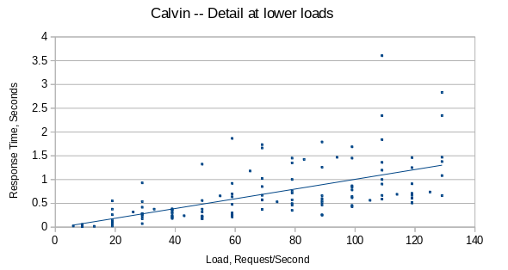
Detail
At low load, the slope should be gentle

Slide 12
Draw Conclusions
Down in the low range we expect, it’s linear and pretty quick
  At “normal overload” it’s ordinarily slow
  At > 250 TPS, it finally hits the wall
If I want to build a ceph array of those disks, that’s the information I need.
  Ditto if it were any other server.
Latency gently increases, from a quite pleasant 0.4s at 40 requests/second to an ugly 1.25 seconds at 120.

Slide 13
Links
Github repo
  https://github.com/davecb/Play-it-Again-Sam/
Tutorial
  https://github.com/davecb/Play-it-Again-Sam/blob/master/Running_Record-Reply_Tests.md
Man Page
  https://github.com/davecb/Play-it-Again-Sam/blob/master/cmd/runLoadTest/runLoadTest.md

Slide 14
Appendix: how to set up
Start on a suitable machine
  I used one of the haproxy LXC virtual machines as it had “headroom” for running other stuff
Pick a target
  That was an haproxy instance on another machine in the same cluster
  I could easily use grafana to watch out for too much CPU usage on the two
Install the load generator

Slide 15
Start on a suitable machine
I used one of the haproxy LXC virtual machines as it had “headroom” for running other stuff
You need to have an account there, mind you
$ ssh -2 -A -Y dcollierbrown@10.92.10.202
The authenticity of host '10.92.10.202 (10.92.10.202)' can't be established.
ECDSA key fingerprint is SHA256:GkBIOWi/+v3Ym8WEdBvGGuQ2UAtm8sqFL6AqpQqWioY.
Are you sure you want to continue connecting (yes/no)? Yes
dcollierbrown@vt-haproxy-002:~$
Or take a copy of /home/dcollierbrown on 10.92.10.201 (vt-haproxy-001)

Slide 16
Install the load generator
Create working directories under your ${HOME}
  mkdir -p go/src/github.com/davecb/Play-it-Again-Sam
  cd go/src/github.com/davecb
Git clone either the saved Rakuten or the newest github copy of the generator
  git clone git@github.rakops.com:david-collierbrown/Play-it-Again-Sam.git
  Or new, git clone git@github.com:davecb/Play-it-Again-Sam.git
Install the generator and go
  cd Play-it-Again-Sam/cmd/runLoadTest/localhost
  make setup
Create a working directory by renaming ./localhost to, for example, vt-haproxy-002

