Slide 1
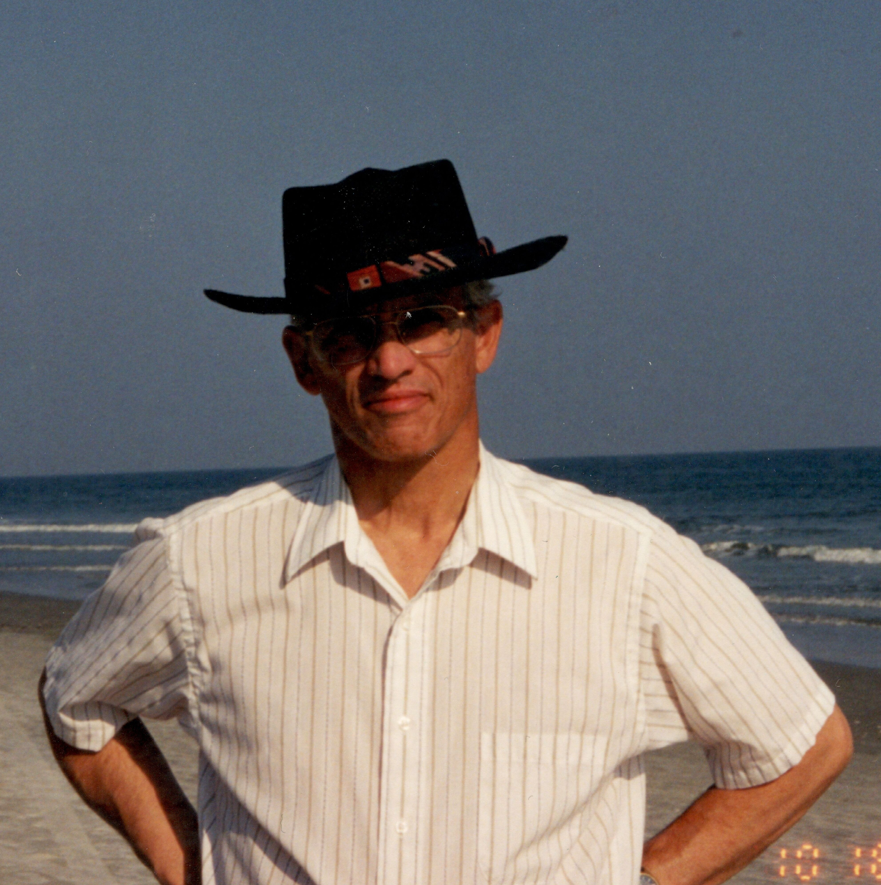

TTime Budgeting at Runtime
Budgeting in Micoseconds
TTime Budgeting at Runtime
David Collier-Brown
Attempted Founder, Leafless

Slide 2
A budget for how slow a program can be, measured in microseconds
If you have a program that has to complete in a certain period of time...
Make that explicit
Warn if it’s getting too slow
Especially at runtime

Slide 3
Why? Because Donald Knuth said so!
He said “premature optimization is the root of all evil”.
So know when to stop “improving” it
  Measure, so you can stop as soon as it’s fast enough
  Only optimize when it’s too slow

Slide 4
How do you know if it’s too slow?
Measure it!
  If doing a day’s billing takes 26 hours ... That Could be Bad
  If your customers defect to the competition because you’re so slow … Ditto
Warn before it cost you money
  Do so at runtime, not just in development or CI/CD
  Set an alarm if it tries to take more time than you budgeted

