Slide 1





Alzheimer's Dementia Recognition through Spontaneous Speech
The ADReSS Challenge
Saturnino Luz*, Fasih Haider*, Sofia de la Fuente*,
Davida Fromm†, Brian MacWhinney†
*Usher Institute, Edinburgh Medical School, The University of Edinburgh, UK
†Carnegie Mellon University, USA
Notes:
1

Slide 2
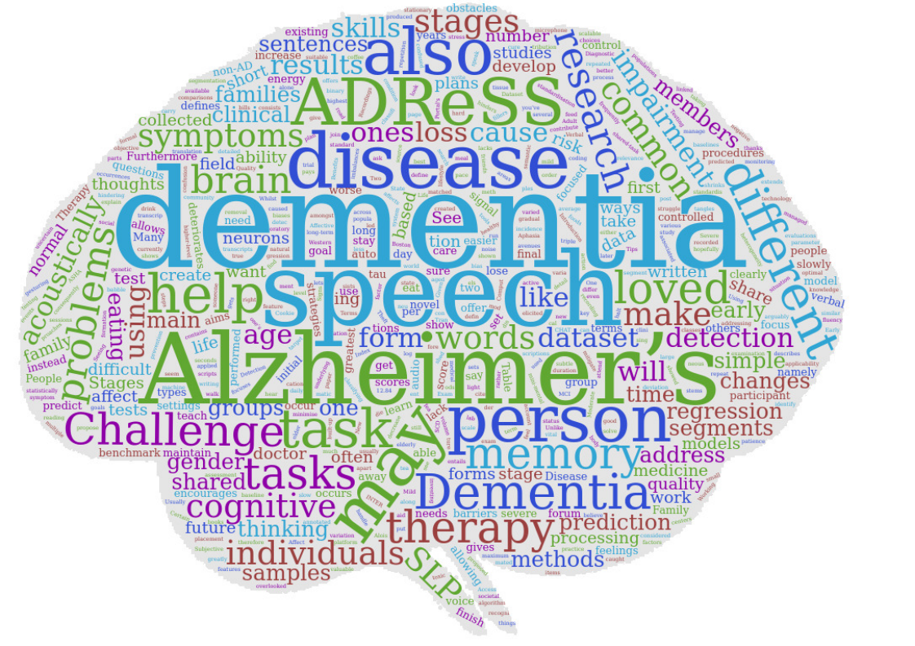
Background
Alzheimer’s is a neurodegenerative disease that entails a long-term and usually gradual decrease of cognitive functioning.
Clinical manifestations include:
Subjective Memory Loss (SML)
Mild Cognitive Impairment (MCI) and
Alzheimer's Dementia (AD)
There is a need for low-cost, scalable approaches to detection of AD and MCI
Speech may provide an easily obtainable and reliable source of data for such approaches
Signal processing and machine learning methods could help with automation and scalability
Notes:
2

Slide 3

Gathering speech data
Standardised cognitive tests exist which use speech in controlled settings.
Use of spontaneous speech data presents some advantages:
Can be captured in natural settings, over time
May overcome daily fluctuations that affect cognitive test performance:
fatigue, mood, attentiveness, short-term illnesses, test anxiety, etc
Some research groups have investigated AD detection based on spontaneous speech
However, the field lacked balanced and standardised data sets on which different approaches can be compared.
Notes:
3

Slide 4



ADReSS
Two automatic prediction tasks:
Alzheimer’s Dementia classification task
Cognitive test (MMSE) score regression task
The ADReSS Challenge dataset is
acoustically pre-processed
balanced in terms of age and gender
Available through DementiaBank: https://dementia.talkbank.org/
Baseline results* provided for acoustic and linguistic modalities separately:
Classification: 62% (acoustic features) and 75% (linguistic features)
Regression: 6.14 rmse (acoustic features) and 5.20 (linguistic features)
Notes:
4

Slide 5
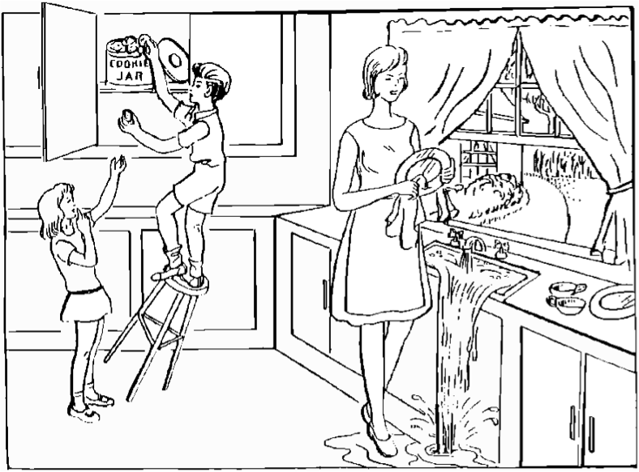
The speech collection task
Cookie Theft picture description task
the Boston Diagnostic Aphasia Exam
Part of DementiaBank’s Pitt Corpus
Transcripts annotated using the CHAT coding system
Recordings were acoustically enhanced with stationary noise removal
Audio volume was normalised across all speech segments
control for variation caused by recording conditions, such as microphone placement.
Notes:
5

Slide 6
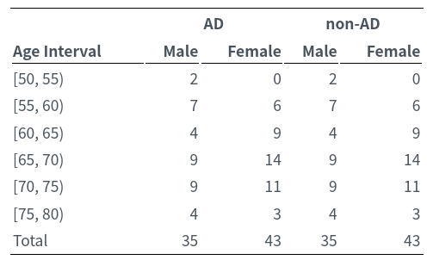
The Dataset
Carefully selected so as to mitigate common biases:
repeated occurrences of speech from the same participant
variations in audio quality, and
imbalances of gender and age distribution.
Segmented for voice activity based on a signal energy threshold.
65dB, maximum of 10 seconds per segment.
1,955 speech segments from 78 non-AD participants and
2,122 speech segments from 78 AD participant.
The average number of speech segments per participant
24.86 (sd=12.84)
Notes:
6

Slide 7
Training-test split
AD
non-AD
Age
M
F
MMSE (sd)
M
F
MMSE (sd)
[50, 55)
1
0
30.0 (n/a)
1
0
29.0 (n/a)
[55, 60)
5
4
16.3 (4.9)
5
4
29.0 (1.3)
Training set
Test set
[60, 65)
3
6
18.3 (6.1)
3
6
29.3 (1.3)
[65, 70)
6
10
16.9 (5.8)
6
10
29.1 (0.9)
[70, 75)
6
8
15.8 (4.5)
6
8
29.1 (0.8)
[75, 80)
3
2
17.2 (5.4)
3
2
28.8 (0.4)
Total
24
30
17.0 (5.5)
24
30
29.1 (1.0)
AD
non-AD
Age
M
F
MMSE (sd)
M
F
MMSE (sd)
[50, 55)
1
0
23.0 (n.a)
1
0
28.0 (n.a)
[55, 60)
2
2
18.7 (1.0)
2
2
28.5 (1.2)
[60, 65)
1
3
14.7 (3.7)
1
3
28.7 (0.9)
[65, 70)
3
4
23.2 (4.0)
3
4
29.4 (0.7)
[70, 75)
3
3
17.3 (6.9)
3
3
28.0 (2.4)
[75, 80)
1
1
21.5 (6.3)
1
1
30.0 (0.0)
Total
11
13
19.5 (5.3)
11
13
28.8 (1.5)
Notes:
7

Slide 8
Baseline: feature generation
Acoustic features:
emobase: MFCC, voice quality, fundamental frequency (F0), F0 envelope, LSP and intensity features with their first and second order derivatives, and functionals. (988 features)
Compare: energy, spectral, MFCC, and voicing related low-level descriptors, including harmonic-to-noise ratio, voice quality, Viterbi smoothing for F0, spectral harmonicity and psychoacoustic spectral sharpness, andfunctionals.(6,373 features)
eGeMAPS: basic set of theoretically motivated acoustic features. (88 features).
MRCG: gammatone filter decomposition of audio in the frequency domain so as to mimic the human auditory filters. Encode the multi-resolution power distribution of the audio signal. (6,912 features; 768 per 20ms frame: 256 MRCG 256 ∆ MRCG and 256 ∆∆ MRCG)
Minimal: statistics (mean, standard deviation, median, minimum and maximum) of the duration of vocalisations andpauses, speech rate, and a vocalisation count.
Linguistic features:
basic set of 34 language outcome measures (e.g., duration, total utterances, MLU, type-token ratio, open-closed class word ratio, percentages of 9 parts of speech) on the CHAT transcripts.
Notes:
8

Slide 9
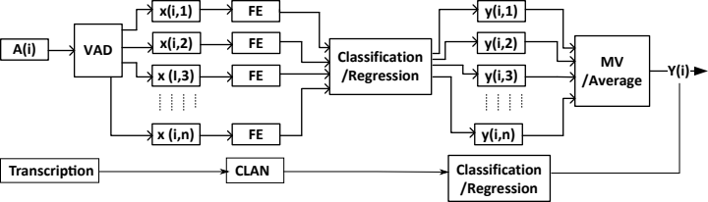
The baseline system
A(i), the recording
segmented using voice activity detection into n segments x(i, n)
Feature extraction is performed at segment level for acoustic features
And at recording level for linguistic features
For acoustic features:
The output for the n^{th} segment of the i^{th} recording is: y(i, n).
MV: majority voting for classification; Average for regression.
Notes:
9

Slide 10
Baseline results for AD/non-AD classification
LOSO cross validation accuracy.
LOSO test set accuracy.
Features
LDA
DT
1NN
SVM
RF
mean
Features
LDA
DT
1NN
SVM
RF
mean
emobase
0.500
0.519
0.398
0.491
0.472
0.476
emobase
0.542
0.688
0.604
0.500
0.729
0.613
ComParE
0.565
0.528
0.574
0.528
0.509
0.541
ComParE
0.625
0.625
0.458
0.500
0.542
0.550
eGeMAPS
0.482
0.500
0.380
0.333
0.482
0.435
eGeMAPS
0.583
0.542
0.688
0.563
0.604
0.596
MRCG
0.519
0.500
0.482
0.528
0.509
0.507
MRCG
0.542
0.563
0.417
0.521
0.542
0.517
Minimal
0.519
0.667
0.426
0.565
0.583
0.552
Minimal
0.604
0.562
0.604
0.667
0.583
0.604
linguistic
0.768
0.704
0.740
0.602
0.750
0.713
linguistic
0.750
0.625
0.667
0.792
0.750
0.717
mean
0.559
0.570
0.500
0.508
0.551
–
mean
0.608
0.601
0.573
0.590
0.625
–
Baseline results summary (LDA)
class
Precision
Recall
F1 Score
Accuracy
SO
non-AD
0.56
0.61
0.58
0.56
A cous
AD
0.57
0.52
0.54
ST
non-AD
0.67
0.50
0.57
0.62
A cous
AD
0.60
0.75
0.67
SO
non-AD
0.76
0.78
0.77
0.77
l i n g
AD
0.77
0.76
0.77
ST
non-AD
0.70
0.87
0.78
0.75
l i n g
AD
0.83
0.62
0.71
Notes:
10

Slide 11
Baseline results for MMSE score regression
LOSO cross validation (chance RMSE = 7.18)
Features
Linear
DT
GP
SVM
LSBoost
mean
emobase
7.44
7.29
7.71
7.71
8.33
7.70
ComParE
15.69
7.29
7.67
7.63
7.84
9.22
eGeMAPS
8.08
7.31
7.72
8.55
8.68
8.07
MRCG
13.46
7.28,
r = −0.76
7.65
7.50
8.02
8.78
Minimal
7.39
7.60
7.18
8.01
7.14
7.46
Linguistic
6.15
4.38,
r = 0.79
7.92
6.34
7.44
6.45
mean
9.70
6.86
7.64
7.62
7.91
–
MMSE prediction test results.
Features
Linear
DT
GP
SVM
LSBoost
mean
emobase
6.80
6.78
6.36
6.18
6.73
6.57
ComParE
6.47
6.52
6.33
6.19
6.72
6.45
eGeMAPS
6.90
5.99
6.28
6.12
6.41
6.34
MRCG
6.70
6.14,
r = 0.22
6.33
6.20
6.31
6.33
Minimal
6.29
6.84
6.58
6.19
7.71
6.72
Linguistic
4.78
5.20,
r = 0.57
5.54
6.24
6.62
5.68
mean
6.32
6.25
6.24
6.19
6.75
–
Notes:
11

Slide 12
Challenge results: classification task (top 14)
Participant | Accuracy | F1-Score (nonAD) | F1-Score (AD) | F1-Score (mean)
University of Michigan | 0.8958 | 0.8889 | 0.902 | 0.8955
Baidu USA | 0.8958 | 0.902 | 0.8889 | 0.8955
UPF Barcelona | 0.875 | 0.8846 | 0.8636 | 0.8741
Auto-ID Lab, Massachusetts Institute of Technology | 0.875 | 0.875 | 0.875 | 0.875
IDIAP | 0.8542 | 0.8444 | 0.8627 | 0.8536
The University of Arizona | 0.8542 | 0.8571 | 0.8511 | 0.8541
RMIT University, Australia/Mehran University of Engineering & Technology, Pakistan | 0.8542 | 0.8627 | 0.8444 | 0.8536
University of Alberta | 0.8542 | 0.8679 | 0.8372 | 0.8526
Winterlight Labs, Toronto | 0.8333 | 0.8261 | 0.84 | 0.8331
SSN College of Engineering Kalavakkam | 0.8333 | 0.8462 | 0.8182 | 0.8322
DFKI | 0.8333 | 0.8333 | 0.8333 | 0.8333
MIT Media Lab, Massachusetts Institute of Technology | 0.8333 | 0.8333 | 0.8333 | 0.8333
INESC-ID's Human Language Technology Lab, Pt | 0.8125 | 0.8364 | 0.7805 | 0.8085
Music and Audio Research Group at Seoul National University | 0.8125 | 0.8085 | 0.8163 | 0.8124
Notes:
12

Slide 13
MMSE score regression results (top 14)
Participant | RMSE
Music and Audio Research Group at Seoul National University | 3.7472
University of Michigan | 4.2902
RMIT University, Australia/Mehran University of Engineering & Technology, Pakistan | 4.3012
SSN College of Engineering Kalavakkam | 4.3268
University of Illinois Chicago | 4.3396
JSI | 4.4388
QMUL | 4.5372
UPF Barcelona | 4.5414
Winterlight Labs, Toronto | 4.5635
Kings College London | 4.5827
MIT Media Lab, Massachusetts Institute of Technology | 4.6017
IDIAP | 4.648
University of Sheifield | 4.6594
Universität Augsburg | 4.686
Notes:
13

