Slide 1



My Final Project – Review-Rating Prediction using Recurrent (LSTM) Neural Network
The task:-
a) retrieve Manchester restaurant reviews from
b) build a neural network to predict the ratings from the text
www.linkedin.com/in/daveclayt
github.com/daveclayt

Slide 2

Part 1:
“An open source and collaborative framework for extracting the data you need from websites.”
Uses XPath (or CSS selectors, but don’t ask me about those), which is a query language for selecting information from XML/HTML documents.
Write your own customised scrapers (known as spiders) to “crawl” the page and extract the data you need.

Slide 3
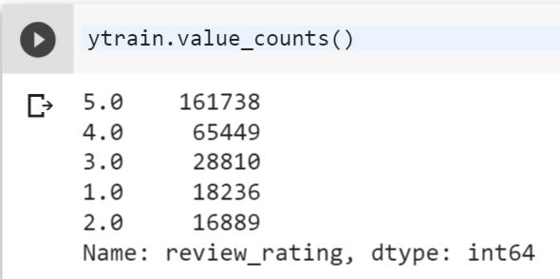
Part 2: Sentiment Analysis using Deep Learning (LSTM Network)
PROBLEM: Class imbalance:
Solution: downsampling to minority class
Lose some information 
Actually trainable in time for me to present this 

Slide 4
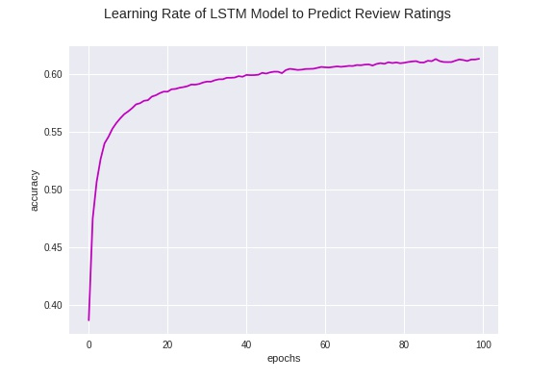
Results
~65% test accuracy
Happy with this!!! :-)
Ways to improve:
  Upsample instead of undersample, as discussed – will mean training takes longer
  Fewer classes (group 1/2 and 4/5 star reviews together to get pos/neg/neutral classes

Slide 5
Questions?

Slide 6
Thanks for listening! (If indeed you still are)
linkedin.com/in/daveclayt
github.com/daveclayt

