Slide 1
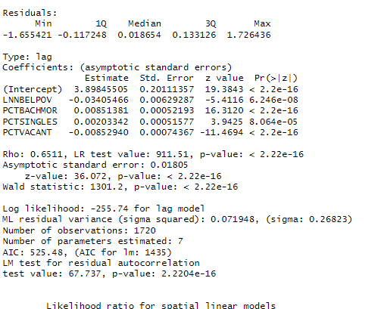
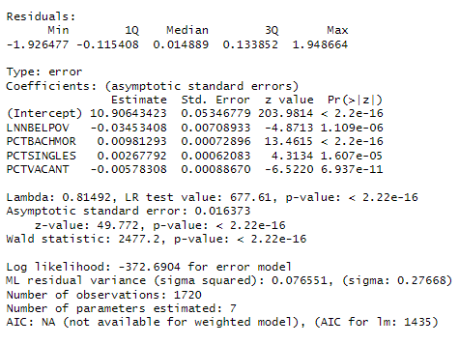
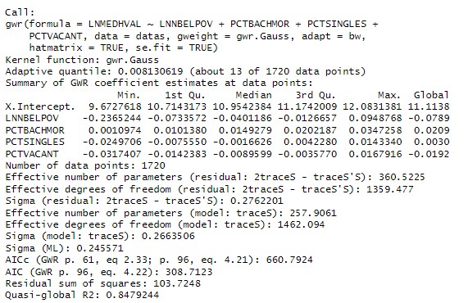
AIC Comparison
Spatial Lag
Spatial Error
GWR
AIC Spatial Lag = 525.48
AIC Spatial Error = NA
AIC OLS = 1,435
AIC GWR = 308.71

