Slide 1
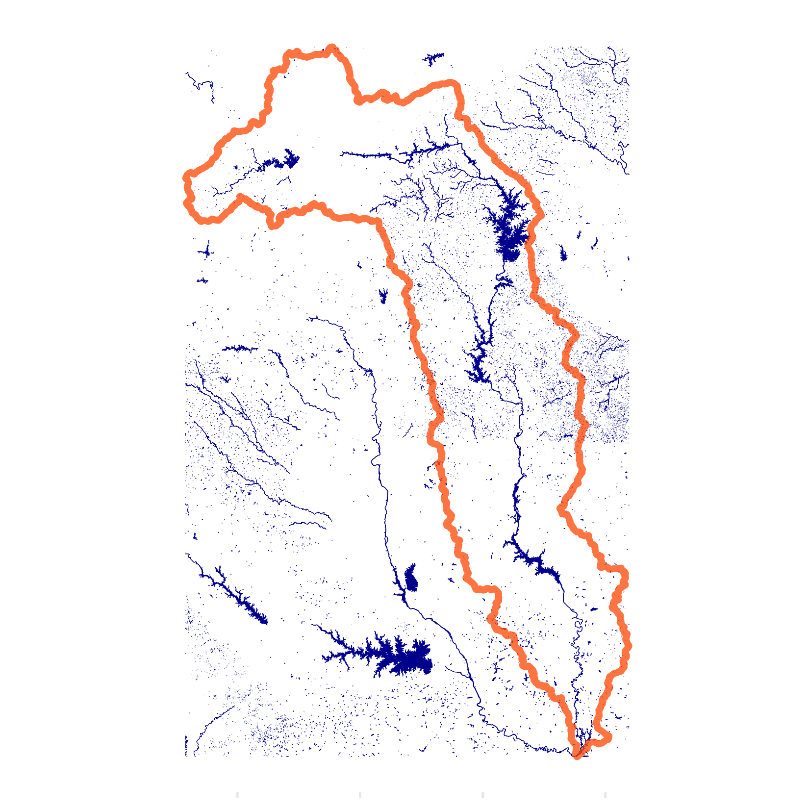
Catawba Wateree Watershed
Infrastructure Mapping and Analysis in North Carolina and South Carolina
Dave Drennan, MUSA ‘24 & Water Center at Penn

Slide 2
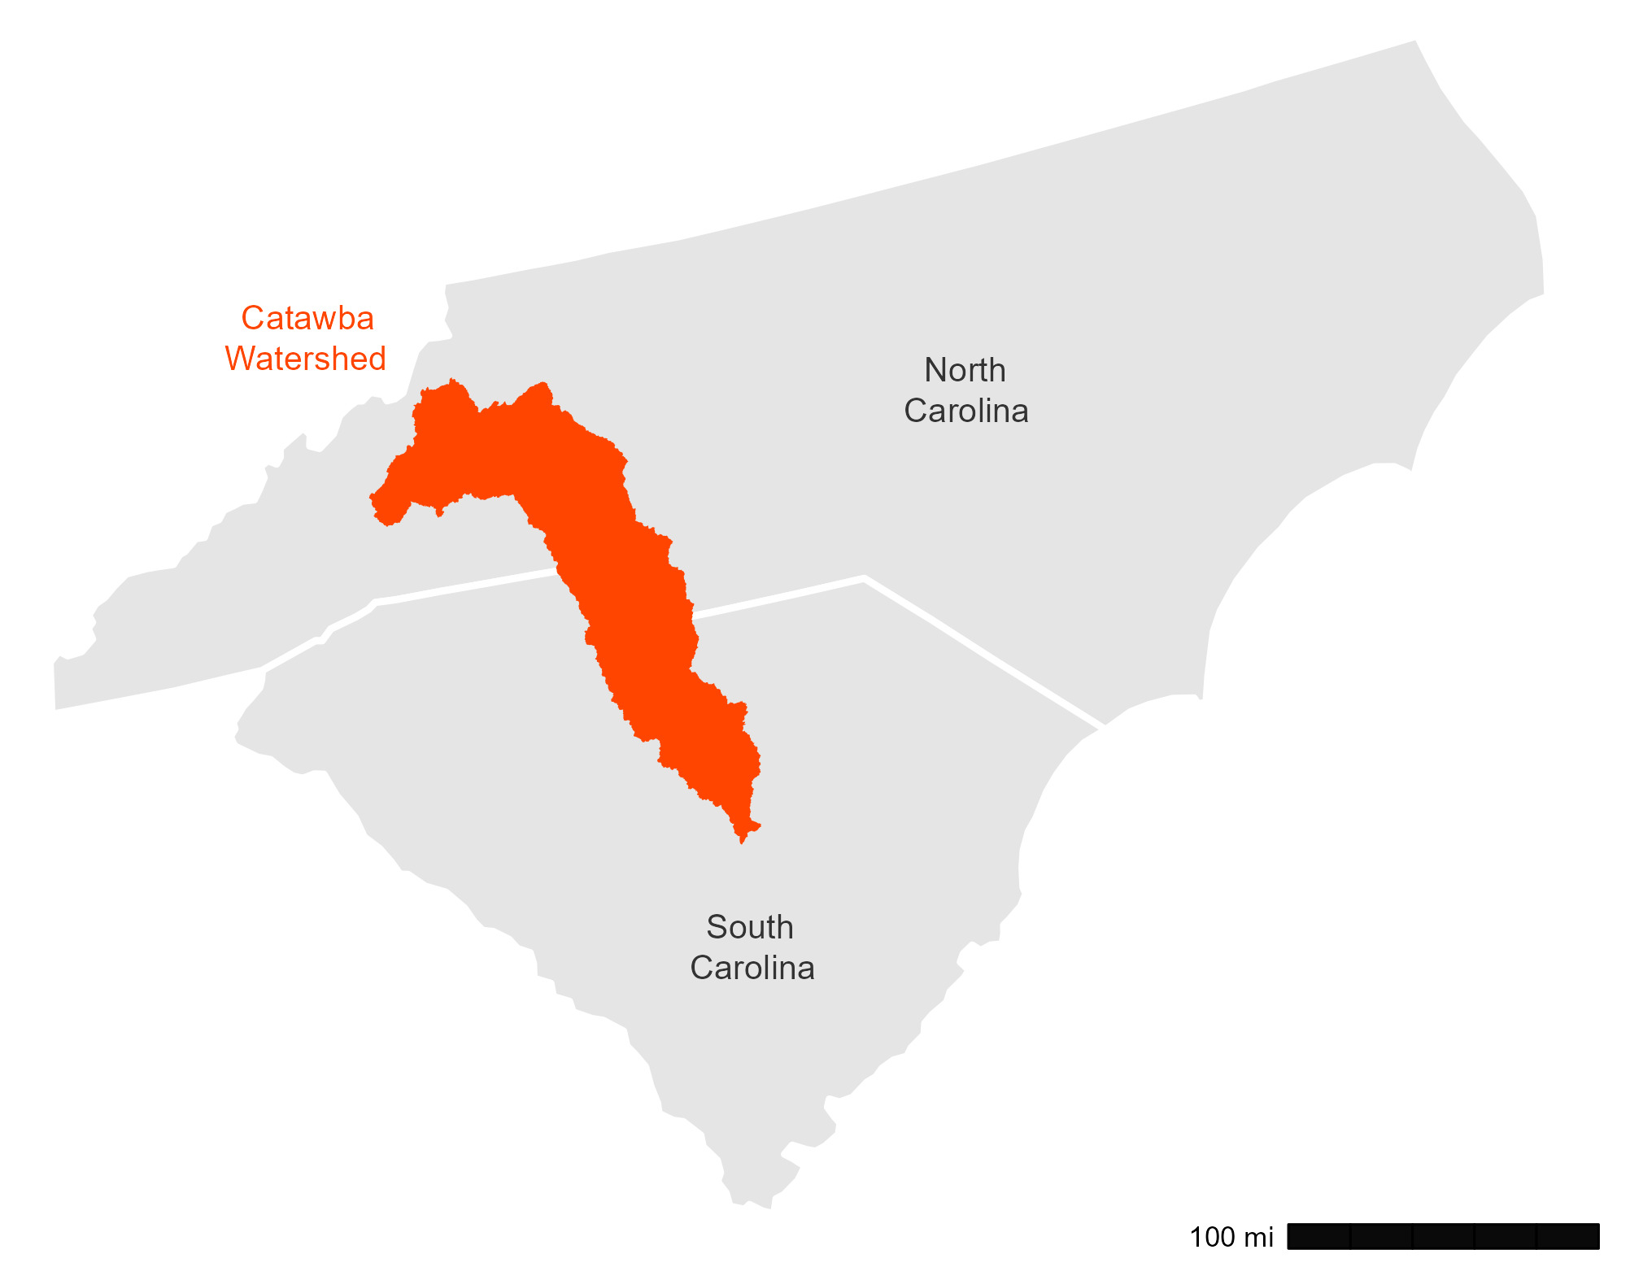
Project Overview
Supports ongoing project with the Water Center at Penn
Goals:
Identify and map water infrastructure across watershed
Determine potential high-need areas for future investment
Incorporate environmental justice and think beyond administrative boundaries

Slide 3
Who’s in Charge?
Watersheds ignore administrative boundaries
Geographic impact varies by infrastructure type
Systems can serve multiple jurisdictions
Ownership: government, non-profit, or business

Slide 4
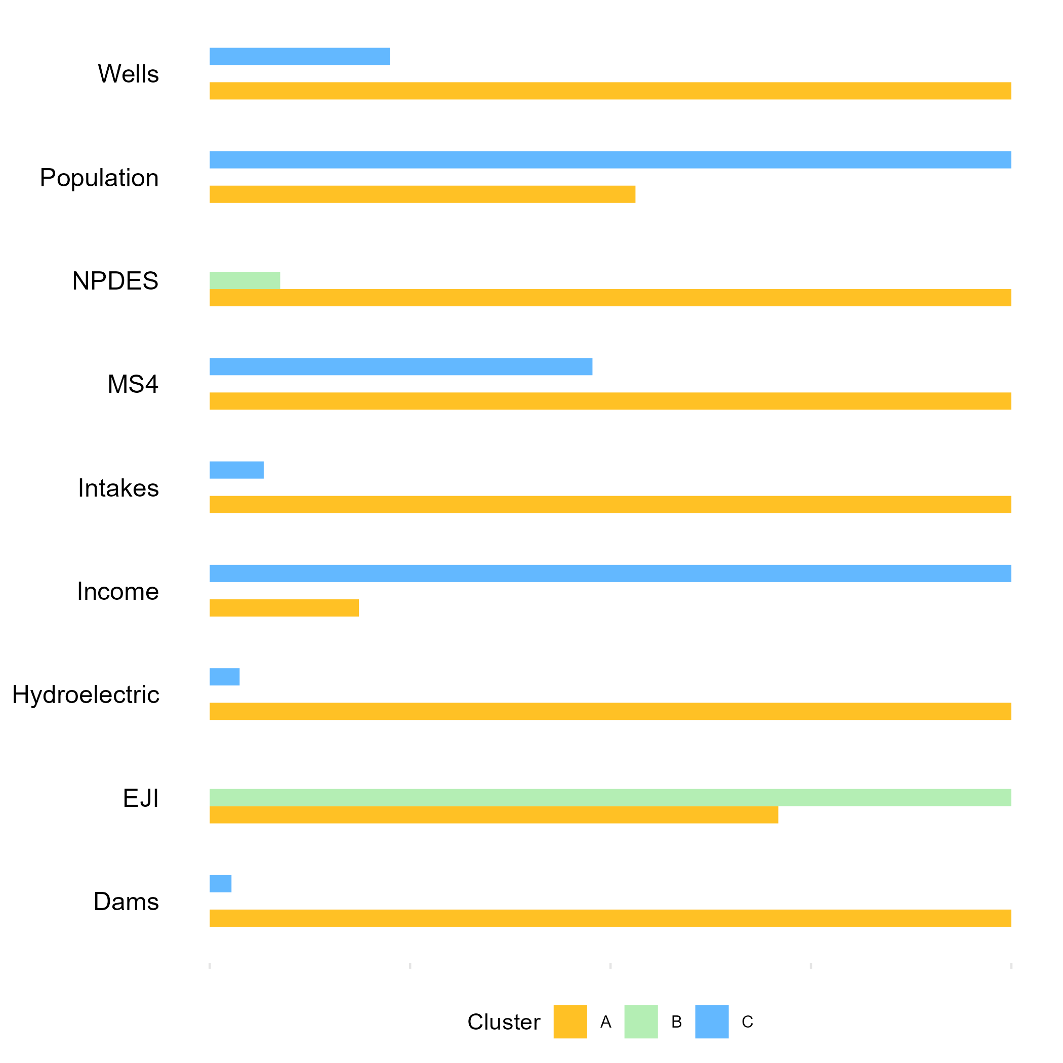
Data and Analysis
Data compiled for clustering and aggregated to census tracts
Three clusters generated using socioeconomic and infrastructure variables
Water infrastructure comes in many forms:
Drinking water
Wastewater
Stormwater
Other (recreation, energy, etc.)

Slide 5
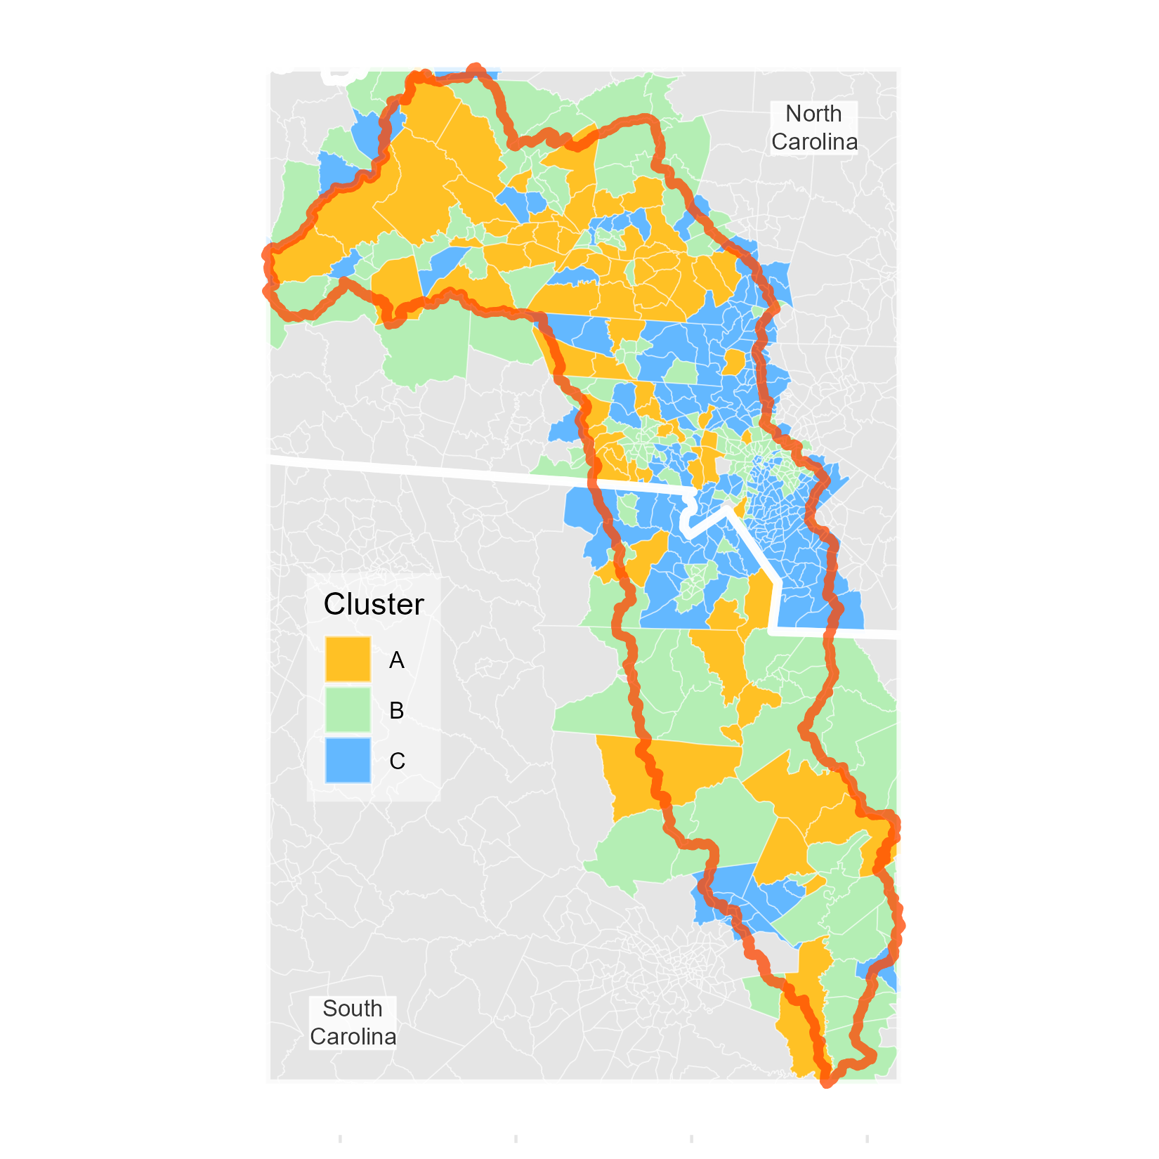
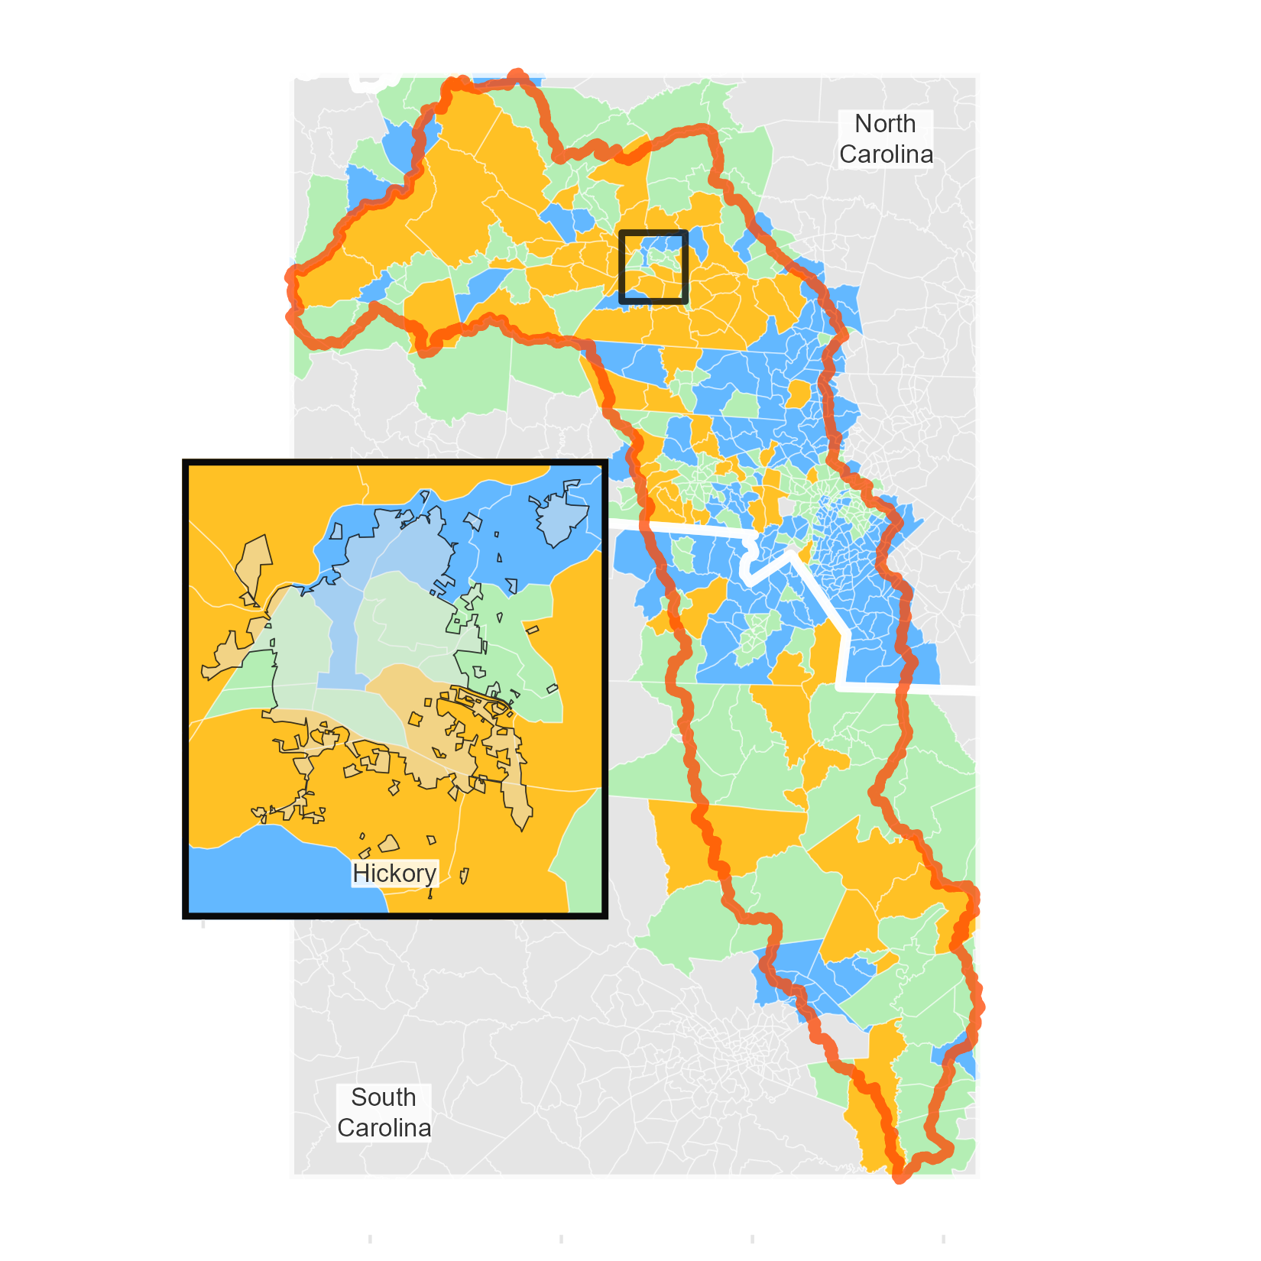
Priority Areas
Cluster A identified as highest priority:
Averaged highest value for all infrastructure inputs
Lower incomes and higher EJ index score
Cluster B highest EJ index score, lowest income
Cluster C lowest EJ index score, highest income

Slide 6
Next Steps
Gather data for existing infrastructure values
Financial reports
Infrastructure Act investments
Coordinate with project partners to conduct water systems outreach
Determine high-level valuation estimate for water infrastructure across the watershed
$1.4 Billion
estimated systems infrastructure value in North Carolina Catawba water systems alone

Slide 7
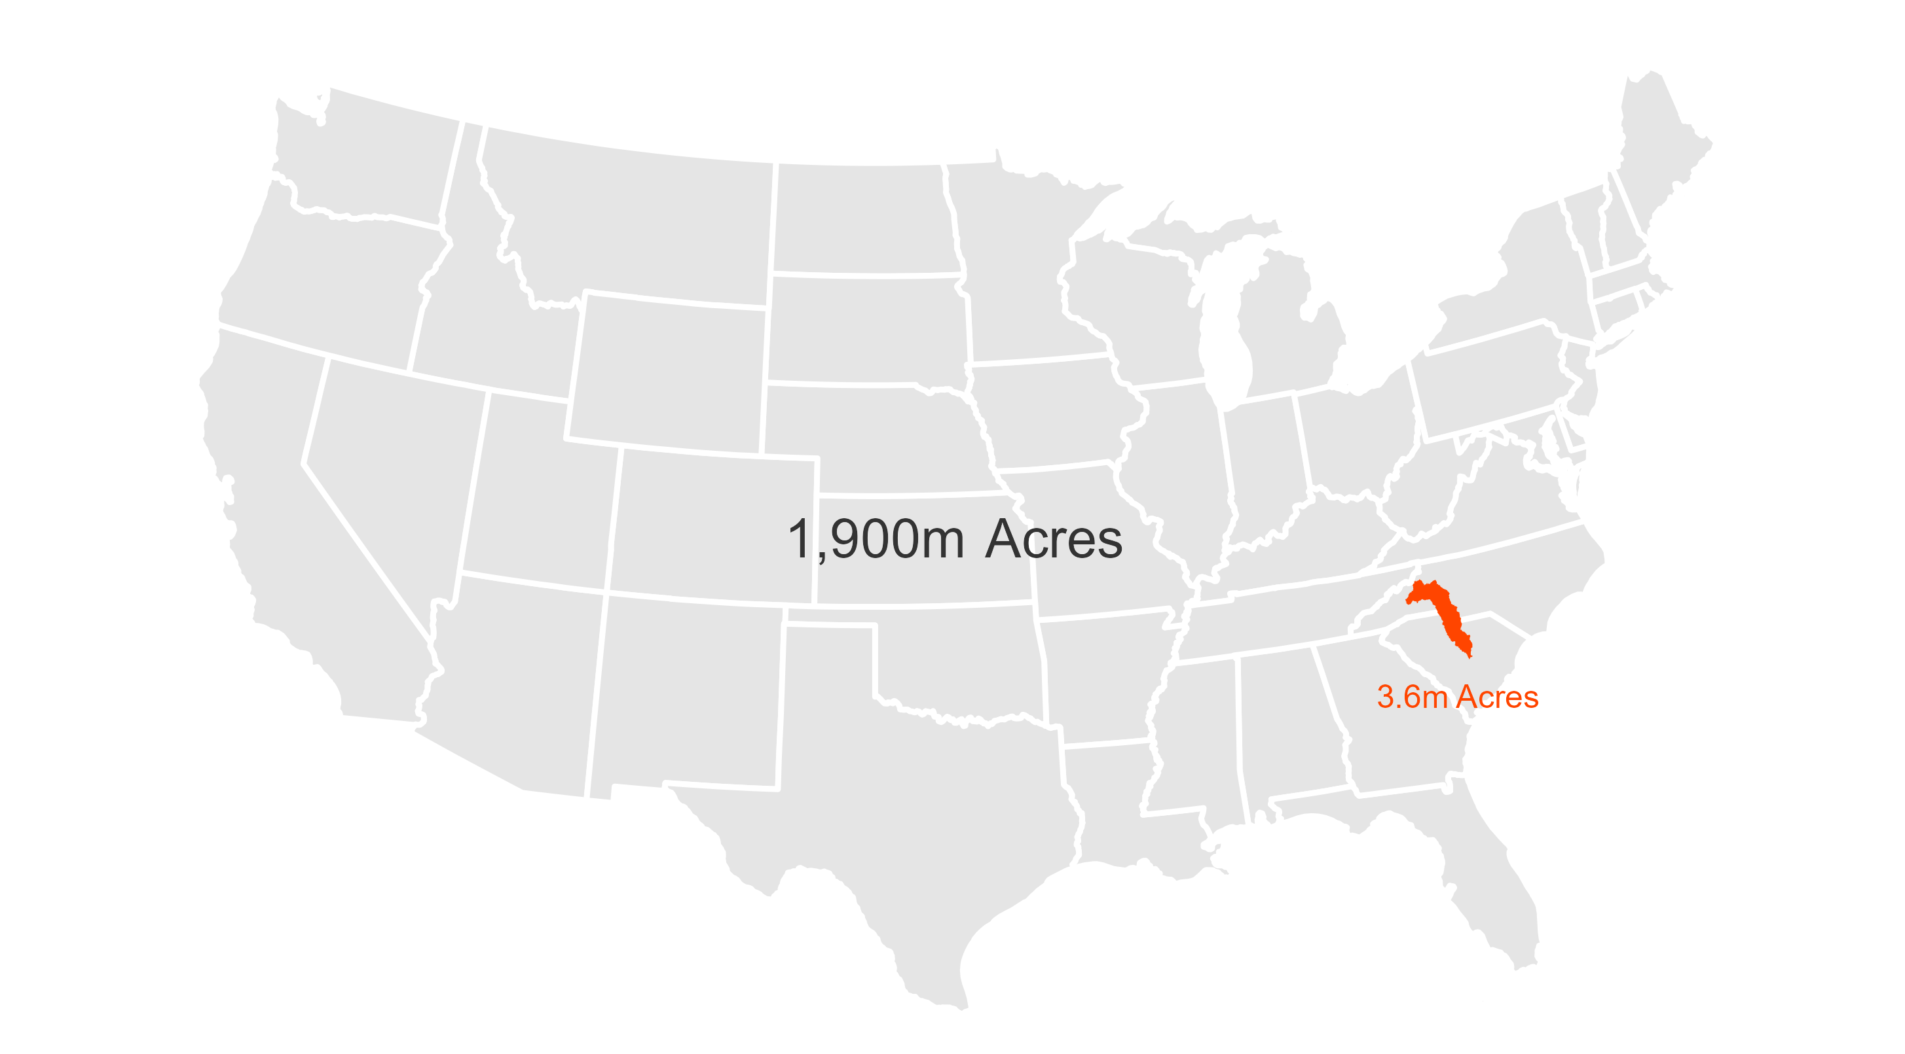
Catawba in Context

