Slide 1
Sakay.ph
“Isang App, Lahat ng Sakyan”
A Multi-Mode Ride-Hailing Platform for Every Filipino Transport Mode
Project Idea Development Proposal
CCS670 – Object-Oriented Software Development
November 2026

Slide 2
PART 1 • PROJECT CONCEPT
1. Project Title
Sakay.ph — “Isang App, Lahat ng Sakyan” (One App, Every Ride)
Sakay is the Tagalog word for “ride” or “to board,” and the .ph domain anchors the platform to the Philippines.
The tagline captures the project’s core promise: a single ride-hailing application that covers every mode of transport a Filipino commuter actually uses — tricycle, habal-habal, jeepney, UV Express, e-trike, and car — instead of just cars and motorcycles.
Tricycle
Habal-habal
Jeepney
UV Express
E-trike
Car
One booking engine • One fare system • Every sakyan

Slide 3
PART 1 • PROJECT CONCEPT
2. Problem Statement
The Philippines has a fragmented transport ecosystem: apps serve only cars and motorcycles, while tricycles, jeepneys, UV Express, and habal-habal — the workhorses of Filipino commuting — remain entirely offline.
▪ First-mile/last-mile gaps. A typical commute needs a tricycle, then a jeepney/UV Express, then another tricycle — each leg negotiated separately, in cash, with variable fares.
▪ No fare transparency or safety accountability. Fares are haggled informally and surge at night or in rain; passengers board unverified vehicles with no driver identity or trip record.
▪ Informal drivers are locked out of the digital economy. Millions of drivers rely only on passing foot traffic — no digital demand, payments, or income records.
▪ LGUs lack transit data. Barangays regulate these modes with no data on routes, supply, or demand.
Who it affects: daily commuters, students, senior citizens, PWDs, women traveling alone, and informal drivers nationwide.

Slide 4
PART 1 • PROJECT CONCEPT
3. Proposed Solution
Sakay.ph is a multi-mode ride-hailing platform that brings every Filipino transport mode into one booking system.
Core flow (standard ride-hailing): Passenger books ride → System matches nearest accredited Driver → Trip starts → Trip ends → Payment processed digitally (GCash/Maya/cash) — including trip cancellation on both sides.
What makes it unique — the layer on top of that core:
▪ A mode-aware booking engine. Enter origin and destination; Sakay.ph suggests the best mode or combination based on distance, road conditions, passenger count, and available drivers.
▪ Formal onboarding of informal drivers. Tricycle, jeepney, and UV Express drivers register through barangay/LGU accreditation — verified profile, digital wallet, standardized fare matrix, rating history.
▪ One seamless journey. Multiple modes chained into a single booked journey with one fare and one receipt.
Digitizing the modes that carry the majority of Filipino commuters — without asking commuters to change how they actually travel.

Slide 5
PART 1 • PROJECT CONCEPT
4. Key Features — unique in today’s market
4.1 Lahat ng Sakyan
Multi-Mode Booking
One booking engine for tricycle, habal-habal, jeepney, UV Express, e-trike, and car. The system recommends the right mode by distance, road type, passenger count, and fare.
4.2 Isang Biyahe
First-Mile–Last-Mile Trip Chaining
Book an entire multi-leg journey in one transaction — one booking, one fare breakdown, one receipt.
4.3 Saan ang Jeep?
Route Live Tracking
Live positions of jeepneys and UV Express along fixed routes, like a bus tracker — turns “waiting and hoping” into a predictable ETA.
4.4 Pakyawan
Smart Share-Ride Matching
Auto-matches commuters going the same direction into one vehicle with fares split automatically — the safe, formalized version of “sabit” culture.
4.5 Sertipikadong Manong
Informal Driver Digital Onboarding
Barangay/LGU-accredited drivers get a verified profile, digital wallet with instant payouts, standardized fares, ratings, and a compliance badge.

Slide 6
PART 1 • PROJECT CONCEPT
5. Target Users
Daily commuters
Students
Senior citizens & PWDs
One app for the entire door-to-door journey; predictable fares; shorter waits.
Affordable share-rides (Pakyawan), student-friendly fares, safer verified trips to and from school.
Pre-booked door-to-door rides; drivers informed of assistance needs in advance.
Women traveling alone
Informal drivers
LGUs & barangays
Verified driver identity, plate number, and trip record for every ride — even tricycles.
Digital demand, digital payments, income records, formal recognition through accreditation.
Real data on routes, supply, and demand for transport planning and regulation.

Slide 7
PART 1 • PROJECT CONCEPT
6. Expected Impact
For commuters
For drivers
Commute time drops through mode-chaining, live tracking, and share-matching; predictable, transparent fares; every trip — down to a ₱20 tricycle ride — becomes safe, recorded, and traceable.
Millions of informal drivers gain steady digital demand, instant digital payments, and a formal, rated identity — with financial records usable for loans and social services.
For communities & LGUs
For the economy & society
First-ever transit data on the informal network — where demand is, which routes are underserved — enabling evidence-based planning, franchise regulation, and disaster response routing.
Reclaiming even 30–60 minutes per commuter per day is a national productivity gain; formalizing informal transport improves road safety and financial inclusion.

Slide 8
PART 2 • USER PERSONA
Persona Profile — The Passenger
Anna Reyes
19 • College student
Quezon City, Philippines
Second-year Information Technology student commuting daily from a QC subdivision to Katipunan Avenue — tricycle to the main road, jeepney or UV Express to school, and the reverse trip home, sometimes late at night. Balances assignments, org work, and a tight allowance. Prefers digital, cashless services she can run from her smartphone.
▪ Goals — complete the door-to-door commute in one booking; know the fare before boarding; travel safely at night; save money through shared rides; cut waiting time.
▪ Tech usage — smartphone and laptop daily; GCash/Maya over cash; food delivery, e-commerce, and social apps; comfortable with little to no onboarding.
▪ Pain points — no advance tricycle booking; haggled fares that surge at night or in rain; no visibility of the next jeep; unverified habal-habal rides; cash in exact change for every leg; no single trip record.
▪ Needs — one app for every leg (tricycle, jeepney, UV Express); live tracking of approaching jeeps; upfront fixed fares with digital payment; verified driver identity, plate number, and shareable trip status.
“I want one app that gets me from our gate to campus — without guessing fares, waiting forever for a jeep, or worrying about my ride home at night.”
Traits: Organized • Budget-conscious • Safety-aware • Technology-savvy

Slide 9
PART 2 • USER PERSONA
Supplementary Persona — The Driver
Mang Tony Santos
47 • UV Express / tricycle driver
Marikina City, Philippines
12 years on the Marikina–Quiapo UV Express route. His income depends entirely on passengers passing his terminal; on slow days he drives back half-empty. Earnings stay in cash with no formal records — which hurt when he applied for a vehicle loan.
▪ Goals — fill more seats per trip; earn during off-peak hours; receive payments digitally without carrying change; build an income record for loans.
▪ Tech usage — Android smartphone for calls, text, Facebook, and basic GCash; prefers simple apps in Filipino/English that work on low-end phones.
▪ Pain points — empty back-trips; dwindling passengers when it rains; cash-only transactions; no formal recognition or benefits as an informal driver; no data on where demand actually is.
▪ Needs — steady digital demand matched to his route; instant payouts; a verified profile that builds passenger trust; a simple driver app with low data usage. Traits: hardworking, resourceful, family-oriented, service-minded.
“Sana may paraan para hindi na ako nag-aabang ng walang pasahero — at maipakita ko sa pasahero na ligtas at lehitimo ako.”

Slide 10
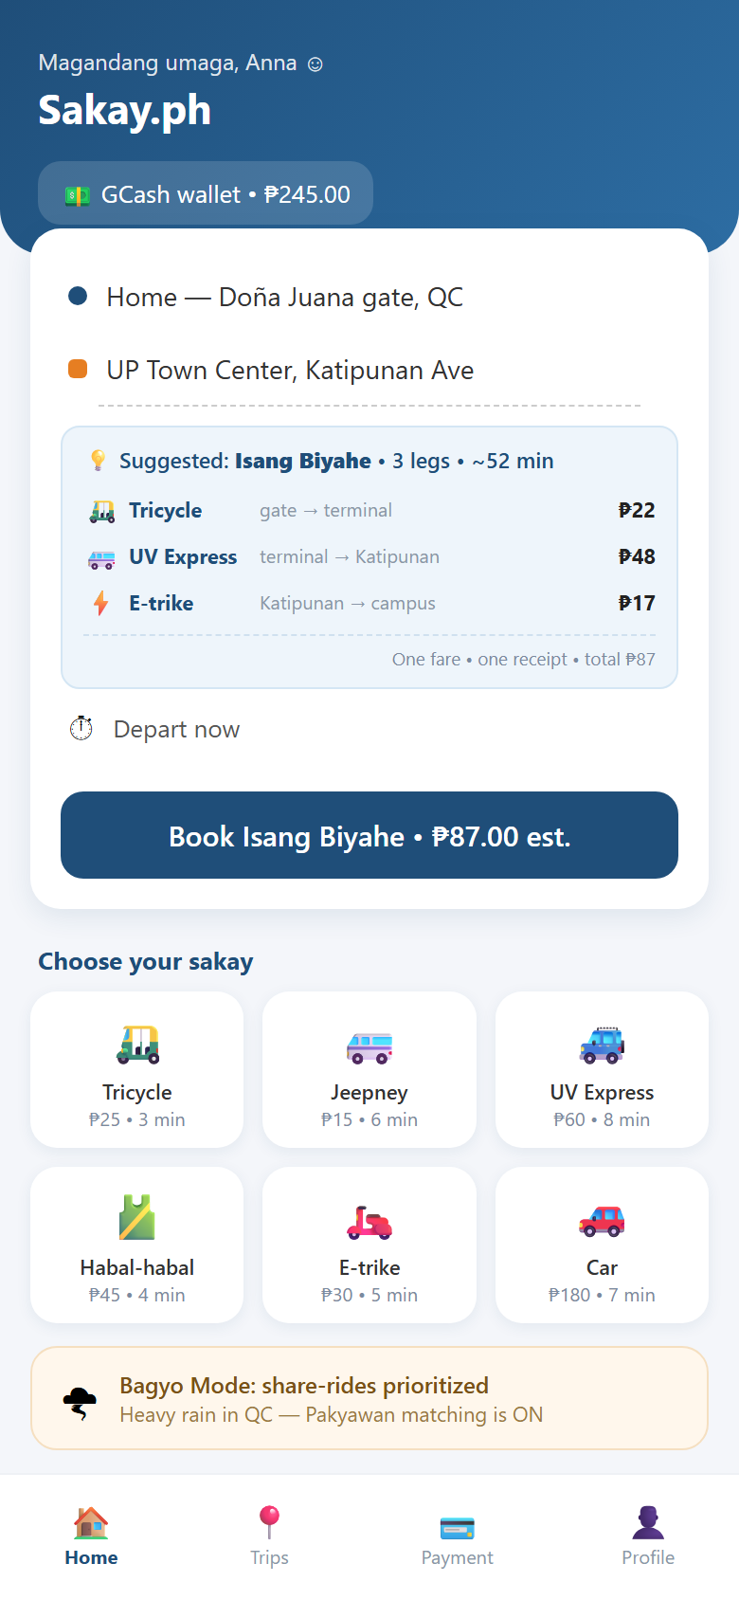
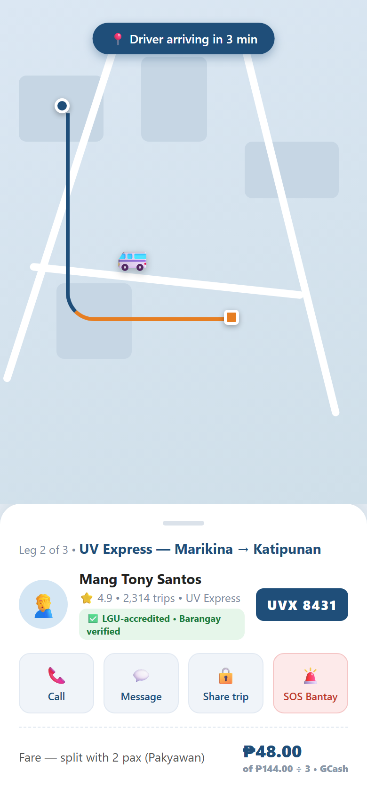
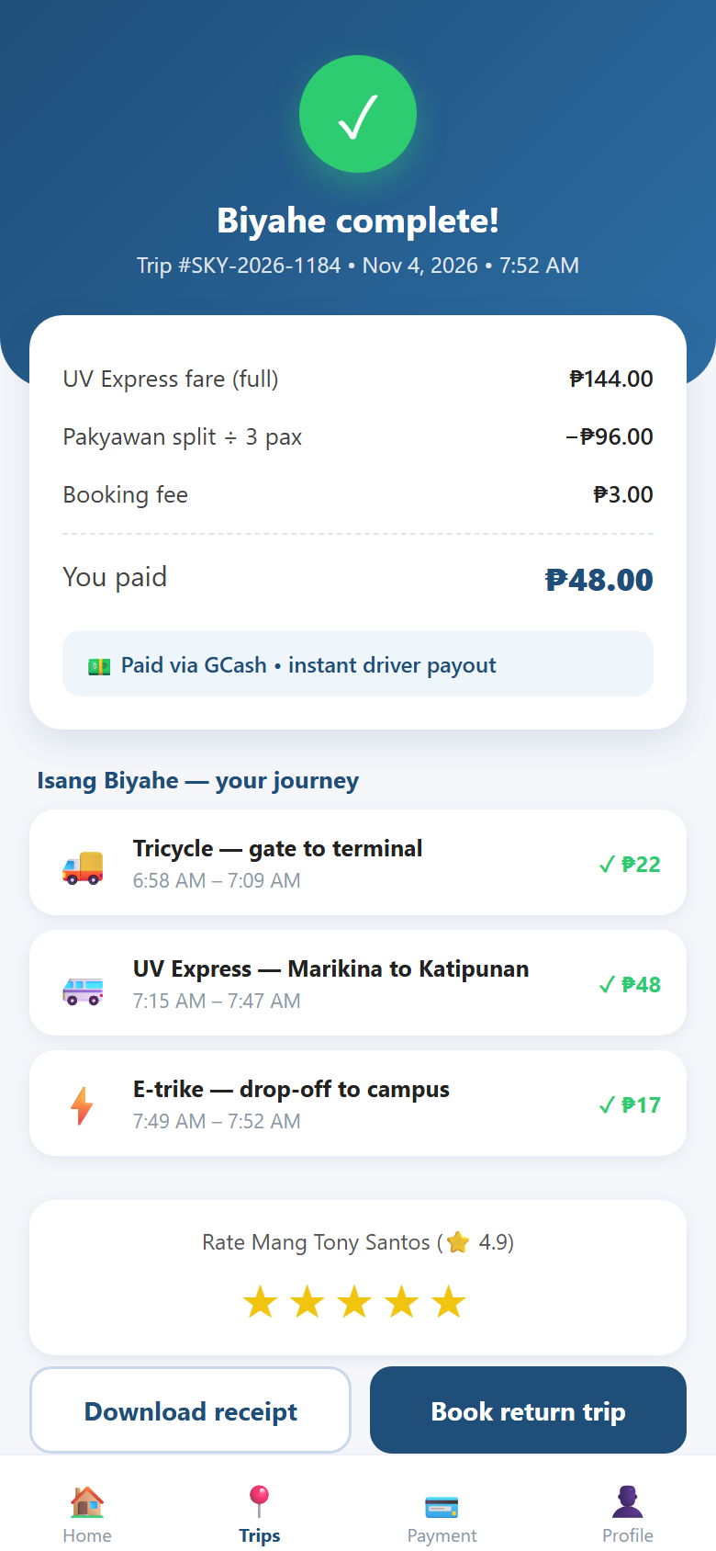
PROJECT IDEA DEVELOPMENT
UI Mockups — Passenger App (mobile web)
Booking — multi-mode + trip chaining
Live tracking — verified driver + Pakyawan split
Payment — journey receipt + rating

Slide 11
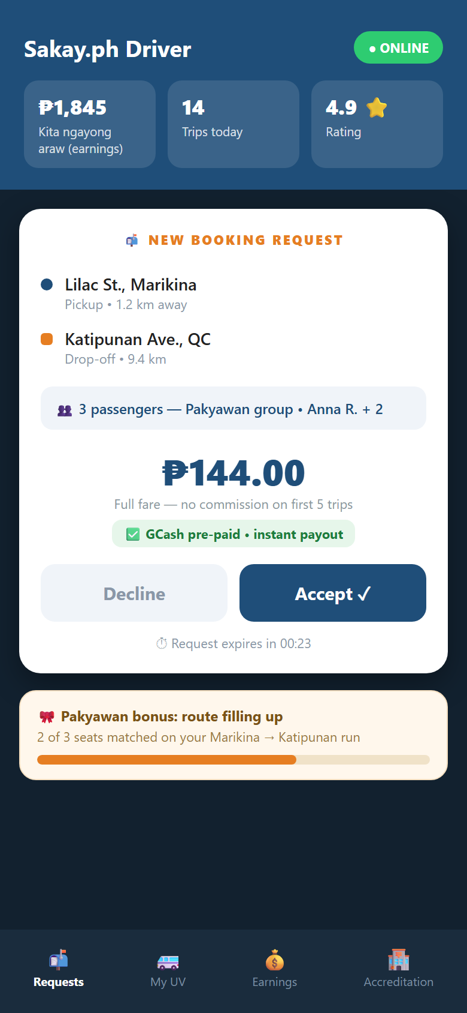
PROJECT IDEA DEVELOPMENT
UI Mockups — Driver App (mobile web)
Booking requests
Full fare shown upfront with Pakyawan group info, pre-paid GCash, and instant payout — earnings dashboard, ratings, and LGU accreditation status in one view.
Pakyawan bonus
The system keeps filling the vehicle’s empty seats along the route, boosting driver income per trip.
Sertipikadong Manong: any low-end Android phone works — low data usage, Filipino/English interface.

Slide 12
FUTURE DEVELOPMENT
Additional Features — Planned for a Later Phase
The five features above define the core release. Two further capabilities are planned for a later phase — both already designed into the database schema and previewed in the mockups, so the groundwork is in place rather than speculative.
SOS Bantay
In-Ride Emergency Response
Bagyo Mode
Weather-Triggered Service
One press during a live trip raises an alert carrying the vehicle’s coordinates, notifies the rider’s trusted contacts with the live trip link, and tracks each acknowledgement through to resolution — tied to a specific ride, not just a location.
When heavy rain or a typhoon warning hits an LGU, a declared fare-multiplier window is published and shown to the passenger by name before booking, while Pakyawan share-rides are prioritised so scarce vehicles carry more people per trip.
Already designed into the schema — SURGE_PERIOD and SOS_ALERT tables, plus the Bagyo Mode banner and SOS Bantay button visible in the mockups above. Scheduled for a later phase, after the core release ships.

Slide 13
Sakay.ph
Isang App, Lahat ng Sakyan — One App, Every Ride.
Salamat! Questions & feedback are welcome.
Next step: use case, class, and sequence diagrams (Part 3 — UML).

