Slide 1
Intro to Cross-Platform Mobile App Development
Flutter + Firebase

Slide 2
A Brief Diversion
Setting up the IDE and building the new application

Slide 3
Back to Business
A few slides, then code

Slide 4
Intro to Cross-Platform Mobile App Development
Flutter + Firebase

Slide 5
Flutter?
Cross-platform (compiles for iOS, Android, Windows, Web and more)
“Strongly typed” but not really
OOP, but also allows heavily imperative patterns, top-level functions, etc
Mixins to allow re-usable code on top of inheritance/composition
All the usual modern stuff: async/await, streams, futures(promises), generics
Built on top of Dart
Rich UI components
Fast Development
Native Performance
Code. Build. Deploy.
Complete with 100s of components designed for mobile
Package store to get 1000s of packages to extend
iOS, Material “Widgets” on top of generic ones
Declarative UI definitions
Multiple editors supported (VS Code for today)
Hot Reload/Restart when debugging
Compilers for many processors / architectures
Cross-compiles to JavaScript for web
VM for the rest
flutter build apk
flutter build ios

Slide 6
Firebase?
Authentication (incl. OAuth)
Databases / Document stores / Remote Config
Hosting + Cloud Storage
Cloud Functions
Pre-Release App Distribution + A/B Testing
Analytics, Crashlytics, Performance Monitoring
Test Lab
In-App Messaging, Push Notifications
Machine Learning

Slide 7
So what shall we build today?
Here we go….

Slide 8
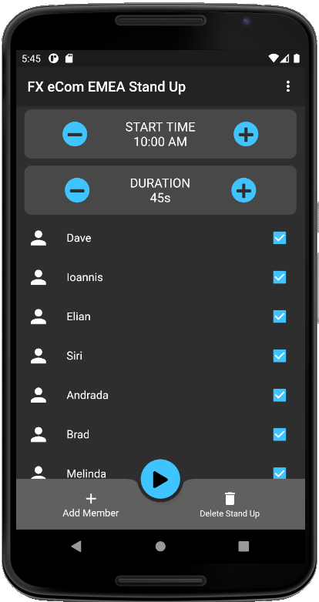
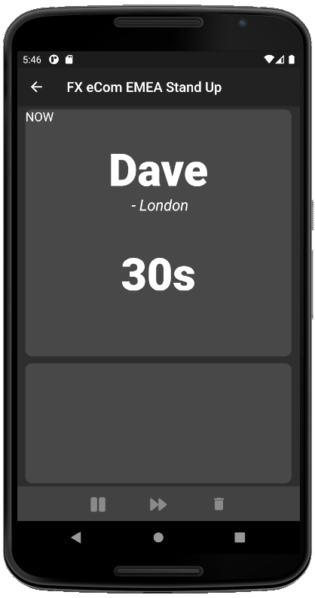
Stand Up Title
Stand Up Title + “Back”
Start Time, +/- to change
Duration for each person. +/- to change
Current Participant
Location
Time remaining (countdown timer, formatted to 2 digit seconds)
List of team members
Un-tick to remove from today’s stand-up
Could eventually include a profile photo
Should scroll when too big for view
Next Participant
+ Add new member (slide up from bottom with fields for “NAME” + “LOCATION”)
|> Starts the stand up (transition to next screen)
U: Deletes this stand up (probably don’t implement yet as to do so we’ll need a “Create new stand up screen which we won’t have time to implement)
Pause
Skip to next
End

Slide 9
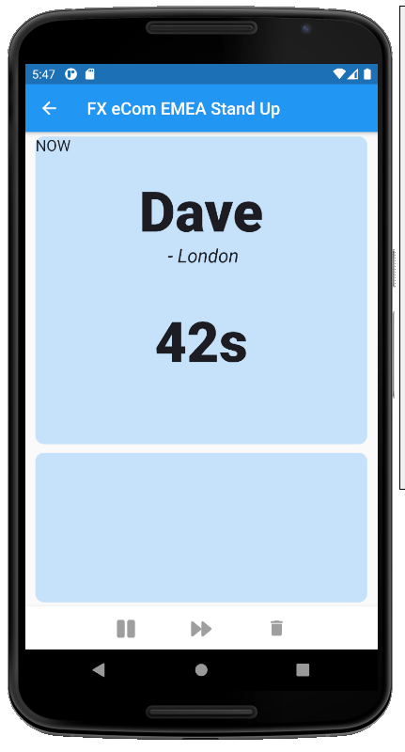
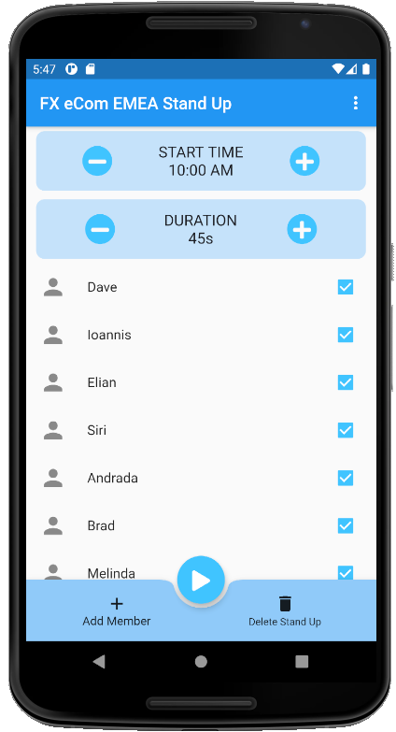
I’m going to try to demonstrate the ability to switch themes, so this will be the alternative. But not sure how much time we’ll have to cover it. We’ll see how far we get
I also need to fix the “NOW” bit on the RHS (for both themes) to be larger, centered and stand out a bit more (maybe with a contrasting background colour). Will update once I have that
Also the “Next Participant” bit needs filling in

Slide 10
Tools
Windows Laptop
Android SDK + Emulator (all comes with Android Studio)
VS Code
Dart, Flutter, Android, git VS Code extensions
Mac in Cloud for iOS builds & deployments
Phone, Simulator or Emulator

Slide 11

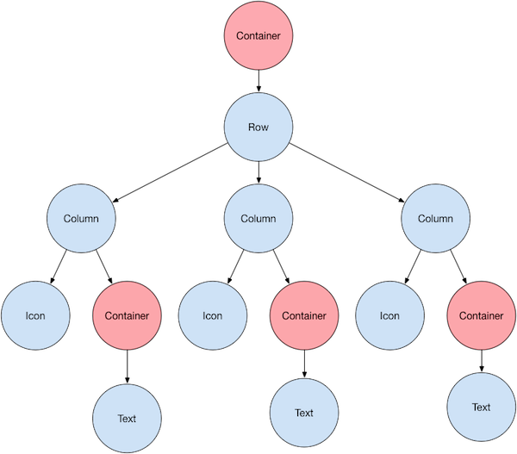
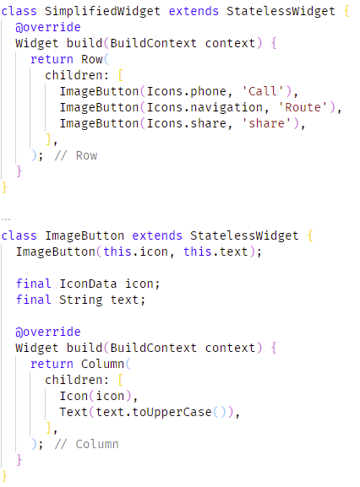
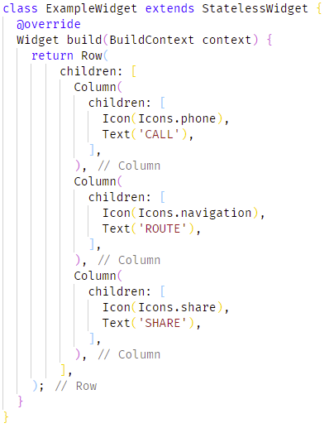
All UI Components are Widgets
Used for controls and layout
Icons, Images, buttons, ListView, GridView, etc, are all Widgets
Compose Widgets together to make more complex Widgets
Widgets are either Stateless or Stateful
Use Stateless where possible – no state so faster to paint
Only use Stateful when you are maintaining State
Override Widget’s “build” method to build display elements

Slide 12
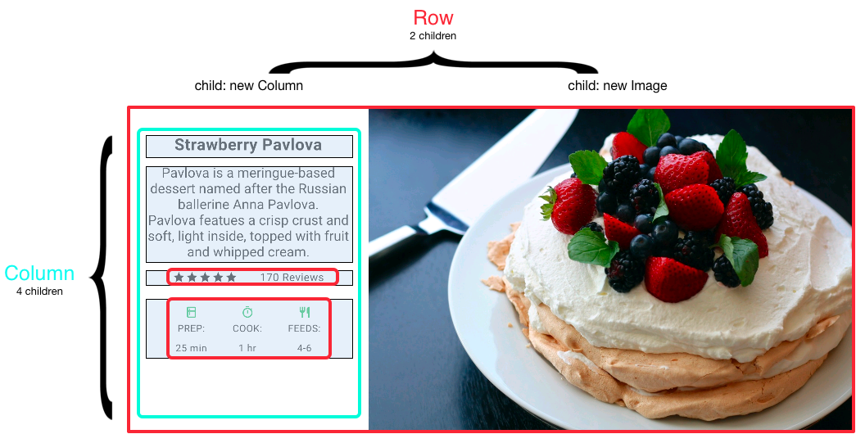
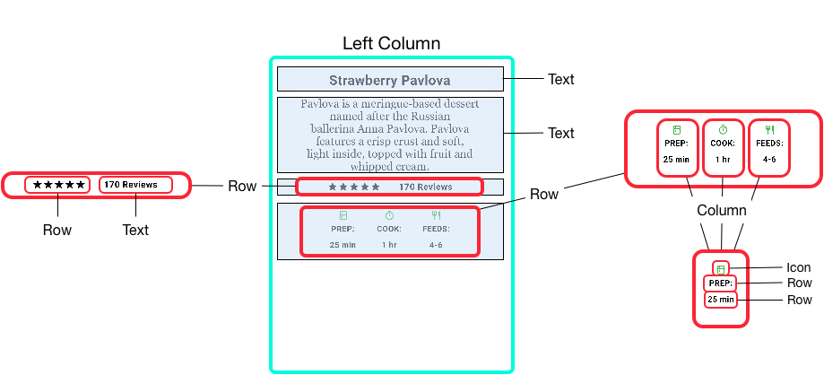
All UI Components are Widgets

Slide 13
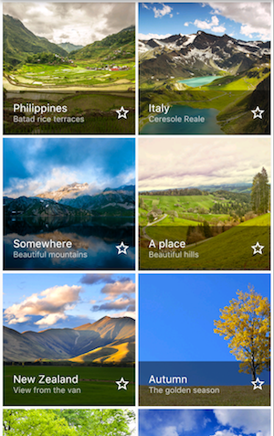
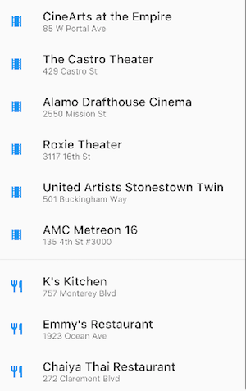

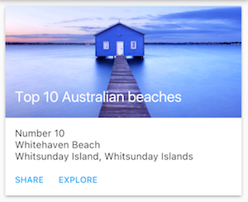
Lots of useful layouts already available
Notes:
GridView
ListView
Stack

Slide 14
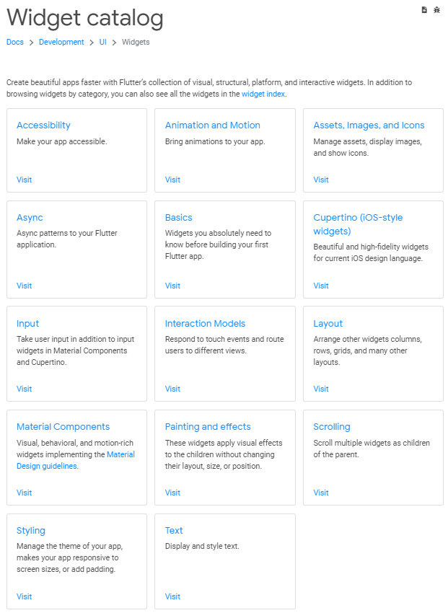
Everything is in the Widget Catalog
https://flutter.dev/docs/development/ui/widgets
Start at https://flutter.dev/docs/development/ui/widgets/basics
Interactive working code examples, etc.

Slide 15
Back to what we’re going to build
View
Scaffold
Text
Column
Bottom App. Bar
+- Card
+- Card
ListView
Bottom AppBar
Item
Bottom AppBar Item
Row
CheckBox
ListTile
Column
Button
Column
Button
Icon
Text
Icon (-)
Text
Text
Icon (+)

