Slide 1
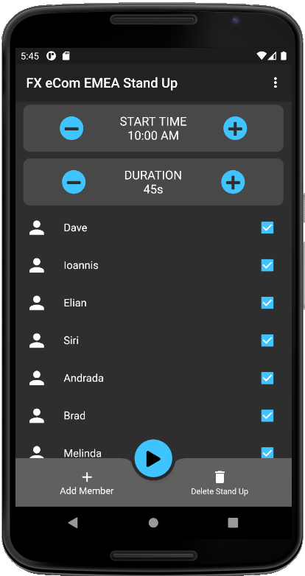
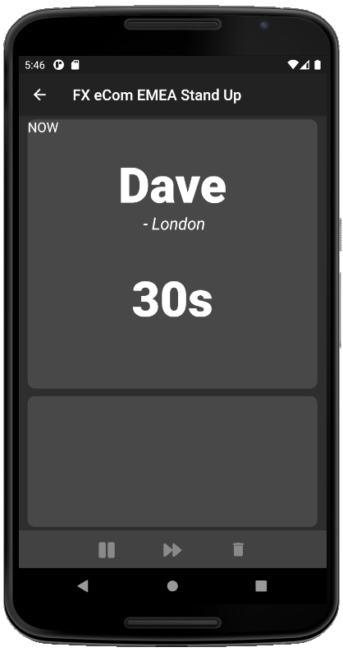
Stand Up Title
Stand Up Title + “Back”
Start Time, +/- to change
Duration for each person. +/- to change
Current Participant
Location
Time remaining (countdown timer, formatted to 2 digit seconds)
List of team members
Un-tick to remove from today’s stand-up
Could eventually include a profile photo
Should scroll when too big for view
Next Participant
+ Add new member (slide up from bottom with fields for “NAME” + “LOCATION”)
|> Starts the stand up (transition to next screen)
U: Deletes this stand up (probably don’t implement yet as to do so we’ll need a “Create new stand up screen which we won’t have time to implement)
Pause
Skip to next
End

Slide 2
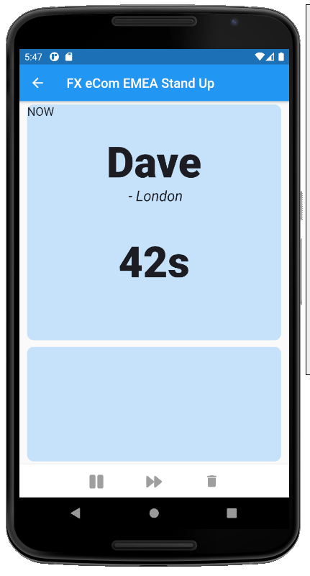
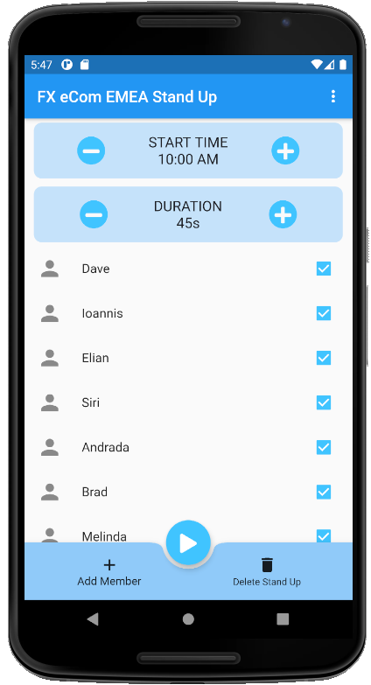
I’m going to try to demonstrate the ability to switch themes, so this will be the alternative. But not sure how much time we’ll have to cover it. We’ll see how far we get
I also need to fix the “NOW” bit on the RHS (for both themes) to be larger, centered and stand out a bit more (maybe with a contrasting background colour). Will update once I have that
Also the “Next Participant” bit needs filling in

