Slide 1
CQC Architecture Governance Architecture Options Paper Project: Production Siebel Database Access Date Published: July 2026
David Garner – [Role / job title]

Slide 2
Version Control
Version | Author (A) / Reviewers (R) / Consult (C) | Date | Comments
0.1 | David Garner (A) [Reviewer name] (R) | 10/07/26 | Initial draft

Slide 3
Architecture Distribution
This document is distributed to:
Name | Role | Date | Version
[Name] | Deputy Director of Architecture
[Name] | Deputy Director of Modern Workspace
[Name] | Deputy Director of Engineering
[Name] | Enterprise Architect
[Name] | Enterprise Architect
[Name] | Solutions Architect
[Name] | Solutions Architect
[Name] | Business Architect

Slide 4
Purpose & Decision Sought
Purpose:
The enterprise data platform (Microsoft Fabric) requires daily Siebel CRM data, both for ongoing integration and to prepare for the eventual migration and decommission of Siebel. Production Siebel is hosted by Computacenter as a managed service on aging hardware, where any additional load carries a material risk of failure.
Decision Sought:
The Architecture Review Board is asked to approve the access pattern for production Siebel data to be used ahead of the Siebel-to-Azure migration completing in November 2026.
Recommendations:
Option 2 – Backup Restore to Oracle PaaS in Azure. It is the only option that delivers daily Siebel data with zero additional load on the fragile production estate, and it de-risks the November 2026 migration by proving the backup/restore path.

Slide 5
Background
Background:
Production Siebel CRM runs on Oracle Database at a Computacenter managed service, on aging hardware where increased load raises the risk of failure.
A programme to migrate production Siebel to Azure is in flight, due to complete in November 2026.
The Microsoft Fabric enterprise data platform needs Siebel data on a daily basis for integration, and the same extraction capability supports migration and decommission preparation.
Computacenter already produces database backups, and an option exists to restore these to an Oracle PaaS database in Azure.
Drivers: protect a fragile production estate from additional load; unblock the data platform and integration roadmap ahead of November 2026; and begin preparing Siebel data for migration and decommission.

Slide 6
Options Summary
Option | Name | Cost | Security Risk | Ops Support Fit | Delivery Confidence | Time to Deliver | Architecture Fit | Key Characteristics
1 | Direct Extract from Production | G | A | R | A | G | A | Direct connection to live production; fastest and cheapest, but adds query load to a fragile estate Computacenter may not warrant.
2 | Backup Restore to Oracle PaaS in Azure | A | G | G | G | A | G | Reuses existing backups; zero additional production load; meets daily freshness; rehearses the Azure migration and seeds the decommission archive.
3 | Continuous Replication to Azure | R | A | A | A | R | A | Near-real-time replica; far exceeds the daily requirement; highest cost and longest lead time for a capability retired at cutover.
4 | Defer Until Azure Migration | G | G | G | A | R | R | Zero risk and zero cost now, but no data until after November 2026 and hostage to migration slippage.
Recommendation: Option 2 – Backup Restore to Oracle PaaS in Azure
It is the only option that meets the daily data need with zero additional load on the fragile production estate, keeps the data inside CQC's Azure tenancy, and de-risks the November 2026 migration by proving the backup/restore path while seeding the decommission archive.
6

Slide 7
Option 1 – Direct Extract from Production
Fabric pipelines connect a read-only account directly to the Computacenter-hosted production Oracle database and run scheduled overnight extracts.
Lens | RAG | Pros | Cons
Costs (project and operational) |  | Lowest build cost – no new infrastructure; native Fabric Oracle connectivity. | Computacenter change request for network access; possible charges if production impact is investigated.
Security Risk |  | Read-only service account over a scoped, private network path. | New external connection direct into production; production credentials held outside the Computacenter boundary.
Operational Support Fit |  | Nothing new to host or operate. | Extract load lands on aging hardware already at risk of failure; contends with overnight batch and backup windows; Computacenter may not warrant it.
Delivery Confidence |  | Well-understood pattern, quick to prove technically. | Dependent on Computacenter network changes; extracts may be throttled or stopped if production is impacted.
Time to Deliver |  | Fastest option – weeks once connectivity is agreed. | –
Architecture Fit |  | Simple; no intermediate data copies. | Couples the data platform directly to a system being migrated and decommissioned; pattern is discarded at cutover.

Slide 8
Option 2 – Backup Restore to Oracle PaaS in Azure
Computacenter's existing daily backups are restored to an Oracle PaaS database in Azure; Fabric extracts from the restored copy – zero additional load on production.
Lens | RAG | Pros | Cons
Costs (project and operational) |  | No load-related Computacenter charges; PaaS spend stops or converts at migration. | Oracle PaaS run costs plus restore-automation effort for ~16 months.
Security Risk |  | No new access path into production; data governed in CQC's Azure tenancy with native access control and auditing. | A full production dataset is copied – DPIA and hardening of the restore target required.
Operational Support Fit |  | Reuses backup artefacts Computacenter already produces; operated with the Azure skills being built for the migration. | A daily restore pipeline must be run and monitored; a failed restore delays data by a day.
Delivery Confidence |  | Restore-from-backup is a proven option already acknowledged by Computacenter; independent of production stability. | Backup transfer and restore automation must be engineered and tested.
Time to Deliver |  | No dependency on complex replication tooling. | Weeks to stand up the PaaS target and automation before first data lands.
Architecture Fit |  | Aligns with Azure strategy; rehearses the migration restore path daily; the copy can seed the decommission archive. | Interim asset that must be reviewed at migration cutover.

Slide 9
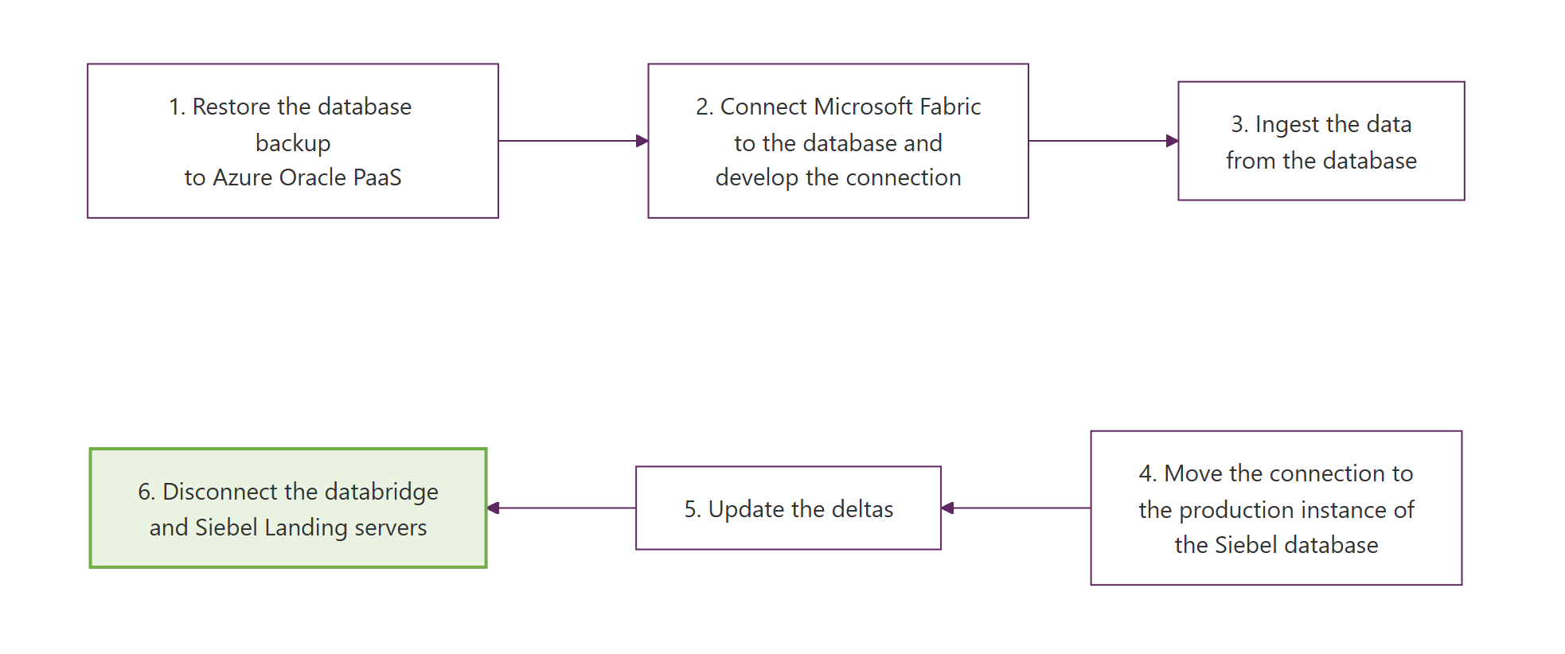
Option 2 – Backup Restore Workflow

Slide 10
Option 3 – Continuous Replication to Azure
A continuously synchronised replica of production is maintained in Azure using Oracle replication tooling (GoldenGate / Data Guard); Fabric extracts from the replica.
Lens | RAG | Pros | Cons
Costs (project and operational) |  | Replica could also offload other reporting workloads. | Replication licensing, Computacenter implementation charges and PaaS costs for a capability retired in 2026.
Security Risk |  | Extract workload fully isolated from production. | Persistent replication channel from production into Azure; Computacenter-side agents and network changes to secure.
Operational Support Fit |  | Mature, widely used Oracle tooling. | A new replication stack to monitor; replication lag or breakage becomes a failure mode nobody currently supports.
Delivery Confidence |  | Well-documented Oracle patterns. | Requires installing and configuring components on the fragile production estate via Computacenter; highest complexity.
Time to Deliver |  | – | Longest lead time – Computacenter contract change, licences, design and build likely take months.
Architecture Fit |  | Would support near-real-time needs if they emerge. | Significantly exceeds the daily-freshness requirement; throwaway at migration.

Slide 11
Option 4 – Defer Until Azure Migration
Make no change now; integrate with Siebel data only after production has migrated to Azure in November 2026.
Lens | RAG | Pros | Cons
Costs (project and operational) |  | No spend before migration. | Cost of delay – integration and decommission-preparation work stacks up after cutover.
Security Risk |  | No new access paths or data copies. | –
Operational Support Fit |  | No new operational burden. | –
Delivery Confidence |  | Nothing to deliver. | Wholly dependent on a migration date that may slip; no fallback if it does.
Time to Deliver |  | – | No Siebel data in the platform for 16+ months.
Architecture Fit |  | Avoids interim assets. | Blocks the data platform and integration roadmap; loses the daily migration rehearsal; leaves decommission preparation to the last minute.

Slide 12
Next Steps
ARB decision on the recommended option – Architecture Review Board – July 2026.
Confirm backup transfer mechanism, restore cadence and costs with Computacenter – Solutions Architect – within 2 weeks of approval.
Stand up the Oracle PaaS target in the Azure landing zone and automate the daily restore – Engineering – 6–8 weeks.
Build Fabric ingestion pipelines from the restored copy into OneLake – Data Platform team – in parallel with restore automation.
Complete DPIA and security assessment for Siebel data held in Azure – Information Governance / Security – before first production restore.
Review the pattern at Azure migration cutover (November 2026): repoint pipelines to the migrated database and retire or retain the restored copy as the decommission archive – Architecture.

