Slide 1

Particle photon
Author: Daniele Pasquini
La Sapienza University of Rome
Pervasive Systems course A.Y. 2016/2017

Slide 2
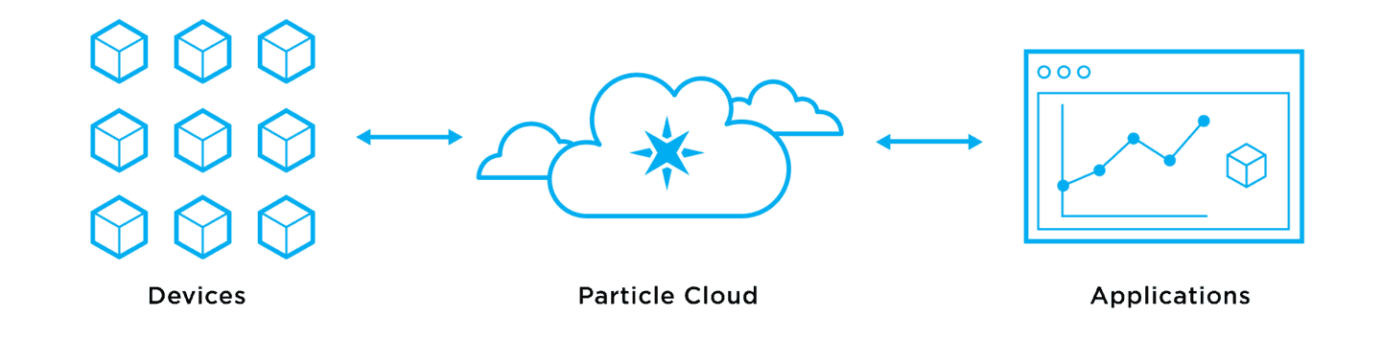
Particle platform
Particle is a full-stack IoT device platform.
It helps in all the phases of the designing, from prototyping to the production.
Their products are the Particle Cloud, a cellular IoT SIM card and data plan, and cloud-connected microcontrollers like the Electron and Photon.

Slide 3
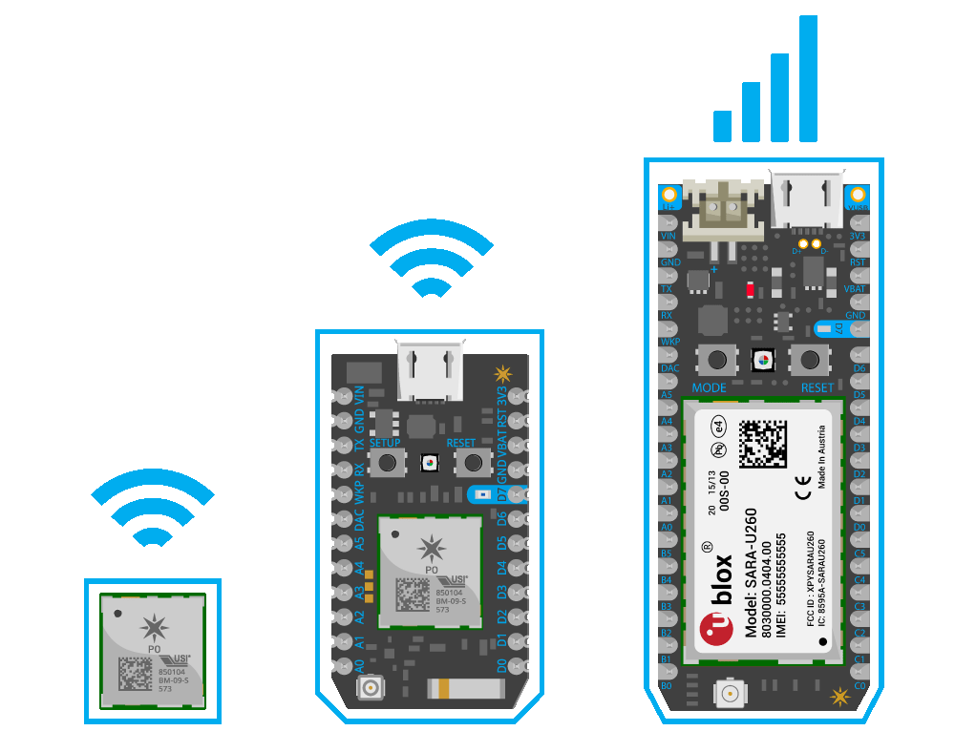
Compatible hardware
Photon
Electron
Raspberry pi
Third party boards

Slide 4
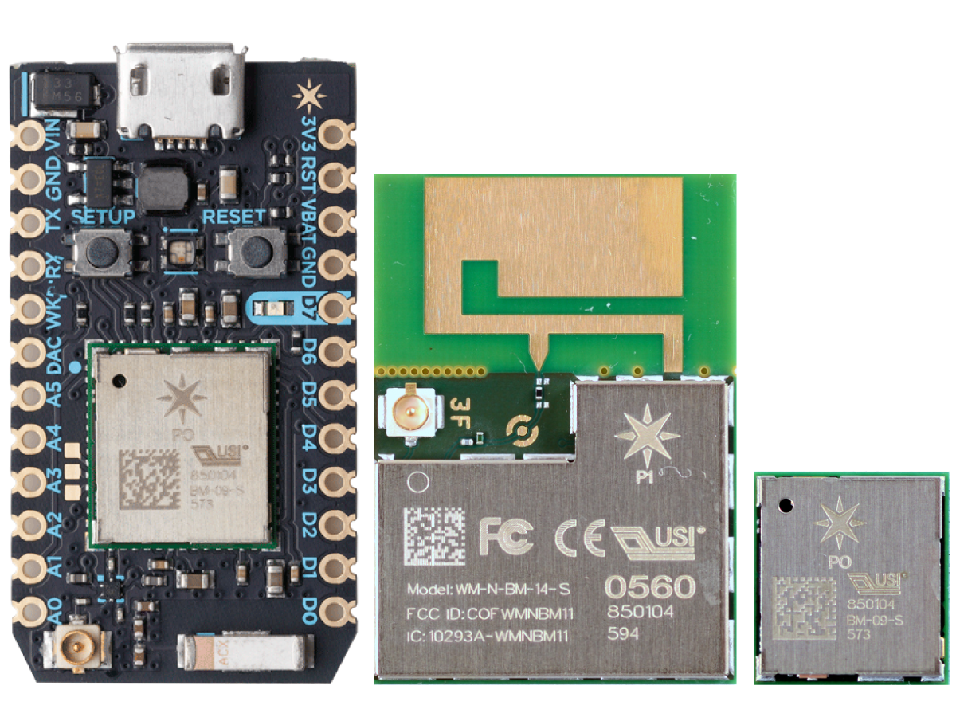
Photon
family

Slide 5
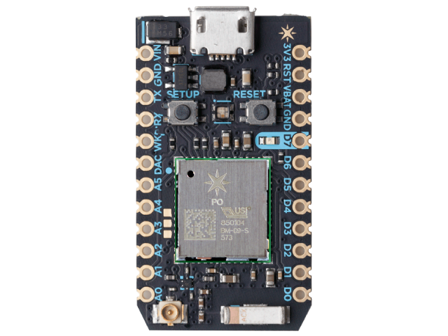
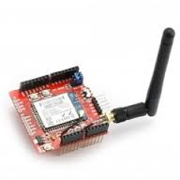
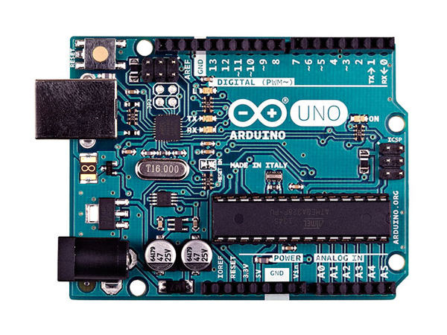
Photon
Cloud platform
Wifi shield
Arduino UNO

Slide 6
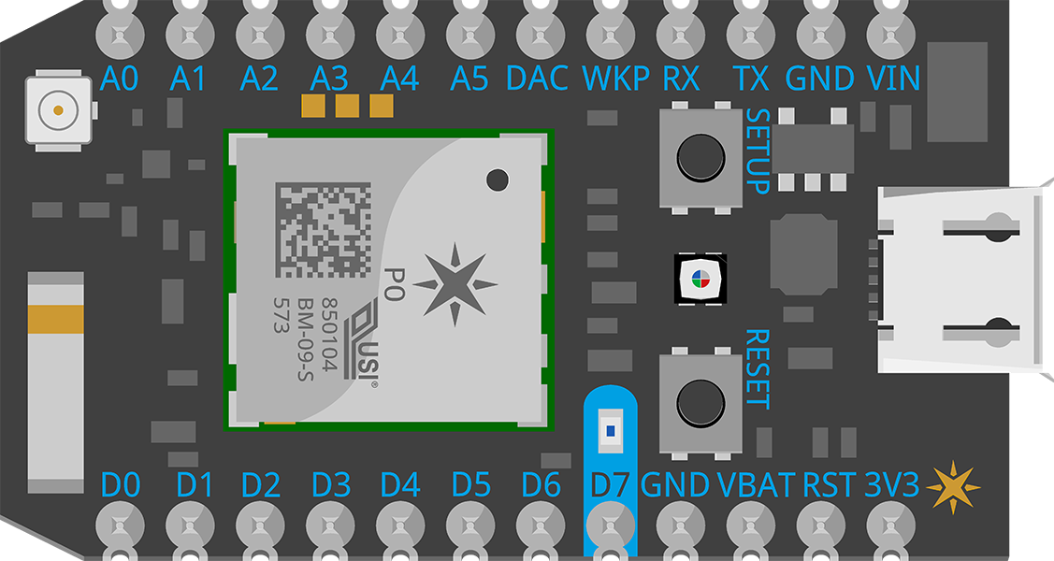
Specifications
Microcontroller STM32F205:
32-bit 120Mhz ARM Cortex M3 CPU
1MB Flash memory
128KB RAM
18 mixed-signal GPIO and advanced peripherals (UART, I2C, SPi)
Wi-Fi chip Broadcom BCM43362:
Single band 2.4GHz IEEE 802.11b/g/n
Supports wireless data rates of up to 65Mbit/s
Ultra low power sleep, stand-by and stop modes
Supported security modes: Open, WEP, WAPI, WPA and WPA2-PSK
WiFi Soft AP setup
FCC, CE and IC certified

Slide 7
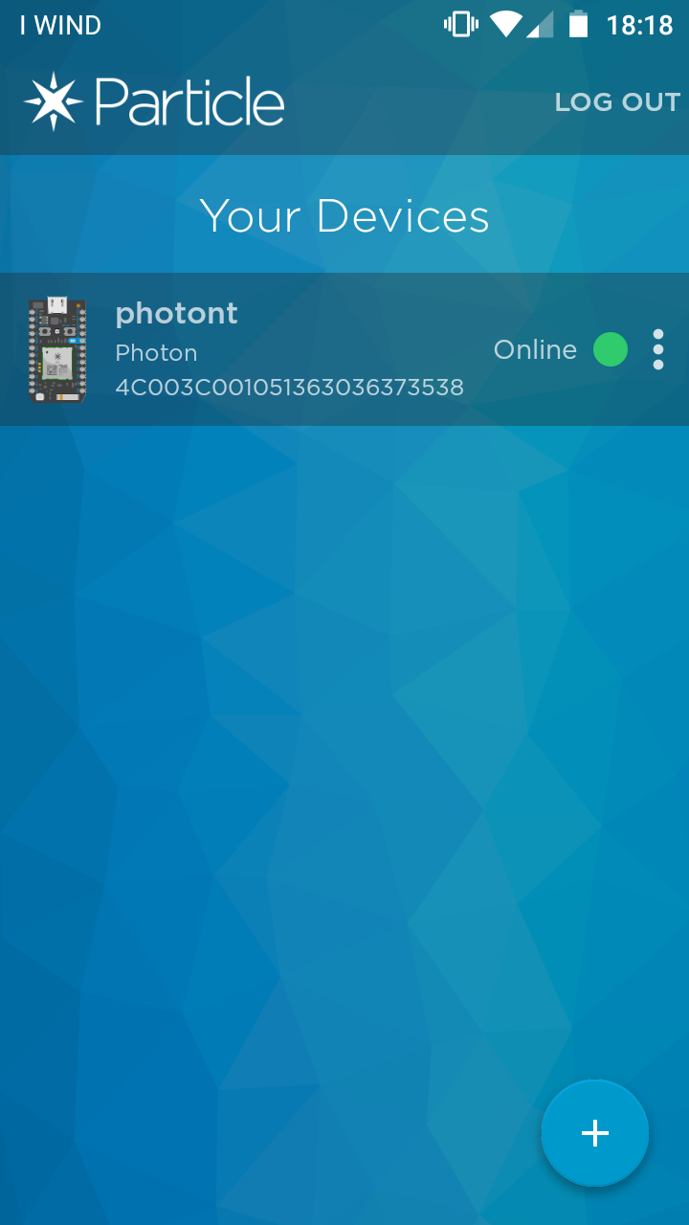
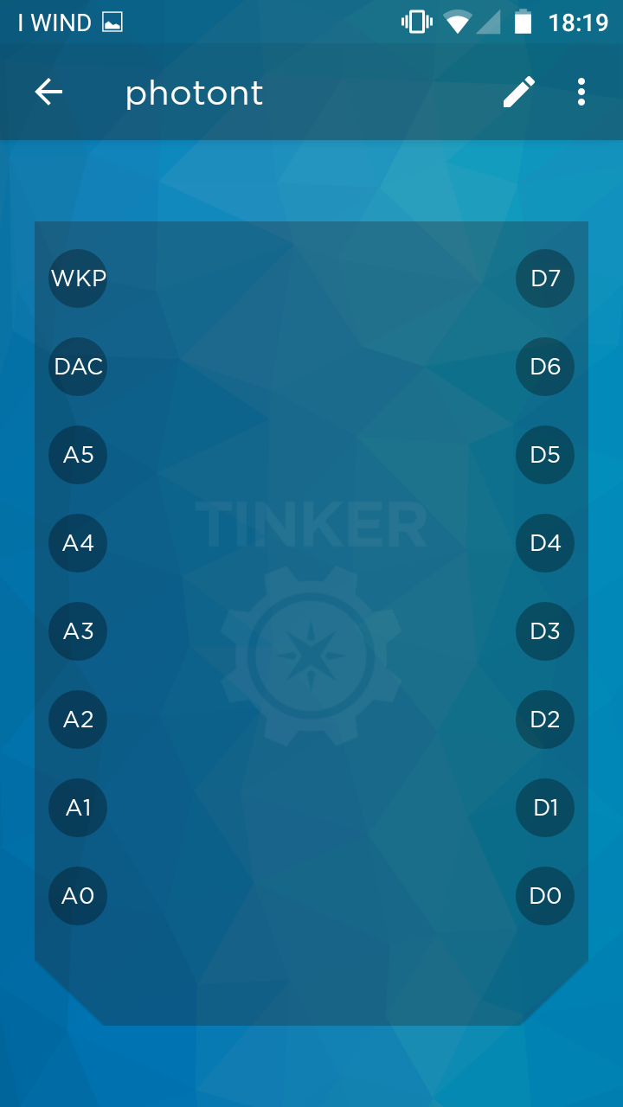
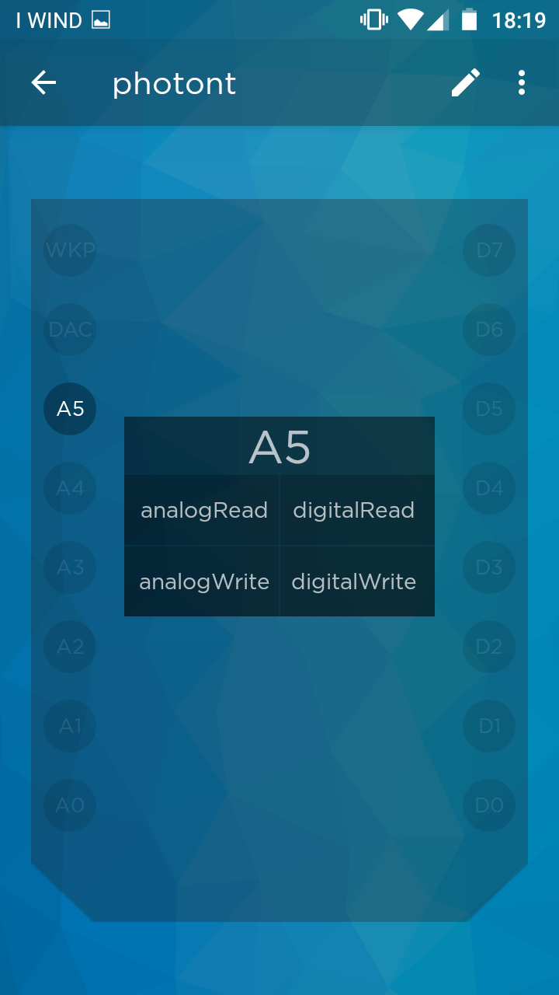
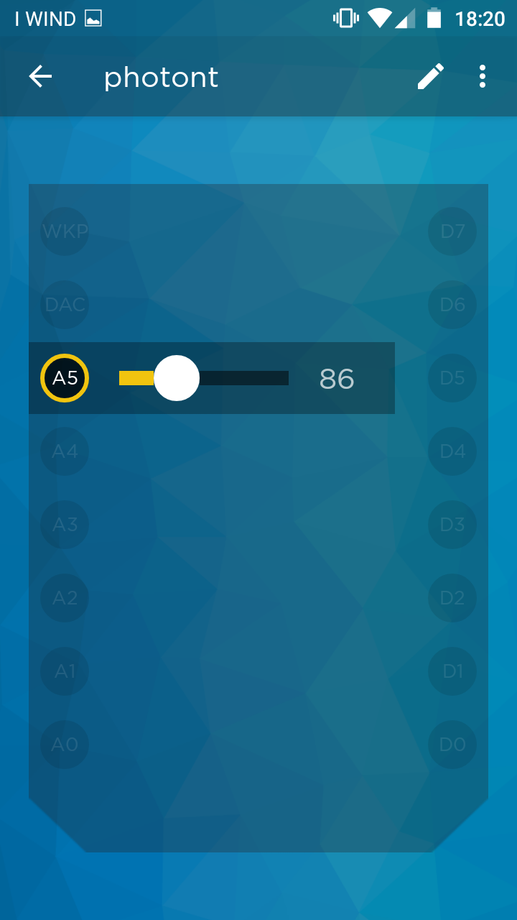
First time setup & mobile app

Slide 8
Development Tools
Web IDE
Desktop IDE
CLI (command line interface)
SDKs:
iOS, Android, Windows and Javascript
Cloud API (https://api.particle.io)
Webhooks
Particle console (https://console.particle.io)

Slide 9
Particle functions
Particle.variable(‘‘variable_name‘‘, variable, type)
Particle.function(‘‘function_name‘‘, function)
Event based functions
Particle.publish(‘‘eventName‘‘, ‘‘data‘‘, ttl, PRIVATE)
Particle.subscribe(‘‘eventName‘‘, &handler, MY_DEVICES)

Slide 10
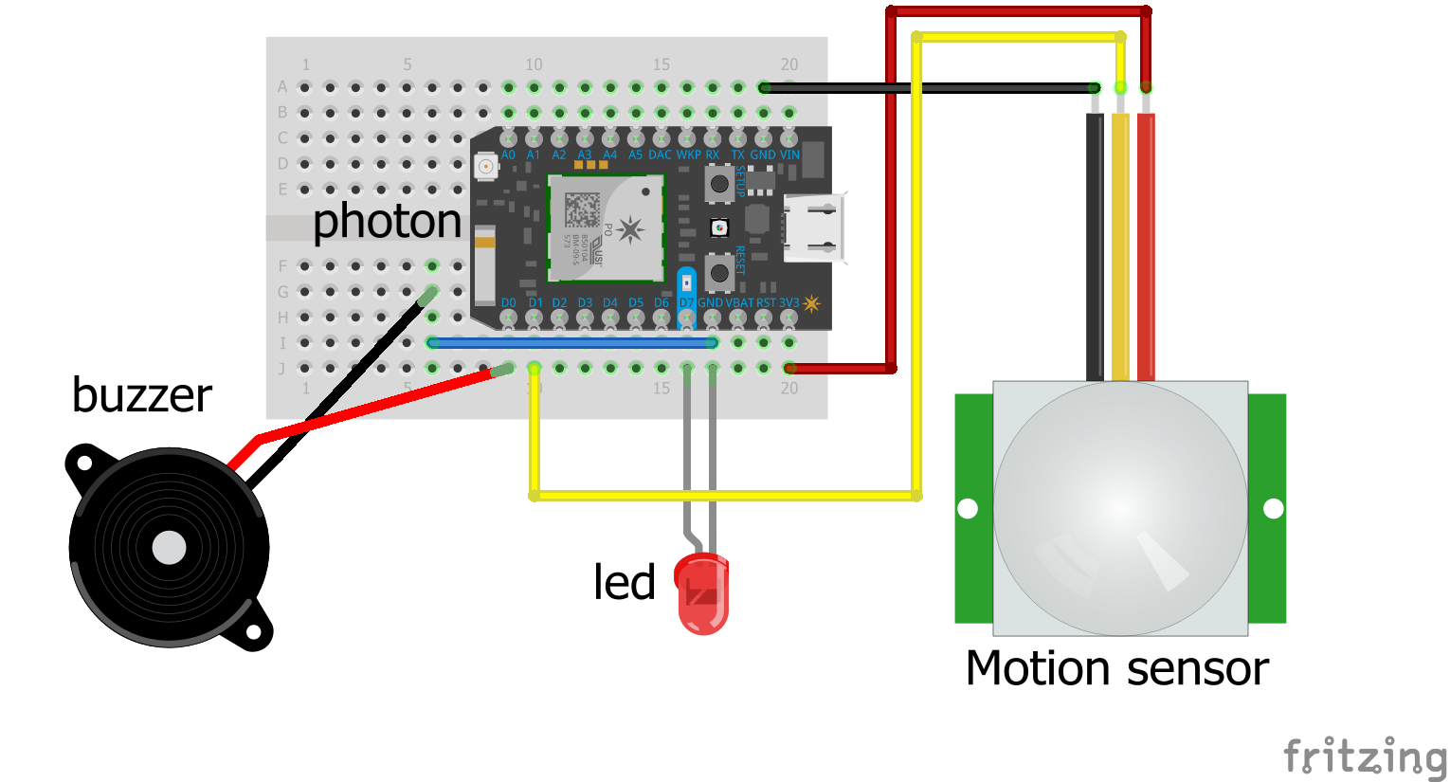
Example: alarm system (circuit)

Slide 11






Example: alarm system
Particle cloud
sendmail.php
alarm.html

Slide 12
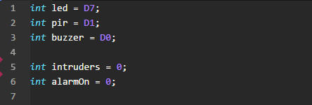
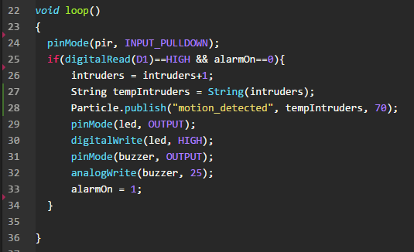
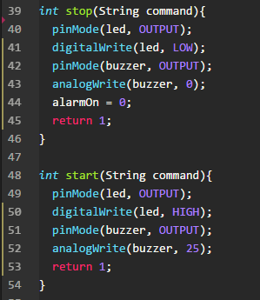
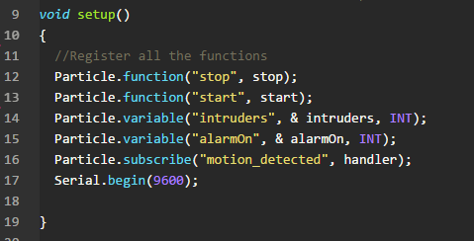
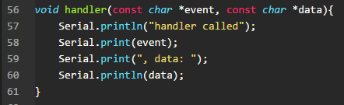
Example: alarm system (code)

Slide 13
Example: alarm system
Live demo

Slide 14


Links
https://github.com/hopelesscoder/photon
https://www.linkedin.com/in/daniele-pasquini-2b5b4466/

Slide 15
That’s all
Thank you!

