Slide 1

Test-Business
Dave Green
Digital Applications Systems Engineer
@neongreenie
http://tookitaway.co.uk/
david.green@tookitaway.co.uk
Notes:
Started with PowerShell about 2009/2010, with Exchange. That grew into a bunch of other stuff, projects for user creation and lots of little utilities.
Worked in 24/7 manufacturing environments making both salad... and Formula 1 cars :)
Work as a digital applications systems engineer, connecting users, integrating systems and acting as the glue of an organisation.
Side projects include my blog, occasional dodgy PowerShell bits (like what I’ll be talking about today), occasionally reviewing technical books and doing other fun computery bits and bobs.
Feel free to contact me using any of the contact details (also shown at the end). Happy to help however I can!
5 mins on slide max

Slide 2
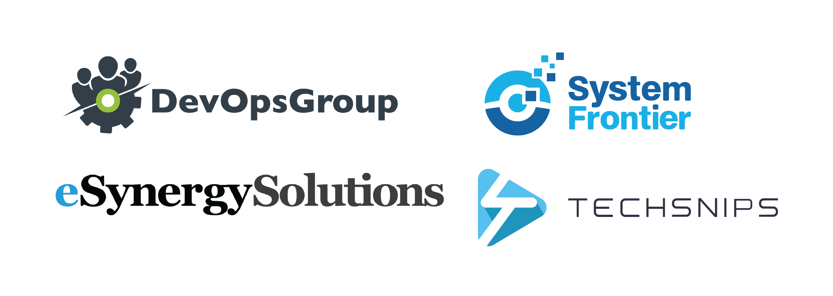
Thanks
Notes:
5 mins on slide max
Thanks to all the sponsors, they help make this possible, but this wouldn’t even be a possibility without you. Each and every one of you, whether you’re a speaker, a contributor, you’ve answered a question, or even just bought a ticket.
All of you should give yourselves a pat on the back for being a part of this amazing community.

Slide 3
Testing?
Ensure things work as expected.
Evolve practices.
Intent and context.
Living specification.
Notes:
What is testing?
Today we’re focusing on operational testing, but these things also apply to unit testing, integration testing, etc.
Work as expected – Obvious, but not always something people do!
Evolve practices – Now you’re sure it’s working, lets experiment, make things better, etc.
Intent – Ah, I’ve found a bug, what is this code supposed to be doing – comments, maybe, testing, another good signal.
Spec – If you’ve got enough tests, you can reimplement to the tests, acting as a spec, a steer, a good deal better than (usually) non-existent documentation.

Slide 4
For?
Safety - Freedom to experiment.
Consistency - Build on success over time.
Visibility - Show business value.
Community - Deepen knowledge, onboard new people.
Notes:
What is it for, what does it enable you to do?
Safety – Freedom to experiment while ensuring functionality. As we said – Evolve practices!
Now we’re safe(ish) we have the freedom, to experiment, build success
Much easier to show KPIs, value, as if we’re set up to test, it’s a short hop to benchmark, or time-test, or signal with business KPIs (Operational). Uptime, etc.
As we’re now specifying and making things more accessible, it’s easier to communicate about, understand and transfer knowledge.

Slide 5
Why Operational Testing?
Many teams, many businesses, many services, same problems.
Difficult to monitor some services.
Testing business requirements.
Notes:
So why operational testing?
Always seeing the same problems, IT is a wonderful machine to create the same old rubbish services.
Difficult – SaaS apps, ensuring configuration of web services when all you’ve got is an SNMP monitor server or SCOM.
Testing business rules and requirements, not just focussing on uptime, CPU/Memory usage.

Slide 6
The Continuum
Test script (Manual run and results). ^ Less automated.
Test suite (Schedule run and reported results).
Compliance scan (Auto-run, history and trend results). More automated.
Compliance mgmt (Auto-run, resolve, full reporting). v State config.
< Test-Business
Notes:
So here is my take on the operational testing continuum, as I go on, it turns more into operational management as I go on.
We start with a test script. One pester file, all the data and other stuff all bundled up inside one or two files, very environment specific
Test suite, a set of test files, separate test data, multiple environment support and perhaps reported result sets.
Compliance scanning, essentially a test suite with more focus on reporting, history, shorter run gaps, guidance on resolution, etc.
Compliance management, everything above with some, or full auto resolution of issues found.

Slide 7
Test-Driven Operations?
What is tested is less important than why.
Keep tests team-public, involve everyone.
Work with existing change control processes.
Incremental improvements and marginal gains.
Notes:
Test driven ops
Like Test driven development (TDD), creating a culture of service reliability, knowledge transfer and process improvement.
Pretty obvious, but here’s my take.

Slide 8
Test-Business
Runs test suites.
Wraps Pester and helper scripts for convenience.
Generates some shiny reports (Invoke-ReportUnit).
Using ReportUnit (http://reportunit.relevantcodes.com/)
Test summaries (Write-TestSummary).
Notes:
So, Test-Business, my take on providing a fairly general framework (kind of like the operational validation framework) for testing arbritrary services.
Wraps pester, as you’d expect.
‘borrows’ the magic of reportunit for some basic reporting.
Writes a test summary which is useful for trending, perhaps PowerBI, etc.

Slide 9
A TestSuite
Test suite framework.
\A.TestSuite
|-\data - Data files describing the desired configuration.
|-\helpers - Helpers for data load, authentication.
|-\tests - Pester test files.
|-A.TestSuite.psd1 - Module description.
|-A.TestSuite.psm1 - Empty?! Relies on Test-Business for normal use.
Notes:
What does a test suite used with test-business look like.

Slide 10
Helpers, Data and Tests
Single helper entry, multiple associated data and test files.
Helper name is used as the key for data and tests.
Get-TestSuiteData shows helpers, data and tests.
Notes:
General search of the data or test folder for anything matching the helper name within the path, so make sure you choose the helper carefully!
Get-TestSuiteData is the magic test for this.

Slide 11
Show me the demo!
Demo

Slide 12
Thanks! Questions?
@neongreenie
http://tookitaway.co.uk/
david.green@tookitaway.co.uk
Notes:
Questions?

