Slide 1
Grasp and Lift EEG Detection
V. Petrella, D. Bourque
Notes:
*) Us

Slide 2
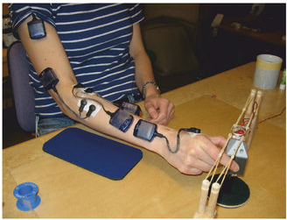
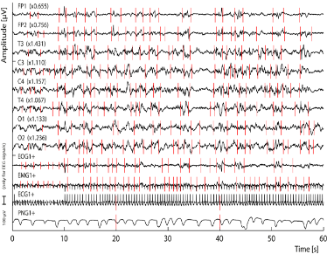
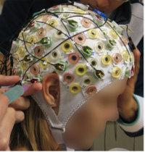
Grasp And Lift
Determine relationship between brain activity and simple motor tasks
Notes:
Describe problem
People missing limbs, need to control prosthetics devises
invasive methods (electrodes in the brain) are more precise, less pleasant. Possibility of infection
Uninvasive methods (EEG) are less precise, but cheap, and not unpleasant
Our problem moving a hand, 6 sequential events.
Predict events using only past data, future does not exist

Slide 3
CSP
ddf
Notes:
32 channels, readings from different electrodes on different areas of the brain, not all of them are useful for a specific task

Slide 4
CNN

Slide 5
Results

