Slide 1
STEMMate Namibia
Plan offline. Deliver when signal returns.
Client briefing and demonstration · Group 2 · NSSDL
Notes:
[0:00–0:40 · Dawid]
Good morning. We are Group 2 from the Namibian Sustainable Software Design Laboratory, and this is our final briefing on STEMMate Namibia.
In A3 you saw a clickable prototype. Today we show you a working vertical slice: one complete path through the real system, from the facilitator's screen, through validation and encrypted storage on the phone, to a server that keeps the plan, and back to a status the facilitator can trust.
In the next seven minutes we cover the problem, what we built, a live demonstration, the test evidence, what we changed because of evaluation and testing, and our recommendation.

Slide 2
Facilitators plan on shared phones with patchy signal
1
2
3
Shared, low-spec phones
Signal comes and goes
Children's privacy
Several volunteers use one device. Drafts must be private to each person, yet never deleted on sign-out.
Data is costly and patchy. Every planning task must work offline; plans send themselves later.
The outreach unit needs comparable plans and counts, but never a learner's name.
Design answer: the phone is the source of truth; delivery is revision-based, never last-write-wins; sign-out locks drafts instead of deleting them.
Notes:
[0:40–1:40 · Phillip]
Three conditions shape everything we designed.
First, phones are shared and low-specification. Several volunteers may use one phone, so each person's drafts must stay private, but signing out must never throw away work that has not been sent yet.
Second, signal is unreliable and data is expensive. So every planning task works with no network at all, and a finished plan sends itself when signal returns.
Third, the work involves children. The outreach unit needs plans it can compare and participation numbers, but the system has no place to type a learner's name.
Our design answer, in one line: the phone is the source of truth, delivery never silently overwrites anyone's work, and signing out locks drafts rather than deleting them.

Slide 3
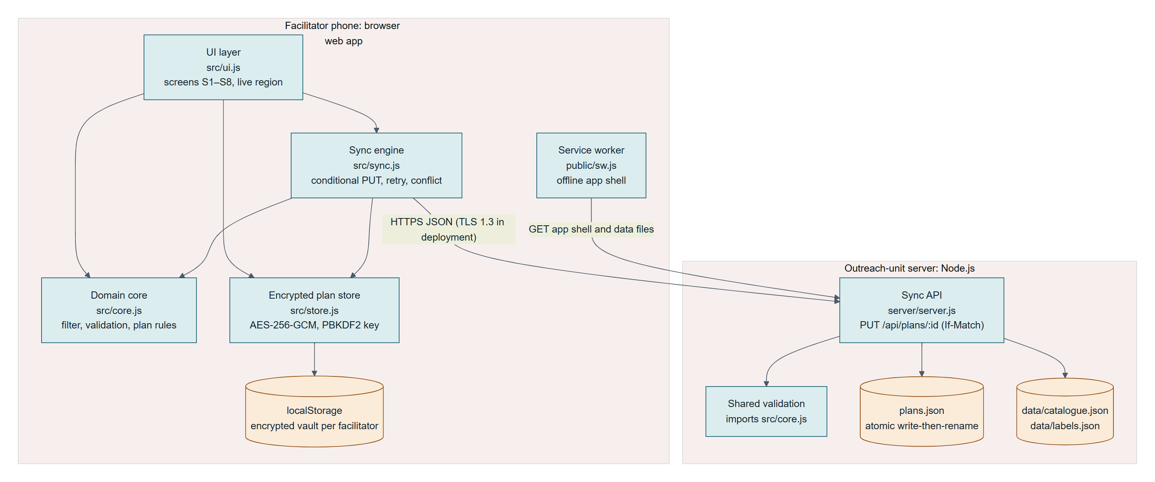
What we built: one complete path through the system
Encrypted on the phone
AES-256-GCM vault per facilitator; key from the PIN, forgotten on sign-out
Never a duplicate
Each send carries an idempotency key; a resend after a lost reply is recognised
Never a silent overwrite
If the outreach unit edited the plan, the facilitator chooses which copy to keep
No paid services · no framework · about 50 KB to install · runs on Node.js and any current browser
Five Architecture Decision Records in the report explain each choice and what it costs.
Notes:
[1:40–2:40 · Phillip]
Here is the slice. On the left is the phone: the screens, a small domain module with all the rules, an encrypted store, and a sync engine. On the right is the outreach unit's server, which checks every plan with the same rules and writes it to a file that survives a restart.
Three properties matter to you as the client.
Drafts are encrypted on the phone, per facilitator, with a key that comes from their PIN and is forgotten at sign-out.
A plan is never duplicated. If signal drops after the server saved a plan, the phone's resend is recognised and nothing is stored twice.
And a plan is never silently overwritten. If your staff edited it, the facilitator sees both copies and chooses.
It needs no paid services, no framework and about fifty kilobytes to install. The five decision records in the report explain each choice and its trade-offs.

Slide 4
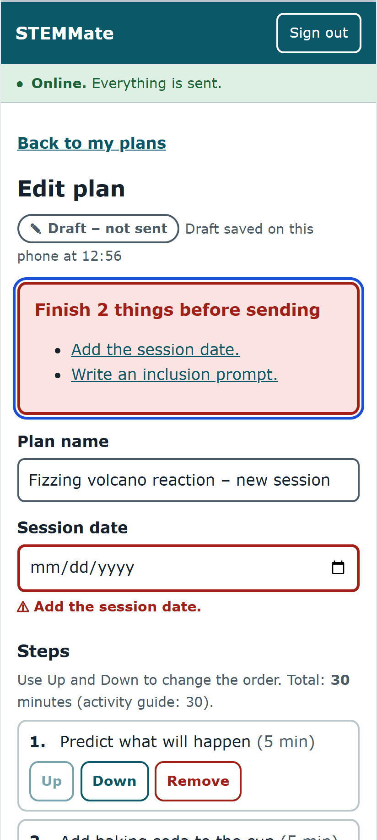
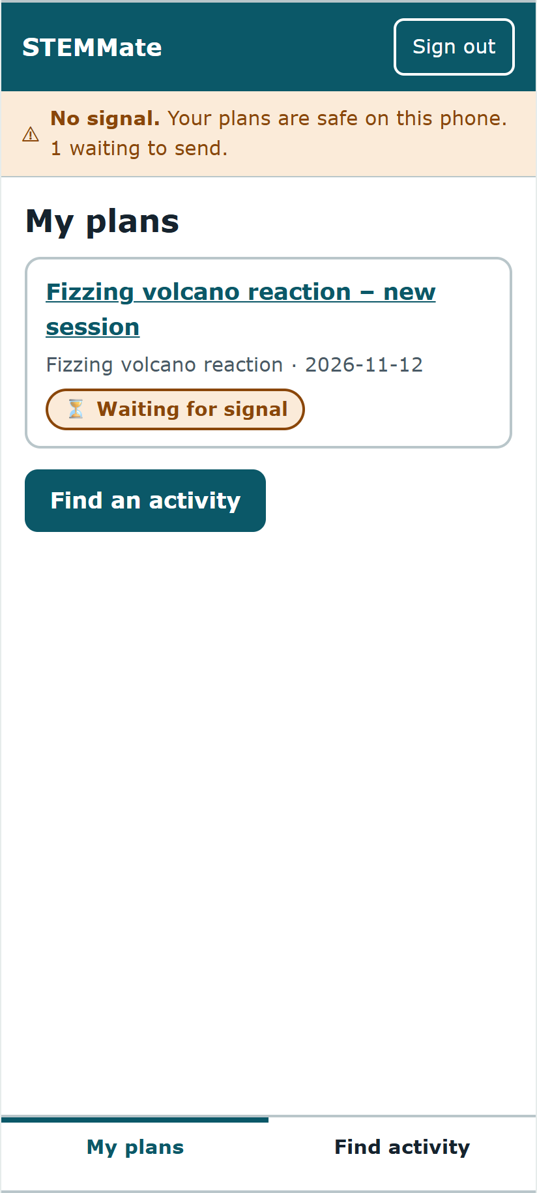
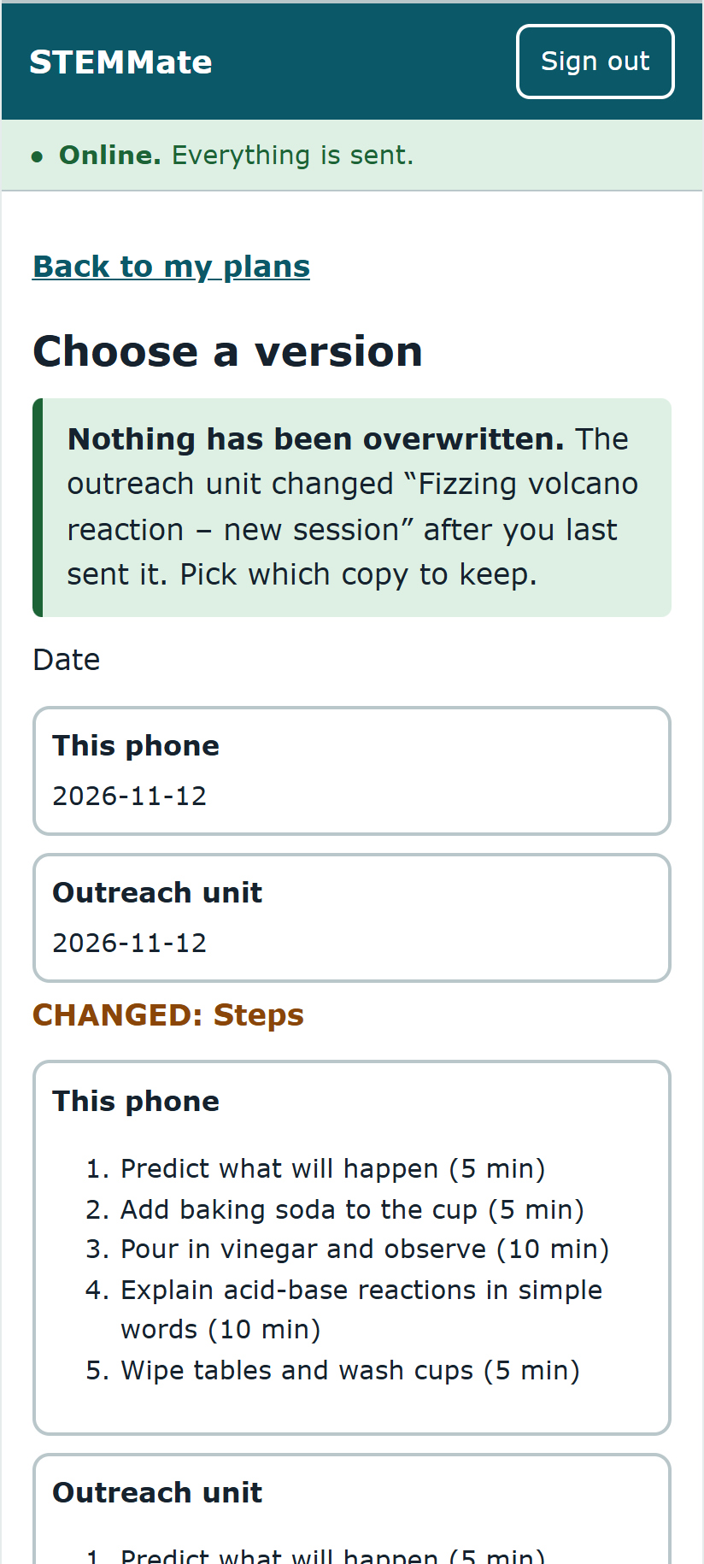
Live demonstration
1
Sign in as Selma; a wrong PIN is refused and named
2
Pick the volcano activity from materials on hand
3
Try to send an incomplete plan: the error summary takes you to each gap
4
Go offline and complete it: "Waiting for signal"
5
Three server errors, then Retry: "Sent to outreach unit"
6
Outreach unit edits it: "Needs your choice", nothing overwritten
Error summary
Waiting for signal
Choose a version
Backup if the live demo fails: these screenshots, captured from v1.3 on 4 November 2026.
Notes:
[2:40–5:00 · Dawid demonstrates, Phillip narrates. Server already running: npm start. Browser at localhost:8080, demo data reset.]
1. I sign in as Selma with the wrong PIN. The message names Selma and puts me back in the PIN box. Now the right PIN.
2. Find activity. I tick vinegar, baking soda and paper cups. One activity matches: the fizzing volcano. Plan a session with this.
3. I press Mark complete and send straight away. The error summary lists what is missing, and each item jumps to its field. A screen-reader user hears the same.
4. I use the test control to go offline, add the date and an inclusion idea, and complete it. The plan says "Waiting for signal" and the banner shows one plan waiting. Nothing is lost.
5. I tell the server to fail the next three sends and go back online. After three tries it says "Not sent – tap Retry", and that the plan is still safe on this phone. Retry, and it is sent.
6. Finally your staff edit the plan while Selma also changes it. She sees "Needs your choice". The screen opens with "Nothing has been overwritten" and labels what changed. She keeps her version, and it is delivered.
If anything fails live, use the screenshots on this slide.

Slide 5
The evidence: tested, including what failed
18 / 18
0
691 B
4
automated unit and integration tests pass
accessibility violations in 14 screen states (axe-core, WCAG 2.2 AA)
for a typical plan upload; limit 500 KB
real defects found by our own tests and fixed
Honest failure: the first test run failed one test. Choosing "Keep this phone's version" left the plan stuck in conflict for ever. The prototype could not show this because its server was simulated. Fixed, and all 29 documented tests are traced to requirements in the report.
Not yet covered: a screen-reader session and a real low-spec Android phone.
Notes:
[5:00–5:50 · Dawid]
How do we know it works? Eighteen automated tests run in under a second; they start the real server and talk to it over the network. All eighteen pass.
An accessibility audit of fourteen screen states, including dark mode, found no violations against WCAG 2.2 AA; no button is too small to tap, and nothing scrolls sideways on a 320-pixel screen.
A typical plan upload is under seven hundred bytes, so sending costs almost nothing.
And we want to be clear about failure. Our first test run failed one test: keeping the phone's version after a conflict left the plan stuck for ever. The prototype hid this because its server was pretend. We fixed it and kept the failing run as evidence.
What we have not yet tested: a real screen-reader session and a real low-cost Android phone.

Slide 6
What we changed because of evaluation and testing
Evidence | Before (A3 prototype) | After (A4 slice)
2 of 5 participants did not understand "Synchronise" | Pending · Syncing · Synced · Sync failed · Conflict | Waiting for signal · Sending now · Sent to outreach unit · Not sent – tap Retry · Needs your choice
Our check: text typed then leaving the screen was lost | Saved 2 s after typing stopped, read from the screen | Saved before every screen change; 1 s autosave
Failing test AT-16 | "Keep mine" kept the old revision and looped | "Keep mine" re-bases on the server revision
Our check: drafts readable on a shared phone | Plain-text storage, PIN compared in code | Encrypted vault per facilitator; server rejects extra fields
Notes:
[5:50–6:40 · Phillip]
Every change here is tied to evidence.
In our A3 sessions, two of five participants did not understand the word "Synchronise". So the statuses now say what is happening in plain words: "Waiting for signal", "Sending now", "Sent to outreach unit". Your staff can change that wording themselves in a data file, with no programming.
Our own check showed the prototype lost typed text if you left the screen within two seconds. Now it saves before every screen change.
The failing test you just heard about changed how "keep my version" works.
And we found the prototype stored drafts in plain text, which on a shared phone means anyone could read them. Drafts are now encrypted for each facilitator.
We also rejected options: automatic merging of conflicting plans was judged too risky to explain on a small screen.

Slide 7
Recommendation: proceed to a supervised pilot-readiness phase
Before any pilot:
Staff sign-in on the server
6-digit PINs with an attempt limit (a 4-digit PIN falls in about 7 minutes)
Screen-reader session and two real low-spec Android phones
Written lecturer approval and ethics clearance before any real facilitator is involved
Notes:
[6:40–7:30 · Dawid]
Our recommendation: proceed to a supervised pilot-readiness phase with this architecture, but do not deploy it to schools yet.
The slice proves the riskiest ideas work in code: offline planning, private drafts on shared phones, no duplicates and no silent overwrites.
Four things must happen first. The server needs staff sign-in. PINs must be longer, because we measured that a four-digit PIN can be guessed in about seven minutes by someone who copies the phone's storage. We need a screen-reader session and tests on real low-cost phones. And no real facilitator is involved without written lecturer approval and ethics clearance.
The source, setup guide, tests and architecture files are all in the handover package. Thank you; we are happy to take questions.

