Slide 1
Predicting the german 2017 elections
Programming Course Project Summer SEMESTER 2017
Presenters: Baljevic, Dorotea; Bohle Moritz; ymeraj, Etjen; wu, jiameng; moore, alexander
Team: Dorotea Baljevic, Moritz Bohle, Etjen Ymeraj, Jiameng Wu, Paola Suarez, Alexander Moore, Elisabeth Cress, Eric Hesse, Negin Zairi, Olver atanaszov, Tamer AJAJ, CLAUDIA XXXX
supervisors: David Higgins and Laura Neumann

Slide 2
The project
Goal
Design Principles
Timeline
Team
Key statistics (i.e. hours, commits etc)

Slide 3
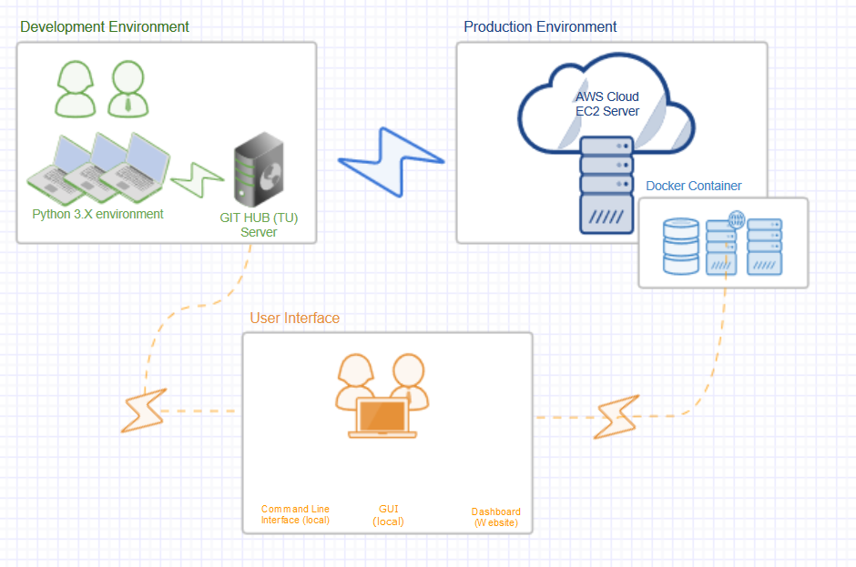
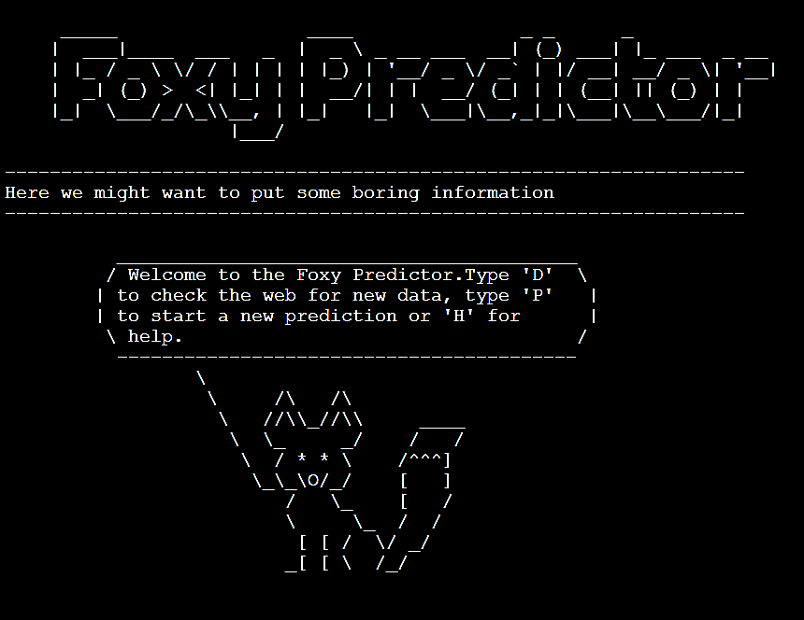

The architecture

Slide 4
The structure
Agile
MVP
Sub-teams

Slide 5
backend
Design Goals
Architecture
What was achieved
Include challenges
What could be done differently

Slide 6
cleaning
Design Goals
Architecture
What was achieved
Include challenges
What could be done differently

Slide 7
modelling
Design Goals
Architecture
What was achieved
Include challenges
What could be done differently

Slide 8
visualisation
Design Goals
Architecture
What was achieved
Include challenges
What could be done differently

Slide 9
Deployment to cloud + docker
Design Goals
Architecture
What was achieved
Include challenges
What could be done differently

Slide 10
Key learnings and discussion
Test more often!
Design early
Fail fast
Communicate often
Overall happy with our output

Slide 11
Thank you

