Slide 1

Predicting the german 2017 elections
Programming Course Project Summer SEMESTER 2017
Presenters: Baljevic, Dorotea; ymeraj, Etjen; wu, jiameng; Bohle Moritz; moore, alexander
Team: Ajaj , Tamer; Atanaszov, Olivér; Baljevic, Dorotea; Bohle, MORITZ; Hesse, Eric; Kress, Elisabeth; Moore, Alexander; Suarez, Paola; Winklmayr, Claudia ; Wu, Jiameng; Ymeraj, Etjen; Zariei, Negin
supervisors: David Higgins and Laura Neumann

Slide 2
The project
A product that would be able to predict the election results in Germany based on the secondary vote, which uses a structured back end. The results are visualised in two charts (an election seat diagram and a timeline prediction graph).

Slide 3

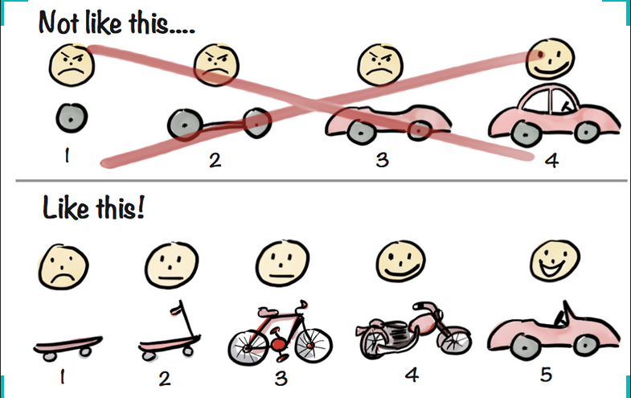

Foxy Predictor
12 Team members
TU and HU students
Four sub-teams
Modern coding practices and techniques i.e. Agile and MVP
2nd of May
21st of June
12 weeks of fun!
Over 550 coding hours
426 Commits
49 Issues

Slide 4
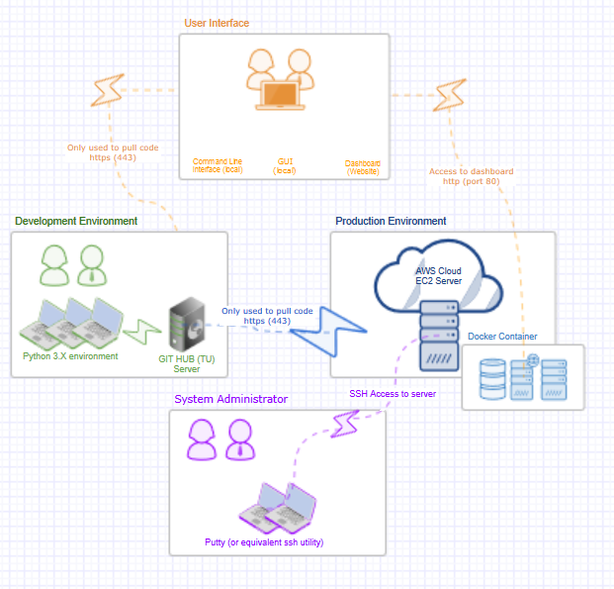
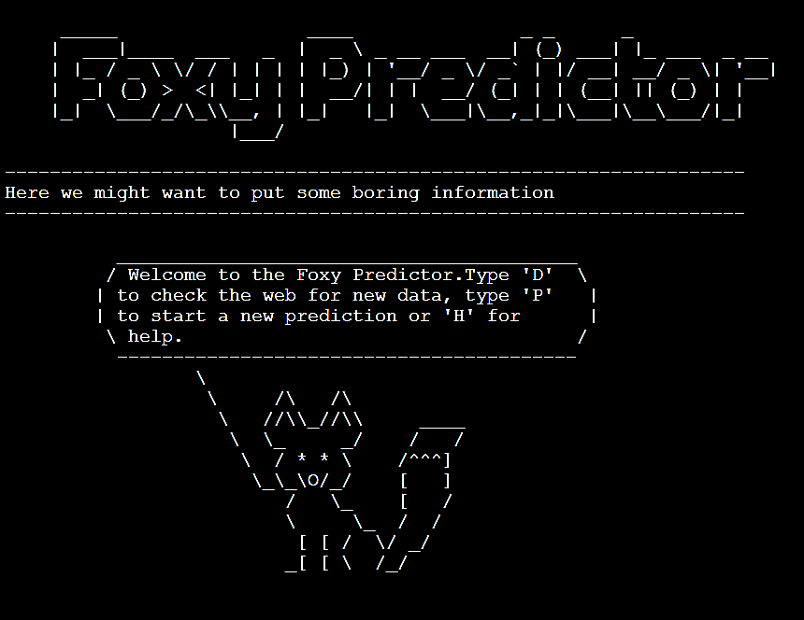

Architecture on a page

Slide 5
Deployment to cloud + docker
Design Goals
Architecture
What was achieved
Include challenges
What could be done differently

Slide 6
backend
Design Goals
Architecture
What was achieved
Include challenges
What could be done differently

Slide 7
cleaning
Design Goals
Architecture
What was achieved
Include challenges
What could be done differently

Slide 8
modelling
Design Goals
Architecture
What was achieved
Include challenges
What could be done differently

Slide 9
visualisation
Design Goals
Architecture
What was achieved
Include challenges
What could be done differently

Slide 10
Key learnings and discussion
Test more often!
Design early
Fail fast
Communicate often
Overall happy with our output

Slide 11
Thank you

