Slide 1
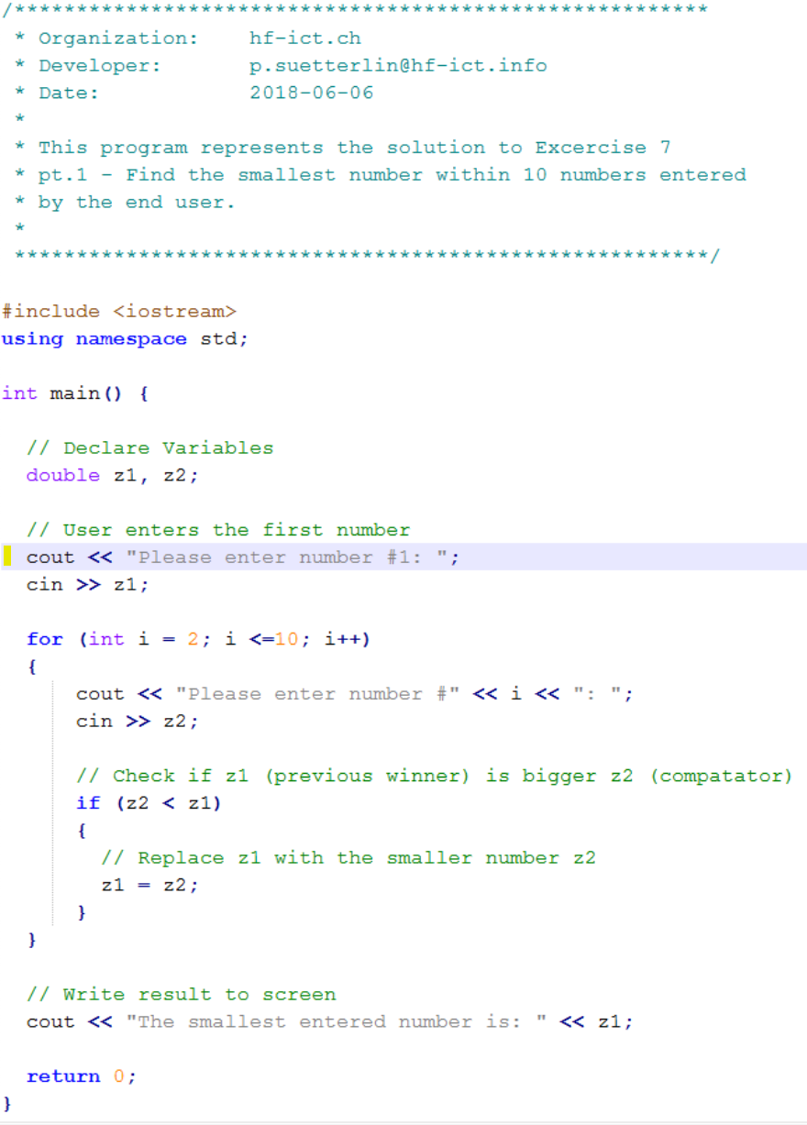
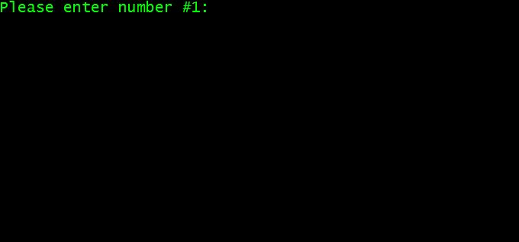
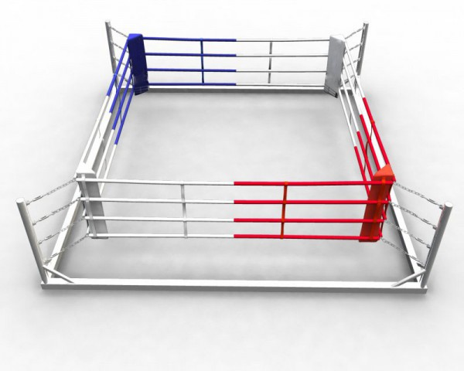
Program starts -> User Prompt appears: “Please enter number #1:”
z1 = <not initialized>
z2 = <not initialized>
Winner Corner
z1
z2
Competitor
Corner

Slide 2
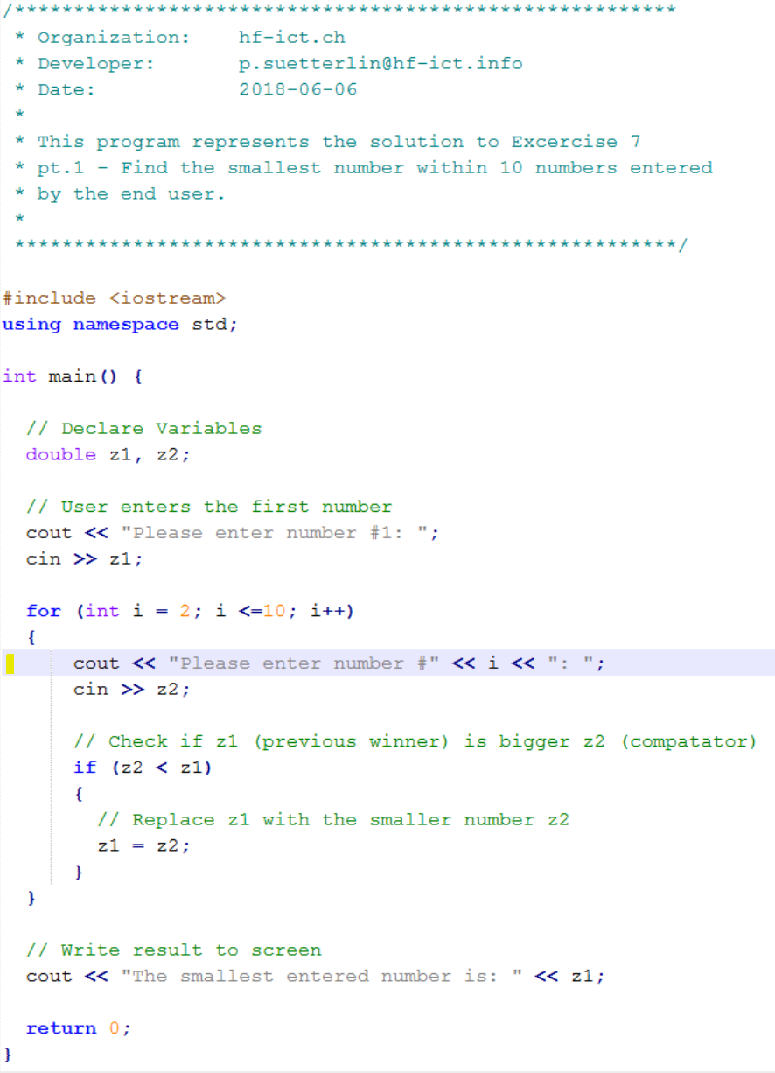
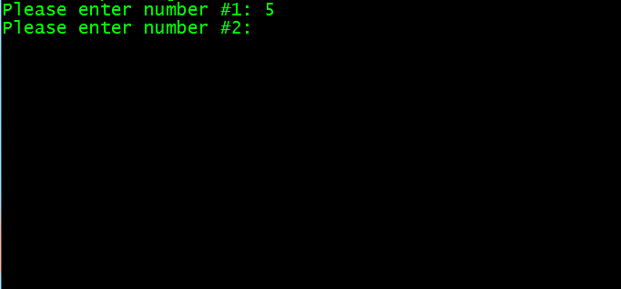
User entered first Number [5] -> User Prompt appears: “Please enter number #2:”
z1 = 5
z2 = <not initialized>
i = 2
As there is no other number yet, the first number is always considered as winner
5

Slide 3

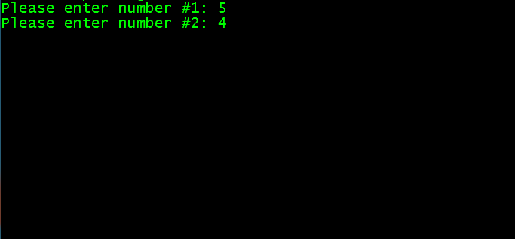
User entered second Number [4]
z1 = 5
z2 = 4
i = 2
5
4
The number that is entered next goes to the competitor corner

Slide 4
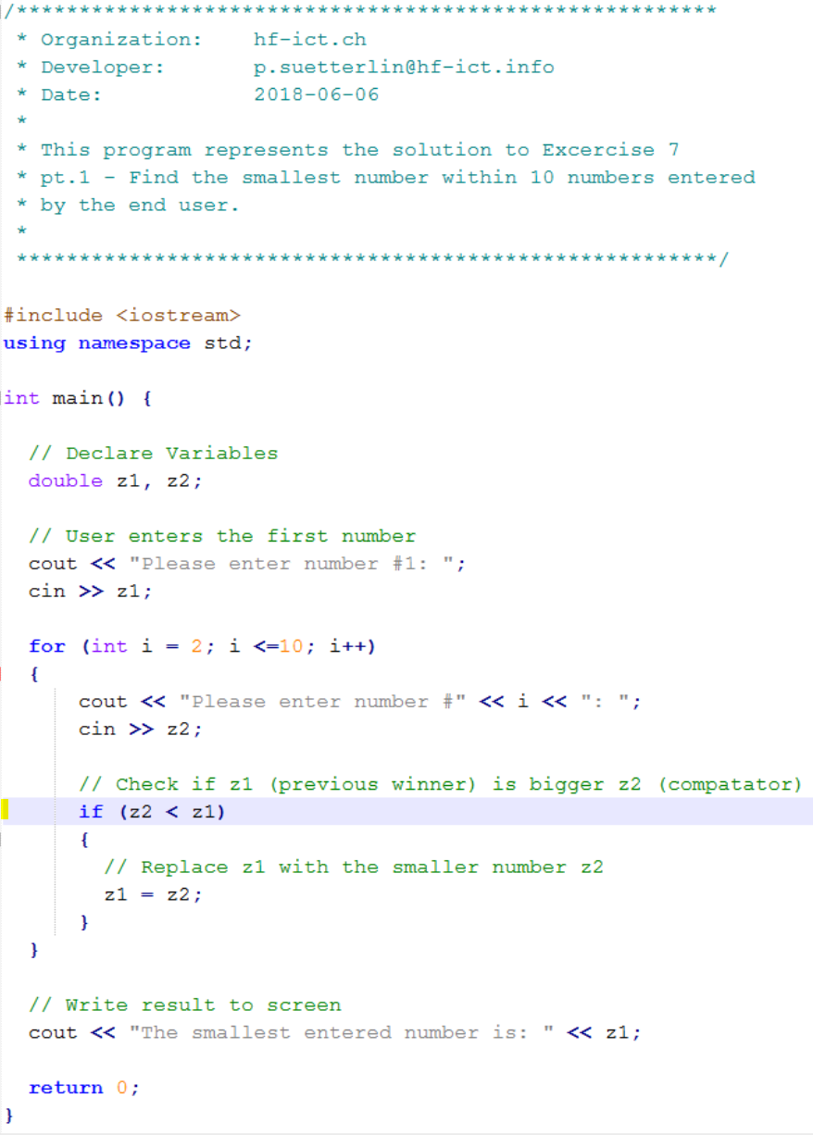

Let the fight begin - which number is smaller ?
z1 = 5
z2 = 4
i = 2
5
4

Slide 5
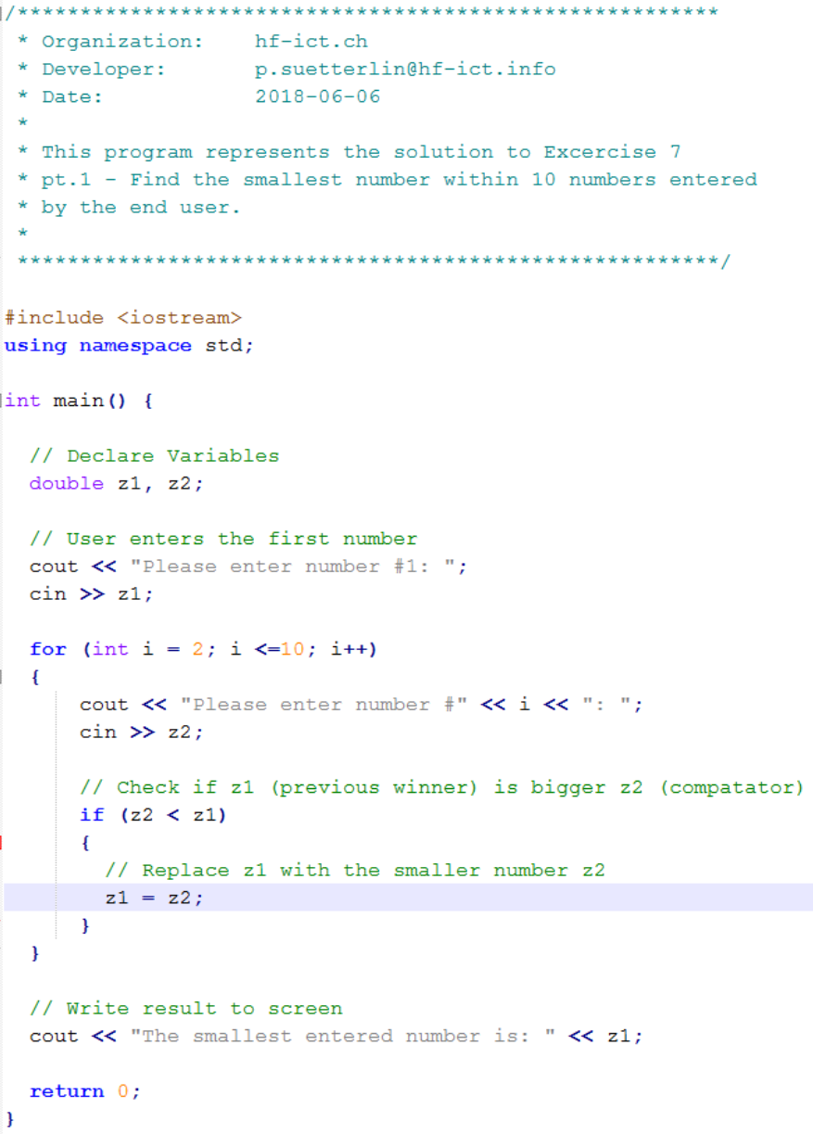

The winner moves to the winner corner - the loser leaves the ring
z1 = 4 (5)
z2 = 4
i = 2
5
4
The winner swaps the corner

Slide 6
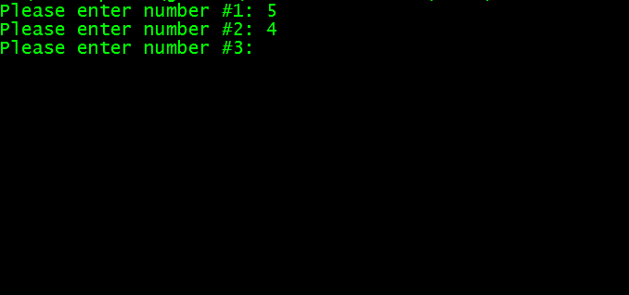
Now a new competitor is required for the next round
z1 = 4
z2 = 4
i = 3
4

Slide 7
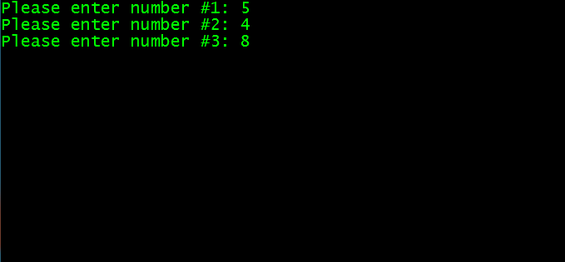
User entered second Number [8]
z1 = 4
z2 = 8 (4)
i = 3
4
8
The number that is entered next goes to the competitor corner

Slide 8
The 2nd fight takes place - which number is smaller ?
z1 = 4
z2 = 8
i = 3
4
8

Slide 9
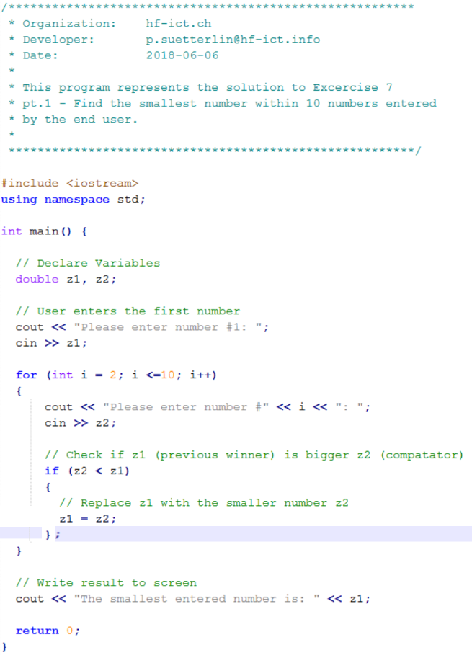
This time the winner stays in the winner corner - the loser leaves
z1 = 4
z2 = 8
i = 3
4
8

Slide 10
finally - fight #nine
takes place
…

Slide 11
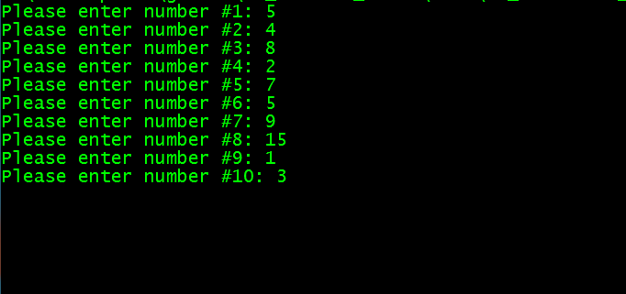
Let the fight a last time - which number is smaller ?
z1 = 1
z2 = 3
i = 10
1
3

Slide 12
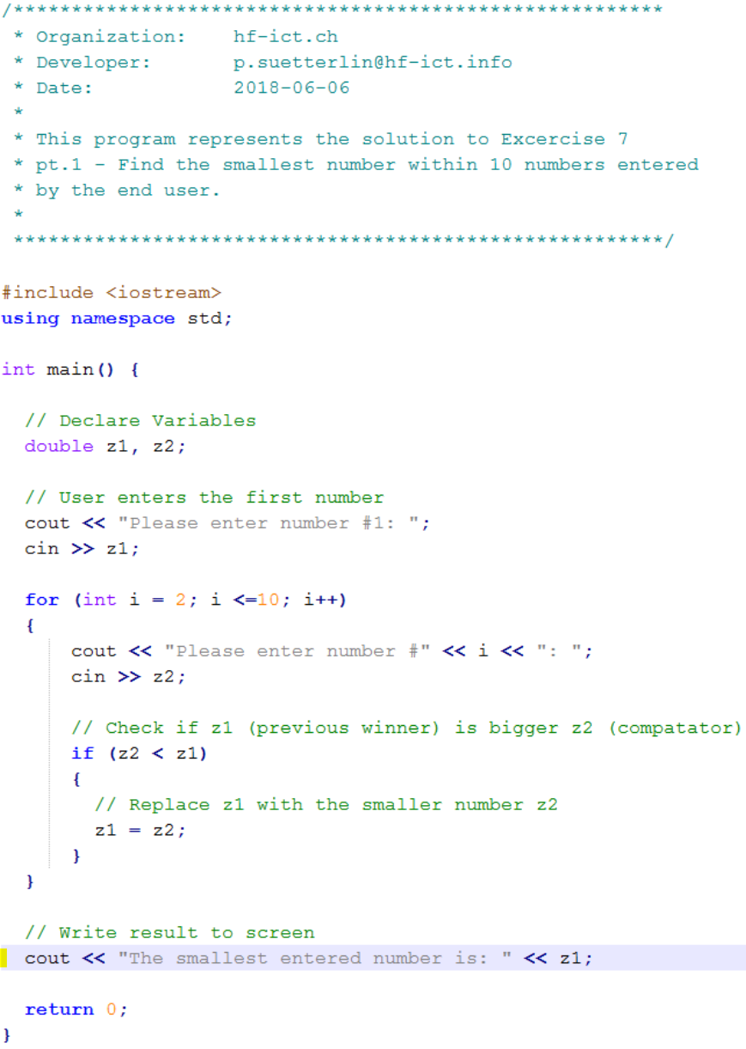


And the winner is ...
z1 = 1
z2 = 3
1

