Slide 1
Web Services Resource Development (WSRD)
Dave Hillman
August 20, 2021
v. 0.4

Slide 2
Objective
In support of the Data Science effort for IWC, establish a baseline for developing web service applications.
This documentation will:
Inform on current technologies for developing and deploying web service applications.
Educate on baseline technologies to support decision making needs.
Describe research on applicable technologies for applying web service technologies to IWC efforts.
Please note that this document is not intended to be a comprehensive educational resource, however, if there are terms, concepts, or ideas that need to be “fleshed out” or detailed, please let me know.

Slide 3
A Symbiosis for Web Services and Data Science
Data Science applications are often a research-driven process to identify features, patterns, correlations and other characteristics of data within a given problem set.
Once a solution is readied, it may be necessary to deploy this to end users who not necessarily experienced in IT or technical application details.
The deployed product, typically called an “analytic” may take on many functional roles including presenting raw data, manipulating data (summing, formatting, etc.), analyzing the data (i.e., look for patterns, correlations, etc.), and providing results to the user.
Web service applications are a well-established architecture for delivering solutions to broad ranges of users.

Slide 4

What is a Web Service Application?
Software that is designed to operate on the internet by exchanging commands and data as required (i.,e., data exchange system).
Communication is managed via standardized protocols that manage data, communications, and accessibility.
Web services typically refer to communication between applications rather than users. Users may be part of the application model.
Web services typically provide an application programming interface (API), a set of functions, that can access data.
Internet (also Cloud): devices connected via TCP/IP-based (and other standardized protocols)
Device
Device
(Computer/Server)
Device
(Client)
Exchange of Commands and Data
Data

Slide 5
A Typical Web Service Application
Twitter is a typical example of a web services application.
Exchange of commands and data to select, view, and store data are exchanged between the client and server.
Twitter Home
User Opens App to View Tweets
Server returns current data as requested
Twitter Client
(Browser, Phone App)
Exchange of Commands and Data
Tweeter Stores Tweets
User Creates/Submits Tweet
Stored “Tweets”

Slide 6
Web Services Data Science Applications
Regardless of domain (e.g., finance, cyber, intel, etc.), data science applications typically ingest and manipulate data (select, sort, sum, mathematically, statistically, algorithmically, etc.) and present results (tables, charts/graphs).
Data science applications, in terms of how applications are constructed, fall into a various approaches:
Tool-based applications, e.g. Excel, Splunk, ElasticSearch, etc. that can often incorporate a range of application types from investigatory to finished.
Investigatory code in Python, R, etc. focusing on pre-processing, exploring, and examining data.
Prototype code focusing on a solution model that can be deployed.
Finished code providing a tool for end users.
For the purposes of this discussion, we will be focusing on Prototype and Finished code applications.

Slide 7
A Generalized Prototype/Finished Application Model
Local Data
User
User I/F Management
Interfaces
Data
Ingestion
Analytic Initialization
Data
Data
Preparation
Algorithmic Processing
Data
CRUD
Post-Processing
External App I/F Mgmt
External
Data
External
Applications

Slide 8
A Generalized Prototype/Finished Web Service Model
Local Data
Analytic Initialization
User
HTTP/S
Protocol
Data
Ingestion
Interfaces
User I/F Management
Algorithmic Processing
Data
Data
Preparation
Post-Processing
Data
CRUD
External App I/F Mgmt
External
Data
External
Apps

Slide 9
Application/Web Service Components (Generalized)
Server
Client
Server Programming Environment
HTTP Request & Response
User
CGI
Web Server
Client Web Browser
Data transport via JSON
Data and algorithmic processing is on server.
User interaction, data presentation, etc. is on the client.
Local File Environment
HTML/CSS
Client Scripting Env.
Data API
Ext App API
External
Apps
3rd Party JS Apps
Data

Slide 10
Python, Flask via Apache2
Uses standard Apache2 configuration.
Virtualenv enables localized execution of Python code by including all Python related files.
Python WSGI (Web Server Gateway Interface, defined by PEP 3333) is an interface between web servers and web apps for python.
mod_wsgi is an Apache HTTP server module that enables Apache to serve Flask applications.
There are a number of alternative implementations (e.g., based on FastAPI, Django, etc.) that can implement a similar capability.
Flask depends on two components: Jinja templating environment and the Werkzeug WSGI environment.
Prog: Python 3.7+
Via VirtualEnv
User
CGI: Flask, WSGI
Web Server
Apache2
Client Web Browser
HTML/CSS
File: Win/Linux
JavaScript
Data: SQLite, MySQL
Ext App API: vai REST
3rd Party:
Bootstrap,
Tabulator, ChartJS
External
Apps
Data

Slide 11
Multiple Virtual Hosts (side topic)
Multiple virtual hosts enables deployment of multiple domain names on a single server (or pool of servers).
Each host runs in its own space protecting use of resources and isolating processes from individual failures.
Server
Web Server
Virtual Host Management
Virtual Host including…
CGI
Server Programming Environment
Database Access (typically to a shared DB)
File Access (may be shared)
Client(s) as X domain
Virtual Host including…
CGI
Server Programming Environment
Database Access (typically to a shared DB)
File Access (may be shared)
Client(s) as Y domain
…

Slide 12
Python, Flask via Nginx
Uses a standard Nginx configuration.
Set up a virtualized Python development environment.
Install Flask (uwsgi flask).
Build Python application; run via Flask (development mode).
Set up uWSGI file (uses a separate socket to run); used to execute Python application
Create systemd Unit File – used to run uWSGI file; enables running the Python app as a system level service.
Configure Nginx to proxy requests (Nginx is able to send requests to the uWSGI application).
Prog: Python 3
Via VirtualEnv
User
Web Server:
Nginx
Client Web Browser
CGI: uWSGI
Run Application as a service
Nginx Proxy Server
HTML/CSS
JavaScript
File: Win/Linux
3rd Party: Tabulator, ChartJS
Data: SQLite, MySQL
Ext App API: vai REST
External
Apps
Data

Slide 13
Python, Flask via Node.js
Uses a standard Node.js configuration with Express.js.
Set up a Python development environment.
Install Flask.
Build Python application; run via Flask (development mode).
Use Postman to test API connection. Postman is a runtime via Node.js to manage requests and collections.
Prog: Python 3
Via VirtualEnv
User
Web Server:
Node.js
Client Web Browser
CGI: Flask Server
Express.js
For Web API calls
HTML/CSS
JavaScript
File: Win/Linux
3rd Party: Tabulator, ChartJS
Data: SQLite, MySQL
Ext App API: vai REST
External
Apps
Data

Slide 14
Assessment Observations
Web Server:
Configuration can be tricky because of WSGI interfaces; same for virtual hosting configurations; use of error logs seems to simplify things by showing file, access error details.
Flask:
Apache/Flask performance appears less than that for Nginx and Node.js; key reason may be that Apache “restarts” WSGI for every interaction; Nginx and Node.js maintain open connections (need to verify this).

Slide 15
References, Resources, Other

Slide 16
Generic Data Model
Basic Idea: use a relational model to capture data structure, format, and organization.
Use as a “smart” transport structure to move data between data systems.
Stores both data and “data about data” to transport and reconstruct data set.
Based on improved data performance in tools such as SQL Server, Oracle and experience with Big Data models (e.g., NoSQL: HBase, Accumulo, Cassandra, based on HDFS).
Enables documentation of data and structure.
Good for small (10K-1M count) data sets; not viable as replacement for operational data models (stick to optimized relational structure or NoSQL Solution).
TABLE n
Field_1 F_2 F_n
Row 1 value value
Row 2 value value
Row 3 value value Row n value value
TABLE 2
Field_1 F_2 F_n
Row 1 value value
Row 2 value value
Row 3 value value Row n value value
TABLE 1
Field_1 F_2 F_n
Row 1 value value
Row 2 value value
Row 3 value value Row n value value
Capture fields: identity, format, sequencing
Attributes
Four table core structure.
DataValues
DataSet
Capture table structure
Capture data, date/time, currency, features
Records
Capture record

Slide 17
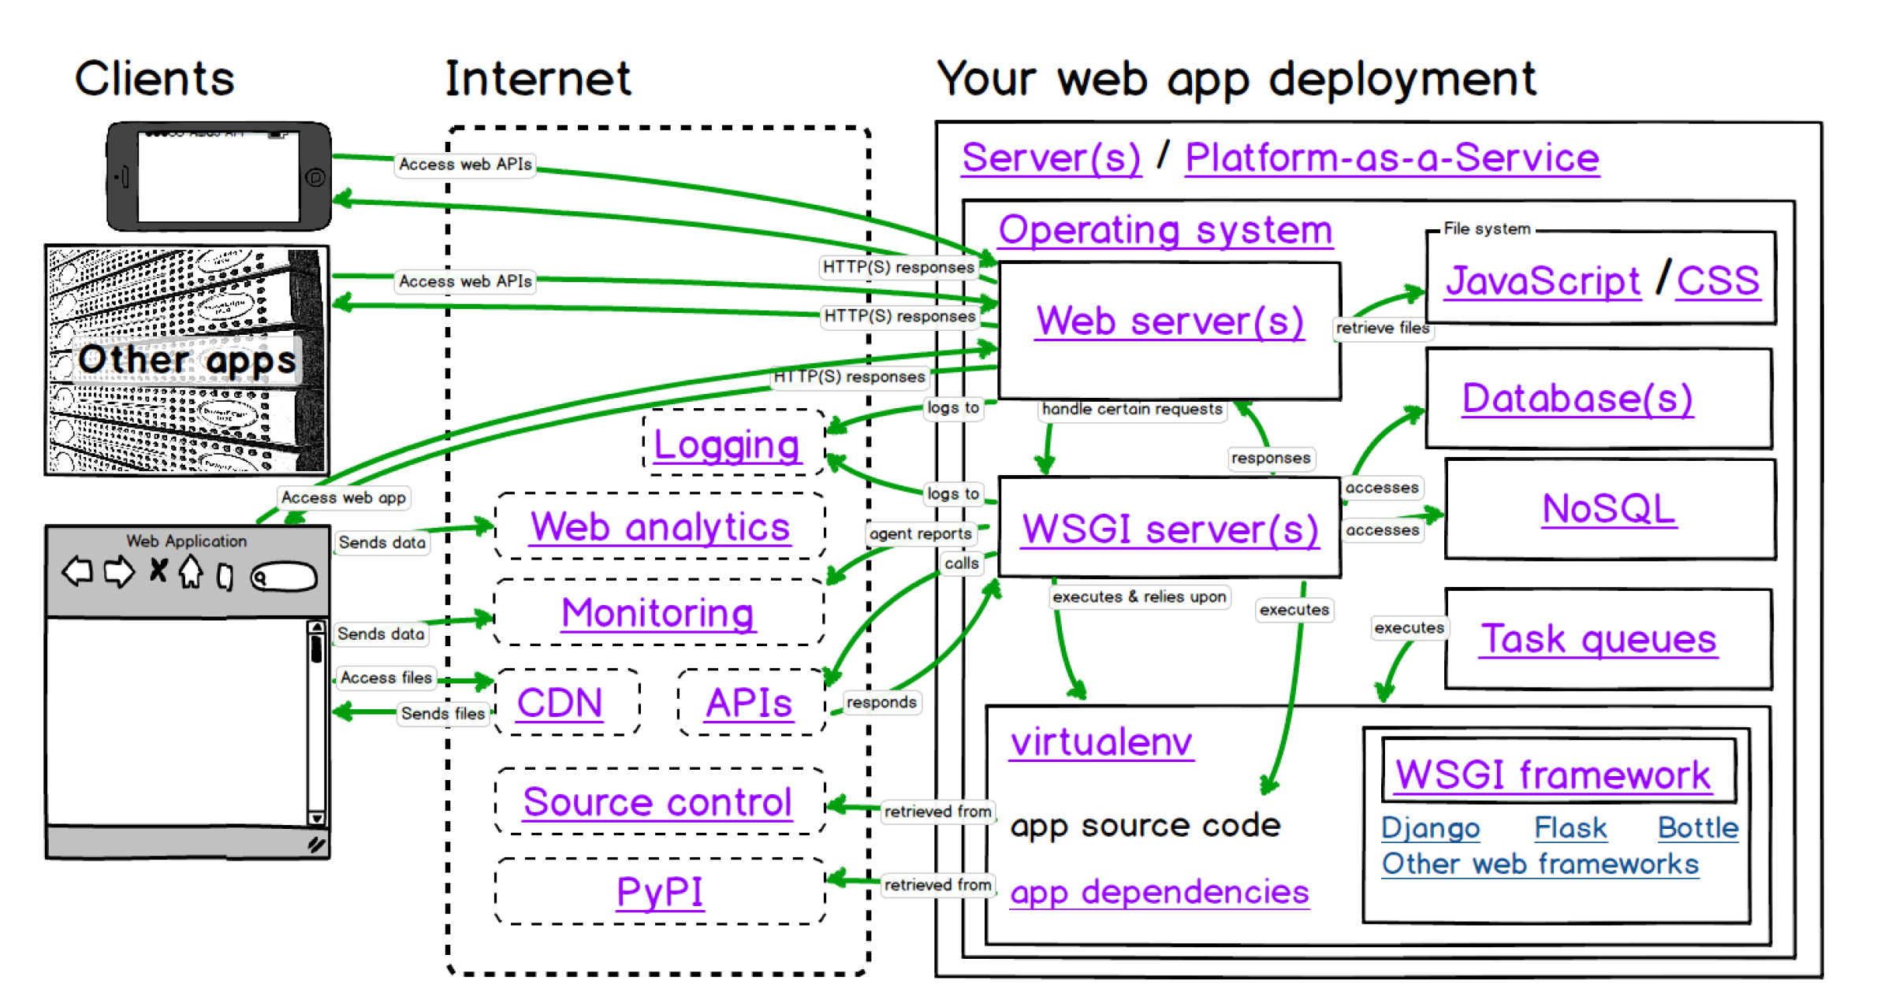
Detailed Diagram of Flask, Web Python
From: https://www.fullstackpython.com/deployment.html

Slide 18
Resources
https://www.fullstackpython.com/table-of-contents.html - Full Stack Python
https://www.python.org/dev/peps/pep-3333/ PEP 3333 Reference
https://flask.palletsprojects.com/en/2.0.x/ Flask Reference
https://realpython.com/api-integration-in-python/ - REST and Web Service basics
https://wiki.python.org/moin/WebFrameworks - listing of web frameworks for python environments
https://www.digitalocean.com/community/tutorials/how-to-serve-flask-applications-with-uswgi-and-nginx-on-ubuntu-18-04 -- set up and run Nginx and Flask
https://medium.com/javarevisited/connecting-flask-with-node-js-7b9d823ca923 - set up and run Node.js and Flask

