Slide 1


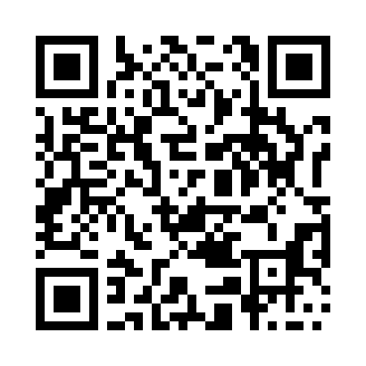

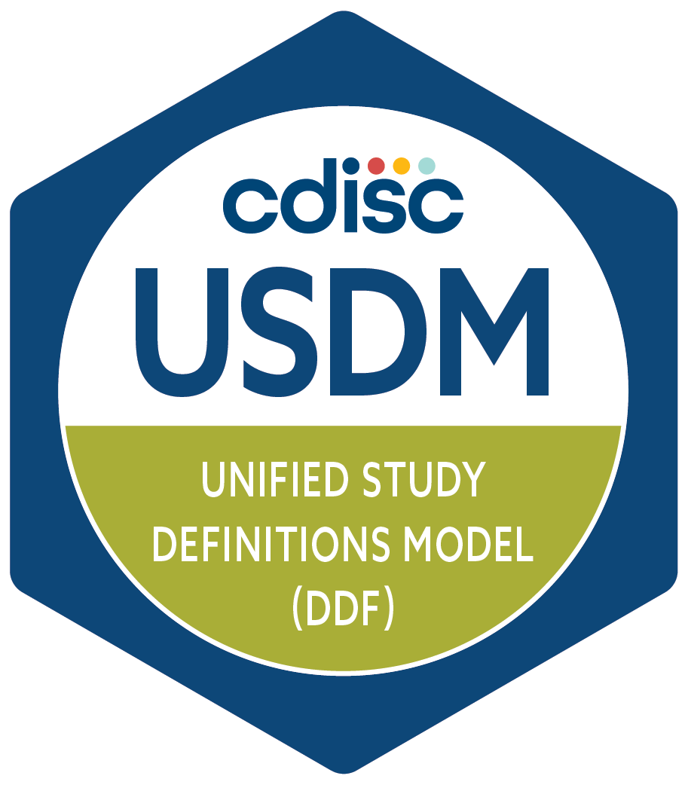


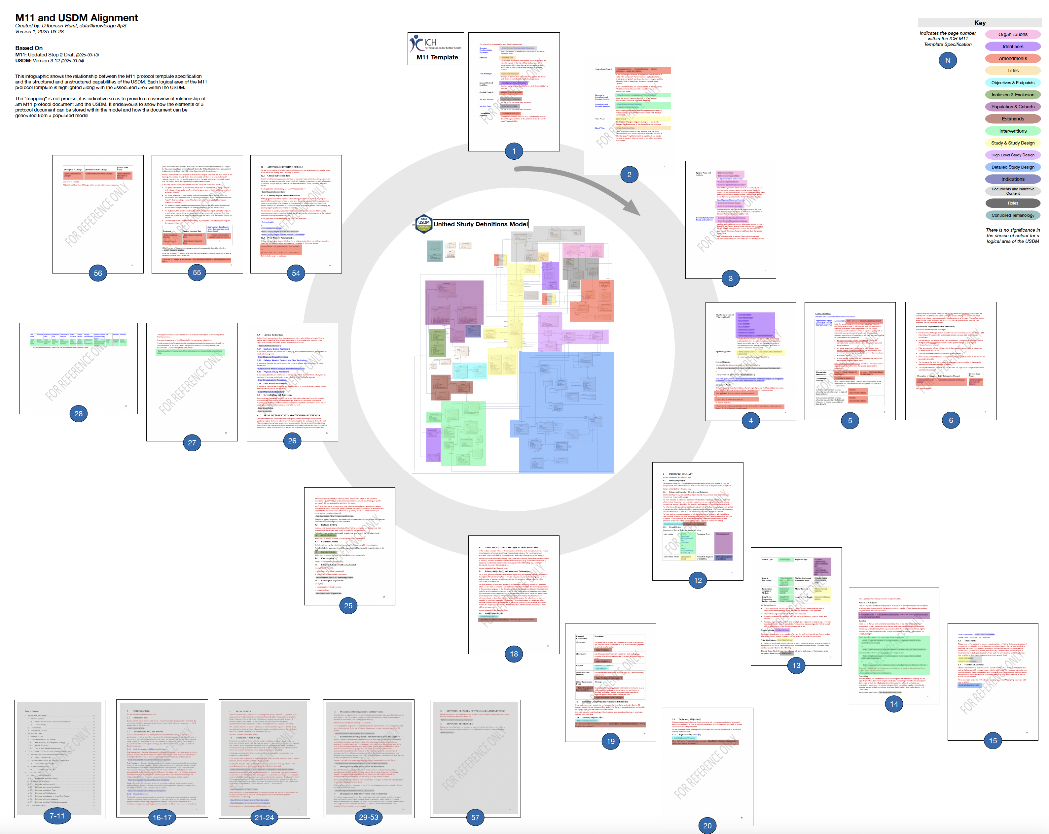
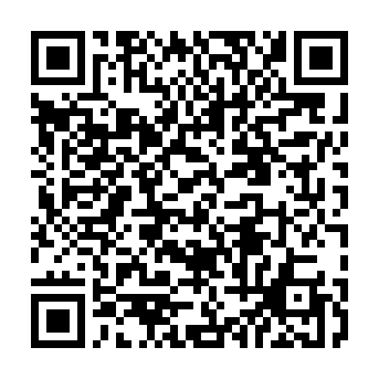
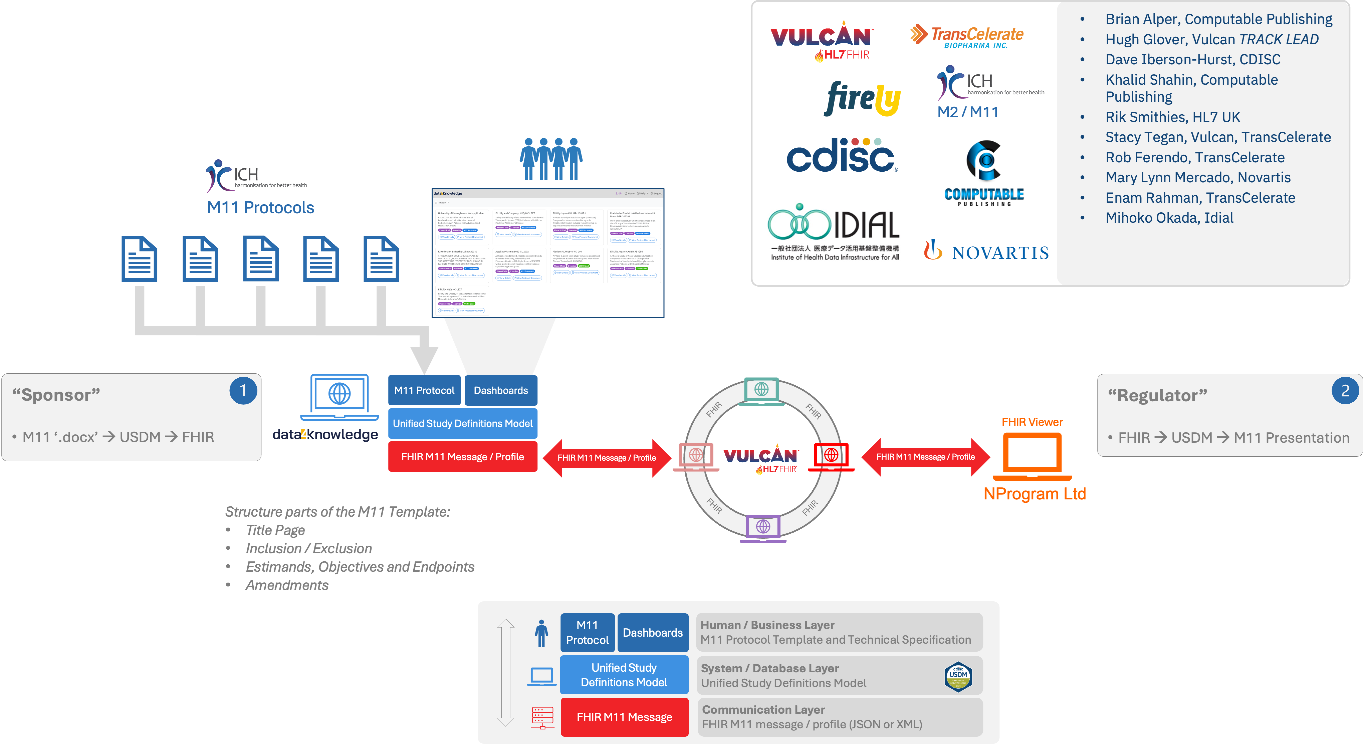
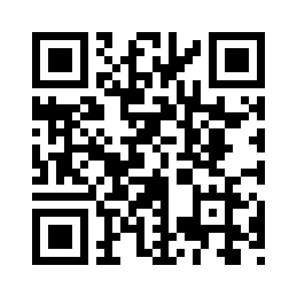
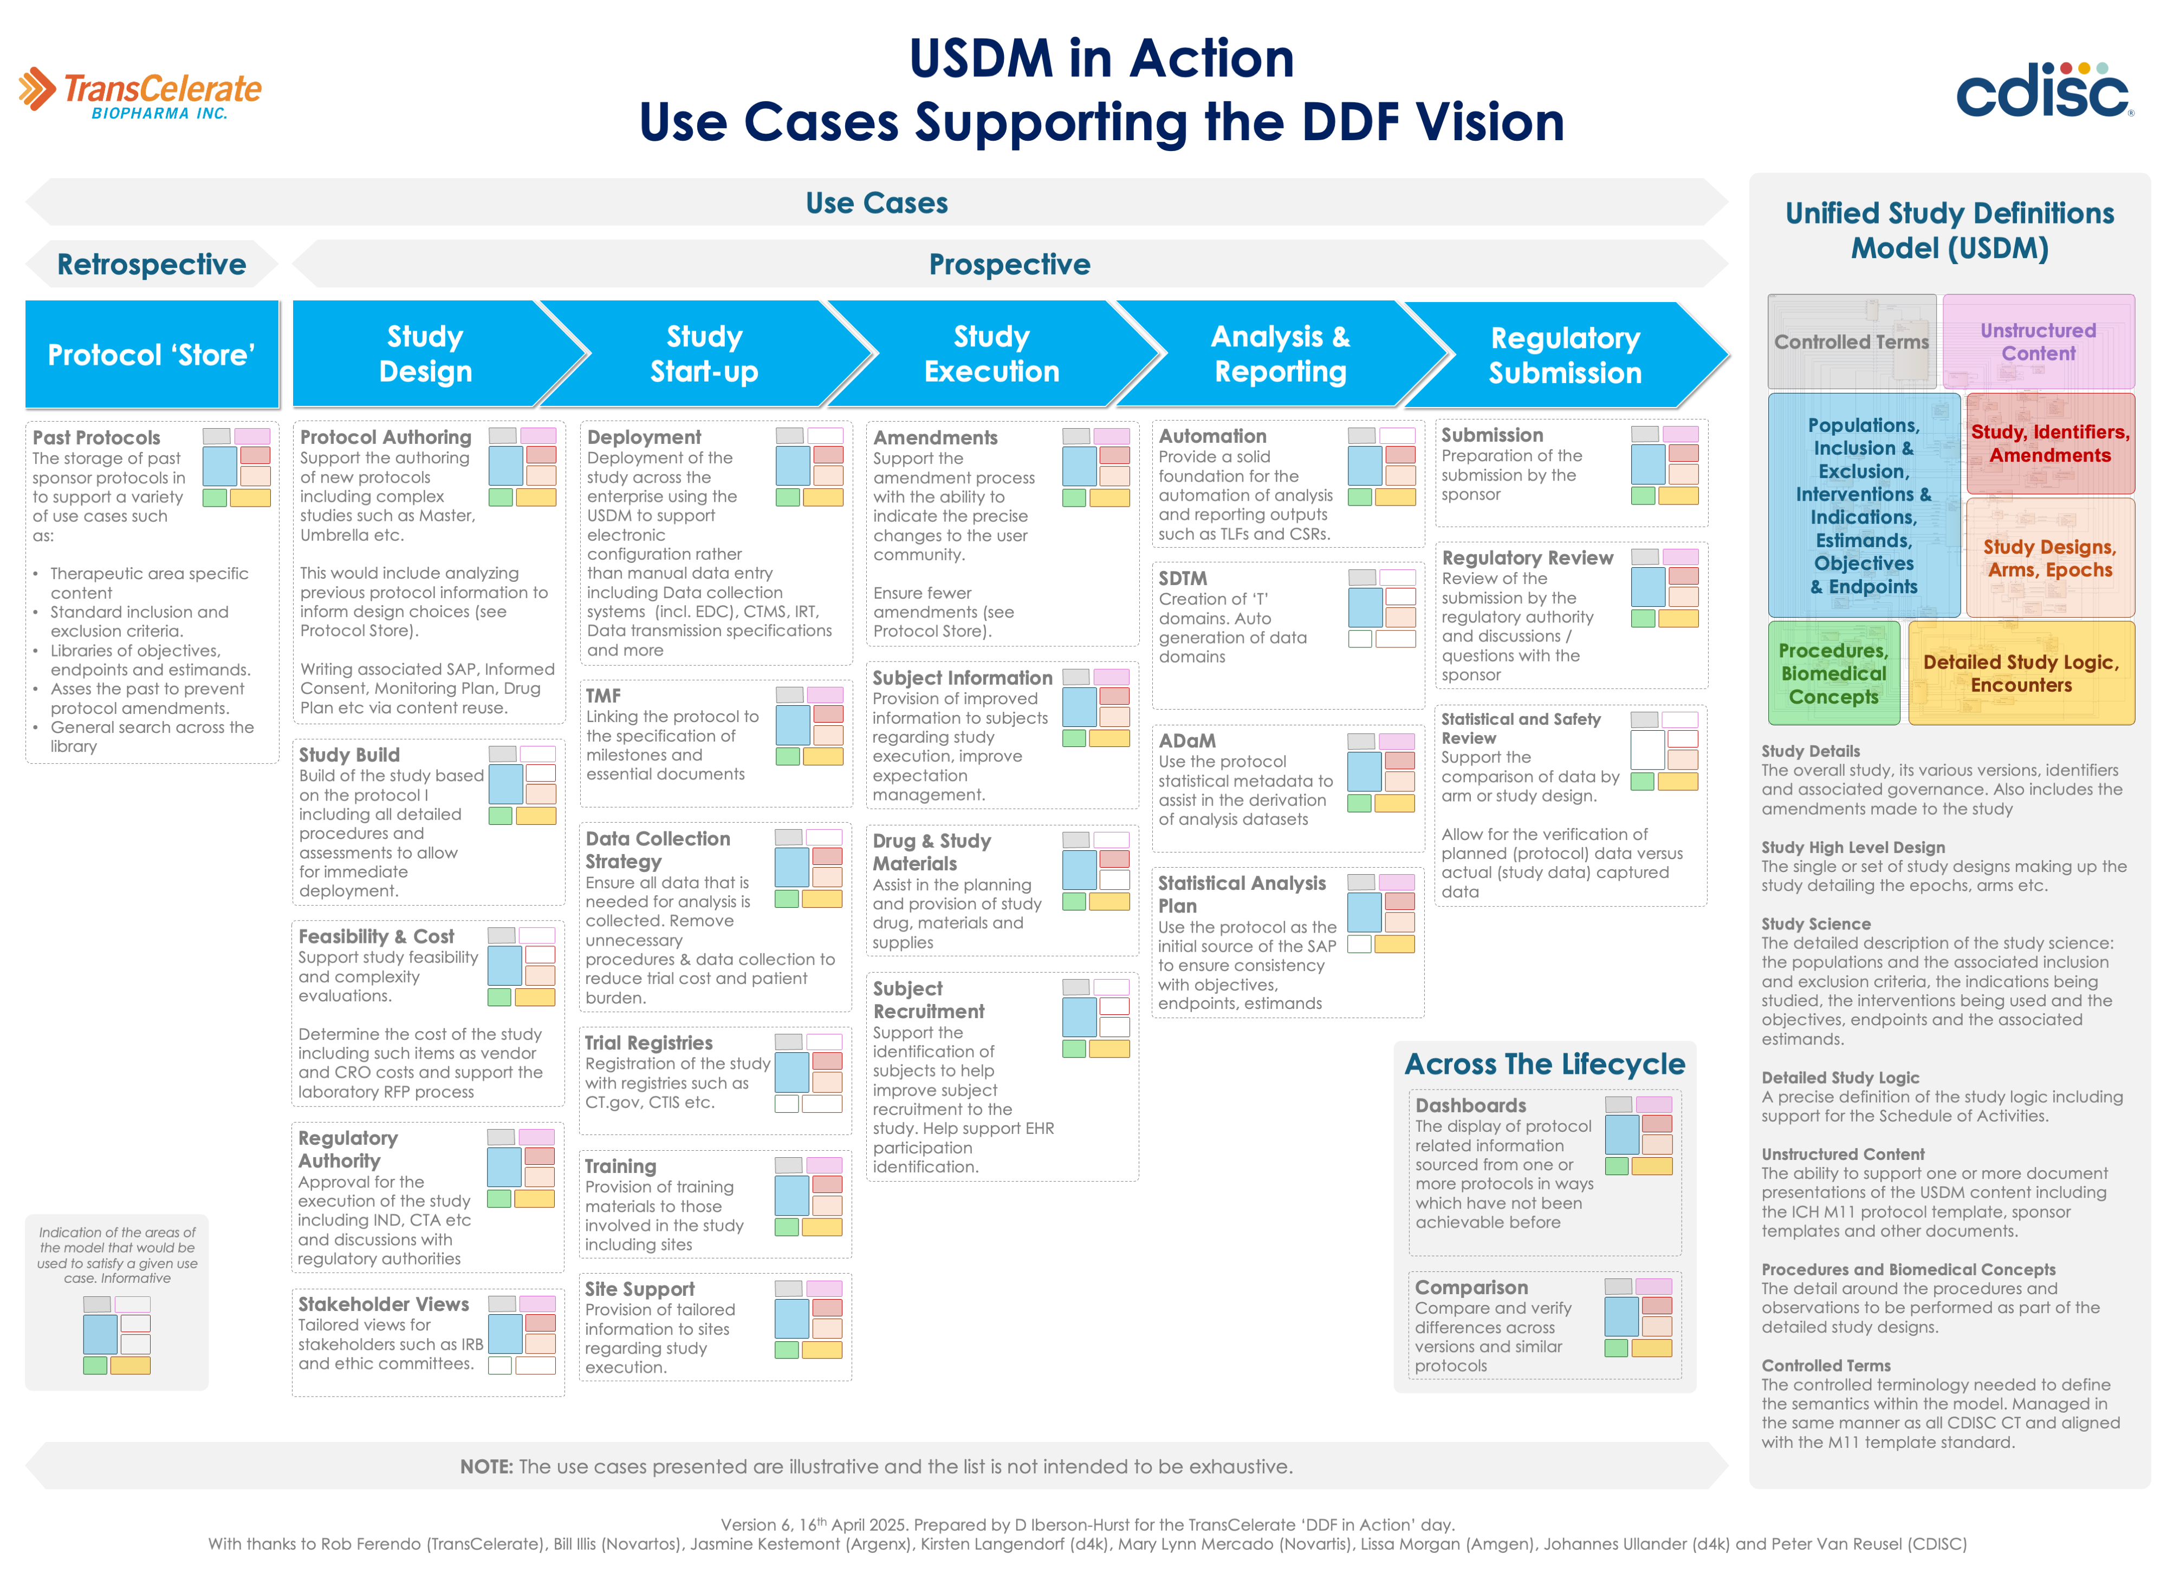
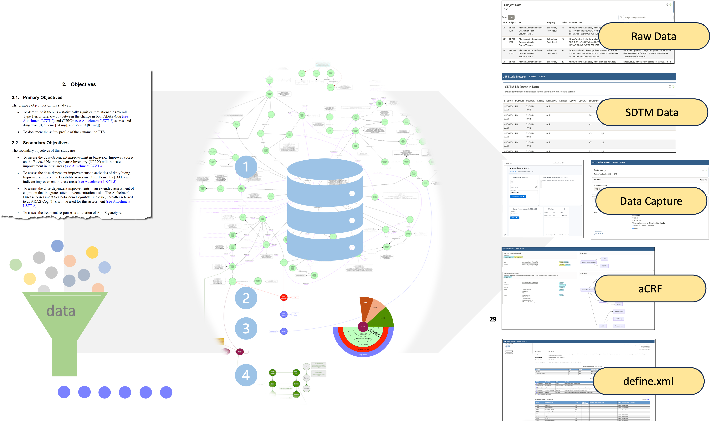
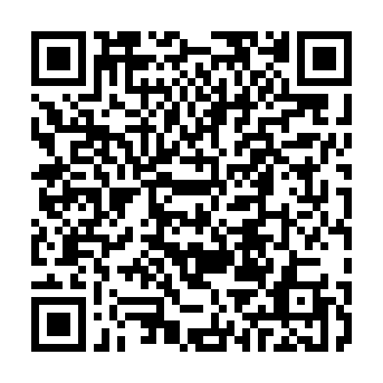

PP14: CDISC USDM & ICH M11: Practical electronic Protocols
With CDISC's Unified Study Definition Model (USDM) and ICH's M11 Clinical Electronic Structured Harmonized Protocol (CeSHArP) both being released this month we are witnessing a revolution in how sponsor companies operate. Say goodbye to outdated silos and hello to dynamic, data-centric workflows! These powerful standards, working in tandem, promise to transform industry operations. This poster details the connection between USDM and the M11 template and discusses the implementation efforts already underway.
ICH M11 Protocol Template
USDM & M11
USDM Data Exchange
The ICH M11 Working Group has developed a specification that specifies a comprehensive clinical protocol organization with standardized content with both required and optional components.
ICH M11 WG
USDM Offers Full Support For M11
The infographic below shows the crucial relationship between the M11 Template Specification and the USDM, clearly demonstrating how USDM provides comprehensive support for ICH's innovative M11 standard. It breaks down each M11 element, precisely identifying where and how it's supported within the USDM framework, creating a visual roadmap for seamless integration between the standards.
The USDM seamlessly integrates with the ICH M11 standard and allows for data exchange in a variety of formats:
M11 Protocol
Human / Business Layer
M11 Protocol Template and Technical Specification
Unified Study
Definitions Model
Persistance Layer
Unified Study Definitions Model
Data Exchange (USDM, FHIR, Others)
Data Exchange Layer
USDM JSON, FHIR M11 or SOA message, Other formats
The two main components of the specification are:
A template that includes the identification of document headers, common text and a set of data fields and terminologies for creating protocol documents
CDISC USDM: Native JSON serialization.
HL7 FHIR Messages: Import/export to HL7 Vulcan M11 FHIR message; export to HL7 FHIR SoA message .
Other Formats: Support for the TransCelerate CPT protocol template, ClinicalTrials.gov registry, EMA CTIS structures, and CDISC SDTM Trial Design Domains.
Scan Me
Scan the QR code to visit the ICH M11 WG webpage
USDM <-> M11
A technical specification that uses an open, non-proprietary standard to enable electronic exchange of clinical protocols
From Theory to Reality
Unified Study Definitions Model
ICH M11, USDM, and FHIR integration has moved beyond concept to practical implementation at HL7 connectathons
Scan Me
CDISC's USDM is a logical model for clinical trial protocols and study definitions. It captures standard protocol information plus enhanced Schedule of Activities details, creating a comprehensive study design representation.
The USDM enables automated downstream applications supporting multiple use cases, embodying the "write-once, use many" principle that increases clinical trial efficiency.
USDM GitHub
Scan the QR code to download a large version of the USDM M11 Infographic
2024 Dallas and Atlanta: showcased transmission of M11 protocols between systems. This was used in the FDA PRISM pilot.
2025 Virtual: showcased the seamless integration of USDM with the Schedule of Activities (SoA) FHIR message proving that critical SoA data in USDM can be transmitted through the HL7 FHIR
Scan Me
Scan the QR code to access the USDM GitHub
Business Drivers
The combination of USDM and M11 provides the electronic, foundation for clinical trial execution despite implementation challenges. Digital study definitions offer:
Costs: Significant reduction of effort from days to potentially hours while reducing the number of study amendments.
Quality and Clarity: Eliminating ambiguity and transcription errors through precision while providing traceability.
Capacity: Running more trials with existing resources
Automation: Many opportunities including generating SDTM and submission artifacts automatically
Enable: Creating a single source of truth powering cross-study AI analytics for breakthrough insights
Unleashing USDM
Use Cases
USDM isn't just another standard, it's a versatile powerhouse with countless applications! The d4k technology demonstrator takes USDM to the next level by extending the model into operational territories never before explored.
Scan Me
Scan the QR code to download a large version of the Use Case infographic
This groundbreaking demonstrator reveals how USDM creates the solid foundation needed to revolutionize downstream processes including the auto generation of SDTM datasets
Poster (v7) developed by D Iberson-Hurst, data4knowledge ApS, for the PHUSE EU CSS Meeting 2025. Contact: dih@data4knowledge.dk

