Slide 1


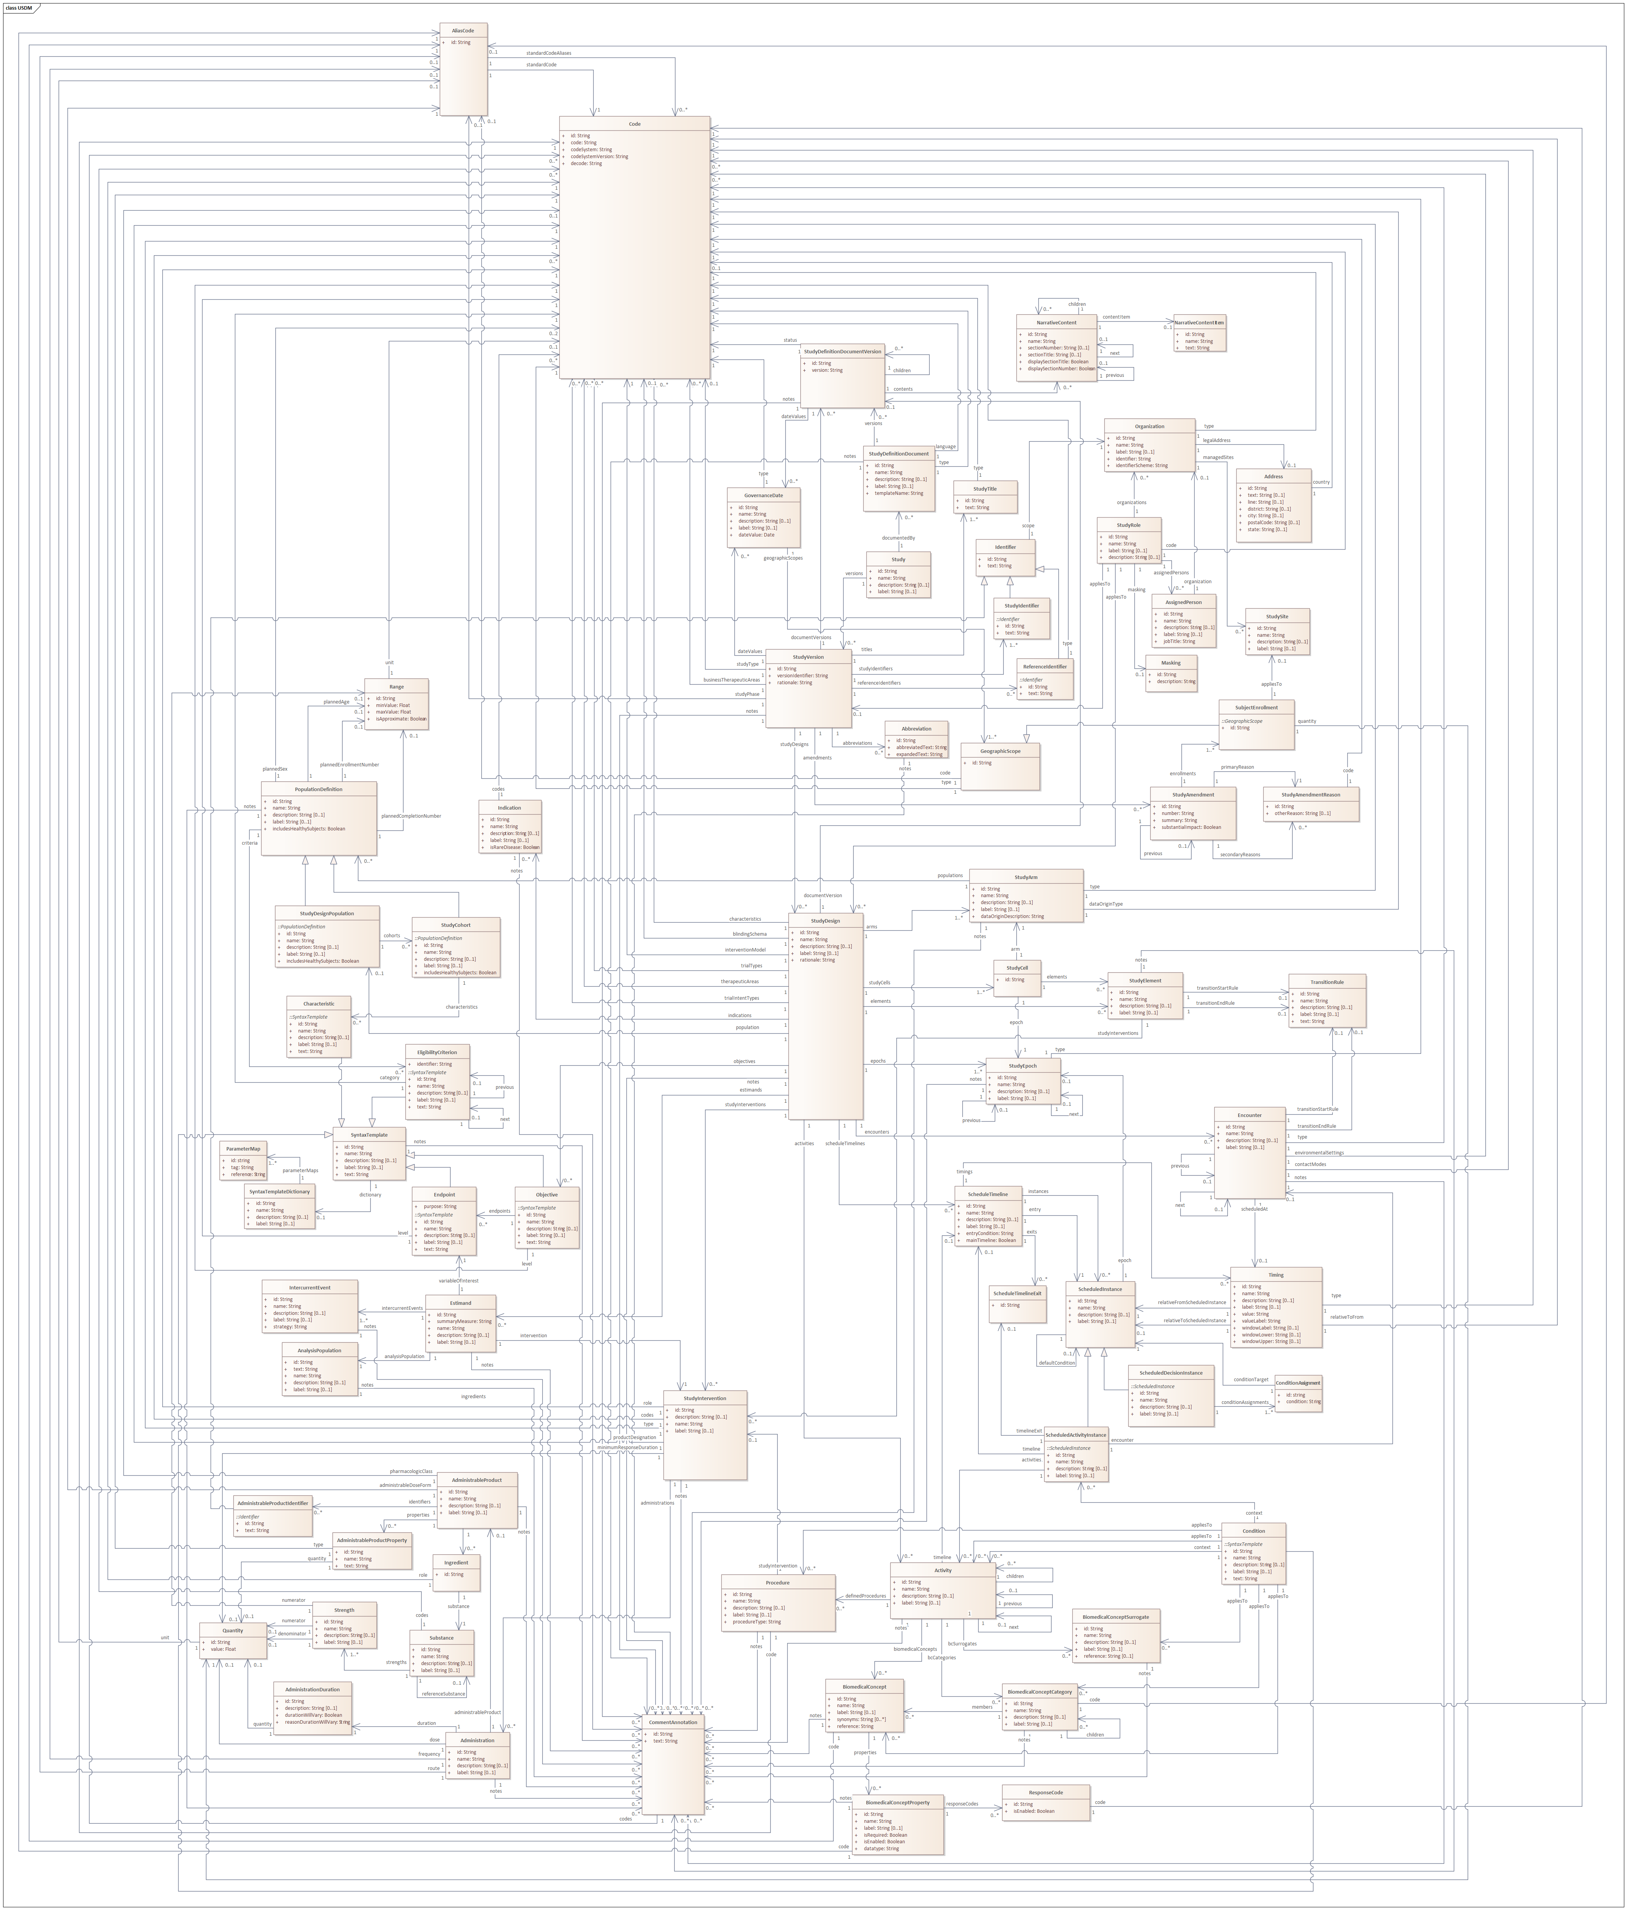


USDM in Action Use Cases Supporting the DDF Vision
Use Cases
Unified Study Definitions Model (USDM)
Retrospective
Prospective
Protocol ‘Store’
Study
Design
Study
Start-up
Study
Execution
Analysis & Reporting
Regulatory Submission
Controlled Terms
Unstructured Content
Past Protocols
The storage of past
sponsor protocols in
to support a variety
of use cases such
as:
Therapeutic area specific content
Standard inclusion and exclusion criteria.
Libraries of objectives, endpoints and estimands.
Asses the past to prevent protocol amendments.
General search across the library
Protocol Authoring
Support the authoring
of new protocols
including complex
studies such as Master,
Umbrella etc.
This would include analyzing previous protocol information to inform design choices (see Protocol Store).
Writing associated SAP, Informed Consent, Monitoring Plan, Drug Plan etc via content reuse.
Deployment
Deployment of the
study across the
enterprise using the
USDM to support
electronic
configuration rather
than manual data entry including Data collection systems (incl. EDC), CTMS, IRT, Data transmission specifications and more
Amendments
Support the amendment process with the ability to indicate the precise changes to the user community.
Ensure fewer amendments (see Protocol Store).
Automation
Provide a solid foundation for the automation of analysis and reporting outputs such as TLFs and CSRs.
Submission
Preparation of the submission by the sponsor
Populations,
Inclusion & Exclusion,
Interventions & Indications,
Estimands,
Objectives
& Endpoints
Study, Identifiers, Amendments
Study Designs, Arms, Epochs
SDTM
Creation of ‘T’ domains. Auto generation of data domains
Regulatory Review
Review of the submission by the regulatory authority and discussions / questions with the sponsor
Procedures, Biomedical Concepts
Detailed Study Logic, Encounters
TMF
Linking the protocol to the specification of milestones and essential documents
Subject Information
Provision of improved information to subjects regarding study execution, improve expectation management.
ADaM
Use the protocol statistical metadata to assist in the derivation of analysis datasets
Statistical and Safety
Review
Support the
comparison of data by
arm or study design.
Allow for the verification of planned (protocol) data versus actual (study data) captured data
Study Build
Build of the study based
on the protocol I
including all detailed
procedures and
assessments to allow
for immediate
deployment.
Study Details
The overall study, its various versions, identifiers and associated governance. Also includes the amendments made to the study
Study High Level Design
The single or set of study designs making up the study detailing the epochs, arms etc.
Study Science
The detailed description of the study science: the populations and the associated inclusion and exclusion criteria, the indications being studied, the interventions being used and the objectives, endpoints and the associated estimands.
Detailed Study Logic
A precise definition of the study logic including support for the Schedule of Activities.
Unstructured Content
The ability to support one or more document presentations of the USDM content including the ICH M11 protocol template, sponsor templates and other documents.
Procedures and Biomedical Concepts
The detail around the procedures and observations to be performed as part of the detailed study designs.
Controlled Terms
The controlled terminology needed to define the semantics within the model. Managed in the same manner as all CDISC CT and aligned with the M11 template standard.
Data Collection
Strategy
Ensure all data that is
needed for analysis is collected. Remove
unnecessary
procedures & data collection to reduce trial cost and patient burden.
Drug & Study Materials
Assist in the planning and provision of study drug, materials and supplies
Statistical Analysis Plan
Use the protocol as the initial source of the SAP to ensure consistency with objectives, endpoints, estimands
Feasibility & Cost
Support study feasibility
and complexity
evaluations.
Determine the cost of the study including such items as vendor and CRO costs and support the laboratory RFP process
Subject Recruitment
Support the identification of subjects to help improve subject recruitment to the study. Help support EHR participation identification.
Trial Registries
Registration of the study with registries such as CT.gov, CTIS etc.
Across The Lifecycle
Regulatory Authority
Approval for the execution of the study including IND, CTA etc and discussions with regulatory authorities
Dashboards
The display of protocol related information sourced from one or more protocols in ways which have not been achievable before
Training
Provision of training materials to those involved in the study including sites
‘DDF In Action’
Indicates that a poster touching on the use case described will be presented at the respective event.
Stakeholder Views
Tailored views for stakeholders such as IRB and ethic committees.
Site Support
Provision of tailored information to sites regarding study execution.
Comparison
Compare and verify differences across versions and similar protocols
Europe, Copenhagen
US, New jersey
NOTE: The use cases presented are illustrative and the list is not intended to be exhaustive.
Version 3, 10th October 2024. Prepared by D Iberson-Hurst for the TransCelerate ‘DDF in Action’ day. With thanks to Rob Ferendo (TransCelerate), Bill Illis (Novartos), Jasmine Kestemont (Argenx), Kirsten Langendorf (d4k), Mary Lynn Mercado (Novartis), Lissa Morgan (Amgen), Johannes Ullander (d4k) and Peter Van Reusel (CDISC)

