Slide 1
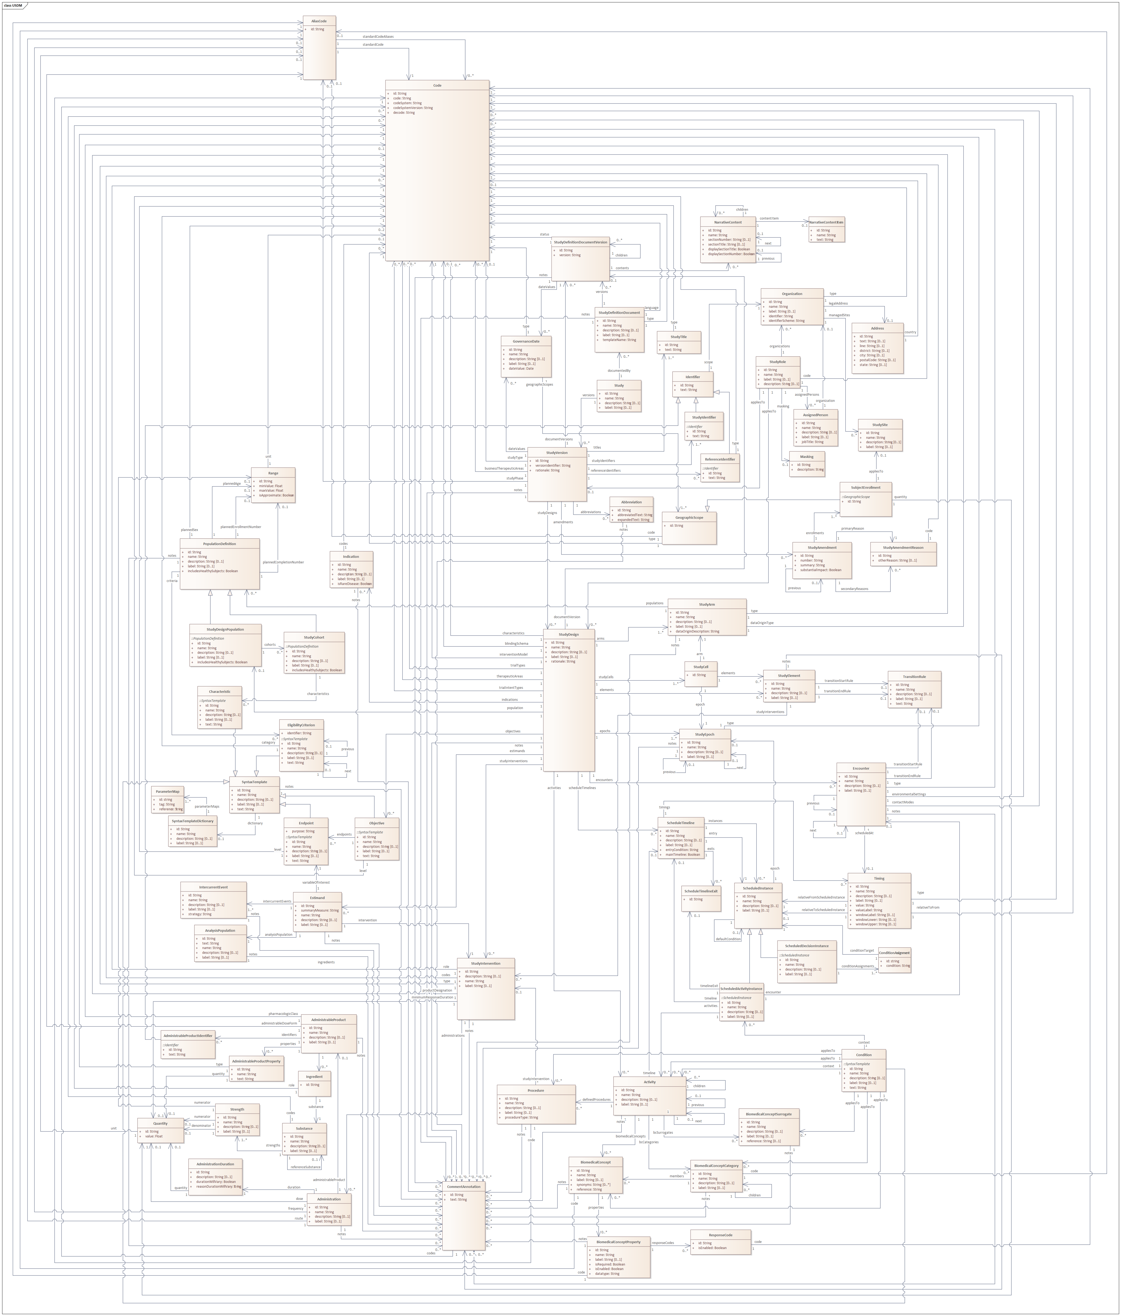
USDM in Action: Use Cases Supporting the DDF Vision
Use Cases
Unified Study Definitions Model
Retrospective
Prospective
Protocol ‘Store’
Study
Design
Study
Start-up
Study
Execution
Analysis & Reporting
Regulatory Submission
Controlled Terms
Unstructured Content
Past Protocols
The storage of past sponsor protocols in to support a variety of use cases such as:
Therapeutic area specific content
Standard inclusion and exclusion criteria.
Libraries of objectives, endpoints and estimands
General search across the library
… and more
Protocol Authoring
Support the authoring of new protocols including analyzing previous trial information to inform design choices.
Writing associated SAP, ICD, Monitoring Plan etc via content reuse.
Deployment
Deployment of the study across the enterprise using the USDM to support electronic configuration rather than manual data entry. For example, the configuration of:
Data collection systems including EDC
CTMS
TMF
… and more
Amendments
Support the amendment process with the ability to indicate the precise changes to the user community.
Ensure fewer amendments.
Automation
Provide a solid foundation for the automation of analysis and reporting outputs.
Submission
Preparation of the submission by the sponsor
Populations,
Inclusion & Exclusion,
Interventions & Indications,
Estimands,
Objectives
& Endpoints
Study, Identifiers, Amendments
Study Designs, Arms, Epochs
SDTM
Creation of ‘T’ domains. Auto generation of data domains
Regulatory Review
Review of the submission by the regulatory authority.
Subject Information
Provision of improved information to subjects regarding study execution, improve expectation management.
Procedures, Biomedical Concepts
Detailed Study Logic, Encounters
Complex Studies
Support for complex studies such as Master, Umbrella and other such protocols.
ADaM
Use the protocol statistical metadata to assist in the derivation of analysis datasets
Trial Registries
Registration of the study with registries such as CT.gov, CTIS etc.
Study Details
The overall study, its various versions, identifiers and associated governance. Also includes the amendments made to the study
Study High Level Design
The single or set of study designs making up the study detailing the epochs, arms etc.
Study Science
The detailed description of the study science: the populations and the associated inclusion and exclusion criteria, the indications being studied, the interventions being used and the objectives, endpoints and the associated estimands.
Detailed Study Logic
A precise definition of the study logic including support for the Schedule of Activities.
Unstructured Content
The ability to support one or more document presentations of the USDM content including the ICH M11 protocol template, sponsor templates and other documents.
Procedures and Biomedical Concepts
The detail around the procedures and observations to be performed as part of the detailed study designs.
Controlled Terms
The controlled terminology needed to define the semantics within the model. Managed in the same manner as all CDISC CT and aligned with the M11 template standard.
Cost
Determine the cost of the study including such items as vendor and CRO costs and support the laboratory RFP process
Drug & Study Materials
Assist in the planning and provision of study drug, materials and supplies
Training
Provision of training materials to those involved in the study including sites
Feasibility
Support study feasibility and complexity evaluations.
Subject Recruitment
Support the identification of subjects to help improve subject recruitment to the study
Site Support
Provision of tailored information to sites regarding study execution.
Across Entire Lifecycle
Regulatory Authority
Approval for the execution of the study including:
IND, CTA etc.
Discussions with regulatory authorities
Dashboards
Stakeholder Views
Tailored views for stakeholders such as IRB and ethic committees.
Dashboards
The display of protocol related information sourced from one or more protocols in ways which have not been achievable before
NOTE: The use cases presented are illustrative and the list is not intended to be exhaustive.
Version 1, 10th October 2024. Prepared by D Iberson-Hurst for the Transcelerate ‘DDF in Action’ day. With thanks to Mary Lynn Mercado (Novartis), Rob Ferendo (TransCelerate), Kirsten Langendorf (d4k), Johannes Ullander (d4k)

