Slide 1
Adaptive Wavefront Generation for Multimode Fibre
photonic measuring system technology project
Sebastian Heide
David Krause
Philipp Daferner

Slide 2
Structure
Introduction
Superpixel
Gerchberg-Saxton
Simulated Annealing
Simulation Results and Comparison

Slide 3
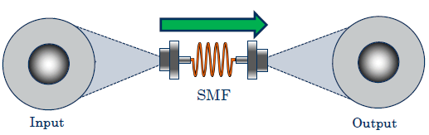
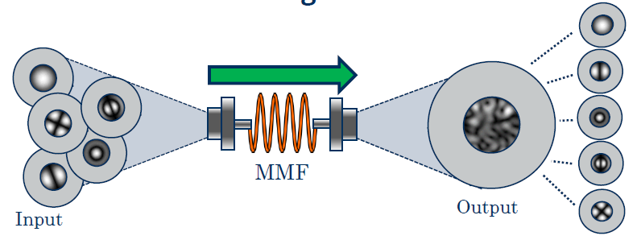
introduction singlemode vs multimode fibre
Singlemode fibre (SMF):
security is only achieved by algorithms
Multimode fibre (MMF):
security is inherently given by the structure
→physical layer security

Slide 4
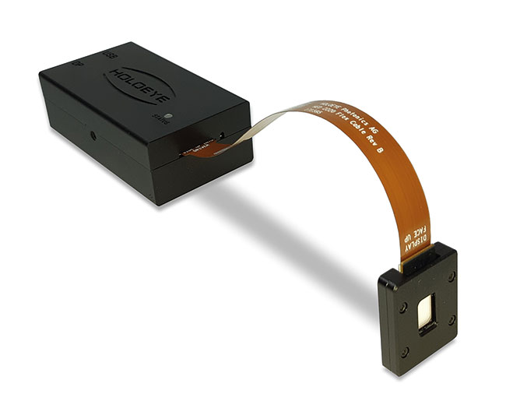
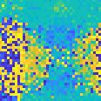

introduction SLM
Spatial light modulator (SLM):
modulates the phase of the incoming light
light propagates after the SLM
→both amplitude & phase change
https://www.photonics.com/Products/Spatial_Light_Modulator/pr65764
SLM
beam splitter
MMF

Slide 5
introduction
hologram

Slide 6
Superpixel algorithm
algorithm to adapt the phase mask

Slide 7
Superpixel results
algorithm to adapt the phase mask

Slide 8
Gerchberg-Saxton algorithm
algorithm to adapt the phase mask

Slide 9
Gerchberg-Saxton results
algorithm to adapt the phase mask

Slide 10
Simulated Annealing algorithm
algorithm to adapt the phase mask

Slide 11
Simulated Annealing
random pixel change
decrease temperature
result improved
Boltzmann condition
no
yes
admit change
met
temperature > 0
yes
not met
no

Slide 12

Simulated Annealing
random pixel change
new fidelity higher than the old one?
$$P=ⅇ^{−\frac{ΔE}{T}}>R$$
decrease temperature
result improved
Boltzmann condition
no
yes
admit change
met
temperature > 0
yes
not met
no

Slide 13
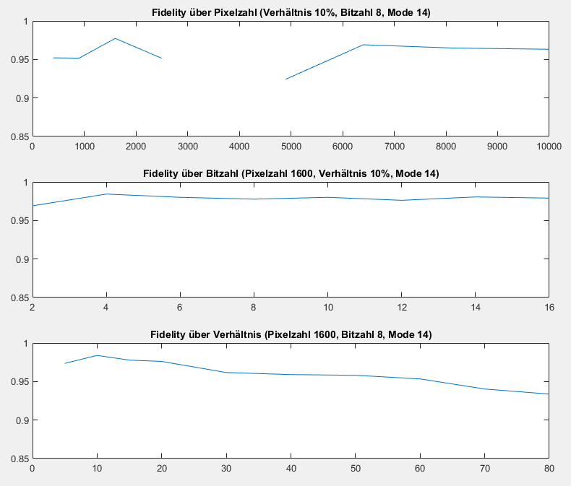
Simulated Annealing results

Slide 14
Comparison
comparison of the best results

Slide 15
Thank you for your attention!

