Slide 1
Microbiome Analysis
Dave Jacobson

Slide 2
Overview
Background
Workflows (16S and metagenomics)
Downstream examples (16S and metagenomics)

Slide 3
Background on my research
Human microbiome diversity and ecology
16S rRNA research
Oral microbiome in Vanuatu
Vaginal/Gut microbiome in Ovarian Cancer
Gut microbiome intra-village diversity in Burkina Faso
Metagenomics
Gut microbiome intra-village diversity in Burkina Faso
Gut microbiome ecological diversity across lifestyles (downloaded data)
Ancient Dental Calculus ecology (downloaded data)
Notes:
Broadly focused on human microbiome diversity and ecology, with interests in different ways study ecological dynamics in these communities
Not trained in computer science, bioinformatics (just have taken the same class you have), computational biology.
Don’t consider myself a programmer at all, don’t think of myself as a data scientist / data analyst. But I’m comfortable enough in these realms to do what i want to do
Because of this, I’m able to work on a number of different projects / datasets. Some where i’ve worked on the project from collection to lab work to analysis, others where i’ve downloaded others data sets.

Slide 4
16S rRNA analysis
Notes:
Going to give a rundown of the various programs used in 16S analysis. Not meant to be all inclusive but this is an example

Slide 5
16S rRNA analysis
Initial Sequence Data Processing
bcl2fastq - Illumina sequencer data to fastqs (demultiplex)
AdapterRemoval2 - quality filter, trim, merge fastqs
Notes:
Initial data processing is just two programs run through command line and you probably won’t have run too often.
Bcl2fastq will only be run if you’re doing the sequencing in-house, usually a core will send back fastqs.
AdapterRemoval variables will depend on your run set-up (2x150, 2x250, 2x300) and insert length. So it’s always good to be informed about how the data were sequenced.

Slide 6
16S rRNA analysis
Initial Sequence Data Processing
bcl2fastq - Illumina sequencer data to fastqs (demultiplex)
AdapterRemoval2 - quality filter, trim, merge fastqs
Package Processing (FASTQ to Statistics Ready Data)
QIIME v1.9 – demultiplex, OTU tables, alpha/beta diversity, rarefaction
USEARCH v10 – de novo OTUs, OTU picking/clustering, zOTUs
Python/Perl – data formatting, program compatibility
Command Line / Shell Scripting – handling data/files, automating analysis
Mafft – phylogenetic tree building
Notes:
Couple of different programs used in this process and can be variable depending on your data and questions.
Bulk of 16S processing is in qiime and usearch
Qiime has a lot of resources online and is used by a lot of people, so trouble shooting for qiime isn’t too difficult. Just a matter of googling correctly
USEARCH is commonly used but resources aren’t great for troubleshooting (in my experience). Also, it is constantly being updated so it check back for new scripts.
What is useful are explanations of clustering/picking and why some approaches are better than others.

Slide 7
16S rRNA analysis
Initial Sequence Data Processing
bcl2fastq - Illumina sequencer data to fastqs (demultiplex)
AdapterRemoval2 - quality filter, trim, merge fastqs
Package Processing (FASTQ to Statistics Ready Data)
QIIME v1.9 – demultiplex, OTU tables, alpha/beta diversity, rarefaction
USEARCH v10 – de novo OTUs, OTU picking/clustering, zOTUs
Python/Perl – data formatting, program compatibility
Command Line / Shell Scripting – handling data/files, automating analysis
Mafft – phylogenetic tree building
Downstream Analysis (Statistics, Tables/Figures, Data Consolidation, etc.)
R – statistics, graphs, figures
Command Line / Shell Scripting – handling data/files, automating analysis
Microsoft Excel – parsing/consolidating metadata

Slide 8
16S rRNA analysis
Initial Sequence Data Processing
bcl2fastq - Illumina sequencer data to fastqs (demultiplex)
AdapterRemoval2 - quality filter, trim, merge fastqs
Package Processing (FASTQ to Statistics Ready Data)
QIIME v1.9 – demultiplex, OTU tables, alpha/beta diversity, rarefaction
USEARCH v10 – de novo OTUs, OTU picking/clustering, zOTUs
Python/Perl – data formatting, program compatibility
Command Line / Shell Scripting – handling data/files, automating analysis
Mafft – phylogenetic tree building
Downstream Analysis (Statistics, Tables/Figures, Data Consolidation, etc.)
R – statistics, graphs, figures
Command Line / Shell Scripting – handling data/files, automating analysis
Microsoft Excel – parsing/consolidating metadata
Notes:
I’d say the most important skills are in command line/scripting and R. The other programs do the bulk of the heavy lifting but it’s up to you to get data in the correct format, etc. And automate, the more comfortable you are with those skills then you can spend more time thinking about the analysis and not worry about files being overwritten, etc.
The most of my time in 16S analysis is spent in R. The stats/graphs in QIIME are limited and working in R is the best way to overcome the limitations.
Can’t even say how many different packages I’ve installed to play around with data in R – stats, models, graphs, etc.
This is also where you have more control over your data and can do the analysis you’re interested in
Read the literature and see other types of cool analysis and then figure out how to do that on your own.
Google and stack exchange are super useful and most people will have encountered you’re problem previously.
However, the specifics of your analysis are up to you. So being aware of the capabilities in R can give you new ideas for analysis.
I’ll give a quick example with an alpha diversity metric about how R gives more flexibility than qiime, but I had to figure out how to do the analysis myself.

Slide 9
16S Example - Hill Numbers Alpha Diversity Profile
Effective number of species
Effective number of common species
Effective number of dominant species
Estimates community richness at different levels of abundance
Notes:
I came across hill numbers reading about how to quantify aspects of ecology, not even microbiome.
Seemed like an interesting idea and looked into microbiome applications and thought it would be a useful thing to do for 16S data (alpha diversity)

Slide 10
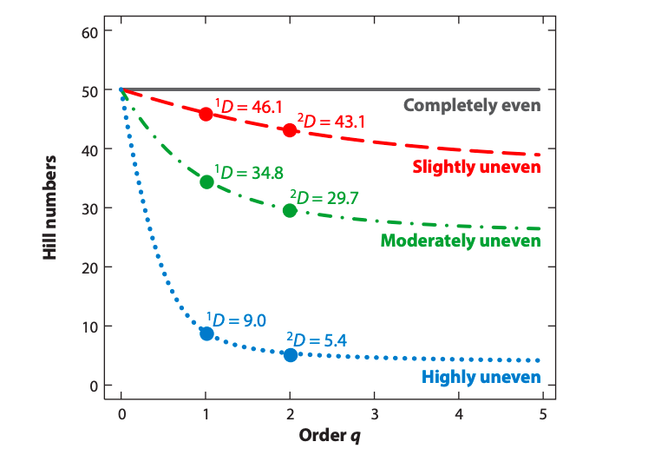
16S Example - Hill Numbers Alpha Diversity Profile
Effective number of species
Effective number of common species
Effective number of dominant species
Estimates community richness at different levels of abundance
Chao, Chiu, and Jost 2014

Slide 11
16S Example - Hill Numbers Alpha Diversity Profile
q = 0, # all species
q = 1, # common species
q = 2, # dominant species
Chao, Chiu, and Jost 2014
Notes:
Allows a more intricate view of microbial abundance and richness, in other words alpha diversity

Slide 12
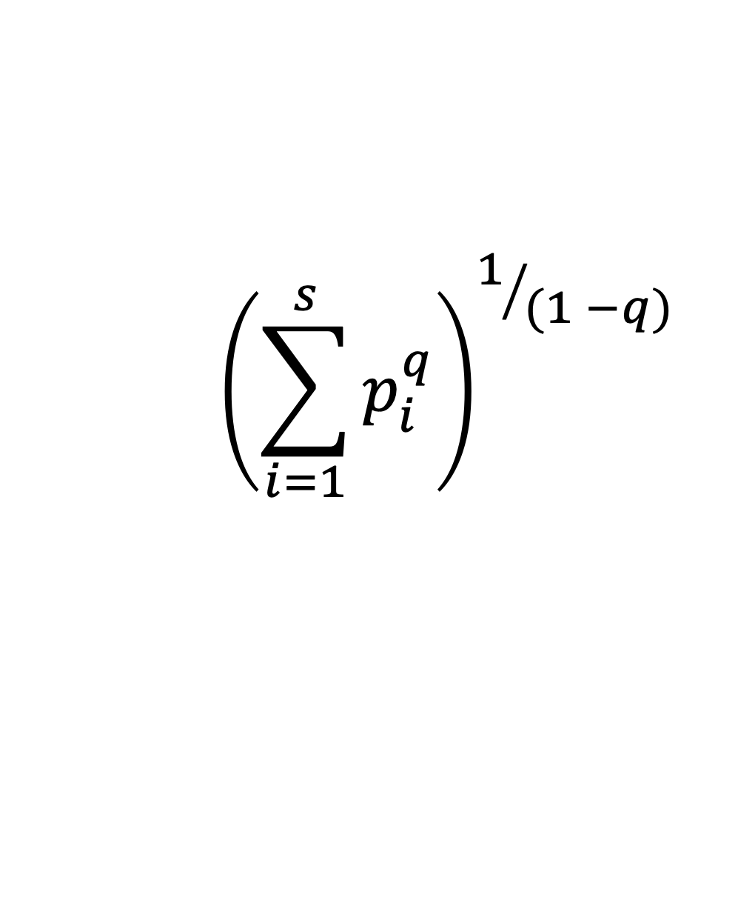
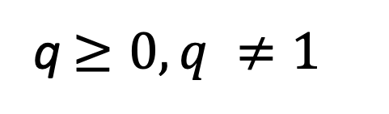
16S Example - Hill Numbers Alpha Diversity Profile
$${\left(\sum_{i=1}^{s}{p_{i}^{q}}\right)}^{1/{(1 −q)}}$$
D = Taxa Diversity
q = Hill Number
s = Number of Taxa
p = Relative Abundance of Taxa
^{q}D =
q $≥0, q ≠1$
Chao et al. 2014; Hill 1973
Notes:
Not coded into qiime and isn’t common in microbiome data analysis, so not in those packages in R, how should I approach this?
Not an awful equation, could certainly figure out how to write a script in R. Would involve a few loops, some trouble shooting. Have to deal with q not equal to 1 by taking the limit but still definitely doable.
But at the same time, this is a common approach in ecology, try google to see if something exists in R

Slide 13
16S Example - Hill Numbers Alpha Diversity Profile
Use vegan package in R
>renyi(t(otuTable), hill = T) -> hillSpecies
Or use hillR package in R
>hill_taxa(t(otuTable), q = 0) -> hillSpecies
Notes:
Seems like complex equation, how exactly am I going to implement this with my microbiome data.
It is coded into qiime and isn’t common in microbiome data analysis, so not in those packages in R, how should I approach this?

Slide 14
16S Example - Hill Numbers Alpha Diversity Profile
Use vegan package in R
>renyi(t(otuTable), hill = T) -> hillSpecies
Or use hillR package in R
>hill_taxa(t(otuTable), q = 0) -> hillSpecies
Notes:
Then just a matter of plotting it in R with ggplot2 and making final adjustments in Illustrator

Slide 15
16S Example - Hill Numbers Alpha Diversity Profile
Use vegan package in R
>renyi(t(otuTable), hill = T) -> hillSpecies
Or use hillR package in R
>hill_taxa(t(otuTable), q = 0) -> hillSpecies
Don’t reinvent the wheel!
Notes:
Being familiar in R makes using new packages easier. Support for packages is pretty common but most are written by academics and may require some tinkering to get your data to fit.

Slide 16
Metagenomics

Slide 17
Metagenomics
Initial Sequence Data Processing
sratoolkit – download data from NCBI
kneadData – remove human reads, quality filter, trim
AdapterRemoval2 - quality filter, trim, merge fastqs
Notes:
Lot of different choices depending on goals, like 16S. Find a program that works and shouldn’t be an issue.

Slide 18
Metagenomics
Initial Sequence Data Processing
sratoolkit – download data from NCBI
kneadData – remove human reads, quality filter, trim
AdapterRemoval2 - quality filter, trim, merge fastqs
Package Processing (FASTQ to Analyzable Data)
Python – program compatibility
Command Line / Shell Scripting – handling data/files, automating analysis
MetaPhlAn2 – taxonomic inventory of metagenomic data
StrainPhlAn– track strains of microbes in large metagenomic datasets
HUMAnN2 – functional + taxonomic profiling
Megahit – de novo genome assembly
Metabat + CheckM – genome binning, taxonomy, QC of bins/genomes
Notes:
This will be highly variable depending on your goals. These are the programs i use most commonly, but for example, I don’t have reference guided assembly up here or protein prediction.
Some of that is wrapped up in these programs and others are independent.

Slide 19
Metagenomics
Initial Sequence Data Processing
sratoolkit – download data from NCBI
kneadData – remove human reads, quality filter, trim
AdapterRemoval2 - quality filter, trim, merge fastqs
Package Processing (FASTQ to Analyzable Data)
Python – program compatibility
Command Line / Shell Scripting – handling data/files, automating analysis
MetaPhlAn2 – taxonomic inventory of metagenomic data
StrainPhlAn– track strains of microbes in large metagenomic datasets
HUMAnN2 – functional + taxonomic profiling
Megahit – de novo genome assembly
Metabat + CheckM – genome binning, taxonomy, QC of bins/genomes
Downstream Analysis (Statistics, Tables/Figures, Data Consolidation, etc.)
R – statistics, graphs, figures
Command Line / Shell Scripting – handling data/files, automating analysis
Notes:
Then finally, just like 16S getting the data to be presentable and meaningful and to test what I want, I spend a lot of time in R and command line getting things figured out

Slide 20
Metagenomics
Initial Sequence Data Processing
sratoolkit – download data from NCBI
kneadData – remove human reads, quality filter, trim
AdapterRemoval2 - quality filter, trim, merge fastqs
Package Processing (FASTQ to Analyzable Data)
Python – program compatibility
Command Line / Shell Scripting – handling data/files, automating analysis
MetaPhlAn2 – taxonomic inventory of metagenomic data
StrainPhlAn– track strains of microbes in large metagenomic datasets
HUMAnN2 – functional + taxonomic profiling
Megahit – de novo genome assembly
Metabat + CheckM – genome binning, taxonomy, QC of bins/genomes
Downstream Analysis (Statistics, Tables/Figures, Data Consolidation, etc.)
R – statistics, graphs, figures
Command Line / Shell Scripting – handling data/files, automating analysis
Notes:
No matter what, there’s not going to be a single program that does everything that you want
Being flexible and reading about new programs is super important.
I don’t write much at all in python but having familiarity with python makes using these programs much easier.
There’s not always a lot of support, and often the issues are installing dependencies and python libraries that the program needs to run. So figuring out the error messages, etc. and knowing how to manipulate python within the program is often necessary to run the program.
Files often have to be in specific formats and it’s up to you to get them in that format, whether its .fa instead of .fasta or a header line with a #, or renaming the header of a fastq/fasta etc.
Same with 16S manipulating and automating R and command line is vital. Spend a lot of time in R getting stuff to work

Slide 21
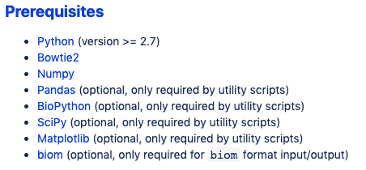
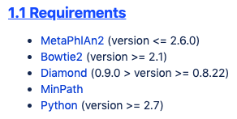
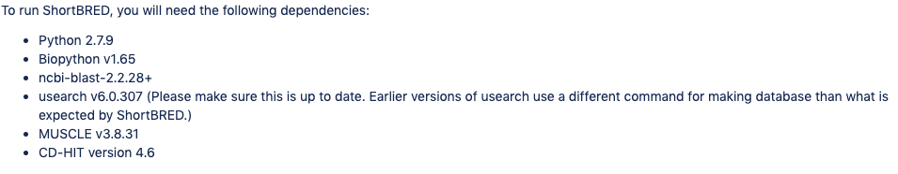
Program Dependencies and Installation
Some programs will provide a bin folder that has executable dependencies
Notes:
Dependencies can be the bane of my existence, can spend full days just figuring out the specific things needed to run a program.
These are good examples where it says what versions you need, there have been times where i get a USEARCH/blast error and all it says is error. So had to keep trying different versions until I found a version that worked. Pretty frustrating
This is particularly true when you’re working on a server and you don’t have root access. On dayhoff, I had to install my own python (had to search google how to install python if not root user).
Then direct every program to that version of python, rather than the python that is distributed with the install.
Some programs need specific dependencies to be in your user folder so that you can call them without a path, so need to read through documentation and understand your operating system and python to get things set up in the way you want.

Slide 22
Troubleshooting Process
Check for typos
Google the error message
Check for typos
Check dependencies
paths/versions
Program-specific support
google groups / forums
stack exchange (R, shell)
biostars (bioinformatic tools)
Email program author(s)

Slide 23
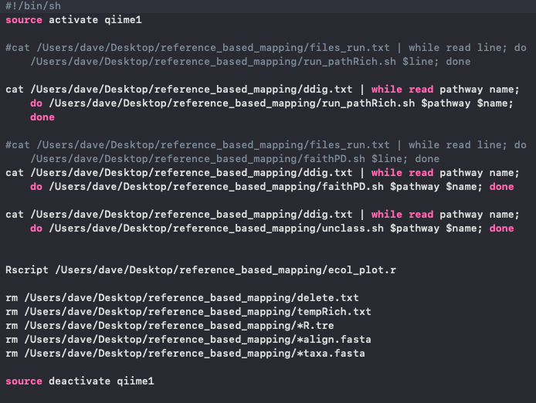
Shell script examples
Most of my code is linking together programs/processes in shell
Notes:
This could all be cleaner code and maybe combine some parts of the code into 2 files. But I was testing out each shell script to see if it worked then combined them together in this larger shell script.
For me, it doesn’t have to all be super clean or efficient code. I just want it to run and work.
I’m not a trained programmer or computational biologist, so my code is more piecemeal to get what works.

Slide 24
Shell script examples
Most of my code is linking together programs/processes in shell
Notes:
This could all be cleaner code and maybe combine some parts of the code into 2 files. But I was testing out each shell script to see if it worked then combined them together in this larger shell script.
For me, it doesn’t have to all be super clean or efficient code. I just want it to run and work.
I’m not a trained programmer or computational biologist, so my code is more piecemeal to get what works.

Slide 25
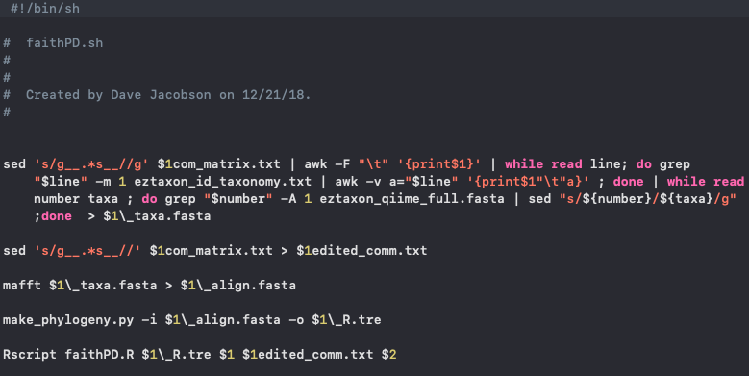
Shell script examples
Most of my code is linking together programs/processes in shell
Notes:
Here’s an example of one of those scripts that was within the previous file.
See it’s a combination of shell scripts (sed, awk, loops, grep). Outside programs like mafft and a script from Qiime, plus a custom script that I wrote in R.
I was doing this analysis on hundreds of files (genes found in a metagenomics run of humann2) so automating this process is really the only way to do it.

Slide 26
Wrap-Up
No ‘one size fits all’ data analysis package
Flexibility and comfortability with new packages/programs is valuable
Shell scripting / python make your life easier
Format input files correctly
Automate repetitive lines of code
Edit program to work on your workstation
Installing dependencies can be awful
Check to see if program details specific version of dependencies
Use google/forums (google groups, stack exchange, biostars)
Lots of trial and error
Don’t reinvent wheel in R

Slide 27
Alpha Diversity
Diversity within a sample
Richness
# of genera/species
Notes:
Observed OTUs, etc don’t give a nuanced view of the community.
Community with 1 species with 90% abundance and 10 with 1% abundance = to community with 10 at 10%

Slide 28
Alpha Diversity
Diversity within a sample
Richness
# of genera/species
Community 1
Community 2
Notes:
Observed OTUs, etc don’t give a nuanced view of the community.
Community with 1 species with 90% abundance and 10 with 1% abundance = to community with 10 at 10%

Slide 29
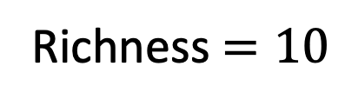
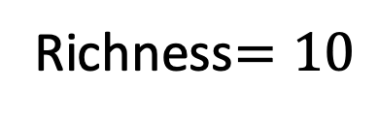
Alpha Diversity
Diversity within a sample
Richness
# of genera/species
Community 1
Community 2
Richness $=10$
Richness$=10$
Notes:
Observed OTUs, etc don’t give a nuanced view of the community.
Community with 1 species with 90% abundance and 10 with 1% abundance = to community with 10 at 10%

Slide 30
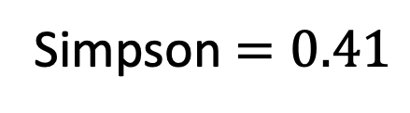
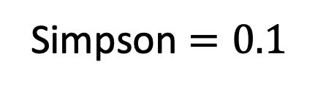
Alpha Diversity
Diversity within a sample
Richness
# of genera/species
Simpson
prob. 2 bacteria chosen randomly are same species
Community 1
Community 2
Simpson $=0.41$
Simpson $=0.1$
Notes:
With 1 dominant species the value approaches 1, so you’re getting more information than just richness. But doesn’t include richness info, so not complete picture

Slide 31
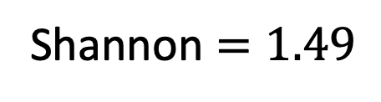
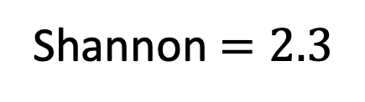
Alpha Diversity
Diversity within a sample
Richness
# of genera/species
Simpson
prob. 2 bacteria chosen randomly are same species
Shannon
Uncertainty in predicting species
Community 1
Community 2
Shannon $=1.49$
Shannon $=2.3$
Notes:
As 1 species is dominant, the value approaches 0. Similar to simpson that it is informative but doesn’t tell you about richness
We want richness information but also information about relative abundance within the community as well

