Slide 1

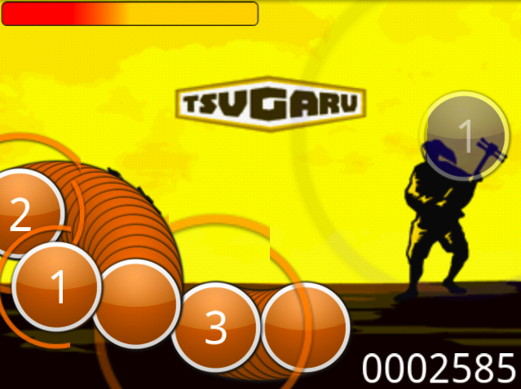
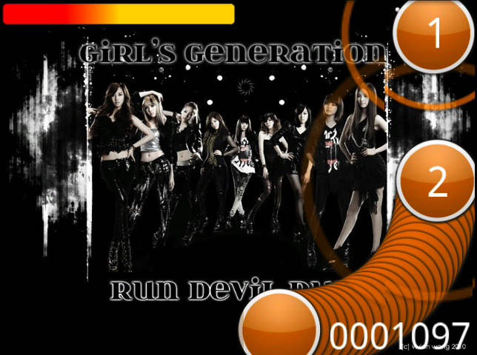
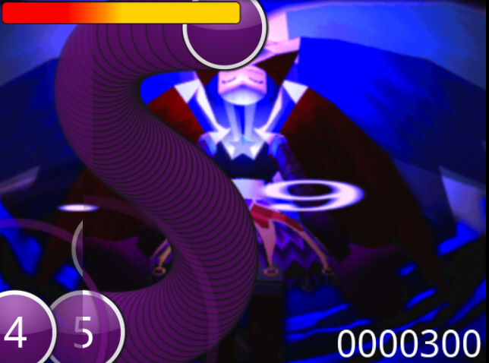
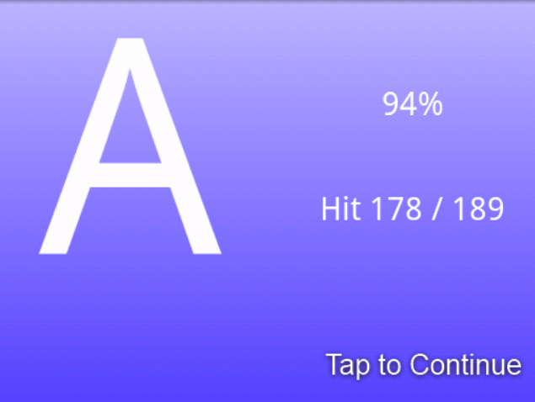
osu!
A music rhythm game...
By David Kilian and Michael Comella
Based on osu! for the PC
Watch the ring, listen to the music, and trust your instincts...
Good luck and osu!

