Slide 1
Graduating to GUI
A PyGTK/PyGObject Workshop for Beginners
Presented by
Paul W. Frields
Red Hat, Inc. / Fedora Project
Copyright © 2013 Paul W. Frields. Licensed under Creative Commons Attribution-ShareAlike 3.0. Some rights reserved.

Slide 2
Agenda
Introduction to concepts (30 min)
Q & A (15 min)
Hands-on exercises (remainder)

Slide 3


Assumptions
You know a little Python and basic programming concepts
  You have read and/or understand the concepts in Chapters 1-5 of Dive Into Python by Mark Pilgrim
  You are not necessarily a skilled programmer
For hands-on, you have glade, pygobject3, and gtk3-devel-docs installed
  If you have the GNOME Software Development yum group installed, you’ve got all this

Slide 4
Concepts

Slide 5
Workflow
Glade to design UI (as GtkBuilder)
  Saved as XML file
  Can be tweaked in Glade or any editor
Python code loads the XML file as a resource
  Interactive elements assigned to objects
  Functions called based on interaction

Slide 6
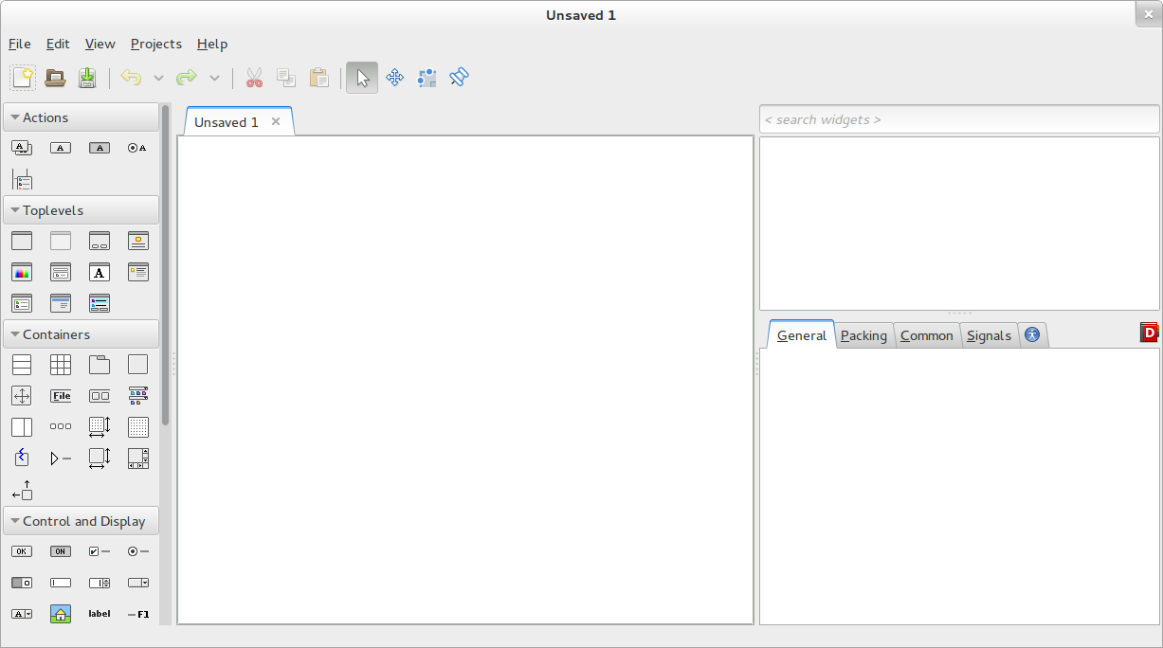

Slide 7
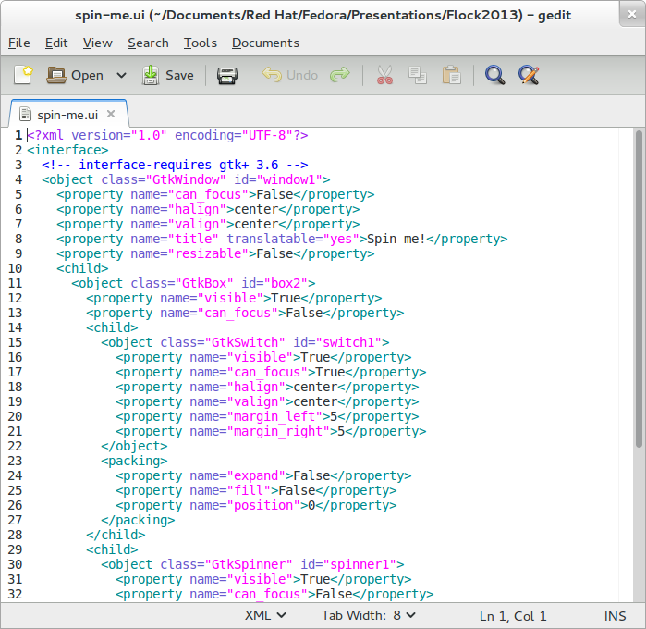

Slide 8
Key GTK information
Objects/Widgets
Signals
Main loop

Slide 9
Objects/Widgets
Based on classes and inheritance
Each object can have its own special properties and methods
Real-life example: Chair object
  FoldingChair adds fold( ) function
  SwivelChair adds rotate( ) function
Similarly, the Chair object may itself be a subclass of something else, e.g. Furniture

Slide 10
How to learn more
This is where devhelp comes in – provides hierarchical listing of inheritance
For example, let's look at GtkButton in the listing
GtkButton inherits the properties and methods of the classes above (e.g. visible property from GtkWidget)

Slide 11
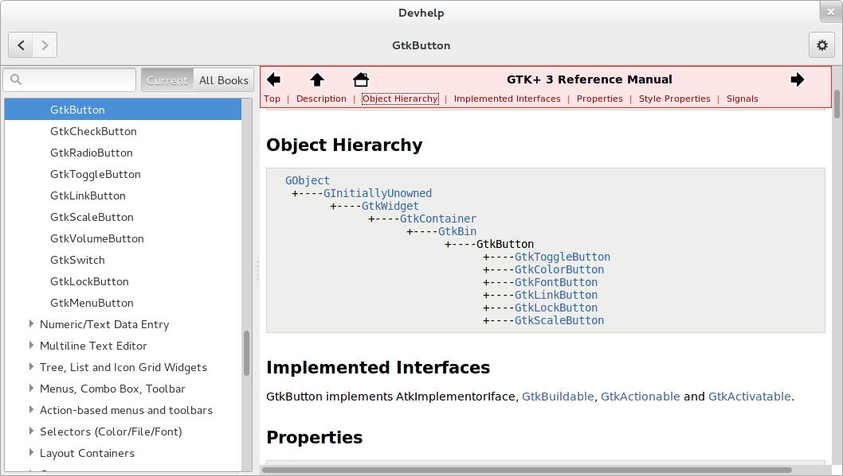

Slide 12
Application as an object
Typically the UI in an application is an object with its own class
For instance, you might subclass Gtk.Application:
class MyProgUI(Gtk.Application):
def __init__(self):
...
...
Pop Quiz: Why would you want to subclass like this?

Slide 13
Building your widget tree
To use GTK library bindings, load using GIR:
from gi.repository import Gtk
Create a GtkBuilder object and use Gtk.Builder.add_from_file( ) to load objects:
def __init__(self):
self.builder = Gtk.Builder()
self.builder.add_from_file('prog.ui')
# Now you can refer to elements using
# the self.builder object

Slide 14
Signals
This is the basis for interactivity and response
Main loop and input interaction
Interaction generates a signal, which can be caught and used to trigger a function
Example: a button click, a checkbox filled or cleared, a slider adjusted...
Signals are emitted by widgets... but where do we get the widgets?

Slide 15
Widget references
The Gtk.Builder.get_object( ) function returns an object based on its name
self.close_button = self.builder.get_object('close')
Now you can reference that GUI element in Python and do things with it

Slide 16
Connecting & callbacks
Almost any widget can use the connect( ) function to map a signal to a callback
A callback is where you code the reaction to the user’s action
self.close_button.connect(‘clicked’, self.hide_dialog)
Not just limited to clicks! For instance, an interface element can react if the pointer drifts over it or away from it.

Slide 17
Writing callback functions
The callback function can receive additional arguments:
self.switch.connect(‘notify::active’, self.do_something,
some_value1, some_value2)
self.button.connect(‘clicked’, self.do_something_else)
Your callbacks will receive standard arguments if you don’t send anything else. Arguments may depend on the widget:
def do_something_else(self, *args):
print args # St00pid debugging to take a peek
...

Slide 18
GTK main loop
The main loop allows your application to accept input from the user – mouse events, key presses, and so on
if __name__ == ‘__main__’:
myProg = MyProgUI()
Gtk.main()
Run Gtk.main_quit() to clean up the application and exit

Slide 19
Hints
Always connect signals to let the user quit the application! For a main or single window, one easy way:
self.window.connect(‘destroy’, Gtk.main_quit)
Show widgets before the main loop runs using e.g. show_all() method. Choose what to show and hide for multiple window or paned applications using hide/show methods or visible properties.

Slide 20
How do I know what widget?
It’s OK not to know which is which when you start
Use glade to get to know the interface widgets
Use devhelp to understand the internals of each widget you care about
  Remember, widgets inherit stuff from their parent classes also!
Anything glade can do, you can do directly in Python via GTK – so you can change your interface as you run

Slide 21
Review
Objects (widgets as Python classes/instances)
Signals (making your UI do things)
Main loop (lets your interface run)
glade -> GtkBuilder XML -> load in Python -> connect signals to functions -> ... -> PROFIT!

Slide 22
Questions?

Slide 23
Hands-on!

Slide 24
Summary
We will split into teams, and each team will complete a project
Each project is a small interface your team will implement in GTK and Python
If you get done quickly, try something harder, in collaboration with your teammates. Try building something more complex on top of the example!

Slide 25
Exercise 1
Make an interface with the following elements:
  An on/off switch and a spinner. The switch activates and deactivates the spinner.
  A text label. When the switch is turned off, the label updates to show the amount of time the spinner ran. When the switch is turned on, the label says “Running...”.
HINT: The datetime module will be helpful here.

Slide 26
Exercise 2
Make an interface with the following elements:
  A control that lets you choose a file (not a directory). Once the user has selected a file, the application grabs the size and timestamp.
  A text label that is empty when you start the application, but once the file has been grabbed, displays the file’s size in bytes and the date and time it was last modified.
HINT: The os.stat() function will be helpful here.

Slide 27
Exercise 3
Make an interface with the following elements:
  Two buttons marked Question and About.
  When the user clicks the Question button, a GtkMessageDialog window appears with a question of your choice (be polite!). The new dialog has buttons for each answer – yes/no is fine. When the user selects an answer button, the dialog returns the output, prints it to standard output, and vanishes.
  When the user clicks the About button, a standard GtkAboutDialog appears with information you provide.

Slide 28
Questions?
Contact:
pfrields@fedoraproject.org
Copyright © 2013 Paul W. Frields. Licensed under Creative Commons Attribution-ShareAlike 3.0. Some rights reserved.

