Slide 1
Free
Fonts

Slide 2
Legal Disclaimer

Slide 3
Free
Fonts

Slide 4
Bedava
Fonts

Slide 5
Bedava
Fonts

Slide 6
Serbest
Fonts

Slide 7
Libre Fonts

Slide 8
Libre Fonts

Slide 9
1. Tools

Slide 10
1. Tools
2. Knowledge

Slide 11
1. Tools
2. Knowledge
3. Business

Slide 12
1. Tools

Slide 13
Broken

Slide 14
Broken

Slide 15
Broken

Slide 16
Tamamlanmamıs

Slide 17
Tamamlanmamış

Slide 18
Lobster

Slide 19
Lobster
Кириллица

Slide 20
Incomplete

Slide 21
Who decides?

Slide 22
Power

Slide 23
Politics

Slide 24
"It is a great misfortune to be at the beck and call of one master, for it is impossible to be sure that he is going to be kind, since it is always in his power to be cruel whenever he pleases.
As for having several masters, according to the number one has, it amounts to being that many times unfortunate."
Discourse on Voluntary Servitude
– Étienne de La Boétie, 1548

Slide 25
Richard Stallman

Slide 26
GNU.org/
philosophy

Slide 27
developer > user

Slide 28
developer = user

Slide 29
1984

Slide 30
GNU

Slide 31
2004

Slide 32
Fedora
Project.org

Slide 33
GIMP.org

Slide 34
Inkscape.org

Slide 35
Scribus.net

Slide 36
Libre-Graphics -Meeting.org

Slide 37
Libre Graphics Magazine.com

Slide 38
FontForge.sf.net

Slide 39
Exo Libre Fonts
Exo Libre Fonts
Exo Libre Fonts
Exo Libre Fonts
Exo Libre Fonts
Exo Libre Fonts

Slide 40
:)

Slide 41
:(

Slide 42
Ugly

Slide 43
Mac?

Slide 44
HomeBrew

Slide 45
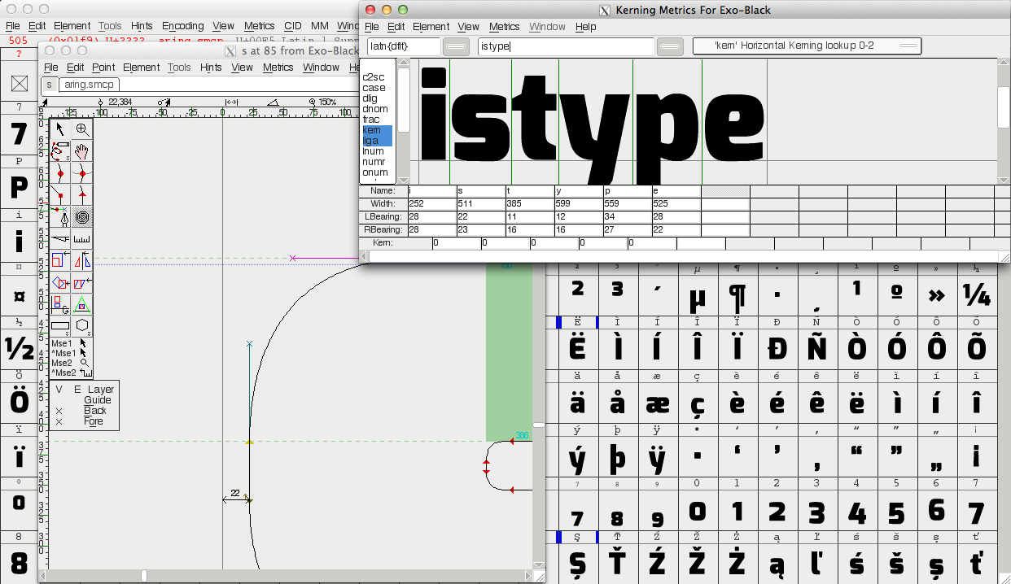

Slide 47
SIL
Open Font License

Slide 48
Copyright

Slide 49
Copyleft

Slide 50
Share
And Share
Alike

Slide 51
Open Font Library.org

Slide 52
:)

Slide 53
:(

Slide 54
£ $ € !

Slide 55
webfonts

Slide 56
google.com/
webfonts

Slide 57
500 fonts

Slide 58
500 fonts
150,301,707,486 seen

Slide 59
500 fonts
150,301,707,486 seen
756,592,150 daily

Slide 60
code.google.com/p/
googlefontdirectory

Slide 61
A New
Business Model

Slide 62
A New
Business Model
For You

Slide 63
?

Slide 64
£ $ € !

Slide 65
Kickstarter.com

Slide 66
Kickstarter.com
Pledgie.com

Slide 67
freetype.org/
ttfautohint

Slide 68
OERT.org

Slide 70
Tools
Knowledge
Business

Slide 71
Libre Fonts

Slide 72
Expletus Sans

Slide 73
Jasper de Waarde

Slide 74
Typophile.com
1996type

Slide 75
14

Slide 76
Thank you very much!

