Slide 1
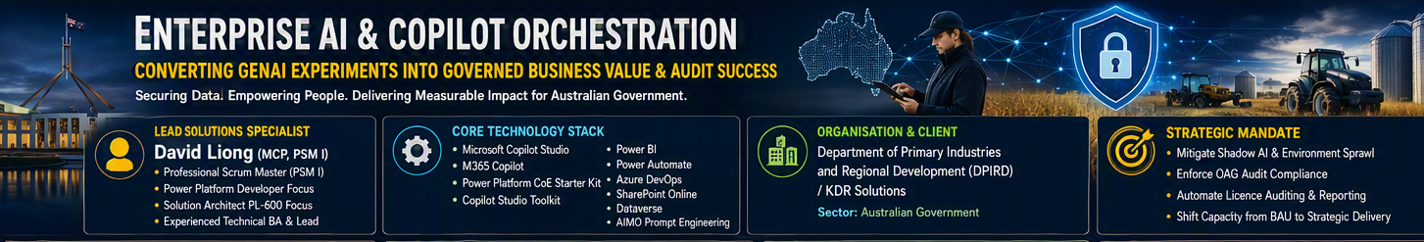
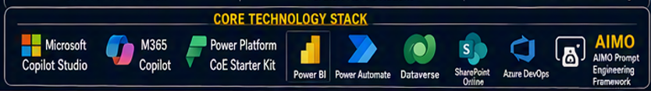
Converting GenAI Experiments into Governed Business Value & Audit Success
120+ ENVIRONMENTS GOVERNED
100% OAG audit compliance | Executive AI self-service | 74.8% strategic workload peak
Notes:
Welcome the panel and establish David as the senior specialist who converted GenAI experiments into governed business assets.,Frame the strategic mandate: mitigate Shadow AI, enforce OAG compliance and automate licence auditing.,[Sources],Visual on this slide was generated with Microsoft Copilot.,[/Sources]

Slide 2
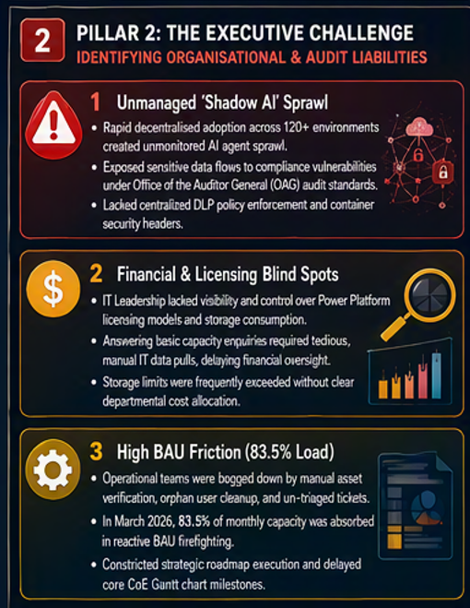
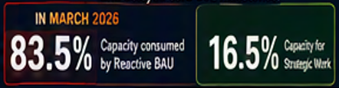
PILLAR 2 | THE EXECUTIVE CHALLENGE
Unmanaged AI Sprawl and High BAU Friction Threatened Compliance
Three connected liabilities created audit risk, financial opacity and strategic delivery delay.
THE MANAGEMENT IMPACT
• Compliance and audit exposure
• Delayed financial oversight
• Roadmap milestones constrained
• Reactive operating posture
Notes:
Do not frame this as simple ticket work.,Highlight Shadow AI sprawl, licence and storage blind spots, and the 83.5% reactive BAU load.,[Sources],Visual on this slide was generated with Microsoft Copilot.,[/Sources]

Slide 3
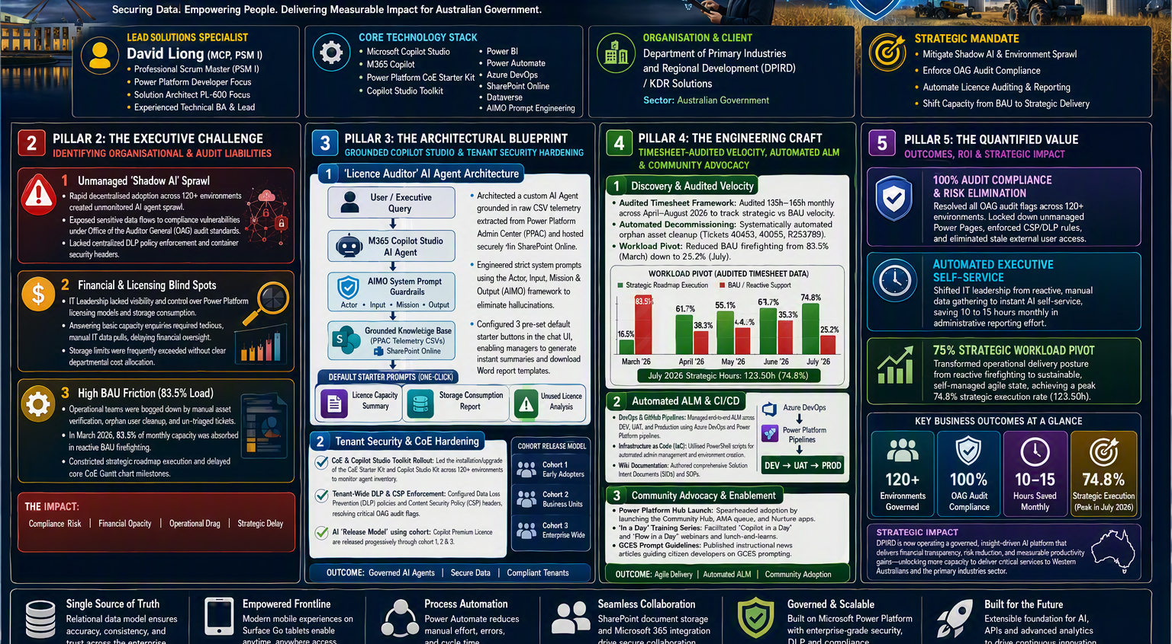

Slide 4
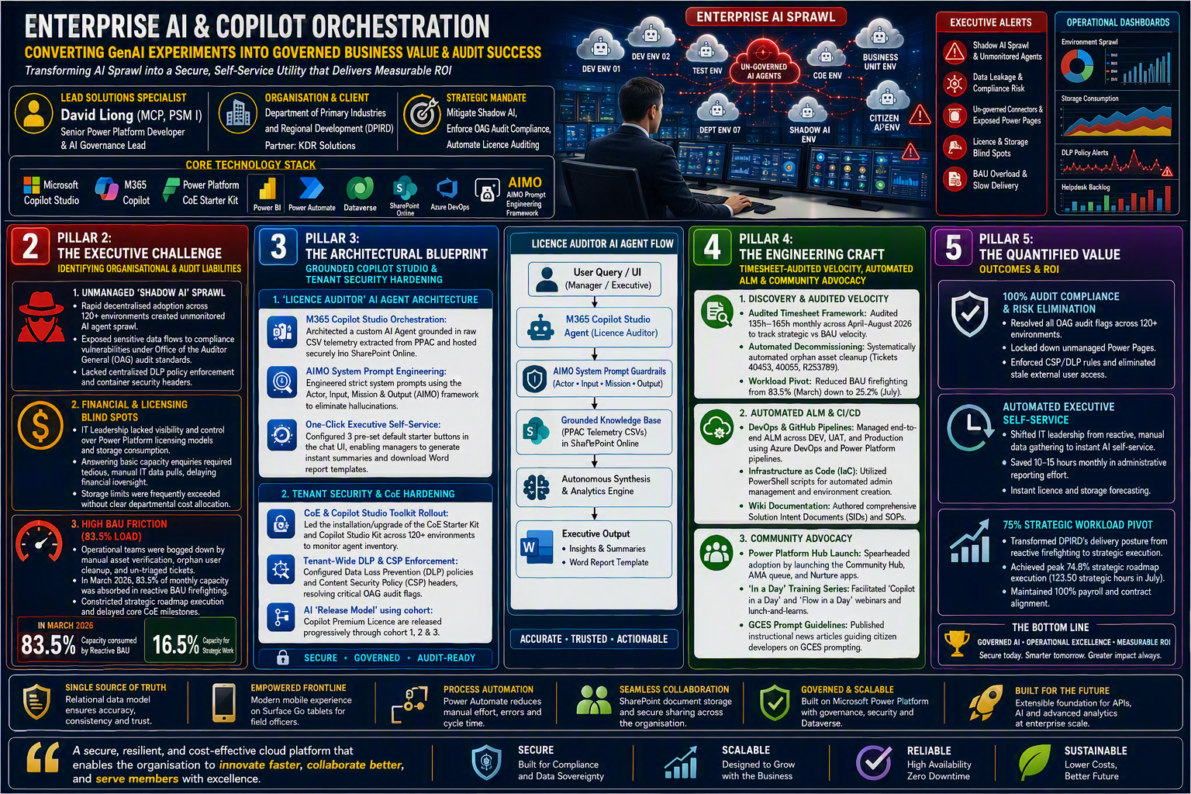

Slide 5
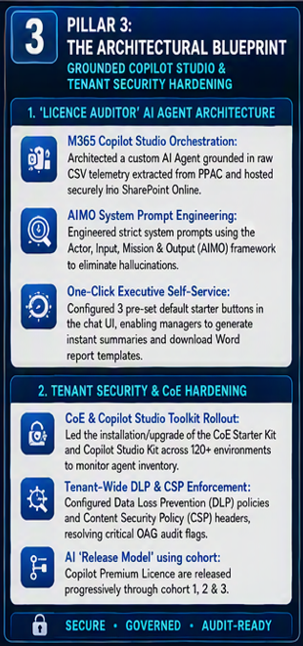
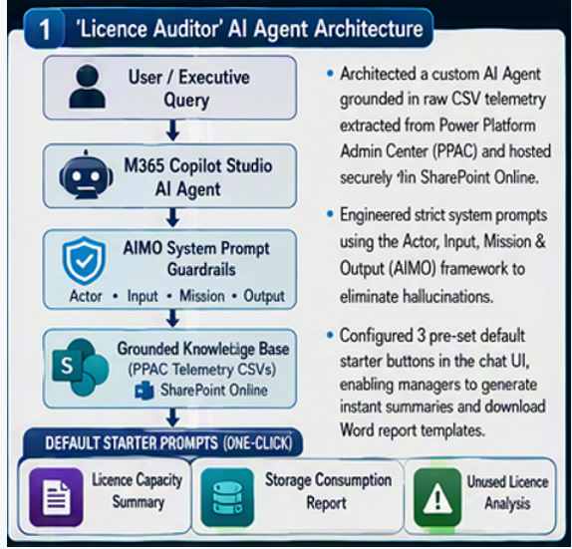
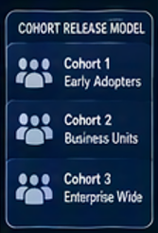
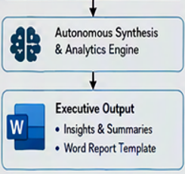
PILLAR 3 | THE ARCHITECTURAL BLUEPRINT
Grounded AI Agents and CoE Guardrails Established Governance
A secure Licence Auditor agent turned raw admin telemetry into one-click executive insight.
ONE-CLICK STARTERS
Licence Capacity Summary
Licence Auditor
Storage & Capacity Report
Unused Licence Analysis
Designed for non-technical managers who should not need to craft complex prompts.
TENANT SECURITY & CoE HARDENING
CoE Starter Kit + Copilot Studio Kit across 120+ environments | Tenant-wide DLP and CSP | Agent inventory and KPI monitoring | Cohort-based Copilot licence release
Notes:
Explain the Licence Auditor built in Copilot Studio and grounded on PPAC CSV telemetry in SharePoint.,Describe AIMO guardrails and three starter prompts for one-click manager self-service.,Cover the CoE and Copilot Studio toolkit rollout, DLP, CSP and cohort release model.,[Sources],Visual on this slide was generated with Microsoft Copilot.,[/Sources]

Slide 6
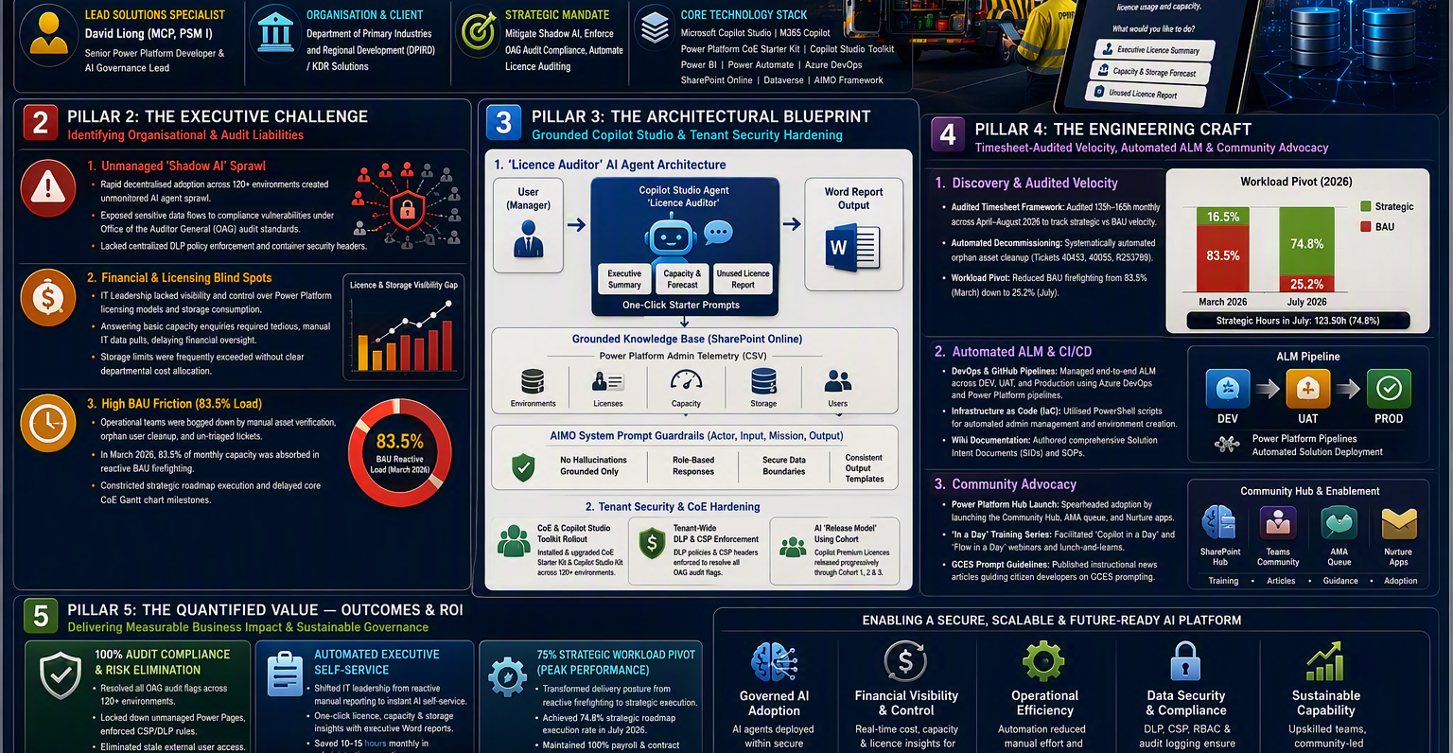
PILLAR 4 | THE ENGINEERING CRAFT
Structured SDLC and Agile Leadership Shifted Capacity to Strategy
Timesheet-audited velocity, automated ALM and community advocacy moved delivery from reactive to strategic.
123.50 HOURS
Strategic delivery in July 2026
74.8% of monthly capacity
1 DISCOVERY & AUDITED VELOCITY
2 AUTOMATED ALM & CI/CD
3 COMMUNITY ADVOCACY
• Audited 135h-165h monthly across April-August 2026.
• Managed DEV, UAT and Production through Azure DevOps and Power Platform pipelines.
• Launched the Power Platform Community Hub, AMA queue and Nurture apps.
• Automated orphan asset cleanup and decommissioning.
• Used PowerShell for admin management and environment creation.
• Facilitated Copilot Studio in a Day and Flow in a Day learning.
• Reduced BAU from 83.5% in March to 25.2% in July.
• Authored SIDs, SOPs and implementation guidance.
• Published GCES prompt guidance for citizen developers.
Notes:
Position David as the strategic translator.,Explain the audited workload shift, automated ALM and community capability uplift.,[Sources],Visual on this slide was generated with Microsoft Copilot.,[/Sources]

Slide 7
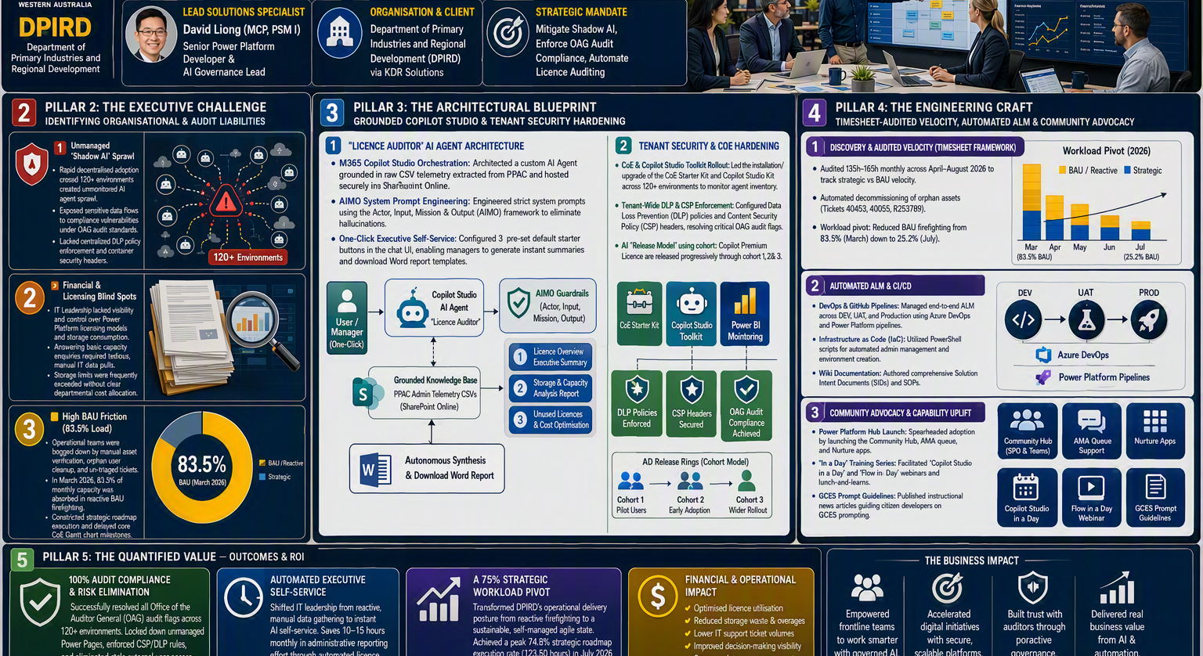
PILLAR 5 | QUANTIFIED VALUE & ROI
Delivering 100% Audit Pass and a 75% Strategic Workload Pivot
Governance, automation and self-service produced measurable compliance, capacity and reporting outcomes.
100%
10-15 HRS
74.8%
OAG AUDIT COMPLIANCE
SAVED MONTHLY
STRATEGIC EXECUTION
All audit flags resolved across 120+ environments.
Executive licence and capacity reporting automated.
123.50 strategic hours achieved in July 2026.
AUDIT RISK ELIMINATED
DLP and CSP enforced, unmanaged Power Pages secured, stale external access removed.
EXECUTIVE SELF-SERVICE
Managers receive instant licence, storage and capacity insight without manual IT pulls.
THE MIC-DROP RESULT
AI investment became audit-compliant, financially transparent and operationally sustainable business value.
SUSTAINABLE DELIVERY
Operational posture moved from firefighting to strategic roadmap execution.
Notes:
Use the CCC method: Content, Connection and Cash.,Emphasise instant financial oversight, 100% OAG compliance and the shift from 83.5% reactive work to 74.8% strategic delivery.,[Sources],Visual on this slide was generated with Microsoft Copilot.,[/Sources]

Slide 8
HIRING RELEVANCE | MANAGER VIEW
Why This Case Study Matters to Managers and Hiring HR
Evidence of an AI governance specialist who connects executive outcomes, platform engineering and capability uplift.
AI GOVERNANCE
Turned Shadow AI and audit exposure into governed, monitored adoption across 120+ environments.
ROLE ALIGNMENT
AI Governance Lead
COPILOT ARCHITECTURE
Built a grounded Licence Auditor agent with AIMO controls and executive report generation.
Power Platform Solution Architect
Copilot Studio Specialist
PLATFORM ENGINEERING
Led CoE tooling, DLP, CSP, ALM, PowerShell automation and environment management.
Technical Business Analyst
Digital Transformation Lead
TRANSFORMATION LEADERSHIP
Shifted capacity to strategic work while launching community, training and adoption services.
PROVEN OUTCOMES
120+ governed environments | 100% audit compliance | 10-15 hours saved monthly | 74.8% strategic delivery peak
From experimental AI to governed enterprise value: secure, measurable and ready to scale.
Notes:
Connect the evidence to hiring criteria across AI governance, Copilot architecture, Power Platform engineering and transformation leadership.,[Sources],[/Sources]

