Slide 1
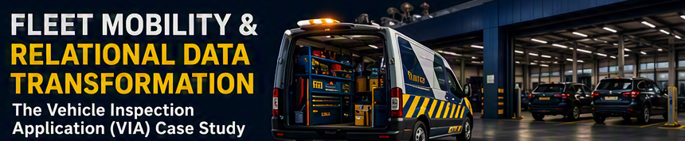

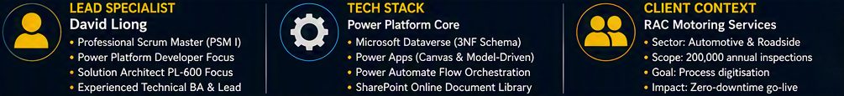
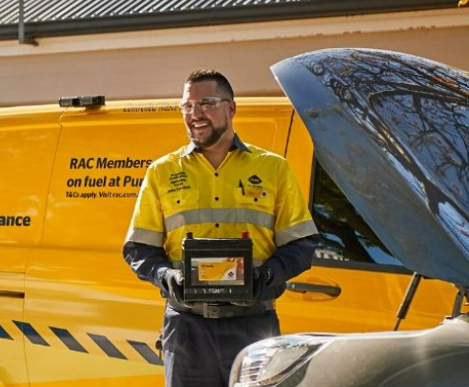
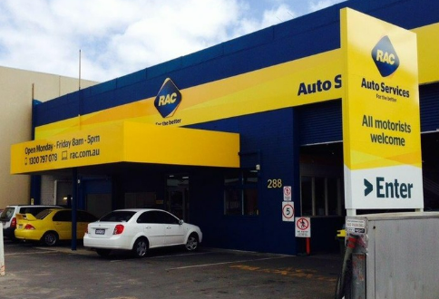

Notes:
SPEAKER NOTES:
Introduce yourself and state your strategic role as a 'Technical Project Lead' and 'Solutions Architect'.
Explain that you are presenting an end-to-end Case Study of the Vehicle Inspection Application (VIA) project.
Highlight that this project represents the perfect intersection of your technical depth in Dataverse/Power Platform and your leadership capabilities as a Scrum Master.
Frame the metadata: built for RAC's heavy-demand Motoring Services, replacing physical operational leakage with relational security.

Slide 2






Un-Governed Legacy Paper Workflows Constrained Growth
Pillar 1: THE EXECUTIVE CHALLENGE (THE PROBLEM)
Executive Impact
RAC's mobile patrols and auto mechanics were bound to a slow, physical paper workflow for car inspections. The lack of standard automation and real-time validation meant that simple transcription took up valuable frontline capacity, exposing the organization to operational friction and compliance threats.
OPERATIONAL INEFFICIENCY
10,000 Hours Wasted Annually
Manual transcription of complex VIN and Engine numbers consumed 2 to 3 minutes of frontline patrol time per job across 200,000 annual runs.
COMPLIANCE & SECURITY THREAT
Field Exposure of Sensitive PII
Physical paper logs with customer and vehicle details remained in roadside vans without obfuscation, creating serious data sovereignty and security risks.
SYSTEM ISOLATION
Siloed Data & Zero Analytics
Data was physically trapped on paper, preventing any real-time tracking, compliance auditing, automated notifications, or Power BI reporting.
BUSINESS RISK
Operational Leakage
Mobile patrols were bound to slow physical forms without standard automation or real-time validation.
.
Notes:
SPEAKER NOTES:
Focus on the 'Executive Challenge' here.
Explain that when you analyzed the environment, you realized this wasn't just an IT development request—it was a critical business sustainability and compliance problem.
Mention that 200k inspections annually meant that even a 2-minute delay per run was highly expensive, translating to massive operational leakage.
Highlight the risks of having physical, un-obfuscated PII paper files floating around roadside patrol vans.
Context (The Business Problem)
"At RAC, I led the digital transformation of the Vehicle Inspection Application (VIA). Our Breakdown Patrols were using paper forms, causing massive data silos and operational delays. As the Analyst Programmer, I was tasked with moving this to a high-performance Dataverse solution optimized for Surface Go tablets. My goal was to create a 'Single Source of Truth' that could handle 200,000 annual inspections while maintaining strict compliance for the Auto Services division."

Slide 3




Structured Agile Lifecycle Delivery & Mitigated Risks
Pillar 2: THE ENGINEERING CRAFT (SKILLS & METHODOLOGY)
1. ANALYSING REQUIREMENTS
Stakeholder Workshop & SID Elicitation
• Facilitated inception workshops directly with frontline patrols to map operational workflows.
• Translated fluid business 'pain' into structured technical and functional requirements.
• Authored comprehensive Solution Intent Documents (SIDs) as the single source of truth.
• Managed technical trade-offs, prioritizing immediate MVP features over long-term API extensions.
2. SCRUM LEADERSHIP & QA
Agile Execution & Zephyr Testing
• Operated as Scrum Master (PSM I), facilitating retrospectives, daily scrums, and backlog grooming.
• Developed and designed a mobile response canvas app and coordinated peer reviews with secondary developers.
• Authored QA checklists and test scripts managed in the Zephyr Scale tool for automated testing.
• Fix bug and deploy solutions to coordinate UAT testing by end-users to sign-off for production release.
3. ALM DEPLOYMENT & POST SUPPORT
Environment Staging & Helpdesk Handover
• Published user manual documentations and conducted end-user training.
• Created deployment guides to manage environment transition.
• Produced approved Service Definition and Transition checklists for BAU operations.
• Conducted hand over Level 1 support to the Helpdesk team.
Notes:
SPEAKER NOTES:
Use this slide to demonstrate your 'Engineering Craft' and complete ownership of the SDLC.
Explain your role as the 'Strategic Translator' bridging the gap between business needs and developer execution.
Discuss Step 1: Running discovery workshops with roadside patrols and writing the SIDs.
Discuss Step 2: Running scrum ceremonies (PSM I), backlog refinement, and introducing Zephyr Scale testing templates to prevent the 'rushed delivery' traps from earlier roles.
Discuss Step 3: Managing pipelines, authoring the environment deployment guides, and handing over support to Helpdesk.
I began by engaging directly with Breakdown Patrols and key stakeholders to gather detailed requirements during inception workshop, deeply understanding their on-the-ground challenges with the manual, paper-based forms.
"A key challenge was the stakeholder's request to pre-fill vehicle data like make, model via a lookup table. After conducting a technical discovery, I authored a Vehicle Data Options Paper. I identified that while an API integration was the 'ideal' end-state for future release, it would introduce significant technical debt and delay the MVP due to the complexity of the Auto Info API authentication.
I made the strategic decision to implement a system for R3—standardizing the data entry within Dataverse but keeping it manual for speed-to-market. I architected the back-end using Relational Data Modeling (Normalizing the Header and Checklist tables) and built a Custom Access Control Model.
I cloned the 'Basic User' security role to create a custom profile that restricted data access to specific AD Groups, ensuring we met PII (Personally Identifiable Information) standards.
Integrated the canvas app with Power Automate for efficient workflow automation and backend data processing.
Save record to Dataverse
Convert the form to PDF and upload the car inspection checklist report to SharePoint doc library, so that mechanic can later email the report to the customers.
I also managed the full pipeline to move the solution from DEV->UAT to Production, ensuring no environment drift occurred.
Export and importing vehicle lookup data from DEV across to UAT & production
Created a comprehensive deployment guide for moving the app from UAT to production, as no existing documentation was available when I inherited the work
Including deployment As-Built document for ISO certification process requires

Slide 4

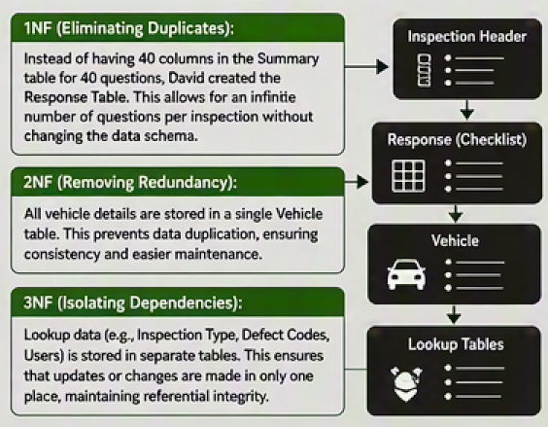

Dataverse Normalisation Strategy
Pillar 3: THE ARCHITECTURAL BLUEPRINT (THE SOLUTION)
Architect the VIA project using this *normalised 5 Dataverse tables relational model to ensure the VIA product could scale to 200,000+ records without performance degradation. By separating Questions from Responses table, David made the system 'Future-Proof.' If a user needs to add a new checklist question tomorrow, they don't need a developer to change the UI; they just add a row to the Questions Table. This reduces technical debt and ensures the new question added in question table is auto populated into the canvas app.
PLATFORM GOVERNANCE & SECURITY
Hardened Security Staging
Custom Dataverse Role (Basic User - MWPSOL-141):
Followed a 'Least Privilege' model - Created a custom role called 'Basic User - MWPSOL-141' by cloning the standard base role and hardening it. This restricted the Delete and Share permissions on the Inspection tables to protect PII. This ensured that only members of the verified AD Security Group could interact with the data, which is the same level of compliance rigor I’d apply to the client's SaaS environment.
Question & Inspection Summary Table:
Granted User-level access of Create & write for users who own the records they create are assigned to the basic user security role. The organisation (every other user else in the basic user security role) will have read access to every record, but no one is allowed to delete the records. This ensured that a patrol member could create and edit their own inspections but couldn't necessarily delete records or view inspections from unrelated departments.
Notes:
SPEAKER NOTES:
This is your 'Architectural Blueprint' slide.
Explain that rather than using a flat-file database like SharePoint which lacks enterprise-grade relational integrity, you insisted on Microsoft Dataverse.
Explain the 5 tables: Vehicle lookup master, Questions dynamic config, Summary header, Response transactional lines, and Media metadata.
Detail how the Questions table keeps the app data-driven: adding new questions doesn't require code updates, eliminating future technical debt.
Discuss security: 'Basic User - MWPSOL-141' custom role cloned to restrict Delete/Share, mapped to AD groups, and released via staged rings (0 to 4).
followed a 'Least Privilege' model. I created a custom role called 'Basic User - MWPSOL-141' by cloning the standard base role and hardening it. I specifically restricted the Delete and Share permissions on the Inspection tables to protect PII.
This ensured that only members of the verified AD Security Group could interact with the data, which is the same level of compliance rigor I’d apply to the client's SaaS environment.
Question & Inspection Summary Table: You granted User-level access of Create & write for users who own the records they create are assigned to the basic user security role. The organisation (every other user else in the basic user security role) will have read access to every record, but no one is allowed to delete the records. This ensured that a patrol member could create and edit their own inspections but couldn't necessarily delete records or view inspections from unrelated departments.

Slide 5

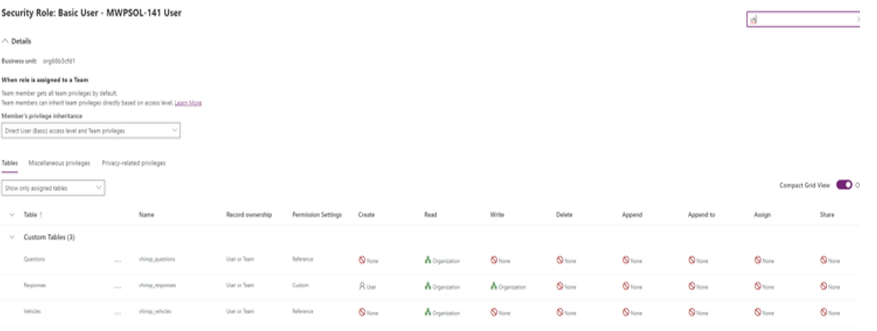
Dataverse Normalisation Strategy
Pillar 3.1 : THE ARCHITECTURAL BLUEPRINT (THE SOLUTION)
PLATFORM GOVERNANCE & SECURITY
Hardened Security Staging
Response Table:
Grant User-level access of Create for users who own the records they create. However, every other user can read any response records and continue to update a record to continue from where the last person had saved it.
Photo Table:
Grant User-level access for Create for users who own the records they create. Admin (organisation) has full visibility to entire record to read, write and delete.
PLATFORM COMPLIANCE SECURITY
Zero Tech Debt
• Relational 5-table Dataverse schema successfully cleared all corporate security and compliance audits.
• Hardened security roles eliminated sensitive PII exposure & protect sensitive data in the field.
Notes:
Response Table: Grant User-level access of Create for users who own the records they create. However, every other user can read any response records and continue to update a record to continue on from where the last person had save it.
Inspection Photo Table: Grant User-level access for Create for users who own the records they create. Admin (organisation) has full visibility to entire record to read, write and delete.
Why this matters:
User scope = Least privilege, good for data isolation.
Organization scope = Broad access, suitable for admins or roles that need full visibility/control.

Slide 6
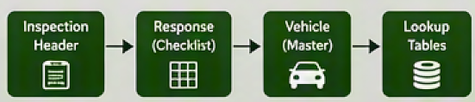
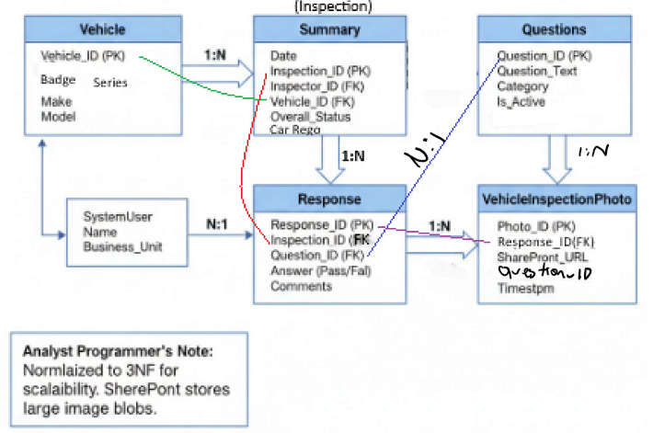
Secure Relational 3NF Schema Replaced Flat-File Limits
Pillar 3.2 : THE ARCHITECTURAL BLUEPRINT (THE SOLUTION)
DATABASE NORMALISATION (3NF)
Relational 5-Table Schema
Vehicle (Master Lookup):
Stores persistent asset data (VIN, Rego, Make, Model) to eliminate repetitive typing.
Questions (Metadata Config):
Keeps the system fully data-driven. Checklist questions are loaded from database dynamically without redeploying code.
Summary (Header Transaction):
Stores core event details (Inspector name, Overall status, GPS location, timestamp).
Response (Line Items Child):
Captures transactional pass/fail answers for 40+ inspection points linked back to Header.
Media Metadata (Attachments):
Stores secure photo links. Files are offloaded to a governed SharePoint Document Library to reduce Dataverse storage costs.
Notes:
SPEAKER NOTES:
This is your 'Architectural Blueprint' slide.
Explain that rather than using a flat-file database like SharePoint which lacks enterprise-grade relational integrity, you insisted on Microsoft Dataverse.
Explain the 5 tables: Vehicle lookup master, Questions dynamic config, Summary header, Response transactional lines, and Media metadata.
Detail how the Questions table keeps the app data-driven: adding new questions doesn't require code updates, eliminating future technical debt.
Discuss security: 'Basic User - MWPSOL-141' custom role cloned to restrict Delete/Share, mapped to AD groups, and released via staged rings (0 to 4).

Slide 7
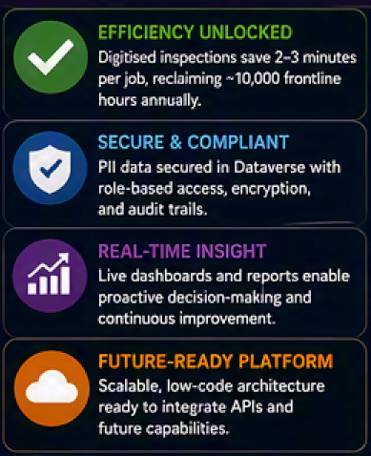
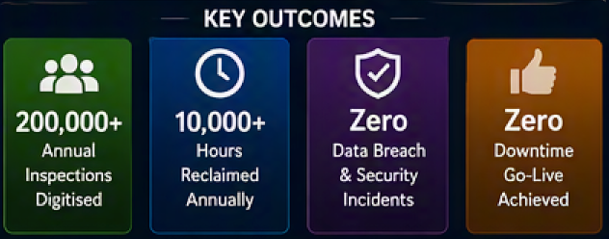

Operational & Compliance Transformation Yielded 100% Success
Pillar 4: DELIVERING DIRECT, MEASURABLE BUSINESS ROI AND FINANICAL SAVINGS WITH OPERATIONAL EXCELLENCE
COMMERCIAL RETURN ON INVESTMENT
AU$500,000+
• Direct operational capacity and human labor value returned to Motoring Services.
• Substantially reduced downstream administrative and data remediation costs.
• Established a secure, scalable model for rapid multi-branch system rollout.
RECLAIMED FRONT-LINE CAPACITY
• Directly saved 2 to 3 minutes of manual transcription effort per job.
• Reclaimed the equivalent productivity of over 5 full-time employees (FTEs)
• Eliminated transcription error logs and automated field reporting workflows.
Notes:
The result was a successful launch on June 3, 2024, saving the business $500,000 annually and It directly saved Breakdown Patrols 2-3 minutes per job, which, based on 200,000 jobs annually, translates to an estimated of total saved time of *416 days annually.
*Total Time Saved (Annual)
-Low Estimate (2 mins): 6,666 hours (approx. 277 days)
-High Estimate (3 mins): 10,000 hours (approx. 416 days)
-100% reduction in manual data entry errors
This project demonstrates exactly how I work: I don't just build apps; I analyze the requirements, weigh the technical trade-offs (like deferring the API for an MVP)
I don't just write code; I solutionize. I can translate complex council requirements into reusable technical designs, manage the Azure DevOps pipeline, and write the .NET/React logic needed to extend Dataverse beyond its standard limits. I’m ready to help you scale the CouncilFirst platform with that same level of rigor."

Slide 8

Operational & Compliance Transformation Yielded 100% Success
Pillar 4.1 : DELIVERING DIRECT, MEASURABLE BUSINESS ROI AND FINANICAL SAVINGS WITH OPERATIONAL EXCELLENCE
GO-LIVE
3 June 2024
Equivalent to approximately 277 to 416 twenty-four-hour days.
RECLAIMED CAPACITY
QUALITY & REPORTING
Manual paper transcription were eliminated, and field reporting was automated.
SCALE & COMPLIANCE
Five-table Dataverse schema, governed PII and a repeatable rollout blueprint support future expansion.

Slide 9
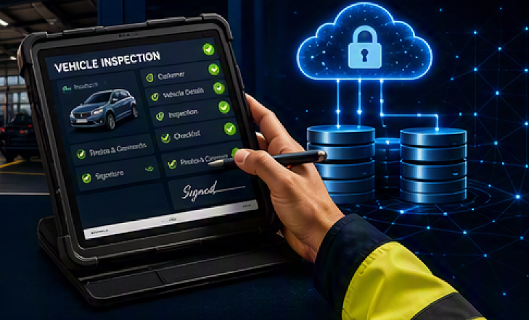
Why the VIA Matters to Managers
Evidence of David Liong who converts frontline problems into secure, scalable and valuable application.
BUSINESS ANALYSIS
Facilitated frontline workshops, authored SIDs and converted operational pain into a prioritised MVP.
SOLUTION ARCHITECTURE
Designed a secure 3NF Dataverse model, data-driven questions and governed document storage.
DELIVERY LEADERSHIP
Led Scrum, QA, peer review, ALM pipelines, deployment guides and Helpdesk transition.
COMMERCIAL IMPACT
Returned 6,667 to 10,000 hours annually and more than AU$500K in operational value.
David do not just build apps. He translate requirements, manage trade-offs and solutionise platforms that deliver measurable value.

