Slide 1

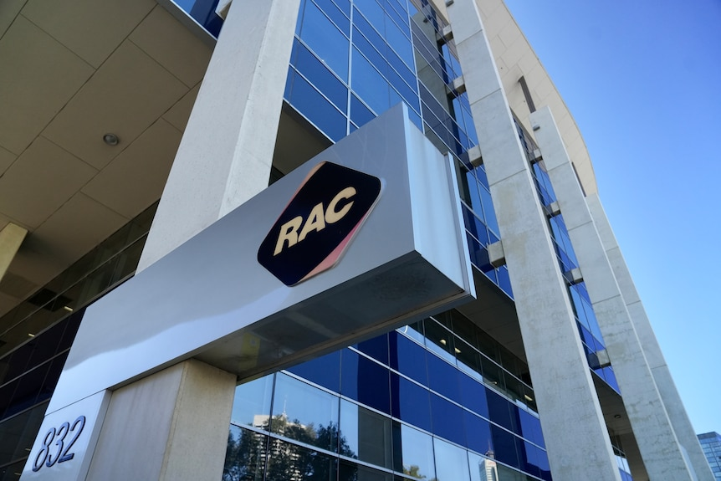
Customer Story
At RAC a house brand insurance company for Western Australia, David Liong with a core team of 7 members lead a large-scale digital transformation project of exiting the data centre by delivering cloud migrations from file shares across to SharePoint Online.
The outcome of delivering the entire migration was reducing annual operational expenditure (OpEx) by approximately $100K (achieved by reducing operational running costs from $112K to $12K per annum when existing the data center on premise)
$100K+ ANNUAL RECURRING SAVINGS – Post migration
130,000+ documents | 13 site collections migrated | zero file loss | 0 P1 incidents
Notes:
Welcome the panel and introduce David Liong as a Senior Solutions Architect with over 15 years in the Microsoft ecosystem.,Explain the migration from legacy on-premises file shares to SharePoint Online, Teams and OneDrive, enabling RAC to exit its physical data centre.,Highlight technical execution and commercial sustainability, producing over $100K in annual recurring savings.,[Sources],Visual on this slide was generated with Microsoft Copilot.,[/Sources]

Slide 2
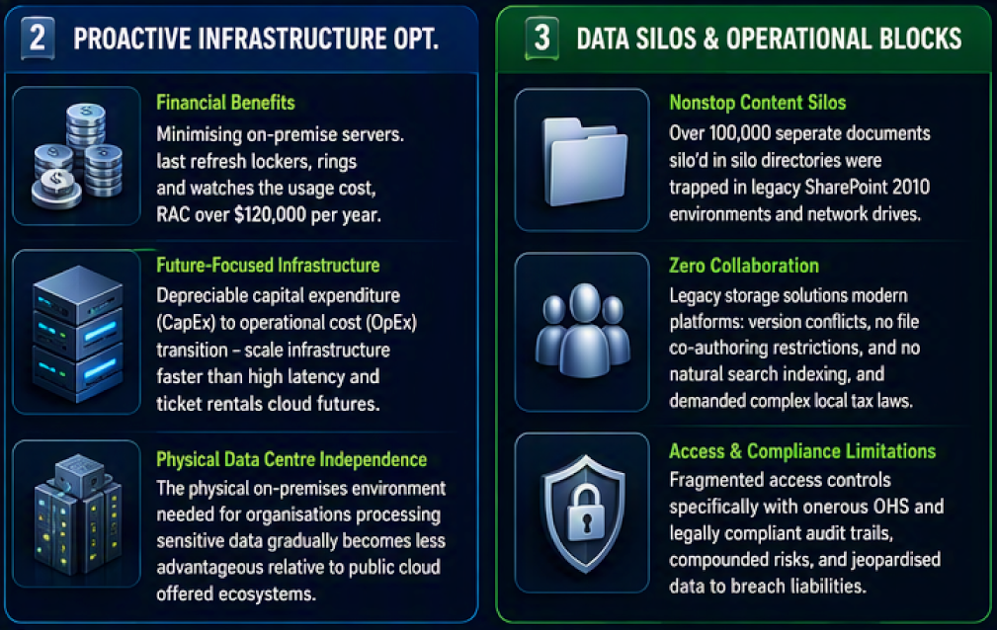
PILLAR 2 | THE EXECUTIVE CHALLENGE
Legacy On-Premises File Shares Imposed High OpEx and Siloed Corporate Data
A costly physical footprint, fragmented content and limited modern collaboration constrained the cloud-first strategy.
$112K
Annual legacy OpEx: Before migration
130K+
Corporate documents migrated
13
SharePoint site collections migrated
$12K
Annual Cloud OpEx:
After migration
$100K
Annual Savings!
Access & Compliance Liabilities: INS and HR lacked mobile responsiveness and governed permissions.
Notes:
Explain the $112,000 annual operating expense and the technical debt of physical servers and NetApps storage.,Describe the 130,000 business-critical files across HR, financial and insurance content.,Emphasise slow search, no co-authoring and poor mobile access for frontline staff.,[Sources],Visual on this slide was generated with Microsoft Copilot.,[/Sources]

Slide 3
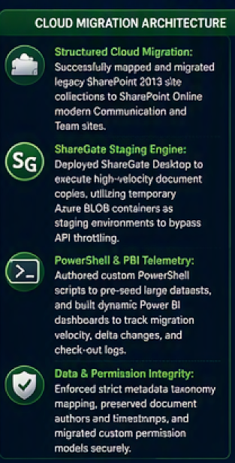
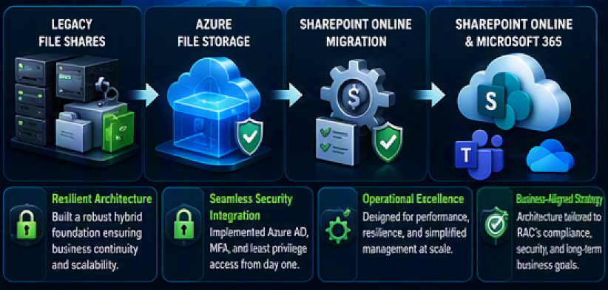
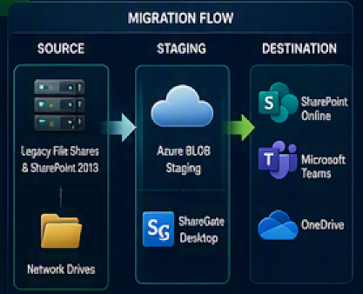
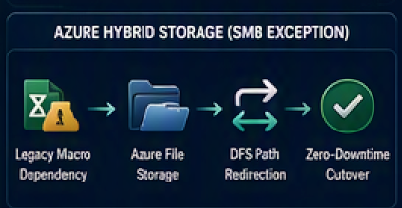
PILLAR 3 | THE ARCHITECTURAL BLUEPRINT
Engineering Content Staging, Permission Preservation and the Azure SMB Exception
A Governed migration pattern moved modern content to Microsoft 365 while protecting macro-dependent legacy workflows.
Legacy Macro Block: Complex Excel macros depended on physical network paths.
Custom-made SMB Solution: 14 secure Azure File Storage folders hosted legacy content.
DFS Path Redirection: UNC paths shifted to Azure endpoints with zero downtime.
Notes:
For approximately 90% of data, use the standard SharePoint Online and Teams migration route through ShareGate.,Explain Azure BLOB staging for API throttling and PowerShell plus Power BI telemetry.,Describe the hybrid SMB exception for VBA macros, 14 secure Azure folders and DFS redirection with zero downtime.,[Sources],Visual on this slide was generated with Microsoft Copilot.,[/Sources]

Slide 4

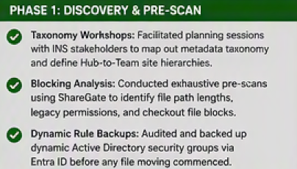
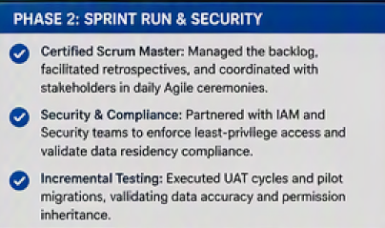
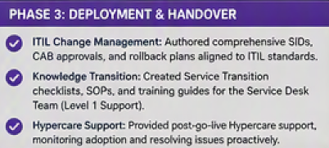






PILLAR 4 | THE ENGINEERING CRAFT
Rigorous Pre-Migration Scans, Agile Backlogs and Service Transition Checklists
A disciplined three-phase SDLC migration processes to achieve protected data integrity, security, delivery velocity and operational readiness.
STRATEGIC MIGRATION PLAN
No content moved without a map, a security baseline, a rollback strategy and an operational handover plan.
Plan → Pre-scan → Build → Test → Delta migration → CAB → Deployment → Handover → Decommission
Notes:
Position David as the Strategic Translator, not only a migration scripter.,Phase 1 established taxonomy, blockers and security-group backups.,Phase 2 used Scrum delivery, SIDs, rollback strategies and DLP controls.,Phase 3 completed audits, Helpdesk handover and server decommissioning.,[Sources],Visual on this slide was generated with Microsoft Copilot.,[/Sources]

Slide 5
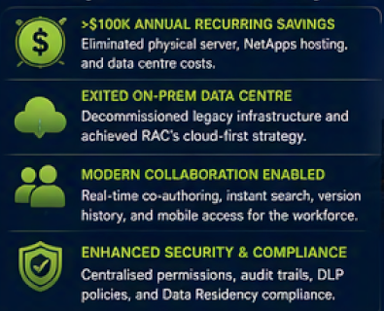
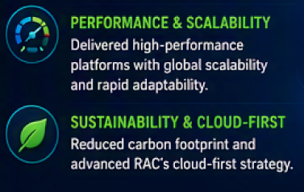
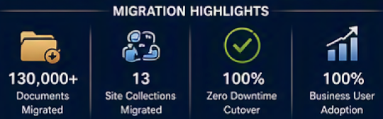
PILLAR 5 | THE QUANTIFIED VALUE
Strategic Outcomes and Business Impact
Delivering financial value (Annual saving of $100K), operational excellence (85% opex reduction)and future ready collaboration
$100K+
85%
100%
ANNUAL RECURRING SAVINGS
OPEX REDUCTION
DATA INTEGRITY
Notes:
Conclude with the quantified value.,Costs reduced from $112,000 to $12K-$16K, representing approximately 85% OpEx reduction and over $100K recurring annual savings.,Emphasise 13 site collections and over 130,000 files with zero data loss, zero downtime and zero P1 incidents.,[Sources],Visual on this slide was generated with Microsoft Copilot.,[/Sources]

Slide 6
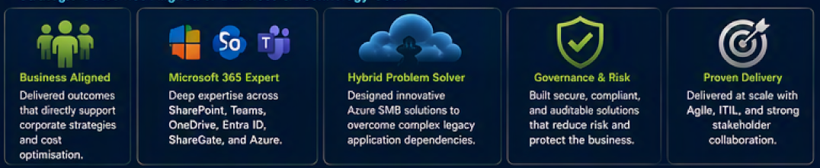
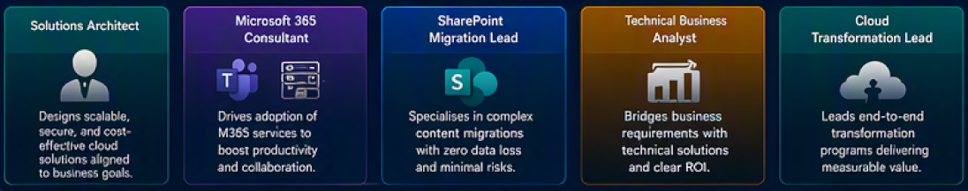
HIRING RELEVANCE
Why This Case Study Matters to Future Managers/Employers
This case matters because strategic outcomes align to business & technology goals
ROLE ALIGNMENT
Role Alignment: How David Liong Adds Value
Notes:
Connect the evidence to hiring criteria: commercial acumen, enterprise Microsoft 365 architecture, hybrid problem solving and controlled delivery.,Highlight role alignment across Solutions Architecture, Microsoft 365 consulting, SharePoint migration and cloud transformation leadership.,[Sources],Visual on this slide was generated with Microsoft Copilot.,[/Sources]

