Slide 1
Fleet Mobility & Relational Data Transformation
The Vehicle Inspection Application (VIA) Case Study
LEAD SPECIALIST
David Liong
• Professional Scrum Master (PSM I)
• Power Platform Developer Focus
• Solution Architect PL-600 Focus
• Experienced Technical BA & Lead
TECH STACK
Power Platform Core
• Microsoft Dataverse (3NF Schema)
• Power Apps (Canvas & Model-Driven)
• Power Automate Flow Orchestration
• SharePoint Online Document Library
CLIENT CONTEXT
RAC Motoring Services
• Sector: Automotive & Roadside
• Scope: 200,000 annual inspections
• Goal: Process digitisation
• Impact: Zero-downtime go-live
Notes:
SPEAKER NOTES:
Introduce yourself and state your strategic role as a 'Technical Project Lead' and 'Solutions Architect'.
Explain that you are presenting an end-to-end Case Study of the Vehicle Inspection Application (VIA) project.
Highlight that this project represents the perfect intersection of your technical depth in Dataverse/Power Platform and your leadership capabilities as a Scrum Master.
Frame the metadata: built for RAC's heavy-demand Motoring Services, replacing physical operational leakage with relational security.

Slide 2
Un-Governed Legacy Paper Workflows Constrained Growth
THE EXECUTIVE CHALLENGE (THE PROBLEM)
BUSINESS RISK
Operational Leakage
RAC's mobile patrols were bound to a slow, physical paper workflow for inspections. The lack of standard automation and real-time validation meant that simple transcription took up valuable frontline capacity, exposing the organization to operational friction and compliance threats.
OPERATIONAL INEFFICIENCY
10,000 Hours Wasted Annually
Manual transcription of complex VIN and Engine numbers consumed 2 to 3 minutes of frontline patrol time per job across 200,000 annual runs.
COMPLIANCE & SECURITY THREAT
Field Exposure of Sensitive PII
Physical paper logs with customer and vehicle details remained in roadside vans without obfuscation, creating serious data sovereignty and security risks.
SYSTEM ISOLATION
Siloed Data & Zero Analytics
Data was physically trapped on paper, preventing any real-time tracking, compliance auditing, automated notifications, or Power BI reporting.
Notes:
SPEAKER NOTES:
Focus on the 'Executive Challenge' here.
Explain that when you analyzed the environment, you realized this wasn't just an IT development request—it was a critical business sustainability and compliance problem.
Mention that 200k inspections annually meant that even a 2-minute delay per run was highly expensive, translating to massive operational leakage.
Highlight the risks of having physical, un-obfuscated PII paper files floating around roadside patrol vans.

Slide 3
Dataverse Normalisation Strategy
THE ARCHITECTURAL BLUEPRINT (THE SOLUTION)
Architect the VIA project using this *normalised 5-table relational model because it mirrors how a professional SaaS product should behave. By separating Questions from Responses, David made the system 'Future-Proof.' If a user needs to add a new checklist question tomorrow, they don't need a developer to change the UI; they just add a row to the Questions Table. This reduces technical debt and ensures the new question added in question table is auto populated into the canvas app.
*Third Normal Form (3NF) Strategy
David applied Third Normal Form (3NF) to ensure the VIA product could scale to 200,000+ records without performance degradation:
1NF (Eliminating Duplicates):
Instead of having 40 columns in the Summary table for 40 questions, David created the Response Table. This allows for an infinite number of questions per inspection without changing the data schema.
2NF (Removing Redundancy):
All vehicle details (Model, Make) live in the Vehicle look up Table. The Summary table only stores a Vehicle_ID foreign key. This ensures that if a make is corrected, it updates across all historical records automatically.
3NF (Transitive Dependencies):
ensured the Summary table only stores data directly related to the event (like the timestamp). Data related to the Inspector (like their user’s name) is looked up via the SystemUser table to prevent data drift.
PLATFORM GOVERNANCE & SECURITY
Hardened Security Staging
Custom Dataverse Role (Basic User - MWPSOL-141):
Followed a 'Least Privilege' model - Created a custom role called 'Basic User - MWPSOL-141' by cloning the standard base role and hardening it. This restricted the Delete and Share permissions on the Inspection tables to protect PII. This ensured that only members of the verified AD Security Group could interact with the data, which is the same level of compliance rigor I’d apply to the client's SaaS environment.
Container Access & Entra ID Security Groups:
Mapped the custom Dataverse security profiles strictly to Active Directory (Entra ID) Security Groups to manage secure user entry automatically.
Controlled Release Rings:
Configured staged deployment via Active Directory release groups (Rings 0 through 4) to manage change rollout and mitigate production risk.
Notes:
SPEAKER NOTES:
This is your 'Architectural Blueprint' slide.
Explain that rather than using a flat-file database like SharePoint which lacks enterprise-grade relational integrity, you insisted on Microsoft Dataverse.
Explain the 5 tables: Vehicle lookup master, Questions dynamic config, Summary header, Response transactional lines, and Media metadata.
Detail how the Questions table keeps the app data-driven: adding new questions doesn't require code updates, eliminating future technical debt.
Discuss security: 'Basic User - MWPSOL-141' custom role cloned to restrict Delete/Share, mapped to AD groups, and released via staged rings (0 to 4).
followed a 'Least Privilege' model. I created a custom role called 'Basic User - MWPSOL-141' by cloning the standard base role and hardening it. I specifically restricted the Delete and Share permissions on the Inspection tables to protect PII.
This ensured that only members of the verified AD Security Group could interact with the data, which is the same level of compliance rigor I’d apply to the client's SaaS environment.
Question & Inspection Summary Table: You granted User-level access of Create & write for users who own the records they create are assigned to the basic user security role. The organisation (every other user else in the basic user security role) will have read access to every record, but no one is allowed to delete the records. This ensured that a patrol member could create and edit their own inspections but couldn't necessarily delete records or view inspections from unrelated departments.
Response Table: Grant User-level access of Create for users who own the records they create. However, every other user can read any response records and continue to update a record to continue on from where the last person had save it.
Inspection Photo Table: Grant User-level access for Create for users who own the records they create. Admin (organisation) has full visibility to entire record to read, write and delete.
Why this matters:
User scope = Least privilege, good for data isolation.
Organization scope = Broad access, suitable for admins or roles that need full visibility/control.

Slide 4
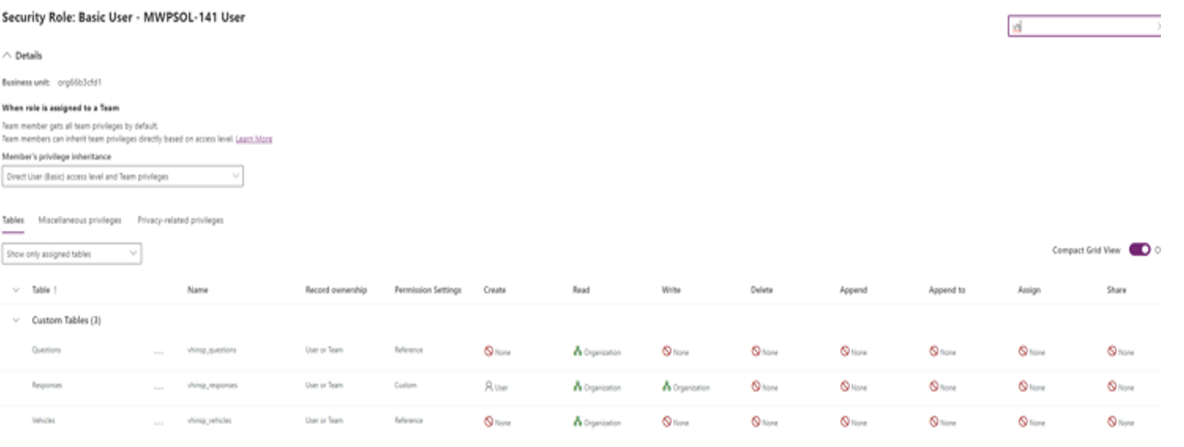

Slide 5
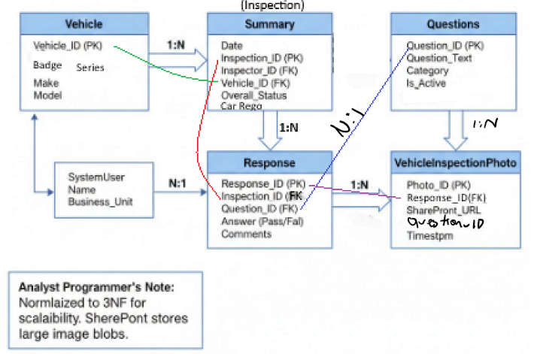
Secure Relational 3NF Schema Replaced Flat-File Limits
THE ARCHITECTURAL BLUEPRINT (THE SOLUTION)
DATABASE NORMALISATION (3NF)
Relational 5-Table Schema
Vehicle (Master Lookup):
Stores persistent asset data (VIN, Rego, Make, Model) to eliminate repetitive typing.
Questions (Metadata Config):
Keeps the system fully data-driven. Checklist questions are loaded from database dynamically without redeploying code.
Summary (Header Transaction):
Stores core event details (Inspector name, Overall status, GPS location, timestamp).
Response (Line Items Child):
Captures transactional pass/fail answers for 40+ inspection points linked back to Header.
Media Metadata (Attachments):
Stores secure photo links. Files are offloaded to a governed SharePoint Document Library to reduce Dataverse storage costs.
Notes:
SPEAKER NOTES:
This is your 'Architectural Blueprint' slide.
Explain that rather than using a flat-file database like SharePoint which lacks enterprise-grade relational integrity, you insisted on Microsoft Dataverse.
Explain the 5 tables: Vehicle lookup master, Questions dynamic config, Summary header, Response transactional lines, and Media metadata.
Detail how the Questions table keeps the app data-driven: adding new questions doesn't require code updates, eliminating future technical debt.
Discuss security: 'Basic User - MWPSOL-141' custom role cloned to restrict Delete/Share, mapped to AD groups, and released via staged rings (0 to 4).

Slide 6
Structured E2E Lifecycle Delivery Mitigated Implementation Risks
THE ENGINEERING CRAFT (SKILLS & METHODOLOGY)
1. ANALYSING REQUIREMENTS
Stakeholder Workshop & SID Elicitation
• Facilitated inception workshops directly with frontline patrols to map operational workflows.
• Translated fluid business 'pain' into structured technical and functional requirements.
• Authored comprehensive Solution Intent Documents (SIDs) as the single source of truth.
• Managed technical trade-offs, prioritizing immediate MVP features over long-term API extensions.
2. SCRUM LEADERSHIP & QA
Agile Execution & Zephyr Testing
• Operated as Scrum Master (PSM I), facilitating retrospectives, daily scrums, and backlog grooming.
• Established standard code-quality metrics and coordinated peer reviews with secondary developers.
• Authored developer-ready QA checklists and test scripts managed in the Zephyr Scale tool.
• Designed try-catch logic and local data imports to troubleshoot and resolve empty-table errors in UAT.
3. ALM & DEPLOYMENT GOVERNANCE
Environment Staging & Helpdesk Handover
• Standardized Infrastructure as Code (IaC) using automated pipelines (Azure DevOps and GitHub).
• Created first-of-their-kind, robust deployment guides to manage environment transition.
• Produced approved Service Definition and Transition checklists for BAU operations.
• Conducted peer mentorship and training to hand over Level 1 support to the Helpdesk team.
Notes:
SPEAKER NOTES:
Use this slide to demonstrate your 'Engineering Craft' and complete ownership of the SDLC.
Explain your role as the 'Strategic Translator' bridging the gap between business needs and developer execution.
Discuss Step 1: Running discovery workshops with roadside patrols and writing the SIDs.
Discuss Step 2: Running scrum ceremonies (PSM I), backlog refinement, and introducing Zephyr Scale testing templates to prevent the 'rushed delivery' traps from earlier roles.
Discuss Step 3: Managing pipelines, authoring the environment deployment guides, and handing over support to Helpdesk.

Slide 7
Operational & Compliance Transformation Yielded 100% Success
DELIVERING DIRECT, MEASURABLE BUSINESS ROI AND ARCHITECTURAL STABILITY
RECLAIMED FRONT-LINE CAPACITY
10,000 Hours
• Directly saved 2 to 3 minutes of manual transcription effort per roadside patrol job.
• Reclaimed the equivalent productivity of over 5 full-time employees (FTEs), returning them directly back to active field service.
• Completely eliminated transcription error logs and automated field reporting workflows.
COMMERCIAL RETURN ON INVESTMENT
AU$500,000+
• Direct operational capacity and human labor value returned to Motoring Services.
• Substantially reduced downstream administrative and data remediation costs.
• Established a secure, scalable model for rapid multi-branch system rollout.
PLATFORM COMPLIANCE SECURITY
Zero Debt
• Relational 5-table Dataverse schema successfully cleared all corporate security and compliance audits.
• Hardened security roles eliminated sensitive PII exposure in the field.
• Provided a repeatable governance blueprint for future Power Platform implementations.
Notes:
SPEAKER NOTES:
Deliver the 'Quantified Value'—your mic-drop moment.
Explain that you didn't just build an app; you recovered 10,000 hours, equivalent to over 5 FTEs.
Highlight the financial impact: over AU$500,000 in recurring annual value returned to RAC's Motoring Services.
Close by emphasizing that you achieved this with zero technical debt—a clean 3NF database schema and custom security roles that cleared all compliance reviews.
Frame this as the exact blueprint of the results, security posture, and quality standards you will bring to the hiring manager's team.

