Slide 1

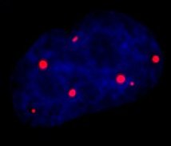
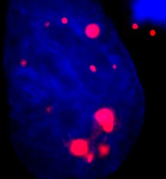
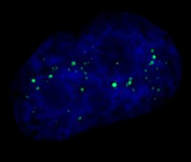
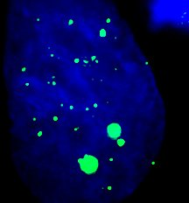
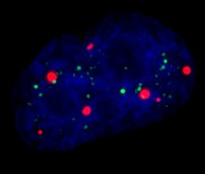
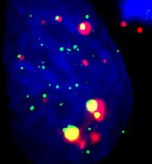
Development of a high content, automated platform for rapid analysis of alternate lengthening of telomeres (ALT)-associated promyelocytic leukemia nuclear bodies (APBs) in human cancer cells Manali Aggrawal, David Halvorsen, Thomas Hunt, Avni Singhal, Haroldo Silva*
Abstract
Results
Summary
Most cancers prevent telomere loss, senescence and apoptosis by expressing telomerase. Yet, about 10-15% of cancers employ a telomerase-free, homologous recombination-based mechanism known as alternative lengthening of telomeres (ALT). Unlike the telomerase-based pathway, no ALT-specific targets or therapeutics are yet available due in part to a lack of robust ALT assays. Here we develop and validate a high-speed, high-content version of the established ALT-associated promyelocytic leukemia (PML) nuclear body (APB) assay, wherein co-localization of PML with telomeric chromatin (e.g., TRF2) occurs prominently in ALT cells. Currently, the APB assay is impractical for high-throughput applications as it requires complex three-dimensional (3-D) confocal image acquisition, reconstruction and analysis using a supercomputer for robust statistical results. Here we use the Molecular Devices ImageXpress Micro Widefield High Content Screening System and MetaXpress imaging and analysis software running on a regular desktop computer for automated imaging and analysis of APBs in human ALT cells in multi-well plates. We validated our platform by treating cells with agents previously reported to modulate APB levels. During image acquisition, a maximum pixel intensity projection algorithm collapses Z-stacks into a two-dimensional (2-D) image. This platform reproduces key published data (e.g., average number of APBs per nuclei) in a less data-intensive format (2-D vs. 3-D) and therefore it is about 5-6 times faster than previous methods while keeping similar statistical power. Our platform provides useful parameters for the standardization of the APB assay and a powerful tool to screen drugs and genetic targets for functional impact on ALT activity.
Cell count & APB count
TRF2 Analysis
CONTROL
DMSO
1mM HU
Green bars represent the % fraction of FITC in APBs and Red bars represent the % fraction of Texas Red in APBs. Yellow bars are the co localized spots, or APBs.
Time Estimate
 | 60X | 40X | 20X
 | (hours) | (hours) | (hours)
Acquisition run time | 21 | 17 | 12
Image analysis time | 8 | 5 | 3
Total time | 29 | 22 | 15
APB count
 | 60X |  | 40X |  | 20X
 | Average | SEM | Average | SEM | Average | SEM
control | 4.10 | 0.07 | 4.02 | 0.00 | 3.82 | 0.01
dmso | 4.05 | 0.06 | 3.47 | 0.01 | 3.37 | 0.00
0.5mM HU | 5.92 | 0.12 | 5.35 | 0.02 | 5.19 | 0.01
1 mM HU | 6.22 | 0.13 | 5.75 | 0.02 | 5.50 | 0.00
2 mM HU | 5.75 | 0.13 | 5.49 | 0.01 | 5.11 | 0.01
3 mM HU | 5.38 | 0.12 | 4.89 | 0.02 | 5.25 | 0.01
Conclusions
A high throughput and high content version of the APB assay was successfully developed and validated for the drug screening.
Hydroxyurea was chosen as a control drug because of its known effect on APB count.
Our results clearly show the increase in the APB count with the Hydroxyurea treatment.
FITC and Texas Red spot analysis indicates that the size and intensity of the proteins (TRF2 and PML respectively) increases with the colocalization.
APB assay was successfully performed to study the effects of Hydroxyurea (HU) on the ALT pathway.
APB count increases by ~2-2.5 APBs on treating with 0.5mM and1mM Hydroxyurea (HU).
At concentrations of 2 and 3mM HU, there is a leveling off effect i.e. no more increase in APB was seen.
The green curves/bars in the figure above represent the total FITC spots and yellow ones represent the FITC spots that are part of APBs. The shift to the right side of the yellow curve indicates that the size/area and intensity of the TRF2 protein increases with co localization, or APB formation.
APB Distribution
PML Analysis
60X
40X
20X
CONTROL
DMSO
1mM HU
References
Introduction
1. Shay, J. W., Reddel, R. R. & Wright, W. E. Cancer and Telomeres--An ALTernative to Telomerase. Science 336, 1388–1390 (2012).
2. Cesare, A. J. & Reddel, R. R. Alternative lengthening of telomeres: models, mechanisms and implications. Nat. Rev. Genet. 11, 319–330 (2010).
3. Wu, L. et al. Pot1 deficiency initiates DNA damage checkpoint activation and aberrant homologous recombination at telomeres. Cell 126, 49–62 (2006).
4. Lackner, D. H., Raices, M., Maruyama, H., Haggblom, C. & Karlseder, J. Organismal propagation in the absence of a functional telomerase pathway in Caenorhabditis elegans. EMBO J. 31, 2024–2033 (2012).
5. Harley, C. B. Telomerase and cancer therapeutics. Nat. Rev. Cancer 8, 167–179 (2008).
6. Osterwald, S. et al. A three-dimensional colocalization RNA interference screening platform to elucidate the alternative lengthening of telomeres pathway. Biotechnol. J. 7, 103–116 (2012).
7. Chung, I., Osterwald, S., Deeg, K. I. & Rippe, K. PML body meets telomere: The beginning of an ALTernate ending? Nucleus 3, (2012).
8. Cesare, A. J. & Reddel, R. R. Telomere uncapping and alternative lengthening of telomeres. Mech. Ageing Dev. 129, 99–108 (2008).
ALT - (control)
ALT + (control)
N = 1556
APB distribution at all three settings (60X, 40X, 20X) shows a right
shift in the curve with the HU treatment which clearly indicates an
increase in the number of APBs per cell.
DAPI/PML
N = 1000
DAPI Analysis
DAPI/TRF2
DAPI/PML/TRF2
Similarly, analysis of Texas Red spots shows that the area and intensity of the TRF2 protein increases with the co localization, or APB formation. This could be due to the enhanced binding of the protein to the telomeres in APB formation.
The trend was similar irrespective of the treatment.
High-throughput APB assay. Fluorescence micrographs of ALT-associated PML nuclear bodies (APBs). Average number of APBs per cell (± SEM, N indicates number of cells analyzed) for ALT (+) and ALT (-) lines. Distribution of APBs per cell for ALT (+) and ALT (-) lines.
Hydroxyurea (HU) blocks cells in the S phase by inhibiting the DNA metabolism enzyme.
The right shift of the curve on treatment with 1mM HU indicates the increase in DNA content from N to 2N.

