Slide 1

We work for tomorrow

Slide 2
Donating Surplus Energy in Socio-Ecological Energy Communities
Rosanna Bruno

Slide 3
Contents of the presentation
01
Project Background
Short introduction to SEEC & SetEnergy
04
Methodolgy & Variables
Survey design und Variables
02
Research objective
What do we want to capture
05
Conlusion & Outlook
Next steps
03
Theoretival Background
Literature & Key Concepts

Slide 4
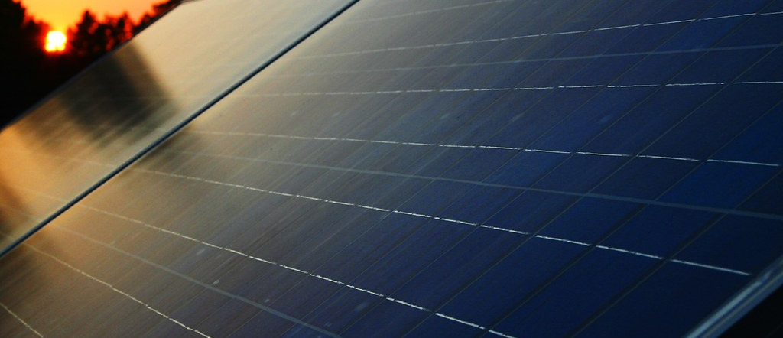
Project Background
01
SetEnergy
The SEEC Concept
Bild: stock.adobe.com
"Dieses Foto" von Unbekannter Autor ist lizenziert gemäß CC BY-SA

Slide 5
Surplus Electricity: What’s Missing?
The Context
Rapid increase in private PV installations
More households become prosumers, generating surplus electricity
Current situation
Surplus is often fed into the grid for a relatively low return
Energy communities enable local sharing or trading
What’s missing
A scalable way to turn PV surplus into social impact (e.g., support for vulnerable / energy-poor households)
Bild: Uni Graz

Slide 6
The SEEC Solution
What is a SEEC?
SEEC = socio-ecological energy community
A local energy community where people and organisations produce, use, and share renewable electricity.
“Socio-ecological” means it has social goals (e.g., fair access / support for vulnerable households) and environmental goals (more renewables, lower CO₂).
It helps use PV surplus locally (sharing, trading, or donating).
Bild: Uni Graz

Slide 7

Robin Powerhood
RobinPowerhood
(real example in Austria)
An Austria-wide energy community where PV surplus from households and companies can be donated.
The donation supports households affected by energy poverty (often via partner charities).
Result: PV surplus creates social impact (lower bills) and supports the energy transition.
Simple flow: PV surplus → donate via Robin Powerhood → support households in need.
Bild: Uni Graz

Slide 8

Energy Poverty — Key Facts
3.2%
Heating not affordable
In 2022, 3.2% of Austrian households reported they could not keep their home adequately warm (≈ 129,500 households)
Austria
129.500 households
16.5%
High energy burden
In 2022, 16.5% of households spent more than 10% of household income on energy costs. Low income + above-average energy costs affected 3.3% (≈ 134,100 households).
10.6%
EU comparison (2023)
EU (2023): 10.6% (~48 million) couldn’t keep homes adequately warm; Austria: 3.9%.
Bild: Uni Graz / Maria Kanizaj

Slide 9
Literature: Why People Donate
┌───────────────────────────────────────────────┐
│ Literature (Bekkers & Wiepking, 2011) │
│ 8 mechanisms of giving │
└───────────────────────────────────────────────┘
│
▼
┌───────────────────────────────────────────────┐
│ Our survey predictors │
│ We measure variables linked to these mechanisms │
└───────────────────────────────────────────────┘
│
▼
┌───────────────────────────────────────────────┐
│ Application to SEEC / PV surplus │
│ Predict donation / sharing intentions │
└───────────────────────────────────────────────┘
• Donation behaviour can be explained by 8 key mechanisms (Bekkers & Wiepking, 2011)
• These mechanisms help structure which predictors we measure and why
• We transfer this logic to donating/sharing PV surplus electricity (social + energy context)
Bild: Uni Graz

Slide 10
The 8 Mechanisms (Bekkers & Wiepking, 2011)
Bild: Uni Graz

Slide 11
From Mechanisms to Our Survey Blocks (Predictors)
Bild: Uni Graz

Slide 12
Research Objective
02
SetEnergy
Bild: stock.adobe.com
"Dieses Foto" von Unbekannter Autor ist lizenziert gemäß CC BY-SA

