Slide 1
Grand Unification
David McGaughey, Ph.D.
OGVFB | NEI | NIH

Slide 2
Situation
500+ clinical sequencing test assays
~5 every two weeks
Two files returned per assay
Report
.xlsx

Slide 3
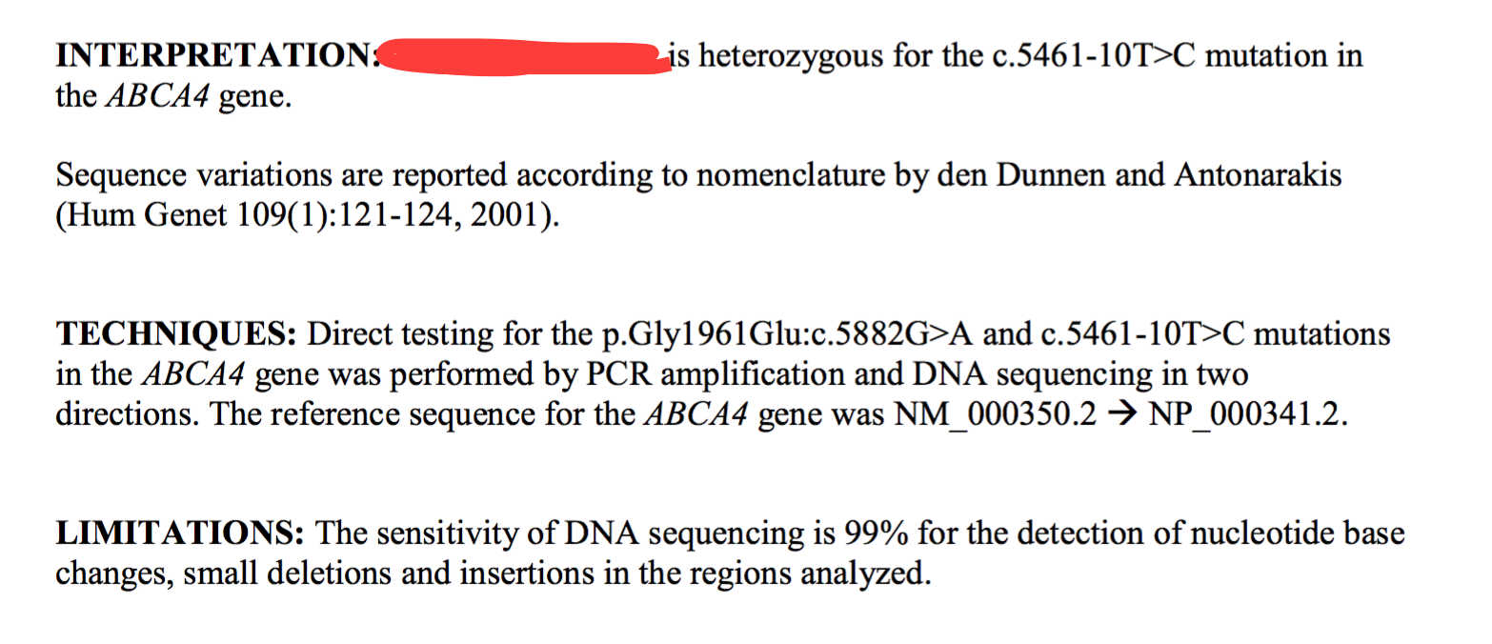
Report

Slide 4
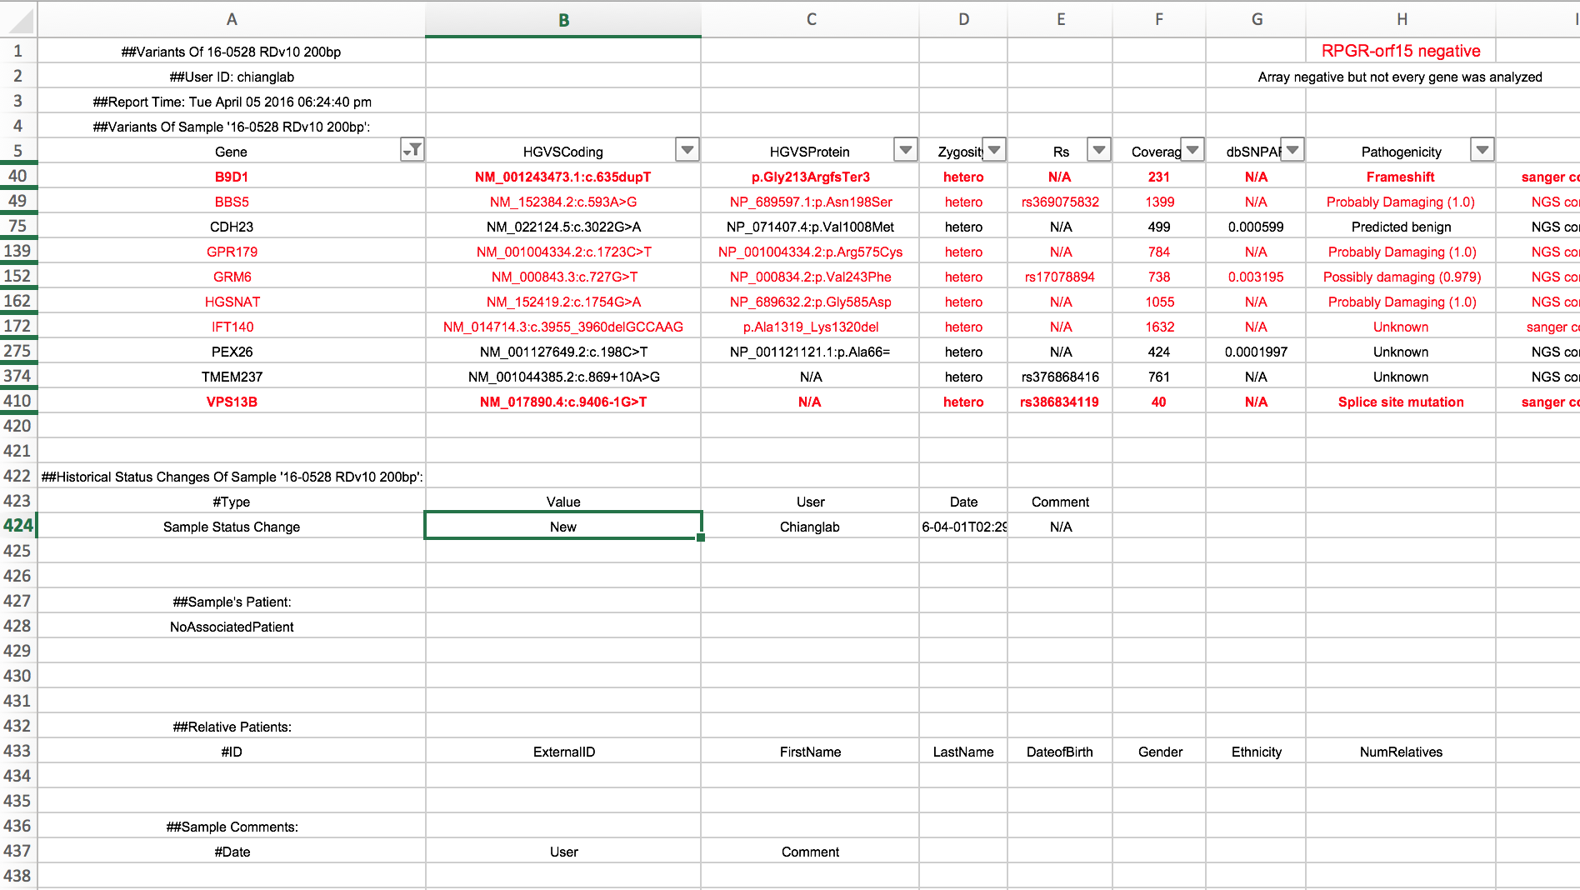
Variants

Slide 5
Workflow
Counselor/clinician (counsilician) reads report
If counsilician agrees:
Confirm at molecular rounds
Else:
Looks at the excel file to see what variants have been identified
Use domain knowledge to alter report
Confirm at molecular rounds

Slide 6
Problems
Difficult to quickly evaluate variants
Excel file is inconsistently annotated
Missing useful annotations (HGMD, clinvar, etc.)
LOTS of ‘hidden’ variants
False negative?
What if MVL put a causative allele in the ‘hidden’ bin?
Impossible to know how prevalent variant is in our population
No cross communication between samples

Slide 7
Prototype Workflow
.xlsx (MVL Genomics)
vcf
failed conversions
annotated vcf
master vcf
master Gemini DB
OGVFB cohort allele counts
McOutput

Slide 8
What do we want McOutput to be?
(Better name)
Information dense
Limited in scope
Only as powerful as necessary
Visually sparse
Only show what you need
(Difficult when Rob has requested 38 fields of information per variant)

Slide 9
McOutput

