Slide 1
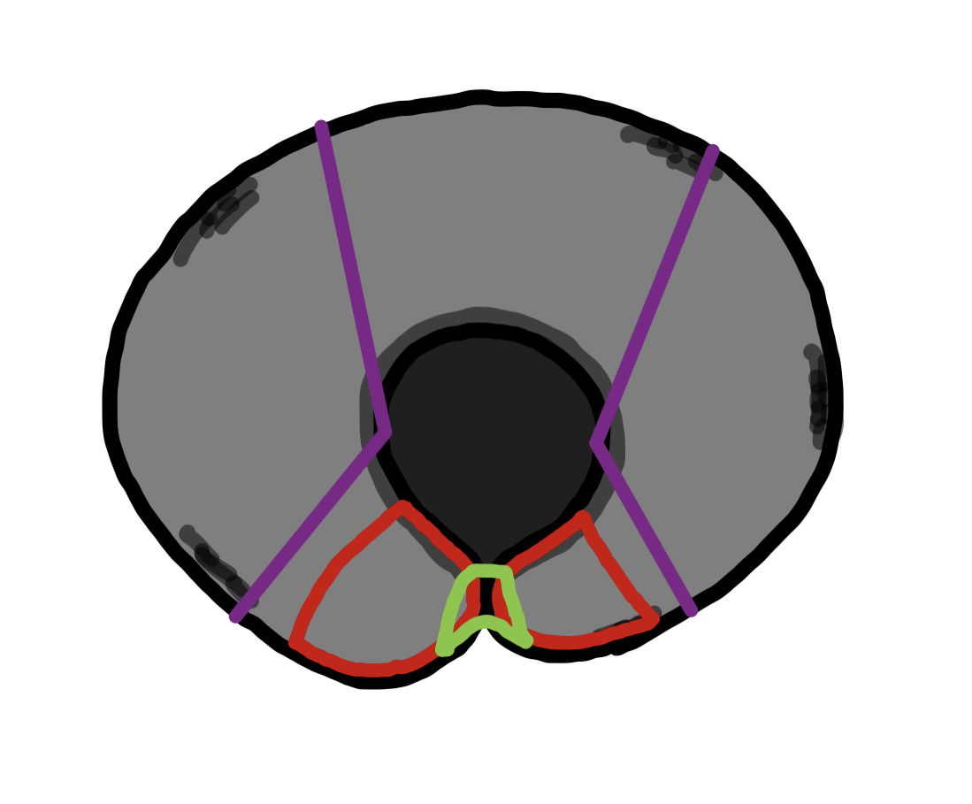
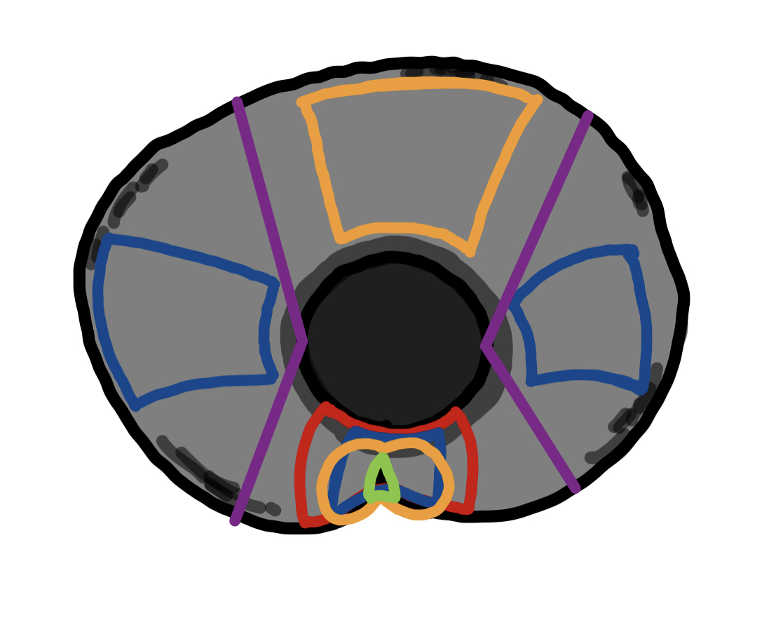
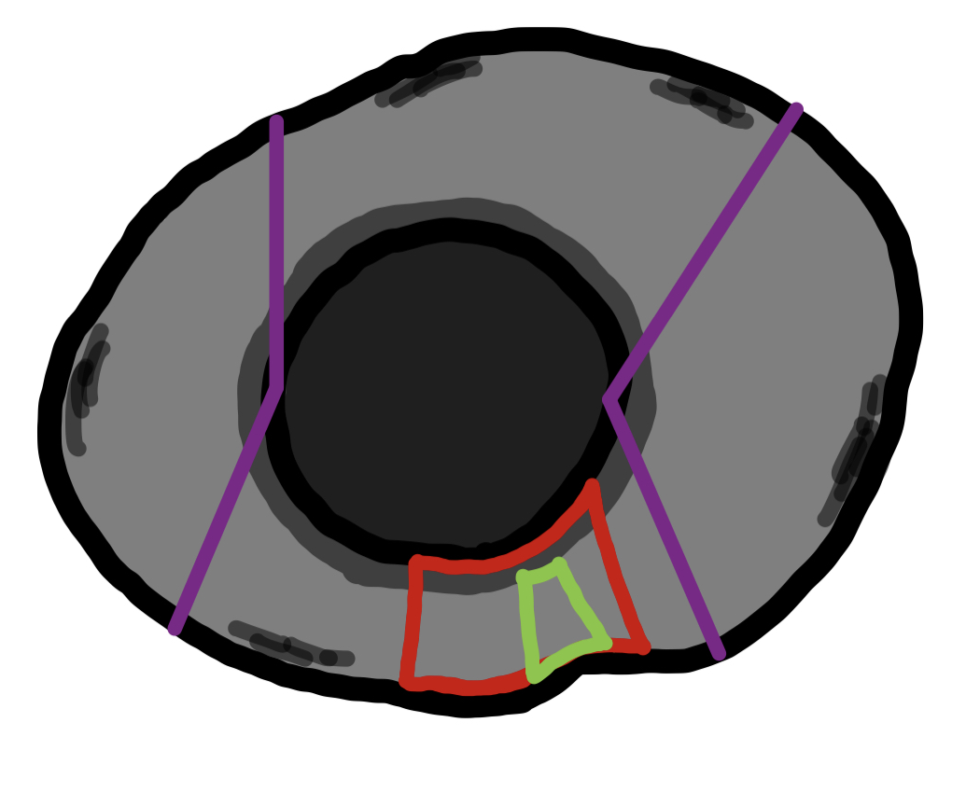
Before Fusion
During Fusion
After Fusion
IRIS
DR
NR
TR
LENS
OFM
OFM
OFM

