Slide 1


Agency Priority Goal Action Plan
Leased Building Operations
Goal Leader:
Daniel W. Mathews, Commissioner, Public Buildings Service (PBS)
Fiscal Year 2019, Quarter 3

Slide 2
Overview
Goal Statement
GSA will generate savings for taxpayers by negotiating 55 percent of the lease office space agreements at or below market rates in FY 2018 and FY 2019.
Challenge
GSA strives to be below commercial office space leasing market rates for every transaction, yet it can be difficult to do so with the complexities of the Government marketplace.
Opportunity
Negotiating leases below market costs results in cost savings for customer agencies and the taxpayer.
Cost avoidance in rent can be reallocated to mission delivery services to the public.
2

Slide 3
Goal Structure & Strategies
GSA will achieve lease cost avoidance for the taxpayer by successfully executing the following strategies:
Capitalizing on opportunities to reduce square footage and engage in longer lease terms when they allow GSA to obtain more favorable rates.
Increasing the use of the force multiplier tools, both the Automated Advanced Acquisition Program (AAAP) and the GSA Leasing Support (GLS) services contract, to maximize staff resources, increase competitive advantage, and ultimately, to increase lease replacement rates.
Improving the planning process to ensure timely replacement of expiring leases. Timely replacement increases GSA’s leverage, which means more favorable rental rates and fewer costly lease extensions.
3

Slide 4
Summary of Progress – Q3 FY 2019
Through the third quarter of FY 2019, GSA negotiated 46 percent (183 out of 399 transactions) of leases at or below the midpoint of market rates. Even though nearly half of the individual transactions were above market costs, the total aggregated GSA lease costs were eleven percent below ($218m in present day dollars) market lease costs.
To improve performance, GSA continues to focus on increasing usage of longer lease terms, reducing the number of extensions, increasing the use of workforce-multiplier tools such as AAAP and GLS, and implementing training on tools and policies which contribute to cost avoidance.
4

Slide 5
Key Milestones
Fostering, developing, and implementing our core strategies will require process re-engineering, change management, and knowledge management projects and initiatives. Below are the key milestones that will enable us to achieve our goal of reducing leasing costs.
Key Milestone | Milestone Due Date | Milestone Status | Comments and discussion of progress, changes from last update, anticipated barriers, or other issues related to milestone completion
Set utilization targets for AAAP and GLS | Q1 FY 2019 | Complete | FY19 targets were developed and communication for each region based on the projected workload.
Set utilization targets for lease replacement rates. | Q1 FY 2019 | Complete | FY19 targets were developed and communication for each region based on the total value of expiring lease inventory. Targets are based on percentage of value replaced, vs. extended.
Review regional lease cost avoidance plans | Q4 FY 2019 | On-track | GSA regularly reviews each region’s plan to replace expiring high-value leases. In these reviews, GSA focused on increasing the use of the tools, procuring longer lease terms, and getting timely requirements; resulting in rates below market and cost avoidance to the taxpayer and Customer agencies. Regional visits are being scheduled with regions to review the plan and recurring deep dive meetings to review progress towards achieving the plans are occurring each month.
Implement staffing plans based on RACI resourcing model | Q4 FY 2019 | On-track | Based on RACI staffing modeling, recommendations for resourcing regional leasing programs were identified. Additional resources are being identified to implement recommending staffing levels.
Measure AAAP and GLS usage against FY19 targets | Q4 FY 2019 | On-track | GSA achieved the AAAP and GLS goals in FY18. FY19 goals were developed and communicated for these two programs. GSA has monthly reporting and tracking against goals.
Measure lease replacement rates against FY19 targets. | Q4 FY 2019 | On-track | GSA developed and implemented a goal for lease replacement rate based on the value of expiring leases and the percent that is replaced, versus extended. GSA monitoring monthly achievement against goals.
5

Slide 6
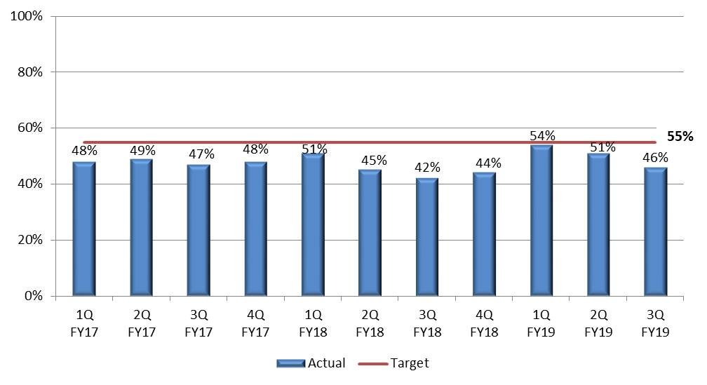
Key Indicators
By enhancing operations, GSA strives to increase the percentage of lease transactions that are at or below market costs.
6

