Slide 1
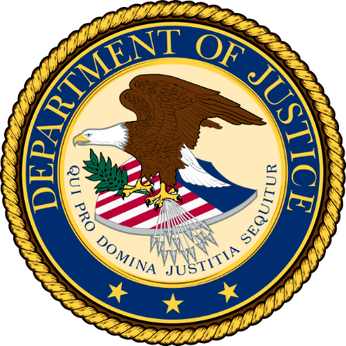


Agency Priority Goal Action Plan
Reduce Consumer Risk from Regulated Products through Modernization
Goal Leader:
Jeremy Todd Reed, Chief Operating Officer
June, 2020

Slide 2
Overview
Goal Statement
The Food Safety and Inspection Service (FSIS) will reduce consumer risk from FSIS-regulated products by systematically controlling and preventing hazards through the use of modernized systems, policies, and scientific approaches. By September 30, 2021, the Department intends to propose or implement eight modernization initiatives.
Challenges
Competing internal and external deadlines as these documents are reviewed during the clearance process.
Opportunities
Leverage current processes to oversee performance, mitigate risk and monitor progress while continuing to ensure strategic alignment.

Slide 3
Leadership & Implementation Team
The Agency leverages its Enterprise Governance process to achieve its APG. This process, formally documented in policy, has executive-level enterprise boards that align up to the Management Council for decision-making and implementation. This process involves all levels of leadership through to the Agency Administrator.
FSIS collaborates with FDA and other Federal agencies, when applicable, to ensure new policies and initiatives are consistently promoting best practices for food safety. Several examples of this include the FSIS-FDA Dual-Jurisdiction Establishments Workgroup, the Interagency Collaboration on Genomics for Food and Feed Safety, and the Interagency Food Safety Analytics Collaboration, to name a few.
Entity | Members | Responsibilities
Management Council | FSIS Executives | Decision-making, prioritization and oversight of the Agency’s public health mission, goals, priorities and resource management
Enterprise Governance Boards | Enterprise Steering Board Enterprise Investment Board Enterprise Architecture Board | Recommending proposals and initiatives for decision-making and implementation
Office of Policy & Program Development | Issuances Staff | Developing and delivering policy and regulations
Office of Field Operations | Regulatory Operations | Implementing policy and regulations.

Slide 4
Goal Structure & Strategies
 | Goal: Reduce consumer risk from FSIS-regulated products by systematically controlling and preventing hazards using modernized systems, policies, and scientific approaches. By September 30, 2021, USDA intends to propose or implement eight modernization initiatives.
Strategies | Leverage current enterprise governance process for decision-making. This process streamlines the approval of new systems, policies, and scientific approaches by allowing governance boards to research details and identify issues early on in the process.
Connection (Strategic Outcome) | USDA Goal 7: Provide All American Access to a Safe, Nutritious and Secure Food Supply FSIS Strategic Plan Goal 1: Prevent Foodborne Illness and Protect Public Health FSIS Strategic Plan Goal 2: Modernize Inspection Systems, Policies and the Use of Scientific Approaches
Limitations | Agency policy staff bandwidth Department clearance process OMB rulemaking process

Slide 5
Summary of Progress – FY 2020, Q1-Q2
Four modernization initiatives are in Agency Drafting
These initiatives address performance standards for various FSIS-regulated products.
Three modernization initiatives are with the Office of General Counsel
These initiatives address inspection and lab modernization.
One modernization initiative has been published
Modernization of Swine Slaughter Inspection – this Rule amends existing Federal meat inspection regulations to establish an optional new inspection system for market hog slaughter establishments that has been demonstrated to provide public health protection at least equivalent to the existing inspection system.

Slide 6
Key Milestones and Status for FY 2020
Key milestones are tracked internally via the Agency’s priority dashboard using the following progress criteria, as applicable:
Key Milestone | Q1 Status | Q2 Status | Q3 Status | Q4 Status
Workplan to OMB
Agency Drafting | 5 initiatives | 4 initiatives
Office of General Council | 1 initiative | 3 initiatives
Agency Clearance
Department Clearance
Office of Management and Budget
Office of Federal Register
Published | 2 initiatives | 1 initiative
*The Agency tracks eight initiatives at any given time. Quarterly status represents the eight initiatives being tracked for that quarter.

Slide 7
Additional Information
Stakeholder / Congressional Consultations
During policy development, the Office of Policy and Program Development consults with the Office of Field Operations and other FSIS program areas, as needed.
FSIS fulfills its obligation to notify the Union of changes in policy through the procedures in the collective bargaining agreement with the National Joint Council of Food Inspectors, which is the exclusive representative of the bargaining unit employees.
Through the Federal Register process, FSIS will request comments before finalizing any of the initiatives. Potential stakeholders may include industry or consumer advocacy groups.

