Slide 1
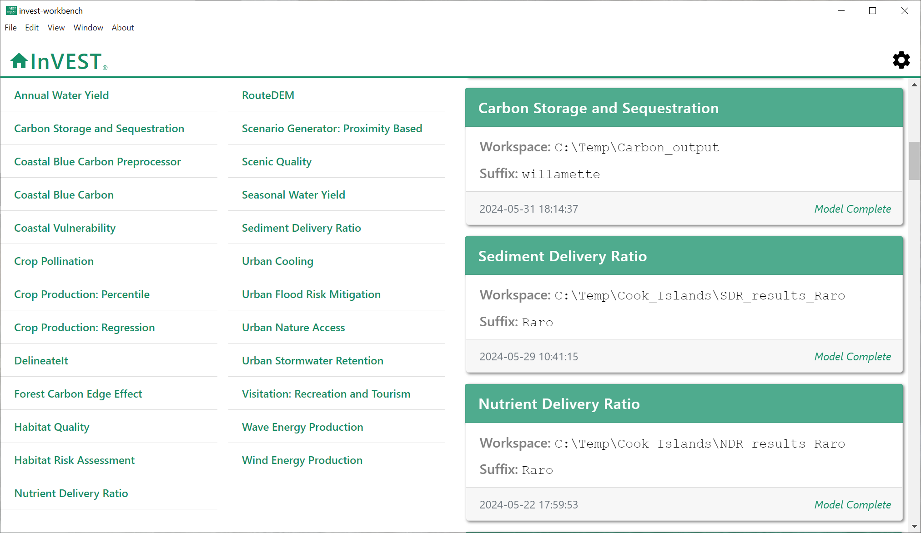
Home
screen
Previous
model runs
Settings/
Sample data
InVEST models

Slide 2
Settings/
Sample data

Slide 3
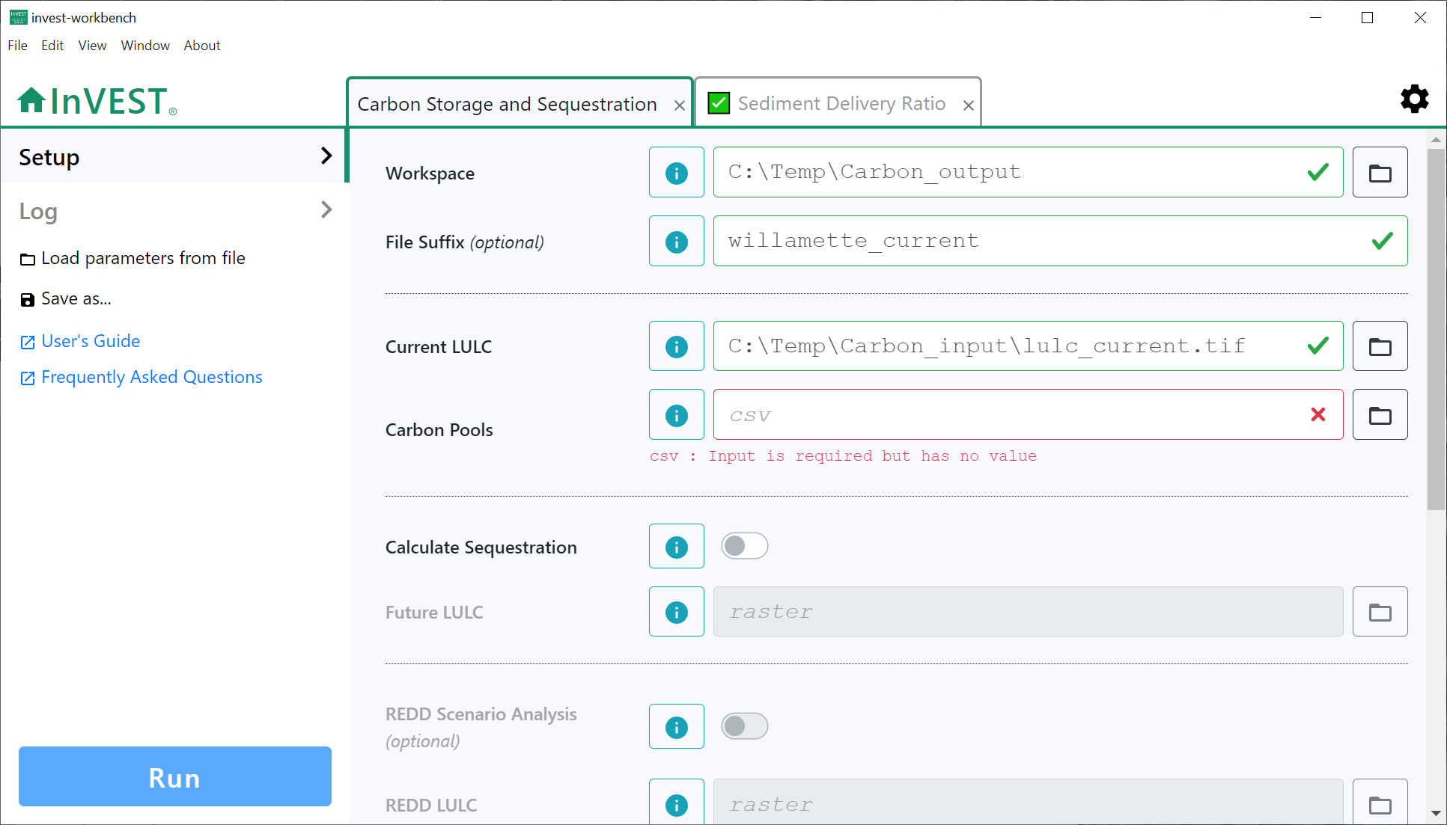
Tabs for multiple
model runs
Model
inputs
Load parameters and optionally data from a saved file
Save parameters and optionally data to a file
Link to User Guide
chapter for this model
Link to Community Forum posts related to this model
Click to run
the model

Slide 4
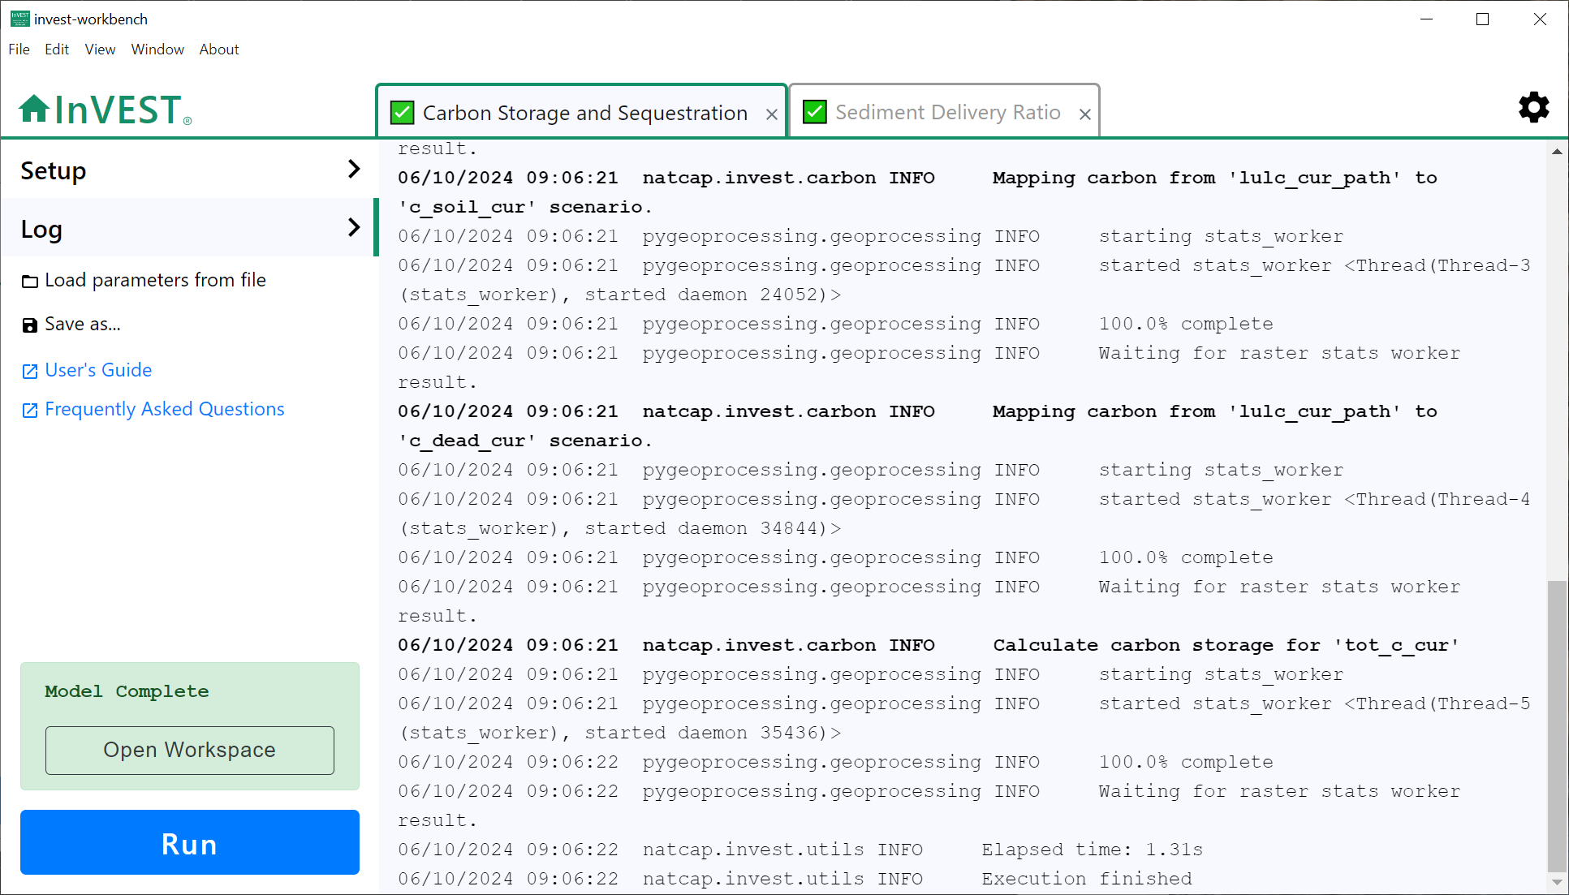
Logging
messages
Click to return to
the model input screen
Click to view logging messages for this model run
Click to view
results

