Slide 1
Intro to App Model Development for SharePoint & O365
October 2014

Slide 2

Dave Milner | @davemilner
.NET developer since inception ~2000
SharePoint and O365 focused since 2007
Apress author
MCITP/MCSD
Microsoft V-TSP

Slide 3
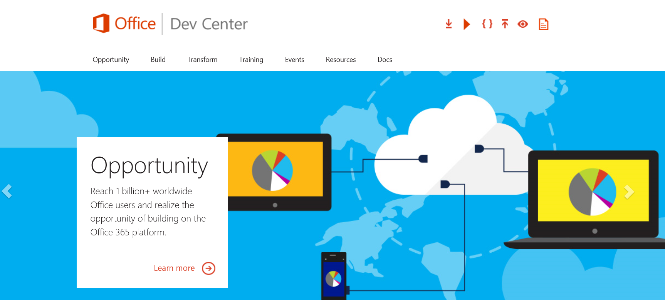
dev.office.com

Slide 4
Jump Start Target Agenda
Office 365 Development
Module 1: Getting started with Apps for SharePoint and Apps for Office
Module 2: Intro to the Office 365 APIs
Module 3: Moving Full Trust Code to the Cloud Using Repeatable Patterns and Best Practices

Slide 5
Intro to the Office 365 APIs

Slide 6
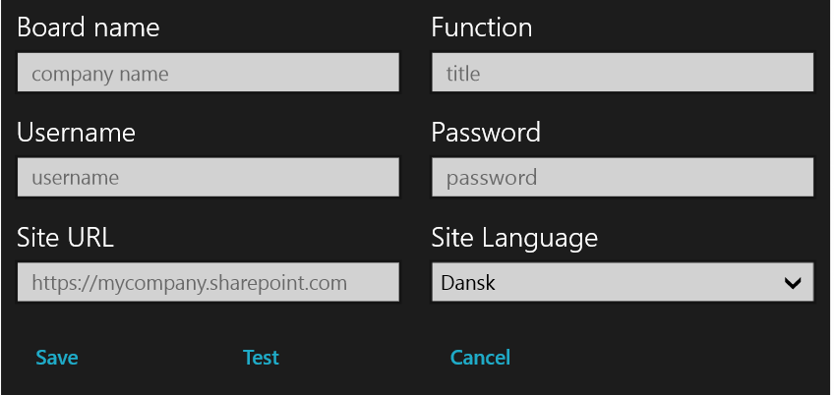
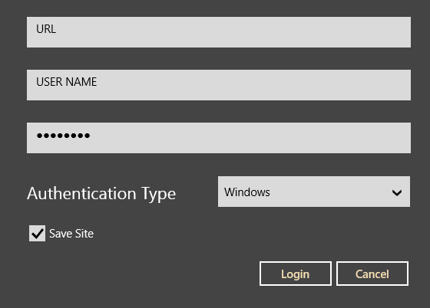
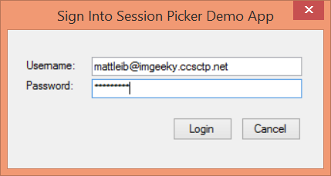
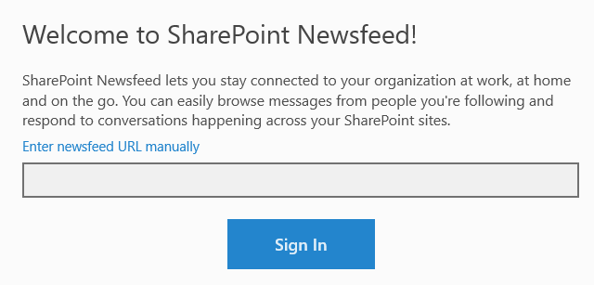
Office 365 device apps

Slide 7
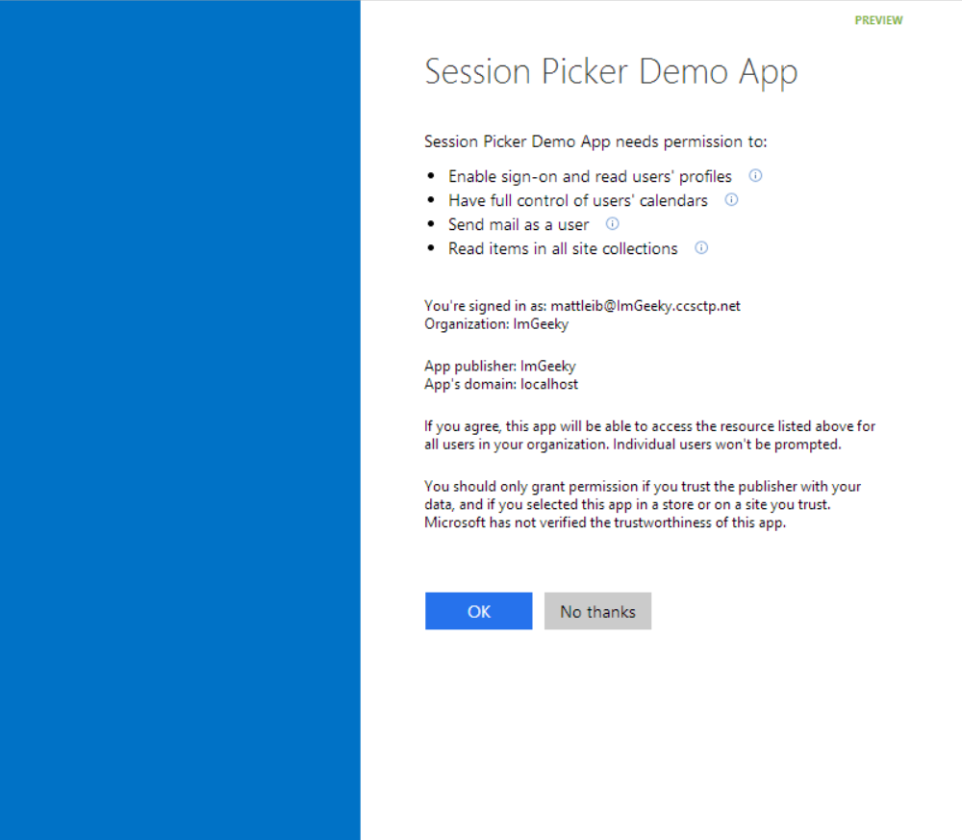
Common consent

Slide 8
Single authentication flow for Office 365
Azure AD graph, Exchange, SharePoint,…
Device apps and standalone websites
Admin and end-user consent

Slide 9
Secure protocol
OAuth 2.0
No capturing user credentials
Fine-grained access scopes
Supports MFA and federated user sign-in
Long-term access through refresh tokens

Slide 10
Office 365 discovery services
Automatically determine URL of O365 services
Supports device app and website flows
Secured using Azure AD authentication
Serves information stored about services in AAD

Slide 11
Office 365 APIs
Active Directory
Exchange
SharePoint
OneDrive
for Business
Users
Mail
Sites
Files
Calendar
Groups
Contacts

Slide 12
The SharePoint client APIs will work
Lists and libraries
User profile
Search
Taxonomy
Feeds
…
_api
Execute query
REST/ OData
JavaScript library
Silverlight library
.Net CLR library
Custom client code

Slide 13
Getting Started

Slide 14
http://aka.ms/o365apis

Slide 15
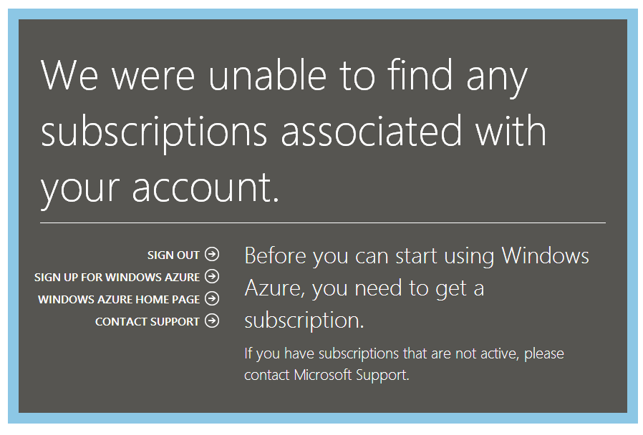

Slide 16
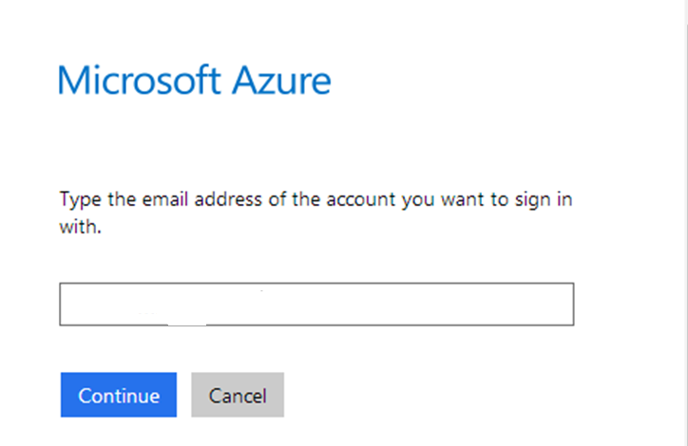

Slide 17
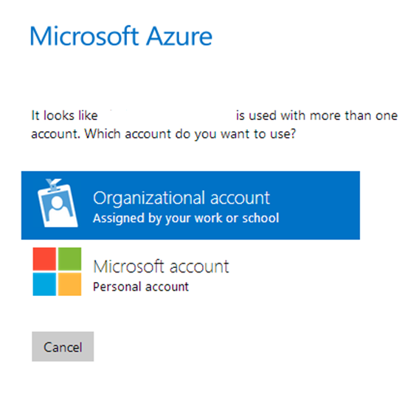

Slide 18
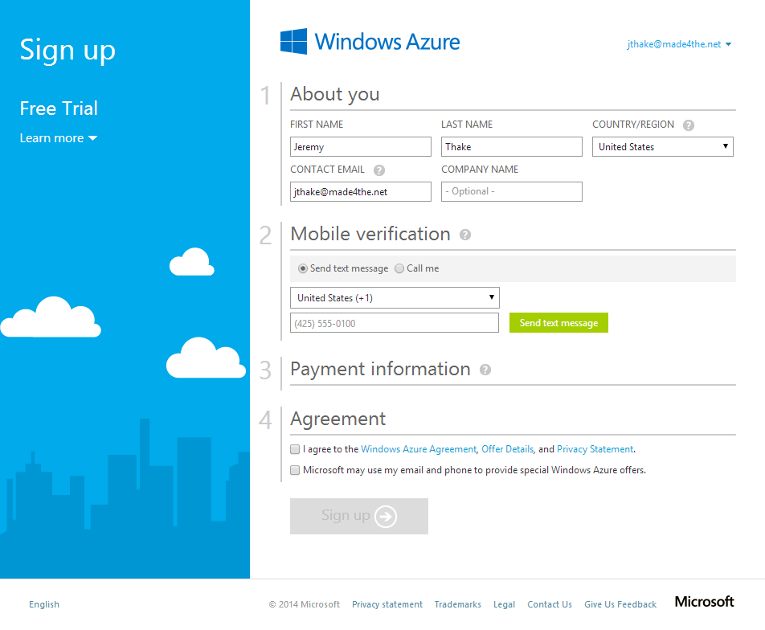

Slide 19
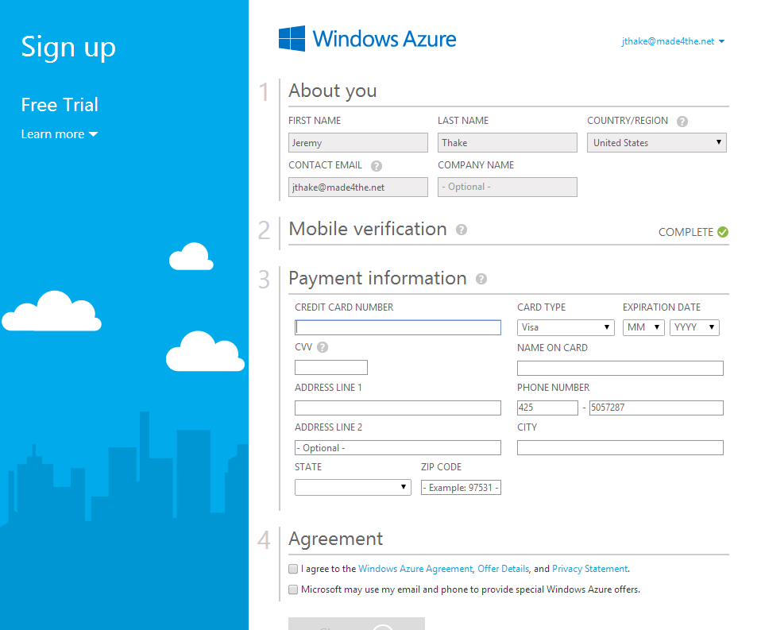

Slide 20
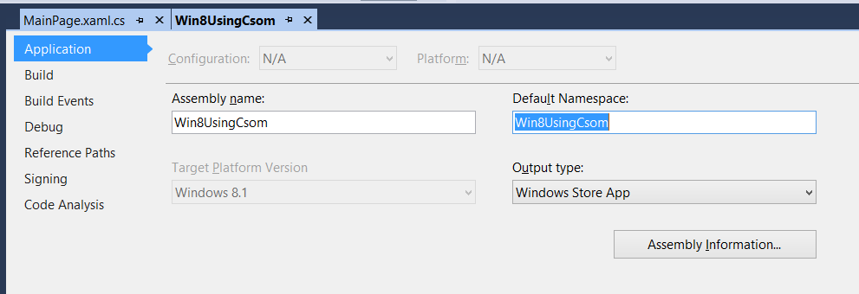

Slide 21
demo
Azure Active Directory portal

Slide 22
demo
Authentication process

Slide 23
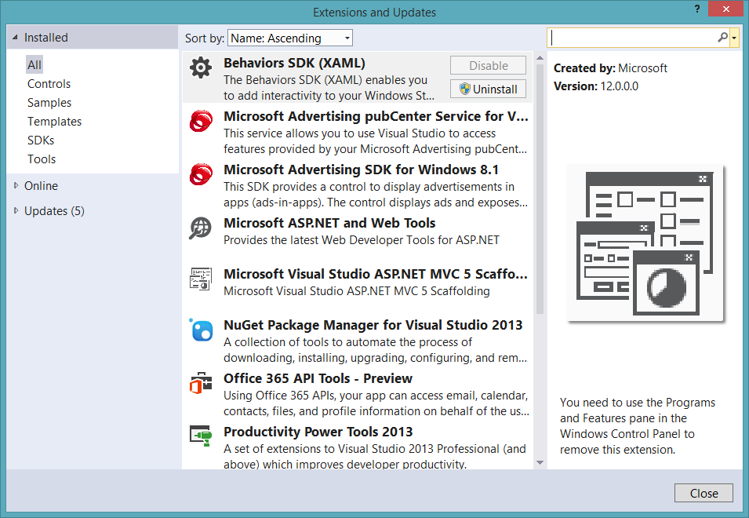
Get the tools

Slide 24
Visual Studio project support
.NET Windows Store Apps
Windows Forms Application
WPF Application
ASP.NET MVC Web Application
ASP.NET Web Forms Application
Xamarin Android and iOS Applications
Multi-device Hybrid Apps (Cordova)

Slide 25
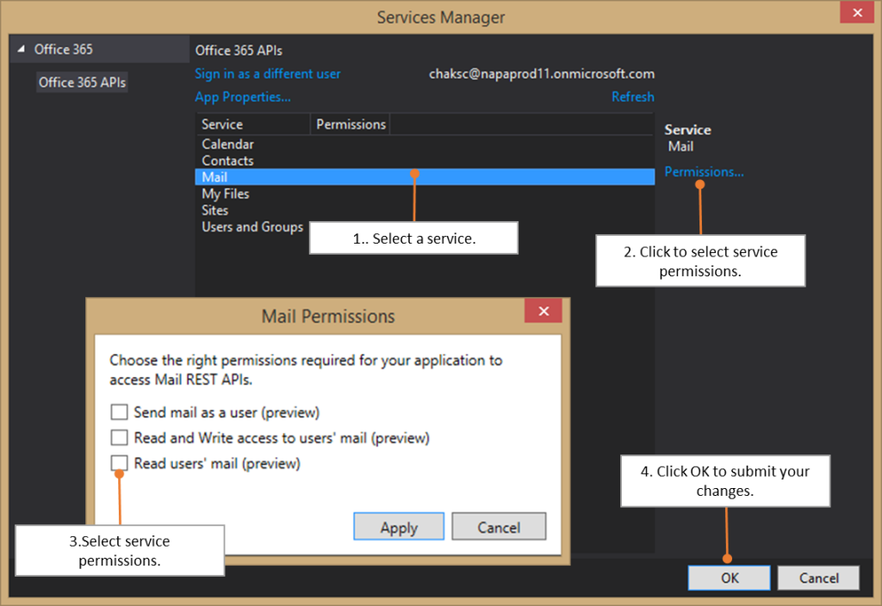

Slide 26
demo
Getting started Office 365 API tools for VS ASP.NET MVC

Slide 27
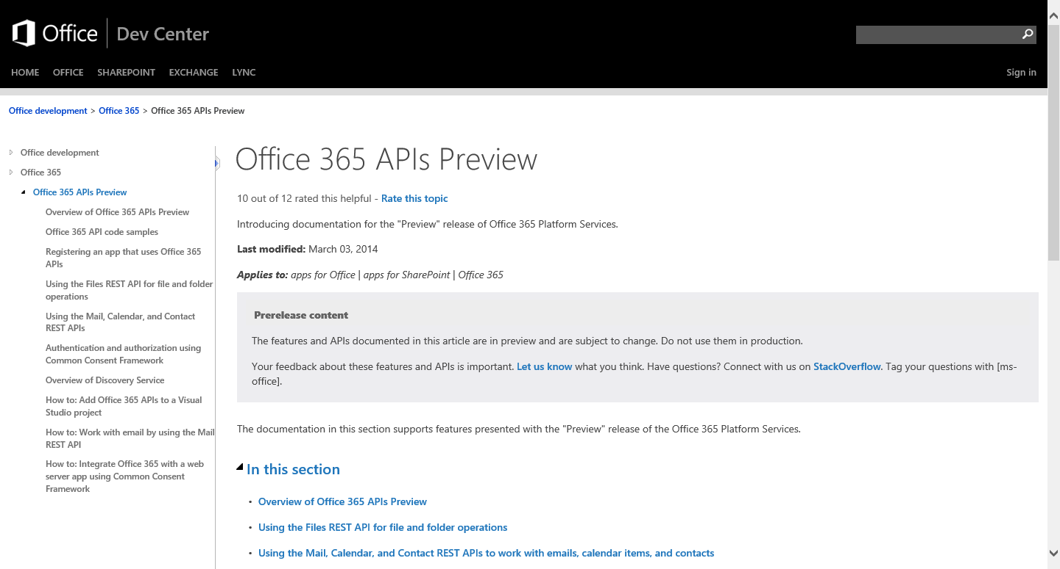
http://aka.ms/Office365DevAPIs

Slide 28
Demos

Slide 29
demo
ASP.NET MVC project demo

Slide 30
demo
Windows 8.1 project demo

Slide 31
demo
AngularJS HTML/JS project demo

Slide 32
demo
Cordova project demo

Slide 33
demo
Calling CSOM and REST using authentication bearer token

Slide 34
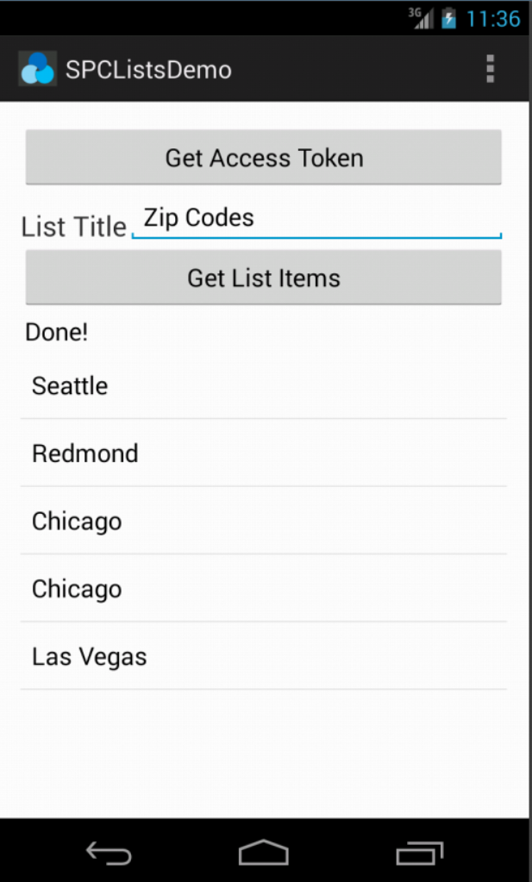
Office 365 SDK for Android
Available today on GitHub
SDK for native Android apps that use Office 365 APIs
Handles files, lists, mail, and calendar
Integrates with AD authentication library

Slide 35
Conclusion
New way of calling Office 365 Services
Available in preview today
Great samples available

Slide 36

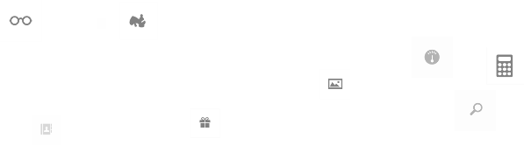
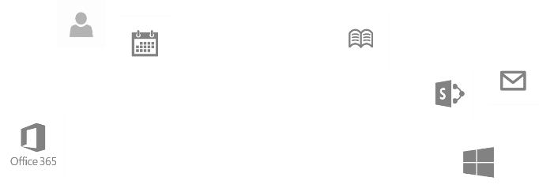
Calls to action
Explore our MSDN library
http://dev.office.com
Play with our code samples
http://aka.ms/OfficeDevSamples
Follow our patterns & practices
http://aka.ms/OfficeDevPnP
Get answers
http://aka.ms/AskSharePoint
http://aka.ms/AskOffice
Give feedback Drive our roadmap http://aka.ms/OfficeDevFeedback

Slide 37
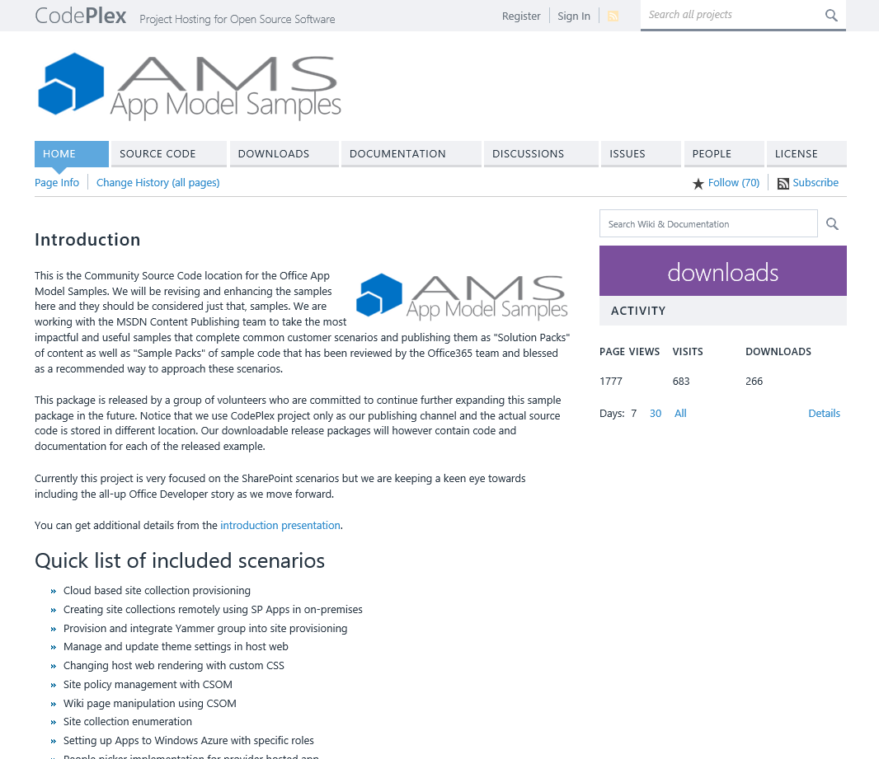
aka.ms/OfficeAMS
Patterns and practices
Providing App Model Patterns for common Full Trust Code scenarios
30+ Visual Studio projects Common scenarios
Branding
Site provisioning
Remote event receivers
Large file support
Taxonomy driven navigation
And much more…
Contribute
Open source coming soon!

