Slide 1
8/22/2022
Welcome
Syllabus
Introductions
Google Drive Folder Link Setup
Lab 1: Introduction to Google Colab

Slide 2
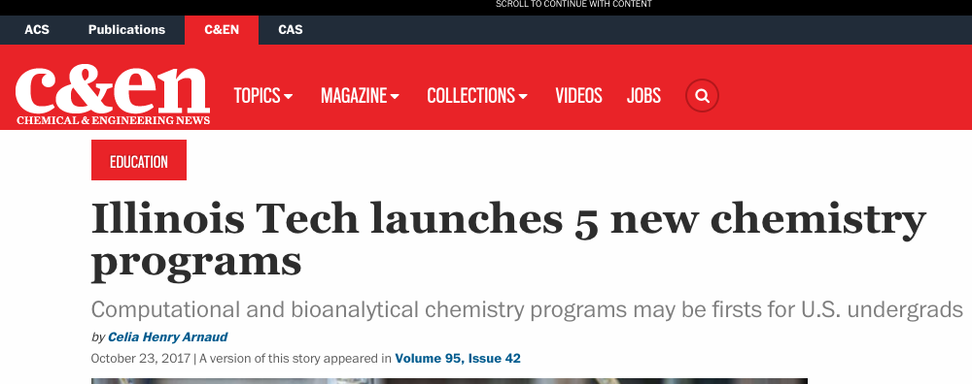
History
2004: I attended a workshop on molecular modeling at the beginning of my Ph.D., helping me get off to a quick start
2017: Illinois Tech launches five specialized chemistry programs
2020: I taught Chem 456 for the first time. It starts in a computer lab and moves online due to the pandemic.
2021: In the summer, I organized an online workshop and ran a small session of Chem 456. Examples could be run on a virtual machine.
2022: In the Spring, I work with four students to run the workshop in Colombia. We migrate the labs to Google Colab.

Slide 3
Syllabus
https://daveminh.github.io/Chem456-2022F/

Slide 4
Introductions

Slide 5
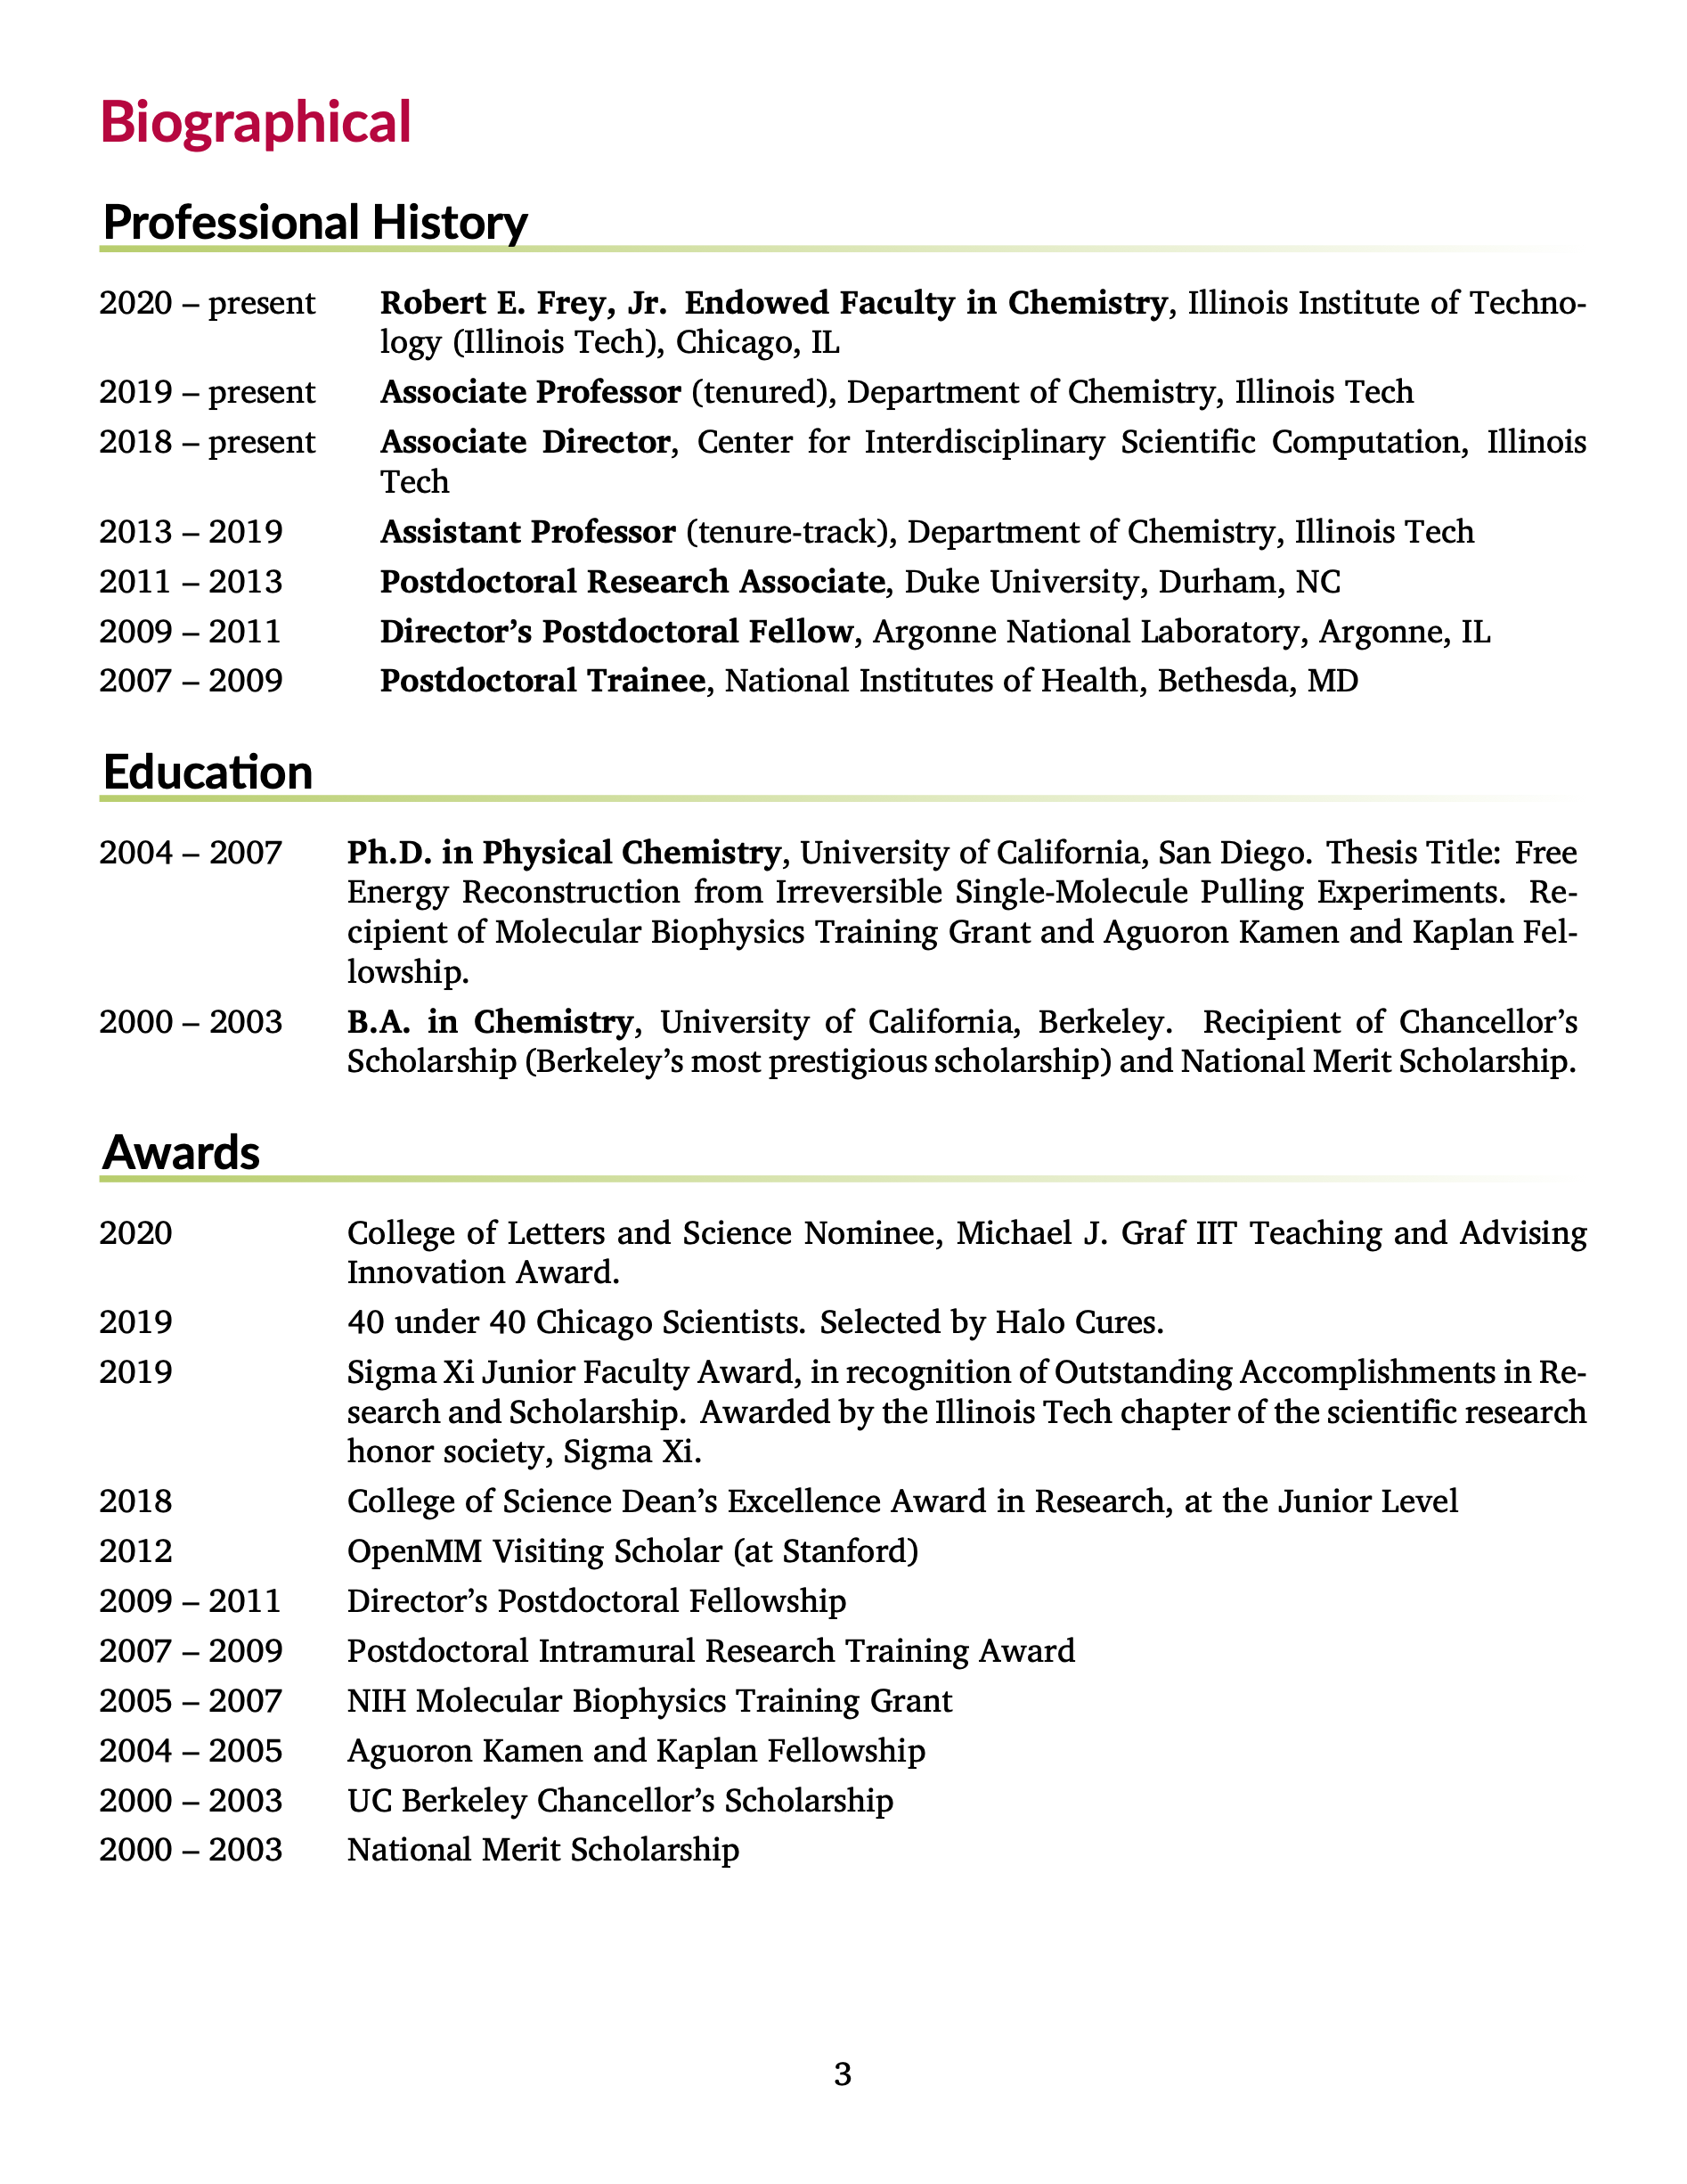
About me: work
Coauthored 50 peer-reviewed journal articles
Cited over 1250 times with an h-index of 19 (19 articles with at least 19 citations), according to Google scholar.
Current research in computational chemistry
Developing methods related to structure-based drug design
predicting binding affinities
simulating biological macromolecules
Involved in virtual screening projects for antibiotic drug discovery
research funded by NIH and NSF
Full curriculum vitae: http://mypages.iit.edu/~dminh/DavidMinh_CV.pdf

Slide 6
About me: beyond work
Outside of work, I like to
play chess and other board games, especially strategy and word games.
play music, especially classical piano. Sometimes I also play guitar and bass.
listen to podcasts and audiobooks. Some of my favorite podcasts are Hidden Brain, Planet Money, and Invisibilia from NPR, and Revisionist History by Malcolm Gladwell.
read news and sometimes books
play video games with my kids, especially on Nintendo Switch
play sports, especially Taekwondo, tennis, and basketball. I also like hockey but haven’t played in a while.
exercise, especially weights, swimming, biking, and skiing
travel. I’ve been to 6 continents
I am
Australian-born and American-raised by Vietnamese parents of Vietnamese and Chinese descent
married, with 2 children
Christian
incredibly blessed!

Slide 7
[Introduce yourself]
What is your full name? What do you like to be called?
Which degree program are you in?
What are you hoping to learn in this class?
How will this help you achieve your goals?
Share something interesting about yourself

Slide 8
Google Drive Folder Link Setup

Slide 9
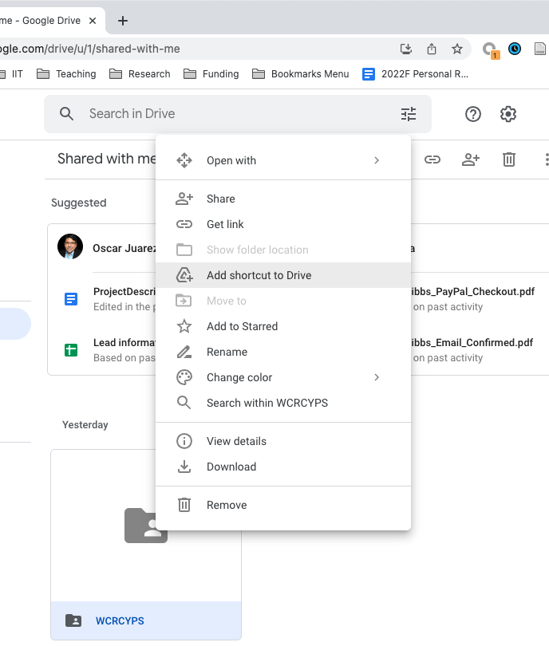
Log in to Google Drive.
Find the folder that I have shared with you under “Shared with me”.
Here, I am creating a link to a folder called “WCRCYPS”, but you will link to a folder with your IIT user name that I shared with you.
If I have not shared a link to the folder with you, then email me and ask me to do so.
Right click on the folder.
Select “Add shortcut to Drive”.

Slide 10
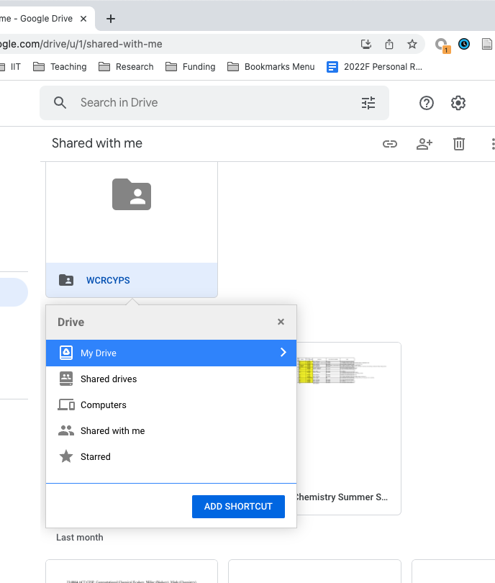
Click on “My Drive” and then “Add Shortcut”
There should be a small popup that says “Shortcut added to My Drive”

Slide 11
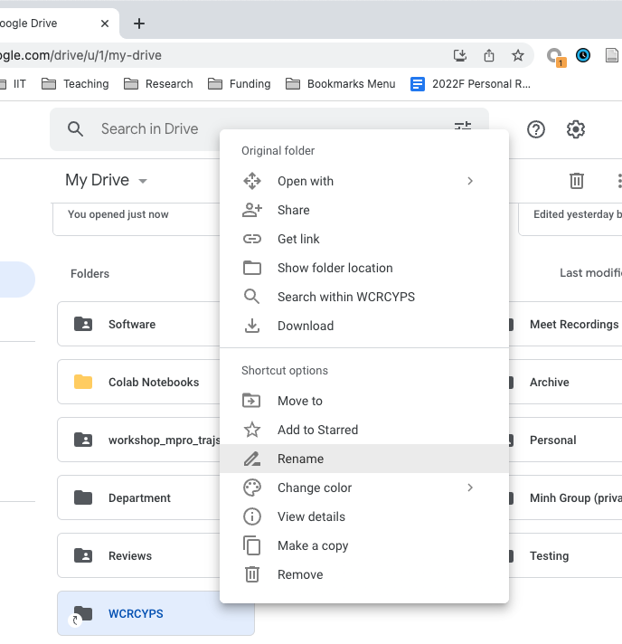
Now navigate to “My Drive”
Find the shortcut to the folder.
Right click on the shortcut and select “Rename”
Rename the shortcut to “Chem456-2022F”. This is where the labs expect your data to be. If you do not take this step, you will have to do more work to change the labs later in the semester.

Slide 12
Lab 1: Introduction to Google Colab
colab

