Slide 1
8/26/2024
Welcome
Syllabus
Introductions
Google Drive Folder Link Setup
Exercise 1: Introduction to Google Colab

Slide 2
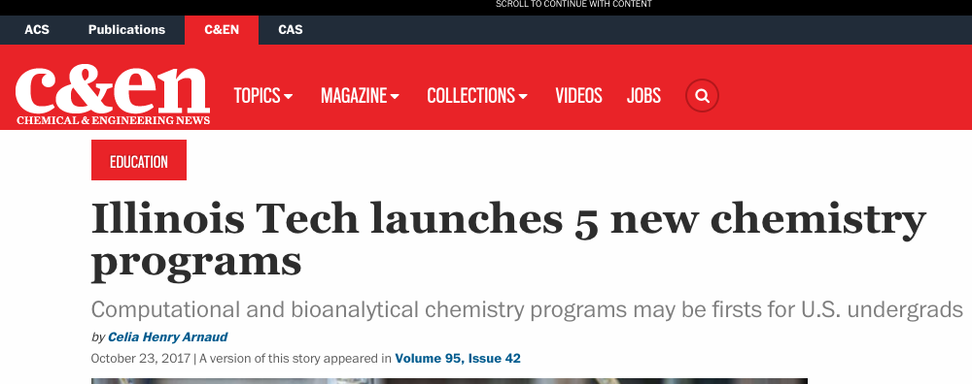
History
2004: I attended a workshop on molecular modeling at the beginning of my Ph.D., helping me get off to a quick start
2017: Illinois Tech launches five specialized chemistry programs
2020: I taught Chem 456 for the first time. It starts in a computer lab and moves online due to the pandemic.
2021: In the summer, I organized an online workshop and ran a small session of Chem 456. Examples could be run on a virtual machine.
2022: In the Spring, I work with four students to run the workshop in Colombia. We migrate the labs to Google Colab. I teach this class in the Fall.

Slide 3
Syllabus
https://daveminh.github.io/Chem456-2024F/

Slide 4
Introductions

Slide 5
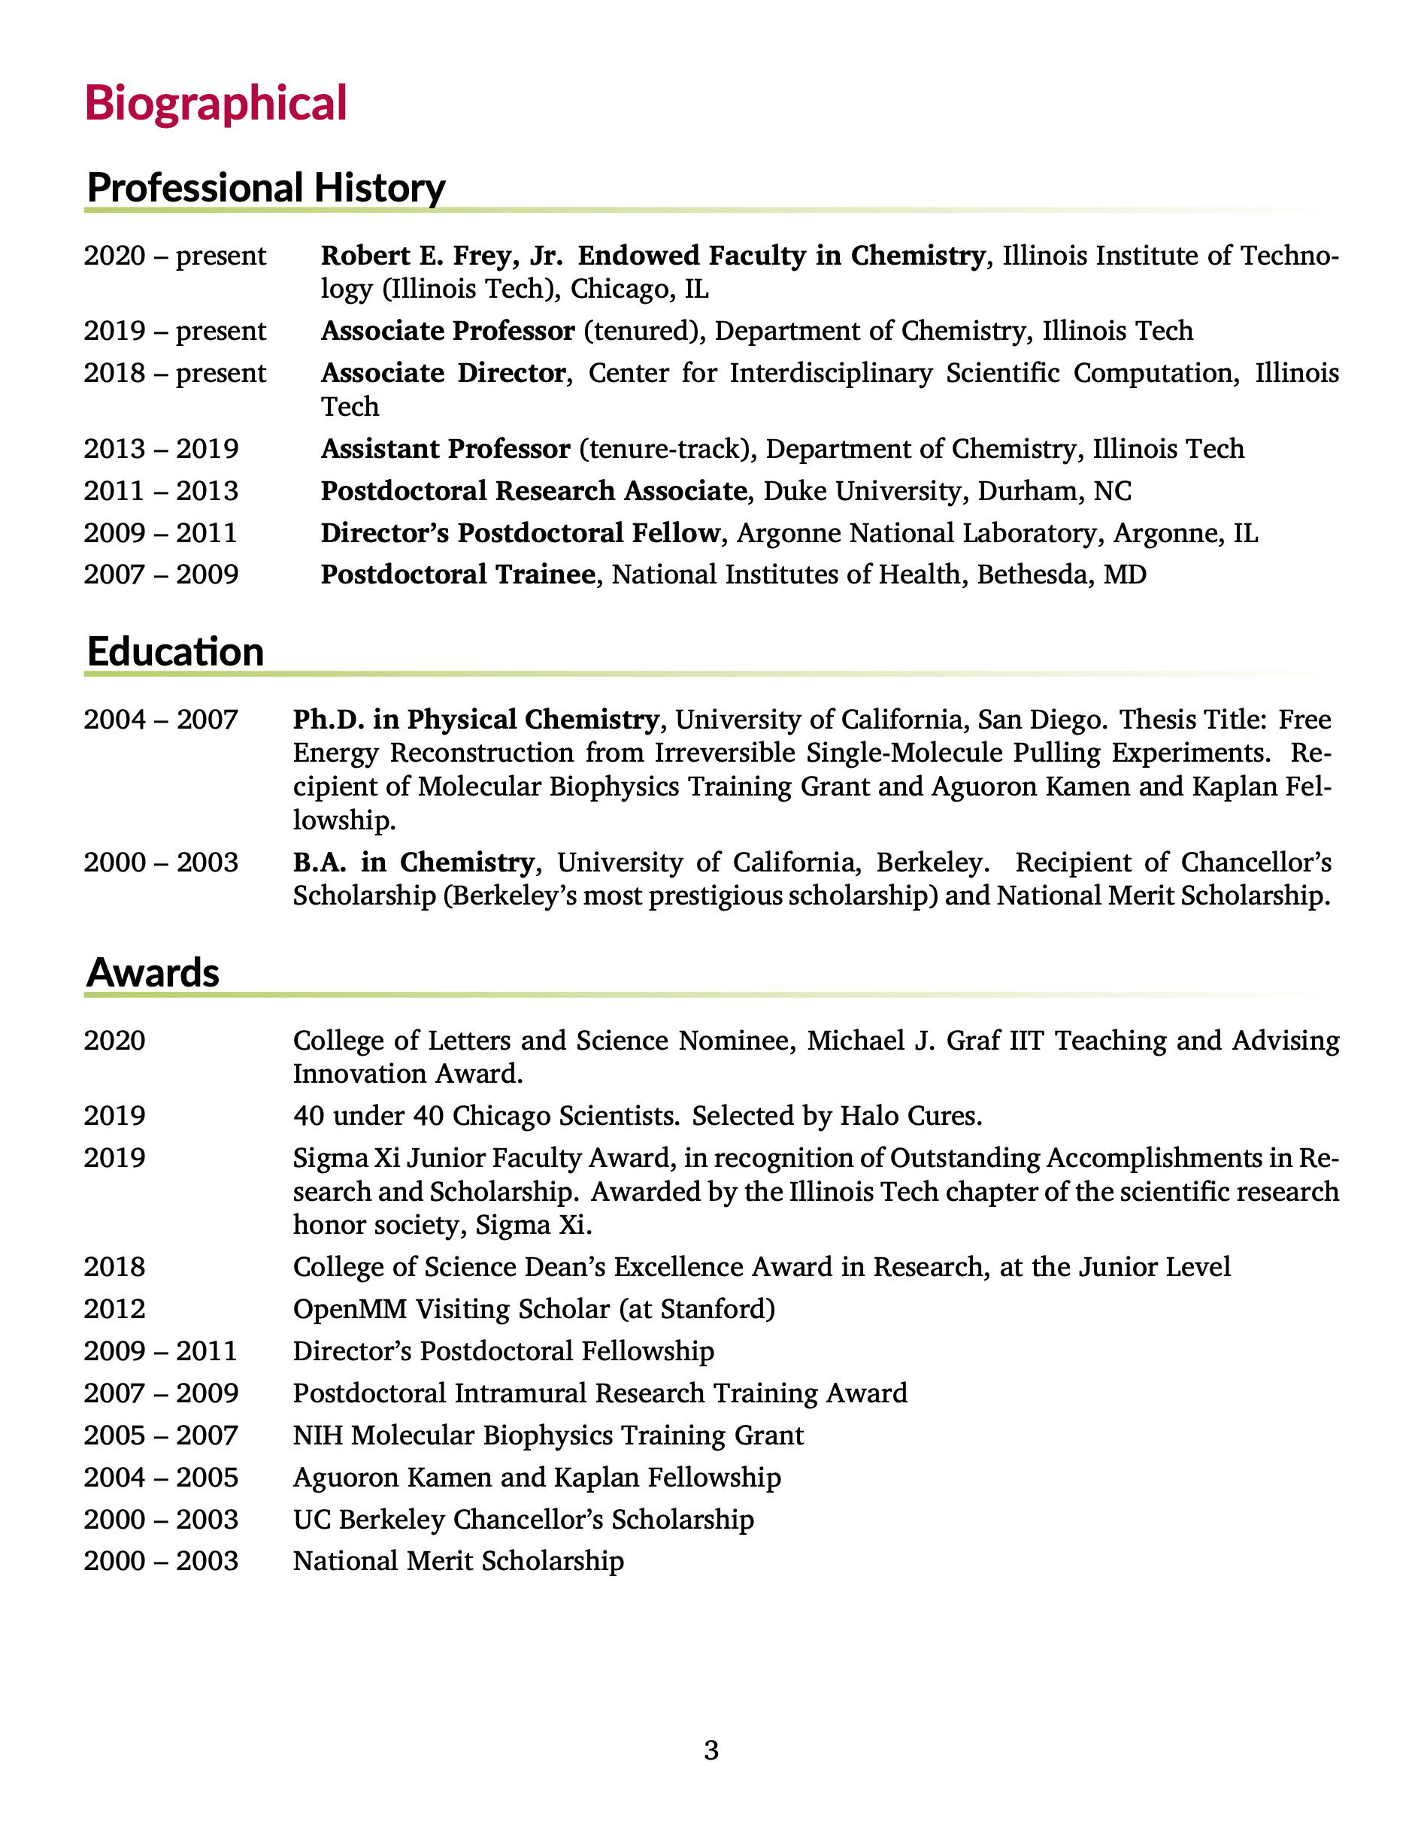
About me: work
Coauthored 56 peer-reviewed journal articles
Cited over 1500 times with an h-index of 22, according to Google scholar.
Current research in computational chemistry
Developing methods related to structure-based drug design
predicting binding affinities and ligand efficacy
simulating biological macromolecules
Involved in antibiotic drug discovery
research has been funded by NIH and NSF
Full curriculum vitae: https://ccbatiit.github.io/downloads/DavidMinh_CV.pdf

Slide 6
About me: beyond work
Outside of work, I like to
play sports, especially Taekwondo, tennis, and basketball.
listen to podcasts and audiobooks. Some of my favorite podcasts are Hidden Brain and Planet Money from NPR.
play board games, especially strategy and word games.
sometimes play music, especially classical piano. Sometimes I also play guitar and bass.
read news and sometimes books
play video games
exercise, especially weights, swimming, biking, and skiing
travel. I’ve been to 6 continents
I am
Australian-born and American-raised by Vietnamese parents of Vietnamese and Chinese descent
married, with 2 children
Christian
incredibly blessed!

Slide 7
[Introduce yourself]
What is your full name? What do you like to be called?
Which degree program are you in?
What are you hoping to learn in this class?
How will this help you achieve your goals?
Share something interesting about yourself

Slide 8
Google Drive Folder Setup

Slide 9
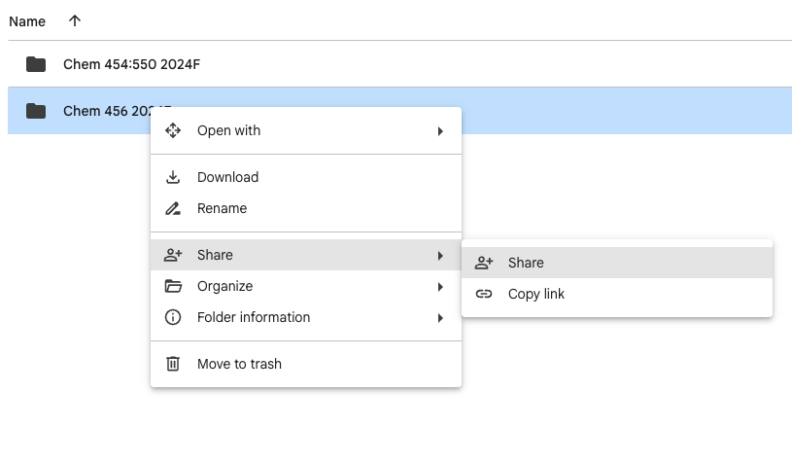
Log in to Google Drive. This can be a school account or a personal account.
Create a folder for this class called “Chem456-2024F”
Create the subfolders “exercises” and “quizzes”
Right click on the folder.
Select “Share”
Share the folder with me, dminh@iit.edu, and the TA, tnguyen48@hawk.iit.edu.

Slide 10
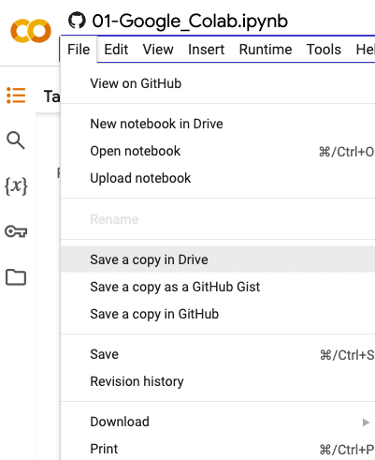
Exercise 1: Introduction to Google Colab
https://colab.research.google.com/github/daveminh/Chem456-2024F/blob/main/exercises/01-Google_Colab.ipynb
After following this link, you should
save a copy of the notebook to Google Drive
rename it to 01-Google_Colab.ipynb
move it to your class folder under the “exercises” folder
work on and save the notebook

