Slide 1
11/18/2024 Replica exchange
The lecture will cover replica exchange
Today’s lecture is a key step towards the following learning objective: Explain key concepts related to binding free energy calculations. Compare and contrast molecular docking and binding free energy calculations.
At the end of this module, you should be able to answer the following questions:
What are the benefits of performing replica exchange?
How do you know if there are enough states along a thermodynamic process?
You should be able to calculate
expectation values
free energy differences between thermodynamic states

Slide 2
Replica exchange
Simulations of multiple thermodynamic states with different parameters
originally, variation in temperature
often used for alchemical coupling
Configurations from thermodynamic states are periodically swapped
Equivalently, thermodynamic parameters are swapped
Swapping satisfies detailed balance; both states sample from respective Boltzmann distributions

Slide 3
Swapping
λ = 1
X
λ = 0.8
X
λ = 0.6
λ = 0.4
λ = 0.2
X
X
λ = 0

Slide 4
Why perform replica exchange?
Improve mixing of MCMC chains; higher-entropy states help sample configurations in lower-entropy states
At high temperature, energetic barriers are crossed more quickly than at low temperature
Decoupled ligands move freely compared to bound ligands. See http://mypages.iit.edu/~dminh/images/pubs/dock_1hnn.gif.
Minimal added computational expense

Slide 5
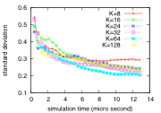
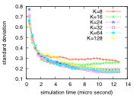
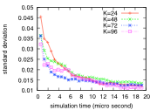
Selecting thermodynamic states
Thermodynamic state selection has been thought to be a tricky optimization problem
In Nguyen and Minh (2016) [1]
processes were simulated 100x each for each number of states, K
the standard deviation of the free energy was evaluated as a function of the total simulation time
If there are not enough states, the convergence curve levels off
If there are enough states, the standard deviation of free energy estimates depends on the aggregate simulation time and is insensitive to the number of states.
Deca-alanine heating
Deca-alanine pulling
Host-guest extraction

Slide 6
References
[1] Nguyen, T. H.; Minh, D. D. L. Intermediate Thermodynamic States Contribute Equally to Free Energy Convergence: A Demonstration with Replica Exchange. Journal of Chemical Theory and Computation 2016, 12 (5), 2154–2161. https://doi.org/10.1021/acs.jctc.6b00060.

